Slide 1
A New Higgs Boson With Electron-Muon Flavor-Violating Couplings
Work with Julio, N. Srimanobhas and P. Uttayarat
2304.13757
Phys.Lett.B 845 (2023) 138129

Slide 2
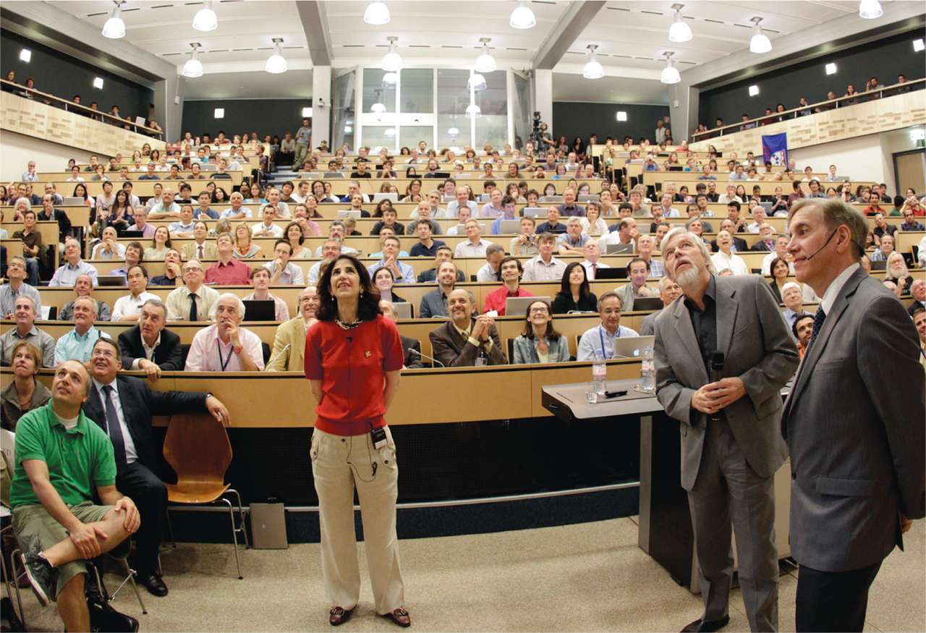

Slide 3
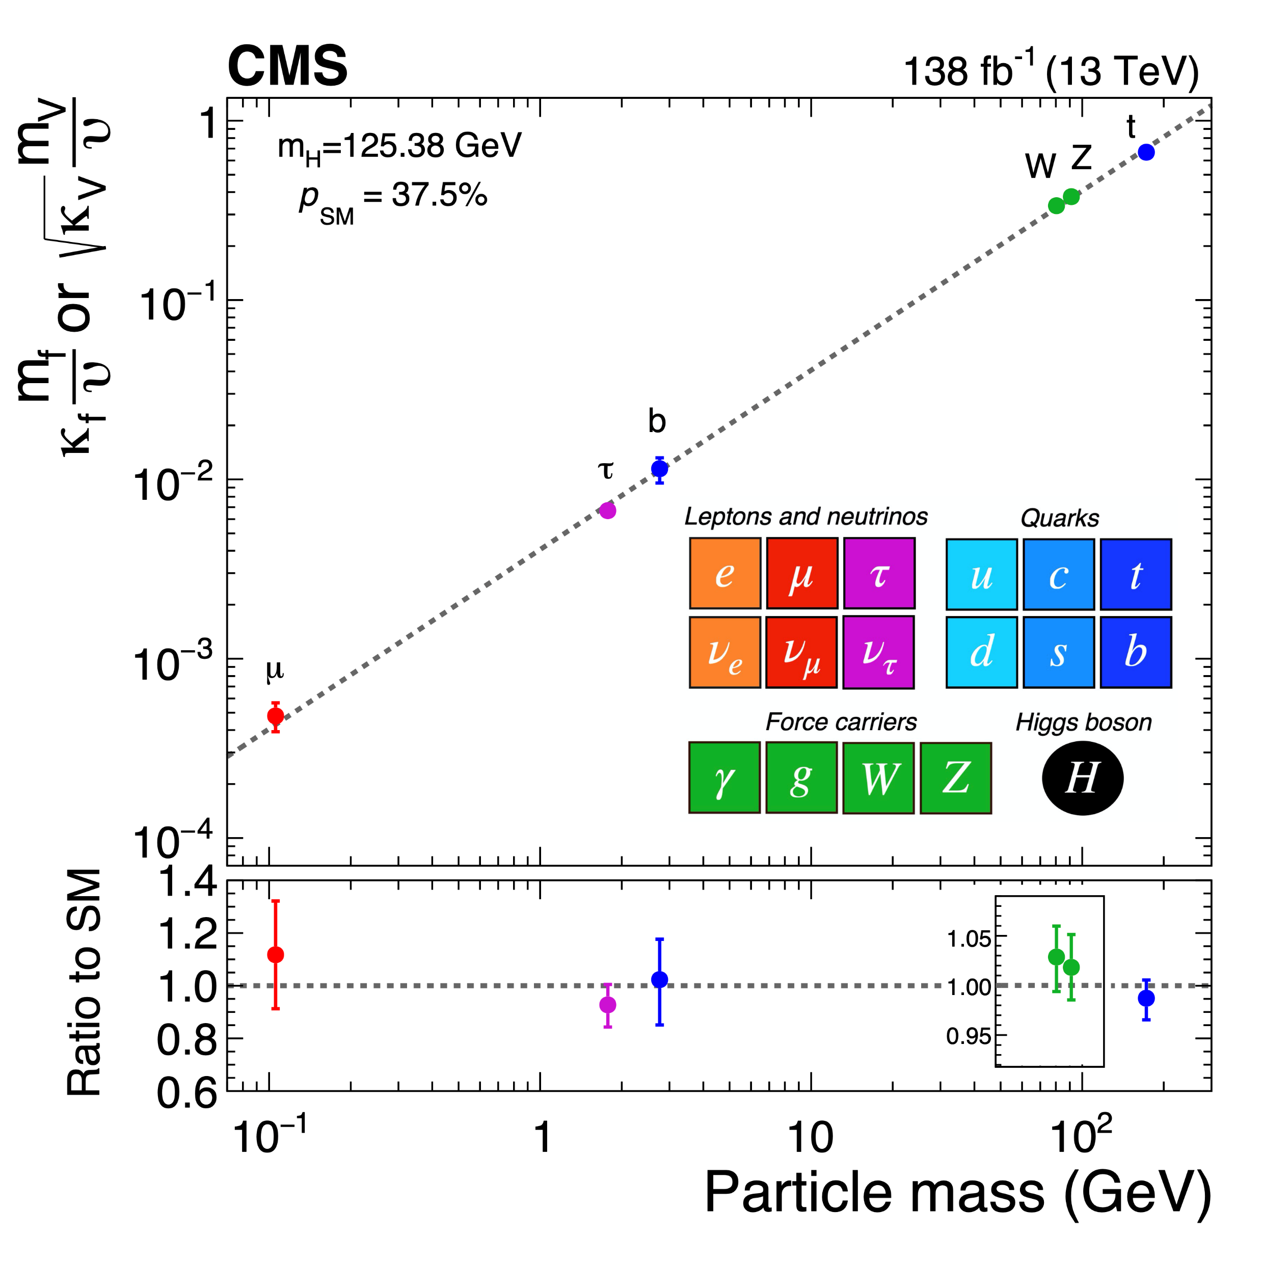

Slide 4
Lepton Flavor Violation with h(125)

Slide 5
Lepton Flavor Violation
Two Higgs Doublet Model Type III (e.g. Branco, et.al. Phys.Rept. 516 (2012) 1-102)
Neutrino mass models (e.g. Herrero-Garcia, et.al. JHEP 11 (2016) 084, Thuc,et.al. Phys. Rev. D 93, 115026 (2016))
Extra-dimension (e.g. Blanke, et.al. JHEP 0903:001,2009, Casagrande,et.al. JHEP 10 (2008) 094)
Supersymmetry (e.g. Arhrib,et.al. EPL 101 (2013) 3, 31003, Arana-Catania,et.al. JHEP 09 (2013) 160)
Leptoquarks (e.g. Baek&Nishiwaki. Phys. Rev. D 93, 015002 (2016), Cheung.et.al. Phys. Rev. D 93, 015010 (2016))
Not a complete list

Slide 6
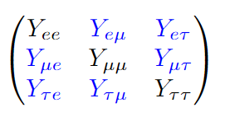
LFV with h(125)
Diagonal Y’s are assumed to have SM values

Slide 7
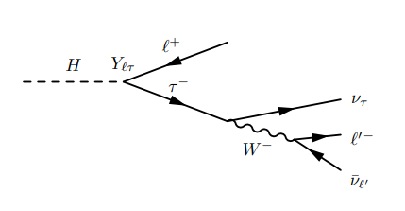
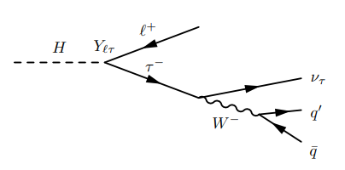
$$h→τ^{±}ℓ^{∓}$$
$$τ_{e/μ}$$
$$τ_{h}$$

Slide 8
Back in 2013
Harnik, Kopp, Zupan (JHEP 03 (2013) 026) recasted LHC $h→ττ$ search

Slide 9
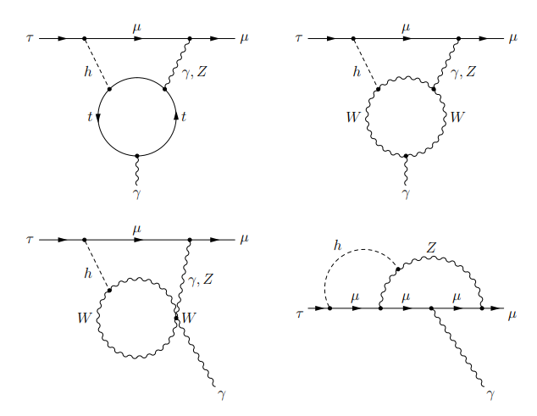
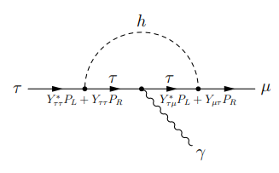
Low Energy Bounds

Slide 10
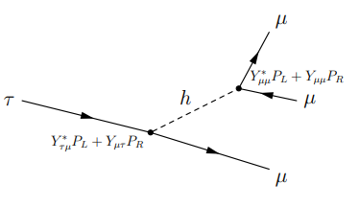
Low Energy Bounds

Slide 11
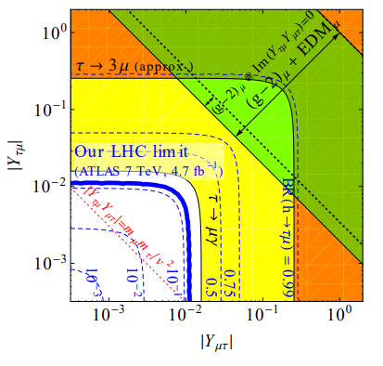
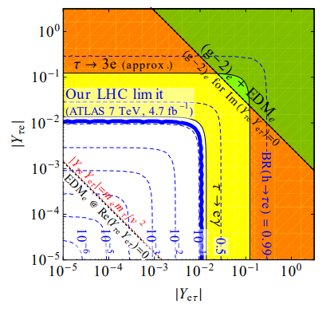
2013 bound

Slide 12
Ten years later
ATLAS, JHEP 07 (2023) 166
CMS, Phys. Rev. D 104, 032013 (2021)

Slide 13
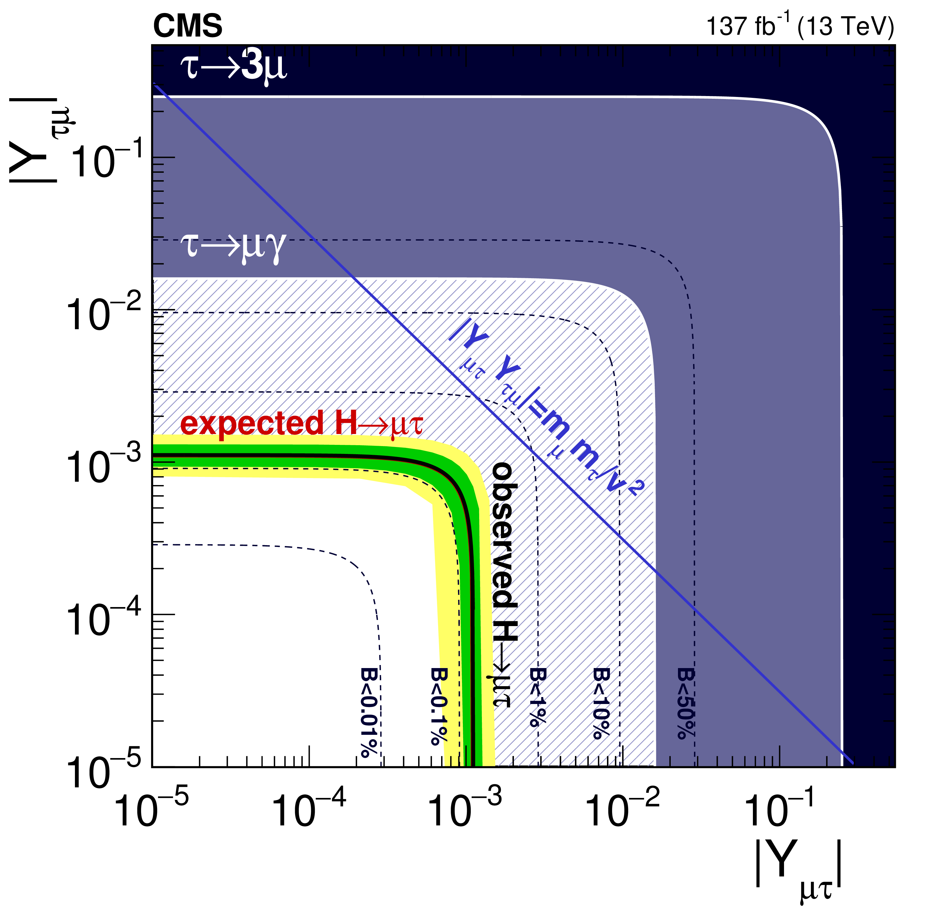
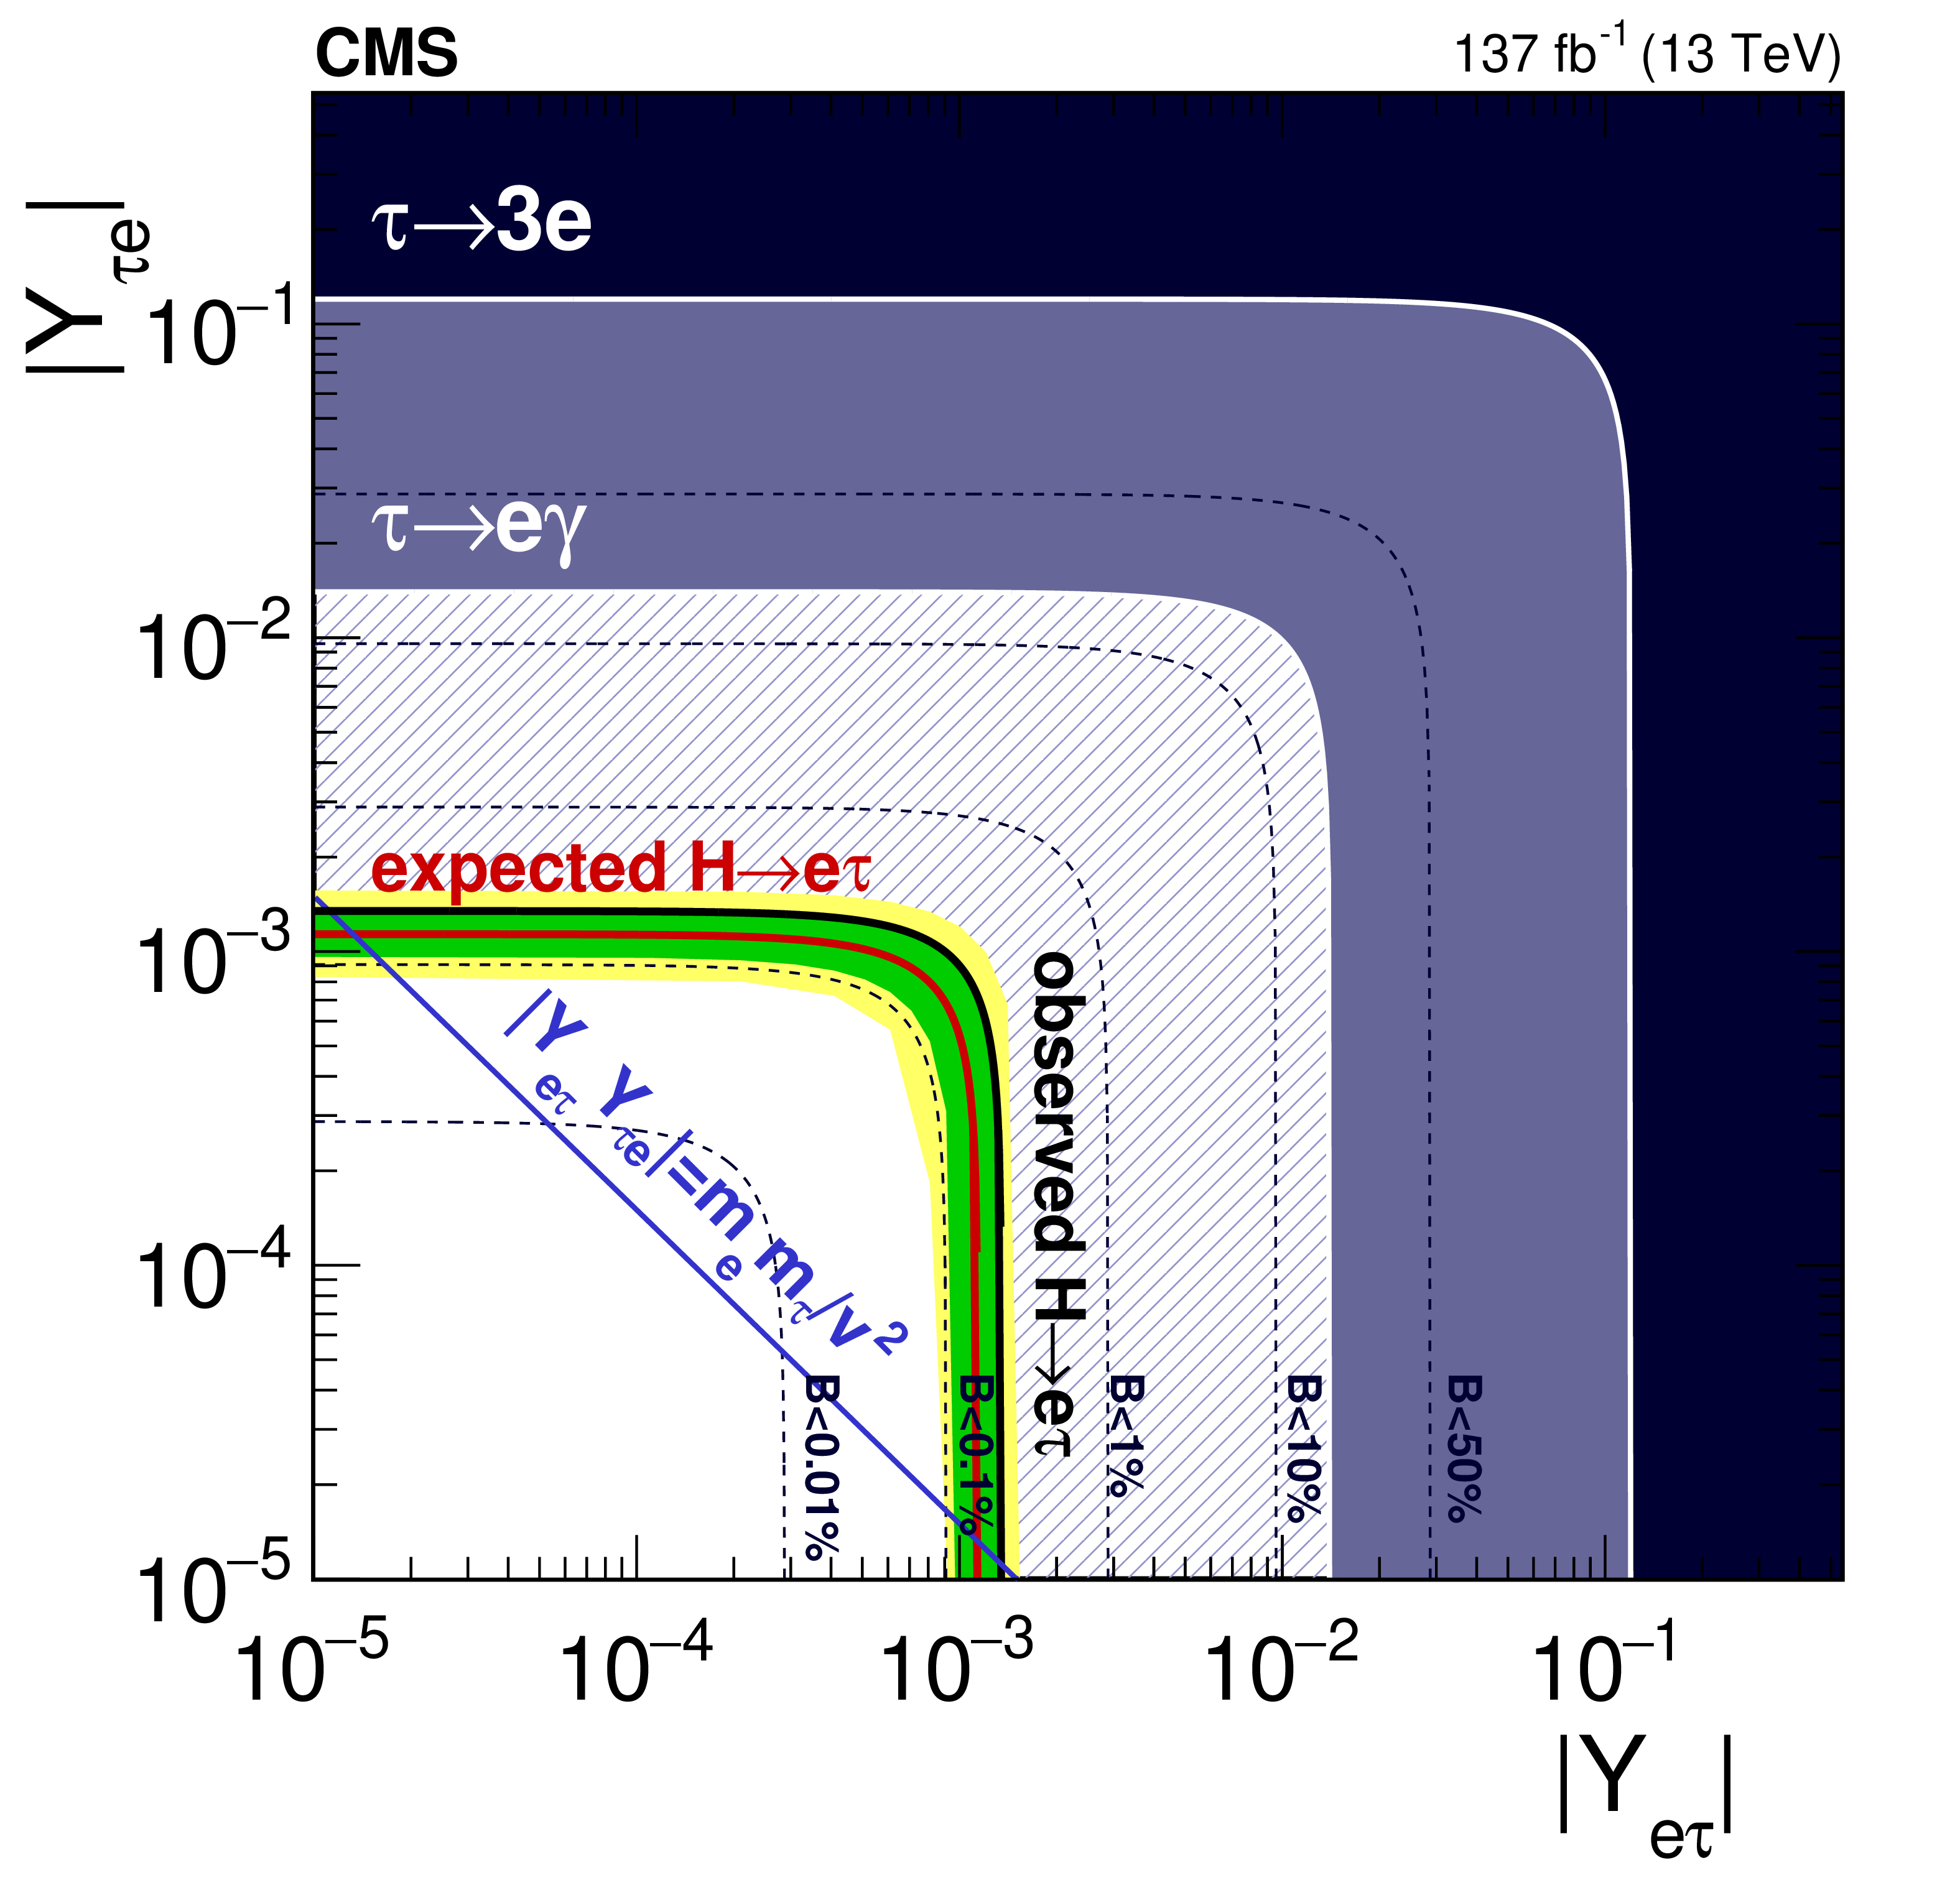
Ten years later
CMS, Phys. Rev. D 104, 032013 (2021)

Slide 14
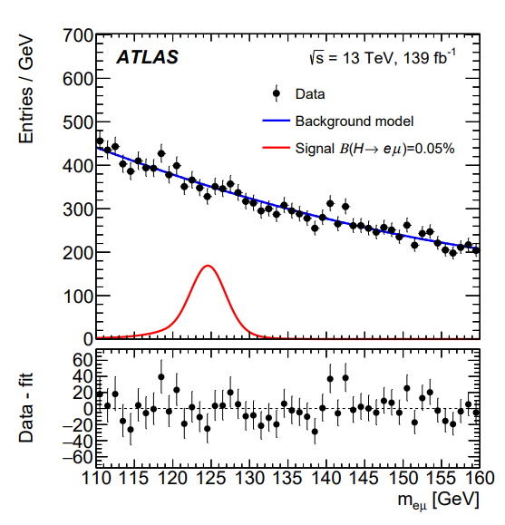
$$h→e^{±}μ^{∓}$$
ATLAS, Phys. Lett. B 801 (2020) 135148

Slide 15
Current Status
ATLAS, Phys. Lett. B 801 (2020) 135148
CMS-PAS-HIG-22-002

Slide 16
Additional Low Energy Bound

Slide 17
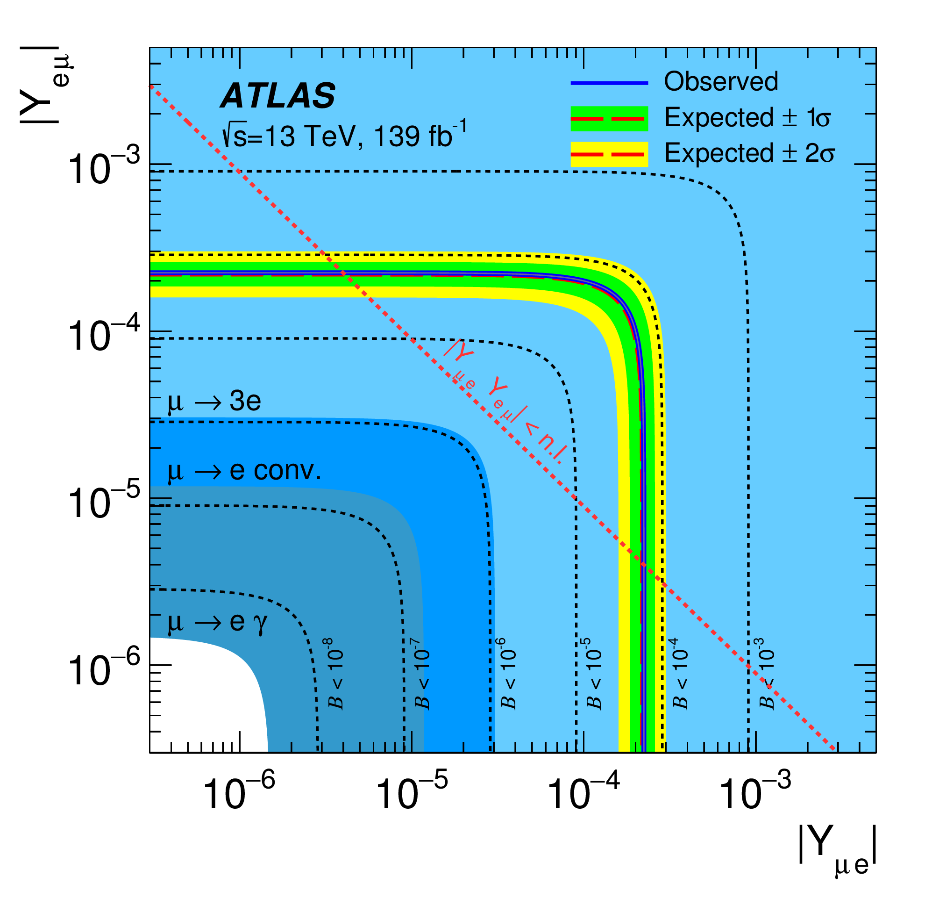
Current Status

Slide 18
2HDM Type III

Slide 19
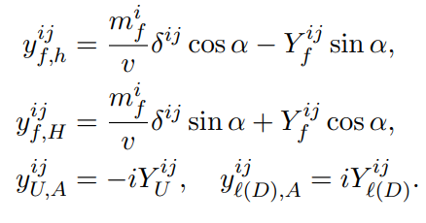
2HDM Type III

Slide 20
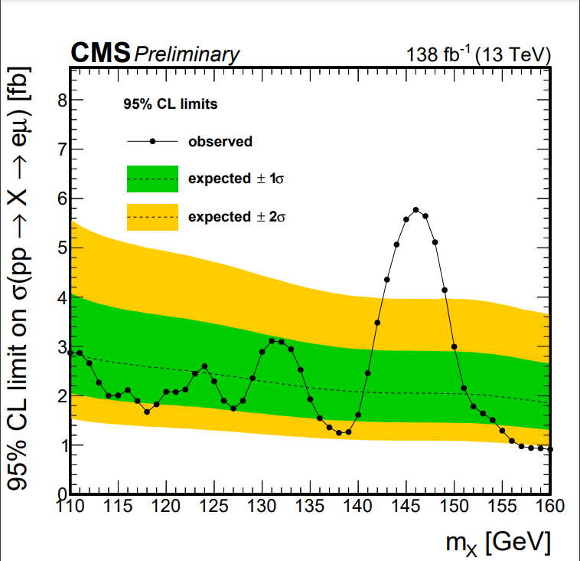
$$H→e^{±}μ^{∓}$$
Excess
$m_{H}=146$ GeV
$3.8σ$ (local)
$2.8σ$ (global)
$σ×BR={3.82}_{−1.09}^{+1.16}$ fb
CMS, Phys.Rev.D 108 (2023) 7, 072004

Slide 21
ATLAS, Phys. Lett. B 801 (2020) 135148

Slide 22
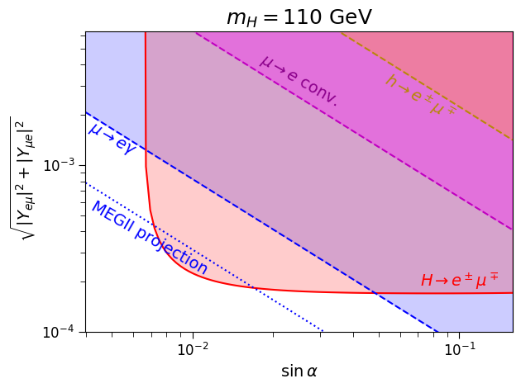
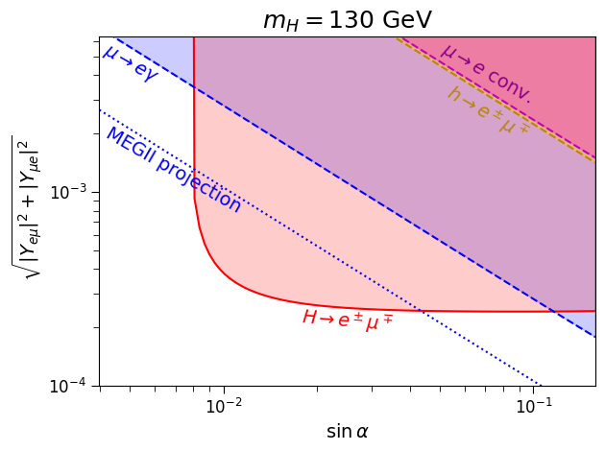
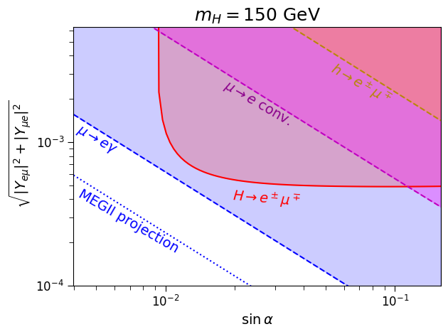
$$e$$
$$\sin{α}$$
$$Y_{eμ}$$
$$μ$$

Slide 23
LFV Diagrams
$$h$$
$$H$$
$$μ$$
$$μ$$
$$μ$$
$$μ$$
$$μ$$
$$e$$
$$μ$$
$$e$$
$$\frac{m_{μ}}{v}\cos{α}$$
$${−Y}_{eμ}\sin{α}$$
$$\frac{m_{μ}}{v}\sin{α}$$
$$Y_{eμ}\cos{α}$$

Slide 24
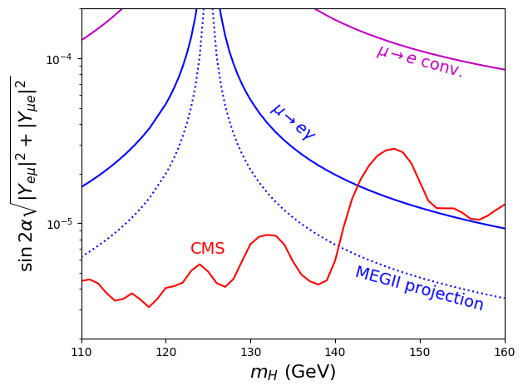

Slide 25
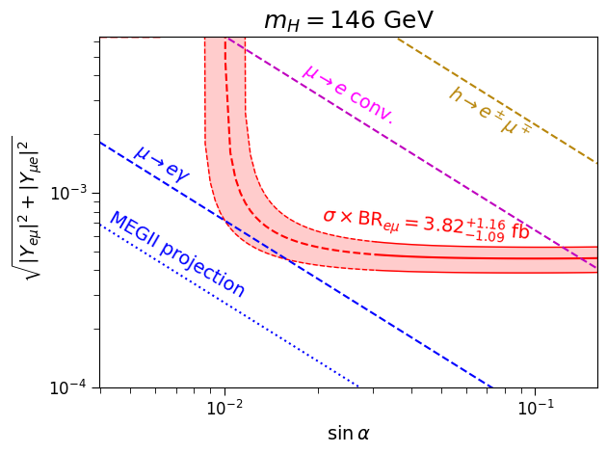
CMS Excess

Slide 26
Conclusion
Collider constraints of LFV decays can be competitive.
In the context of 2HDM type III, the search for other scalar (H) is important and complementary.
We advocate the importance for searching $m_{H}<200$ GeV for all possible LFV couplings.

Slide 27
Thank You!

Slide 28
Backup Slides

Slide 29
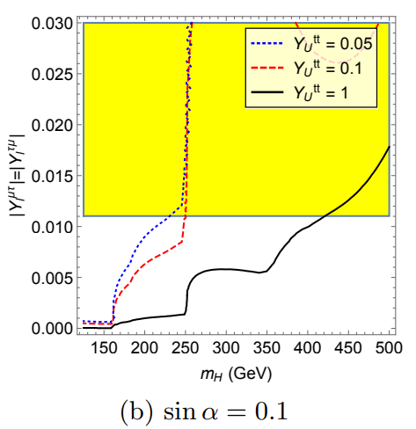
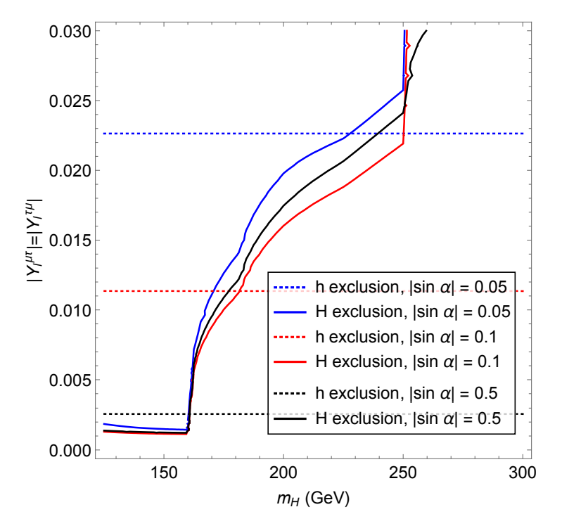
LHC with 300 fb⁻¹

Slide 30
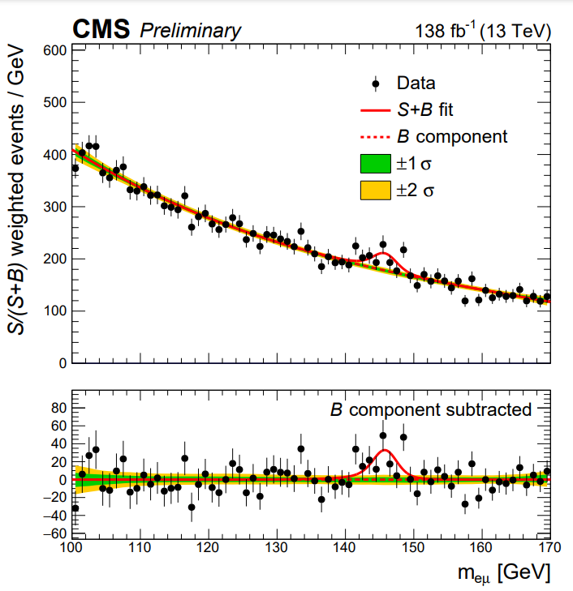

Slide 31
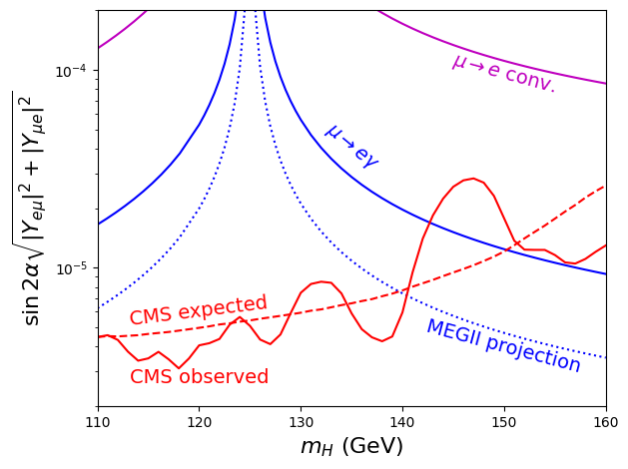

Slide 32
Tentative Combination with ATLAS
$3.4 σ$ (local)
$σ×BR=2.64±0.76$ fb

Slide 33
