Slide 1
Exploring Core-Collapse Supernovae with GPU Acceleration Code GAMER: Dynamics, Magnetism, and Gravitational Waves
Inhyeok Song¹, He-Feng Hsieh^{2,3}, Hsi-Yu Schive^{2,3}, & Kuo-Chuan Pan^{1,3}
¹National Tsing Hua University, Taiwan
²National Taiwan University, Taiwan
³National Center for Theoretical Sciences

Slide 2
Introduction to Core-Collapse Supernova (CCSN)
Supernova 1987A
End of massive stars’ lives $\left(M≳8 M_{⊙}\right)$
Extremely energetic phenomenon ($E_{exp}\sim {10}^{51}erg$)
Leave a neutron star or black hole.
Extreme environments
($ρ>{10}^{9}−{10}^{14} g/{cm}^{3}, T>0.01−1 MeV$)
Nucleosynthesis site for heavy elements
Can trigger star formations
Multi-messenger signals (EM, $ν$, GW)
Credit: NASA, ESA, CSA, STScI, C. Fransson (Stockholm University), M. Matsuura (Cardiff University), M. J. Barlow (University College London), P. J. Kavanagh (Maynooth University), J. Larsson (KTH Royal Institute of Technology)

Slide 3
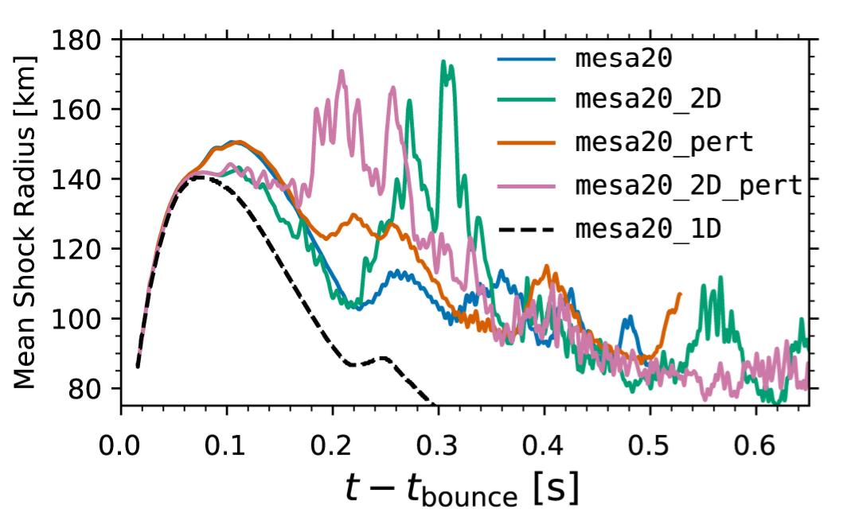
CCSN Problem
Core reaches nuclear density and core bounce $(ρ\sim {10}^{14} g/{cm}^{3})$.
Launches a bounce shock.
Shock stalls $\sim 100 km$ due to
- ram pressure of infalling matter
- photodisintegration
Failed to explode in 1D simulations.
- need multidimensional effects such as convection,
instabilities
2D is more favorable to explode than 1D.
3D is arguably favorable to explode than 2D (Janka+16).
Computationally expensive.
Complexity in physics (nuclear physics, instabilities, convection/turbulence, progenitor, rotation, MHD, and chaotic behaviors).
Credit: Figure 5 from
O’Connor et al., 2018, ApJ

Slide 4
Motivation
Endpoints of stellar evolution.
Major factories of heavy elements.
Multi-messenger signal sources (EM, neutrino, GWs).
Constraint the nuclear equation of state.
Explosion mechanism remains unresolved: neutrino-driven explosion, rotational effect, magnetic field, instabilities…
Wide range of parameter spaces: progenitors, EoSs, neutrino schemes, rotations, B-field…).

Slide 5
GAMER Code
GAMER is a GPU-accelerated Adaptive MEsh Refinement code for astrophysics. It features extremely high performance and parallel scalability and supports a rich set of physics modules.
(Schive+18)
Initial Conditions
Progenitor Model
- s16 (Woosely & Heager, 2007, RvMP)
Rotation
$Ω\left(r\right)=Ω_{0}\left[\frac{R_{0}^{2}}{r^{2}+R_{0}^{2}}\right]$
$\left(Ω_{0}=1.0 rad/s, R_{0}\sim 1.0×10^{8} cm\right)$
Magnetic Field
$$A_{r}=A_{θ}=0, A_{φ}=\frac{B_{0}}{2}\frac{R_{0}^{3}}{r^{3}+R_{0}^{3}}rsin\left(θ\right)$$
$\left(B_{0}={10}^{12}G , R_{0}=1.0×{10}^{8} cm\right)$
(Suwa+07)
Physics
Gravity Treatment
- Gravitational Effective Potential (GREP) (Marek+06)
- GWs analysis
EoS
- SFHo (Steiner+10)
Neutrino Scheme
- Parameterized deleptonization (Liebendörfer 05)
- Leakage scheme with ray-by-ray approximation
(Rufferrt+96; Rosswog+03; Burrows+06; O’Connor+10)

Slide 6
Simulation Setup and Result (Morphology & Dynamics)
● Cartesian coordinate ● Box Size: 96,000 km
● AMR Resolution:
- Maximum resolution : $\sim 488 m$
- Minimum resolution : $500 km$
- Effective angular resolution: $\sim 1.0−2.5°$
$$Ω\left(r\right)=Ω_{0}\left[\frac{R_{0}^{2}}{r^{2}+R_{0}^{2}}\right] , A_{φ}=\frac{B_{0}}{2}\frac{R_{0}^{3}}{r^{3}+R_{0}^{3}}rsin\left(θ\right)$$
 | $$Ω_{0} [rad/s]$$ | $$B_{0}[G]$$
R00_B00 (HD w/o Rotation) | $$0.0$$ | $$0.0$$
R10_B00 (HD w/ Rotation) | $$1.0$$ | $$0.0$$
R10_B12 (MHD w/ Rotation) | $$1.0$$ | $${10}^{12}$$
R00_B00
R10_B00
R10_B12

Slide 7
Result (Morphology & Dynamics)
Entropy
R10_B12
Plasma Beta
Fastest evolution among all models
Clear jet formation
High entropy blobs along the jets
Ye distribution at the end

Slide 8
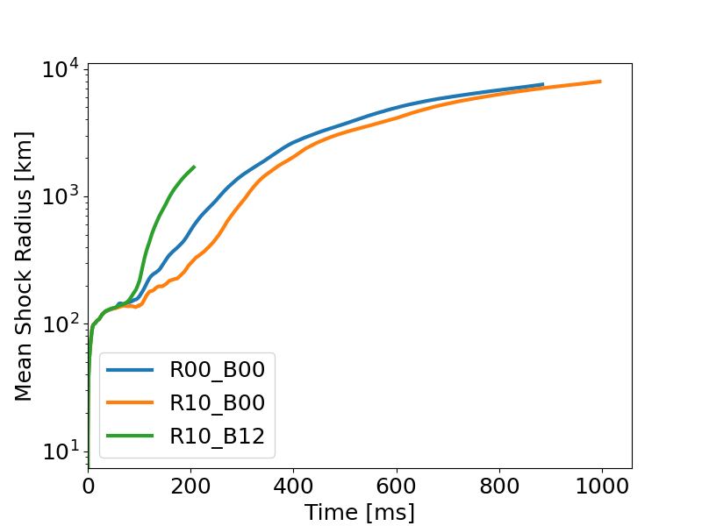
Result (Shock Evolution)
All models evolve rapidly.
MHD simulation is not stable yet (~200 ms).
R10_B12 shows significantly faster evolution compare to others.
Rotation leads to a delayed explosion relative to the non-rotating case.

Slide 9
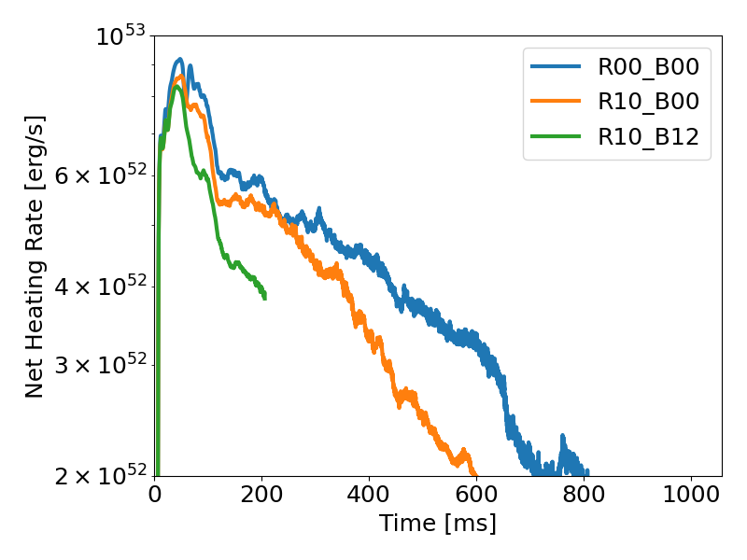
Result (Heating Rate)
Net heating rate in the gain region
The strongest net heating rate is observed in R00_B00.
Rotating case (R10_B00) shows a lower heating rate.
Centrifugal deformation of the neutrinosphere lowers heating efficiency in the gain region (Suwa+18).
R10_B12 exhibits the weakest heating.

Slide 10
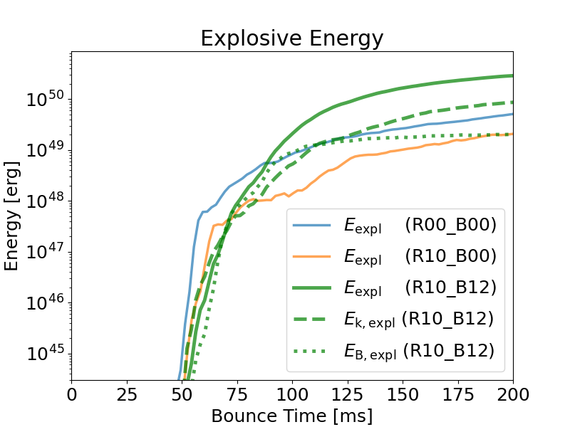
Result (Explosive Energy)
$$E_{expl}=\sum_{i}{E_{tot, i}} where E_{tot,i}>0 and v_{r}>0$$
R10_B12 shows the strongest $E_{expl}$.
Early onset of explosion (~50-100 ms)
$E_{B}$ is comparable or stronger to $E_{k}$ and even dominant during the early phase (~50-100 ms).
The magnetic field aids the early onset of explosion.

Slide 11
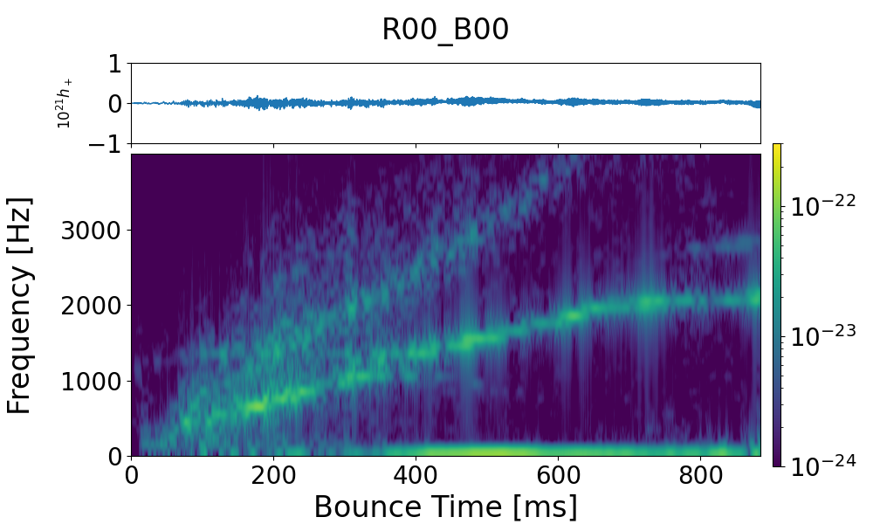
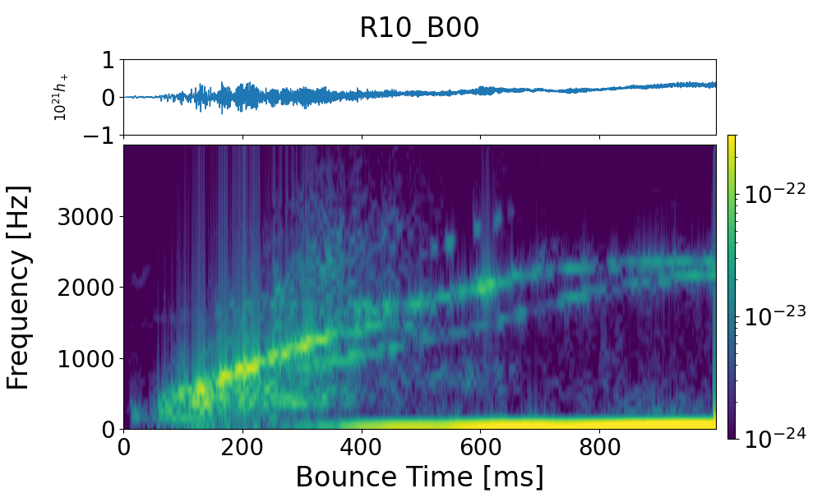
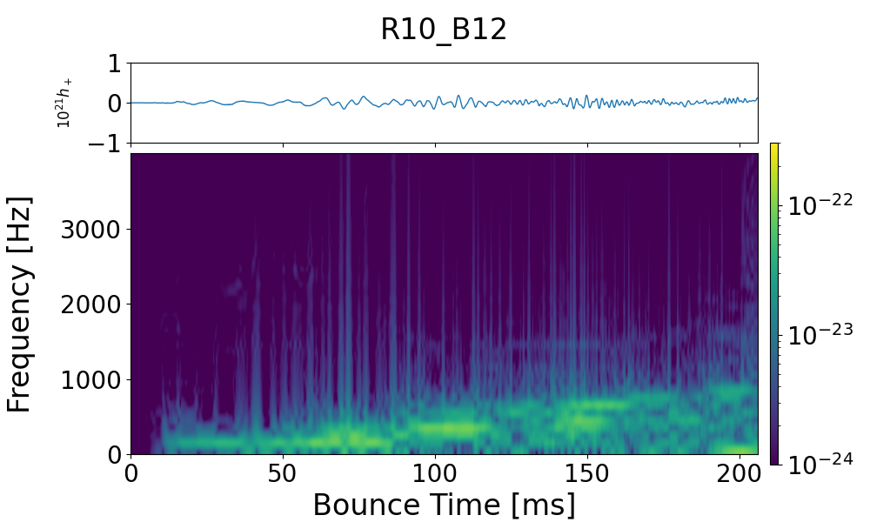
Result (Gravitational Wave)
p-mode
p-mode
f-mode
f-mode & g-mode ?
memory
memory
Can see different modes (p-mode, f-mode)
f-mode frequency increases over time as the PNS contracts.
Can see the memory component due to anisotropic matter ejecta and neutrino emission (>3-400 ms)
GW amplitude remains strong near the end of the simulation.
R10_B12 is unstable, but exhibits a stronger f-mode.
f-mode

Slide 12
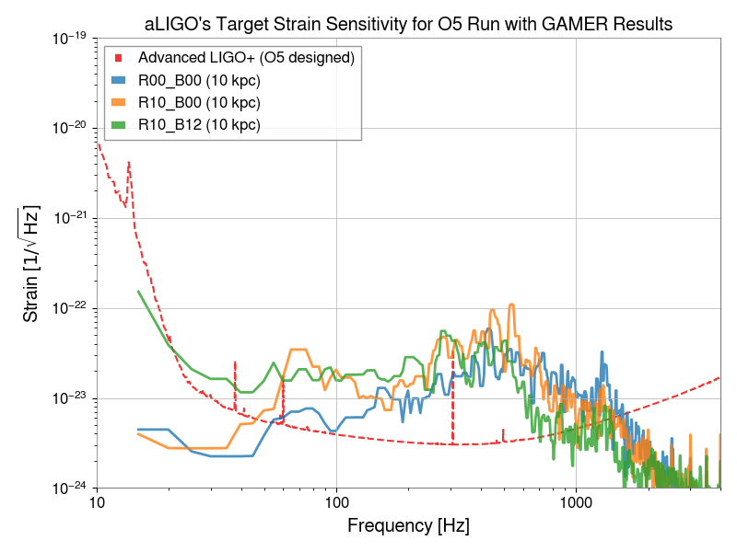
Result (Gravitational Wave)
aLIGO’s designed sensitivity curves for O5 run
First ~200 ms strains from GAMER
Assume that CCSNe are located at 10 kpc
R10_B12 shows stronger strain ~100-500 Hz
Possibly detect Hundreds Hz: mainly from f-mode
Cite: Abbott, B. P. et al (2020) Prospects for observing and localizing gravitational-wavetransients with Advanced LIGO, Advanced Virgo and KAGRA (https://doi.org/10.1007/s41114-020-00026-9)

Slide 13
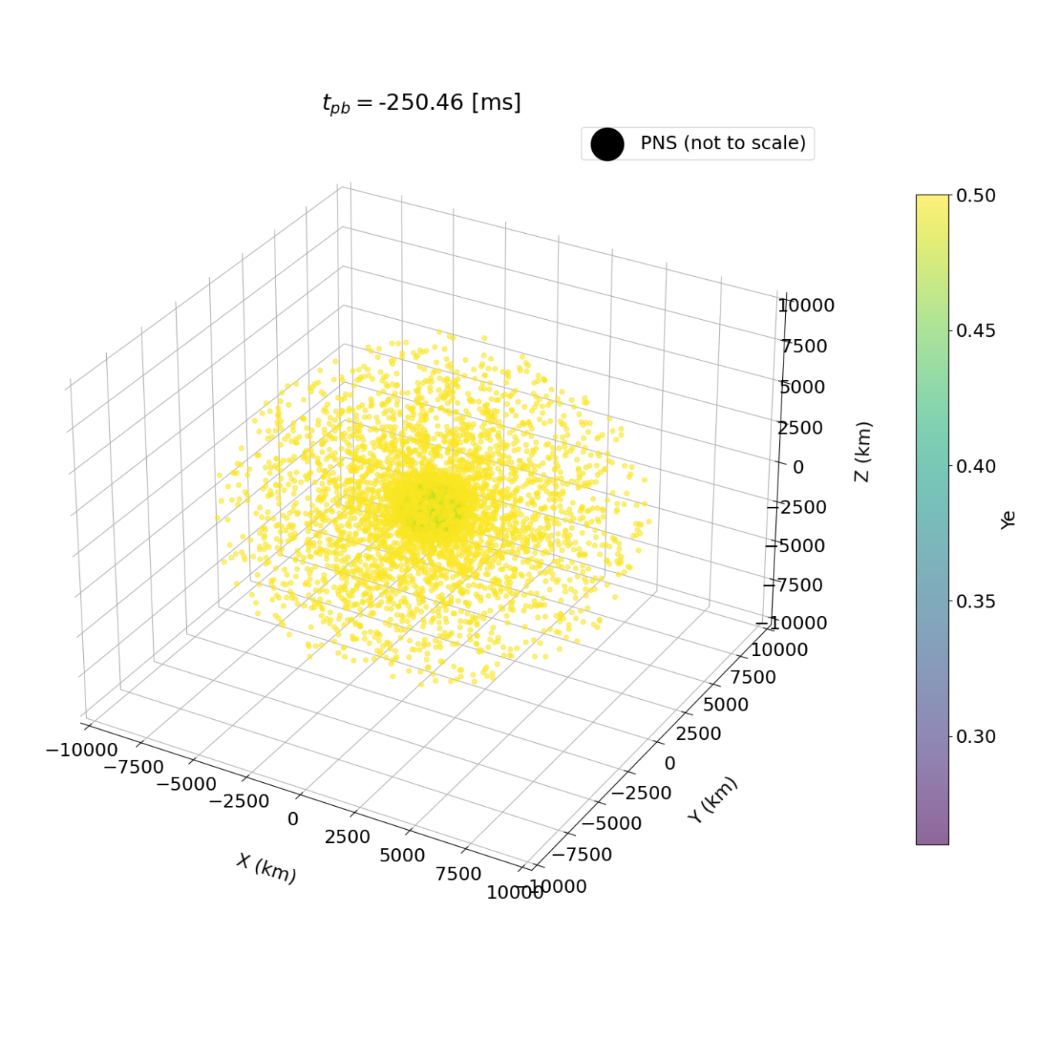
Tracer Particles
Inline tracer particles that is convecting with hydrodynamic fluids.
- Time resolution is much better than popularly used post-processing methods.
- Much more accurate
Placed 100,000 particles ~$ρ_{0}$ profile
Cut by mass coordinate $0.5−2.0 M_{⊙}$

Slide 14
Tracer Particles
R10_B12
Found ejecta from the last snapshot
Ejecta: $E_{tot}>0, v_{r}>0$
Inner tracers are collapsing early time and bounce back and going out late time $(t_{pb}>200 ms)$.
Neutron-rich ejecta (low $Y_{e}$)
Related to the r-process
Neutron-rich ejecta emerge near the PNS ($Y_{e}≤0.5)$.

Slide 15
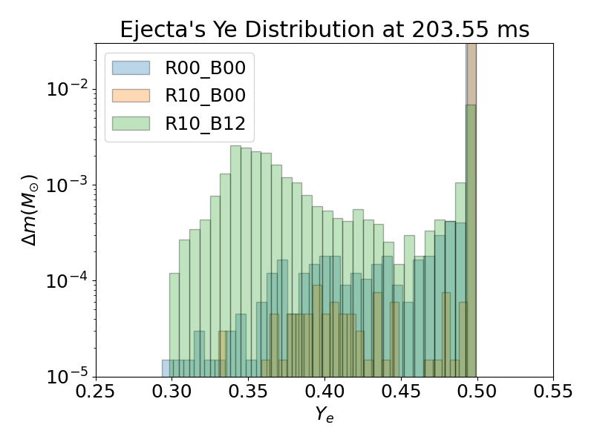
Ejecta
Neutron-rich ejecta (low $Y_{e}$)
More neutron-rich ejecta $(Y_{e}≤0.5)$ in R10_B12
Thought to be due to the early explosion.
Studying nucleosynthesis is worthwhile.
A late-time comparison is required.

Slide 16
Summary & Future Works
GAMER is a fast and powerful tool for CCSN simulations.
Rotation delays explosion onset.
MHD and rotating models show clear jet formation and increased explodability.
GW signals are potentially detectable.
Future works:
code stabilization
implement more advanced physics (e.g., neutrino transport, EOS) explore broader parameter spaces (rotation, MHD, progenitors)
conduct tracer particle–based nucleosynthesis studies.

