Slide 1
Effects on polarization properties of radio galaxies by magnetized AGN jets
Zheng-Xian Hsu (NTHU), Hsiang-Yi Karen Yang (NTHU),
Alvina Y. L. On (NCTS), and Hsi-Yu Schive (NTU)
2025/05/17 ASROC

Slide 2
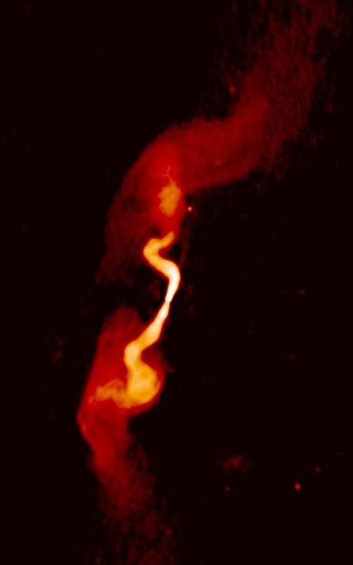
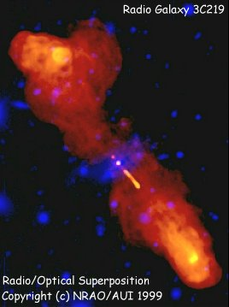
Extended radio emission in galaxies
NRAO/AUI Archives
Radio galaxies are found with extended radio emissions
$L_{10MHz∼100GHz}≈{10}^{38}$ erg/s
Emits through synchrotron radiation
CR electrons from AGN jet
3C31
Notes:
CR electrons -> B field

Slide 3
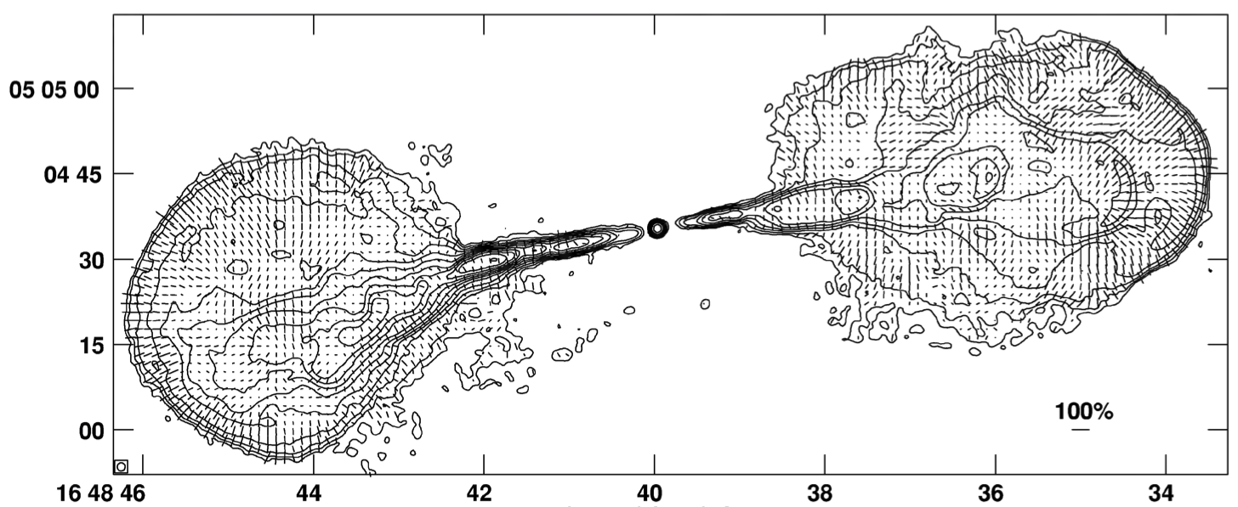
Polarized synchrotron emission
Are they contributed from the jet material?
Hercules A
Compression at lobe edge
E-vector
B-vector
Stretching along jet axis
Gizani and Leahy 2003

Slide 4
The two questions
How can the (un)magnetized jets affect the evolution in a galaxy cluster?
Can we distinguish different jets magnetization with polarized images?

Slide 5
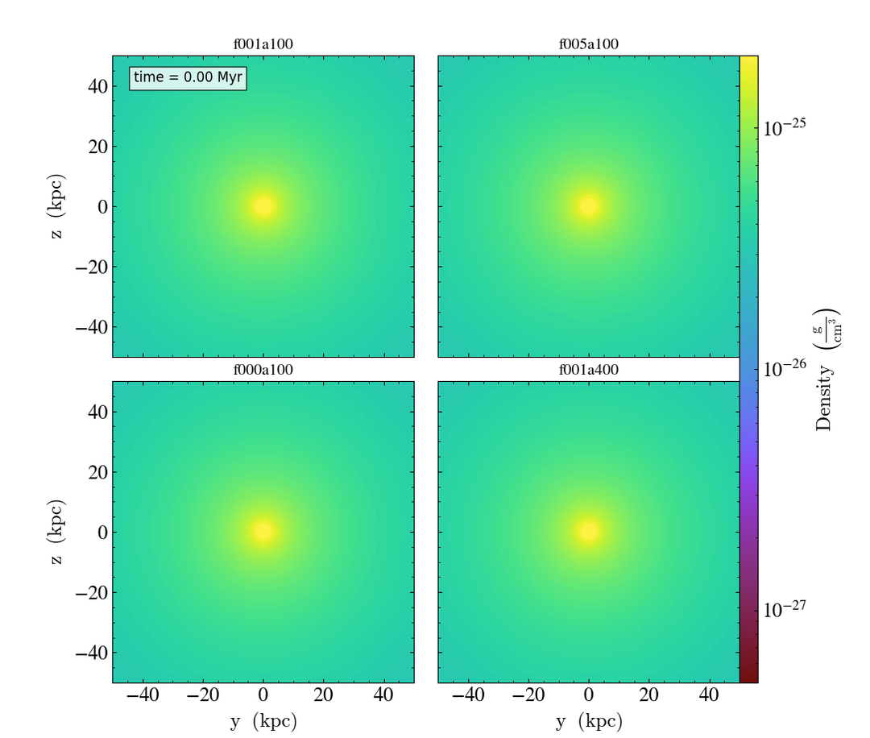
Simulate jets within a Perseus-like cluster
We have 3D-MHD simulations on jets injected in a Perseus-like cluster
GPU-accelerated Adaptive MEsh Refinement code for astrophysics (GAMER; Schive et al. 2018)
Usually ~2 orders of magnitude faster than only MPI/OpenMP computation
1 Mpc box size with ~0.24 kpc best resolution
Ambient tangled B field generated from Kolmogorov spectrum

Slide 6
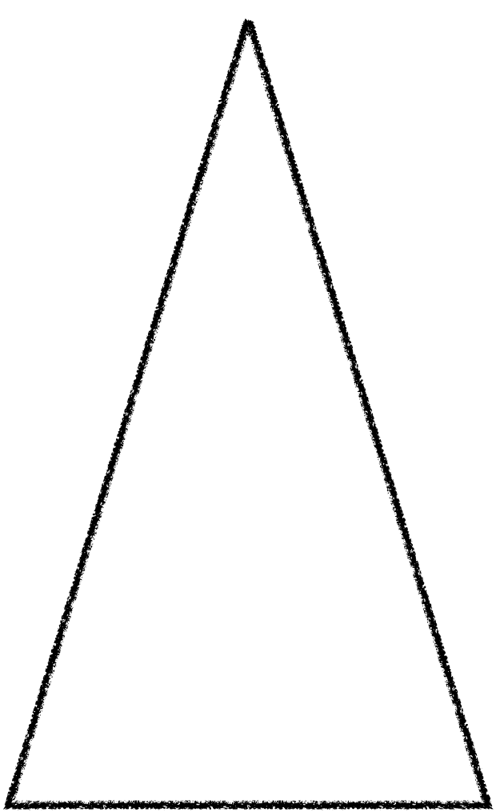
Modeling magnetized jets
Jet components: $E_{jet}=E_{B,inj}+E_{k,inj}+E_{th,inj}$
Jet magnetization $f_{B}=E_{B,inj}/E_{inj}$
Thermal injection $f_{th}=0.2$
Continuous injection
toroidal B field injection
$\overset{→}{B}=B_{0}\frac{r}{R}$$\overset{̂}{ϕ}$ for $r<R$
Tracer = 1
R
$$f_{B}$$
$$1-f_{B}$$
$$f_{th}$$
$$v_{jet}$$
$$1-f_{th}$$

Slide 7
Simulations in this study
ambient field
simulation name | meaning
f001a100 | fiducial run | 0.01 | 100
f000a100 | hydro jets | 0 | 100
f005a100 | more magnetized jets | 0.05 | 100
f001a400 | weaker ambient field | 0.01 | 400
$$f_{B}=E_{B,inj}/E_{inj}$$
$$β=P_{thermal}/P_{magnetic}$$

Slide 8
More injection, more magnetic field?
hydro jets
more magnetization
magnetic field magnitude
With more magnetization, more B-field inside the lobe, but less alignment

Slide 9
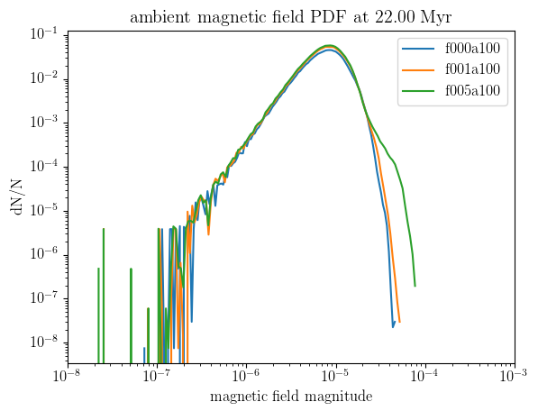
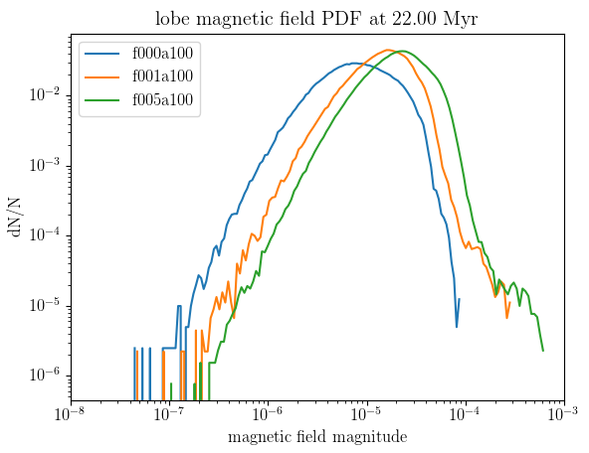
More injection, more magnetic field?
Only more magnetized jets amplify the ambient field
Higher lobe field with higher jet magnetization
Notes:
remove ainf

Slide 10
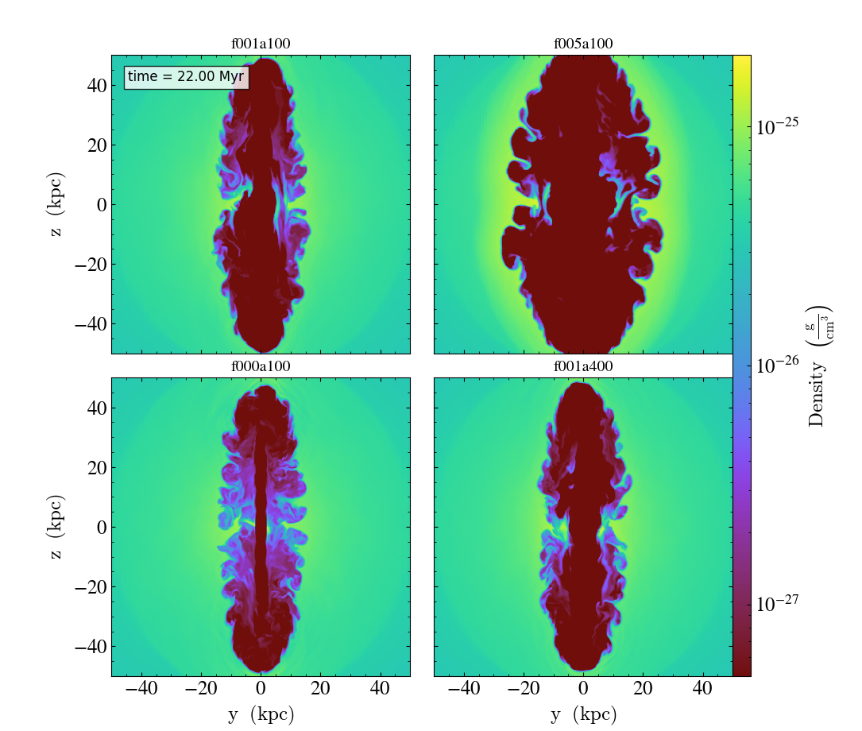
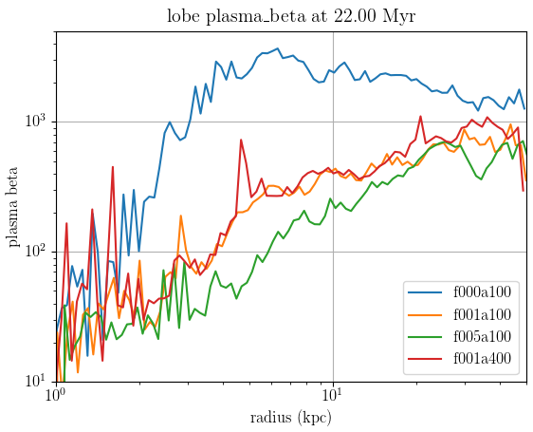
Does magnetic pressure affect lobe dynamics?
YES
density slice plot
$β=P_{thermal}/P_{magnetic}$ in the lobe region
fiducial
more magnetization
hydro jets
less ambient field
Notes:
lower beta -> wider lobe

Slide 11
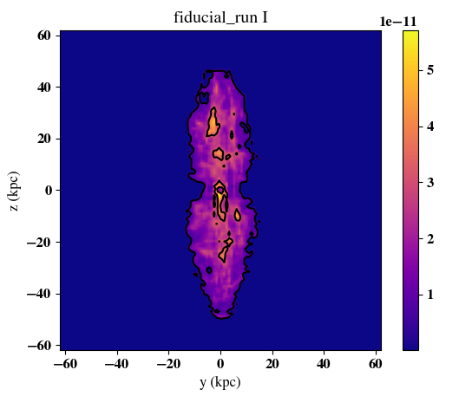
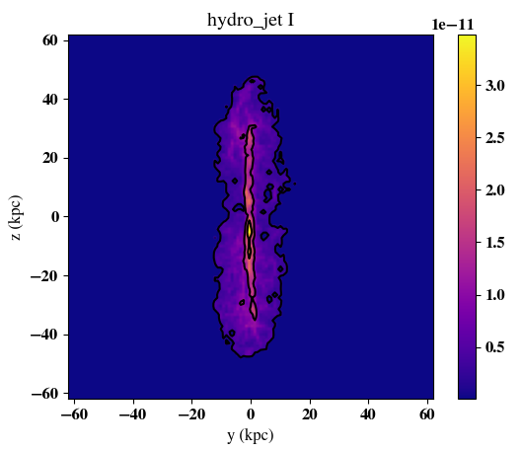
Synthetic I map at 1.4 GHz
Polarized radiative transfer (PRT) simulation at T=22 Myr
3C31
similar to hydro jets
NRAO/AUI Archives
Notes:
1, 5, 10 sigma derived from the whole data

Slide 12
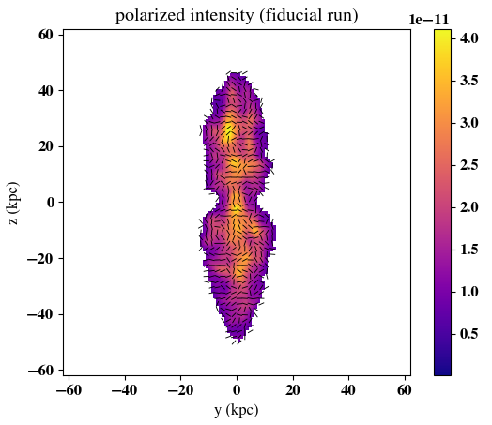
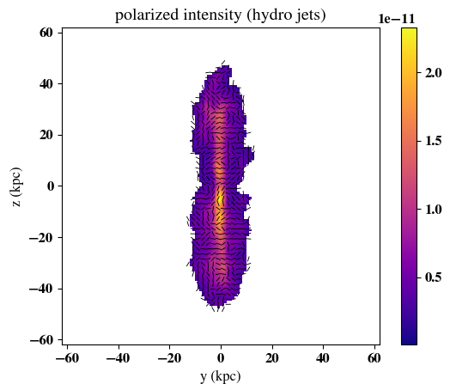
Synthetic polarized intensity at 1.4 GHz
with E-vector
no clear alignment at lobe edge
no clear alignment at lobe edge
less B-field
alignment
B-field along jet axis

Slide 13
Summary
Higher jet magnetization $→$ higher B-field magnitude inside the lobe
Higher magnetic pressure $→$ a wider lobe
No clear difference on lobe dynamic with initial B-field setup
Both stokes I map and polarized E-vectors suggest unmagnetized jet is able to form some features similar to observed images
The polarized E-vectors don’t show the aligned magnetic structure at the edge of the lobes. Non-thermal electron contribution from ambient medium may be necessary to have this feature.
Notes:
PRT

Slide 14
Outline
Introduction
The polarized emission in radio galaxy
Depolarization in observed images
Methods
Simulation code: GAMER-2
Initial setup of an isolated galaxy cluster
Model of our magnetized jet
Results
Comparison on jet magnetization
The effect from initial B-field
Synthetic images from polarized radiative transfer (PRT) simulation
Summary

Slide 15
However, B-field doesn’t only cause synchrotron emission
Faraday rotation
electron density $n_{e}$
length $l$
B-field on line of sight $B_{LOS}$
Polarized light
$$RM(radm^{-2})=0.812∫_{source}^{telescope}\frac{n_{e}}{cm^{-3}}\frac{B_{LOS}}{μG}\frac{dl}{pc}$$
For galaxy clusters, it’s common to have RM more than $100radm^{-2}$

Slide 16
Depolarization in observed images - intrinsic depolarization
LOS, extended source
electron density $n_{e}$
length $l$
B-field on line of sight $B_{LOS}$
Polarized light
$$RM(radm^{-2})=0.812∫_{source}^{telescope}\frac{n_{e}}{cm^{-3}}\frac{B_{LOS}}{μG}\frac{dl}{pc}$$

Slide 17
Depolarization in observed images - beam depolarization
electron density $n_{e}$
length $l$
B-field on line of sight $B_{LOS}$
Polarized light
$$RM(radm^{-2})=0.812∫_{source}^{telescope}\frac{n_{e}}{cm^{-3}}\frac{B_{LOS}}{μG}\frac{dl}{pc}$$

Slide 18
Initial setup of an isolated galaxy cluster
fixed
potential
Dark matter halo & gas
Ambient magnetic field
$M_{200}=8.5×{10}^{14}M_{⊙}$ (Perseus cluster)
Box size $=1$ Mpc
Best resolution $≈0.24$ kpc
Notes:
Skip DM particle descriptions, also reason on box size

Slide 19
Initial setup of an isolated galaxy cluster
fixed
potential
Dark matter halo & gas
Ambient magnetic field
$M_{200}=8.5×{10}^{14}M_{⊙}$ (Perseus cluster)
dark matter density $ρ(r)∝\frac{a^{3}}{x(1+x)^{2.5}}$
$x=\frac{r}{a},a=\frac{r_{200}}{c}$ concentration parameter, $c=6.81$
gas profile follows Vikhlinin et al. 2006
Box size $=1$ Mpc
Best resolution $≈0.24$ kpc
Notes:
Skip DM particle descriptions

Slide 20
Initial setup of an isolated galaxy cluster
Dark matter halo
Ambient magnetic field
vector potential from Kolmogorov spectrum (tangled)
normalized with given plasma beta $β=P_{thermal}/P_{magnetic}$
log E
$M_{200}=8.5×{10}^{14}M_{⊙}$ (Perseus cluster)
$L_{box}$$=1$ Mpc
Best resolution $≈0.24$ kpc
50 kpc
10 kpc
log k

Slide 21
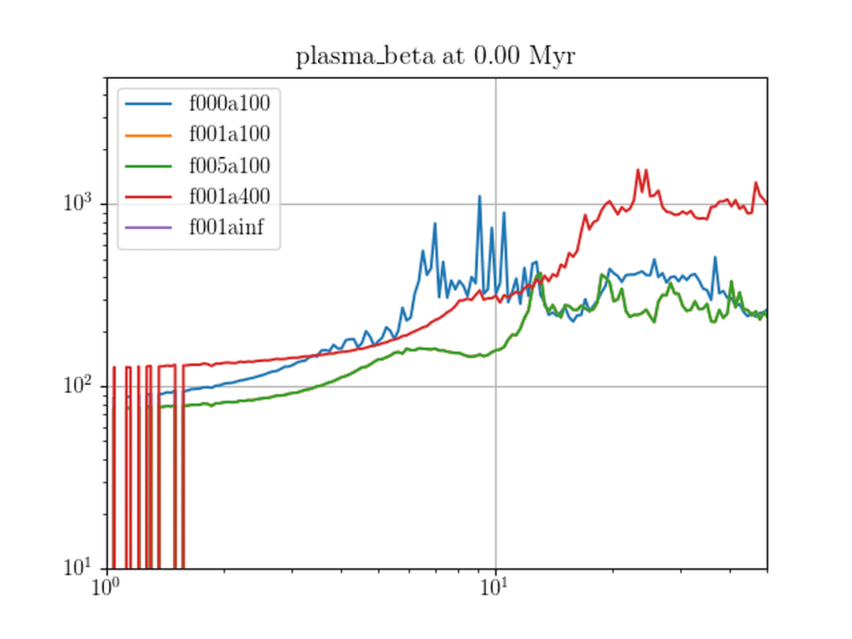
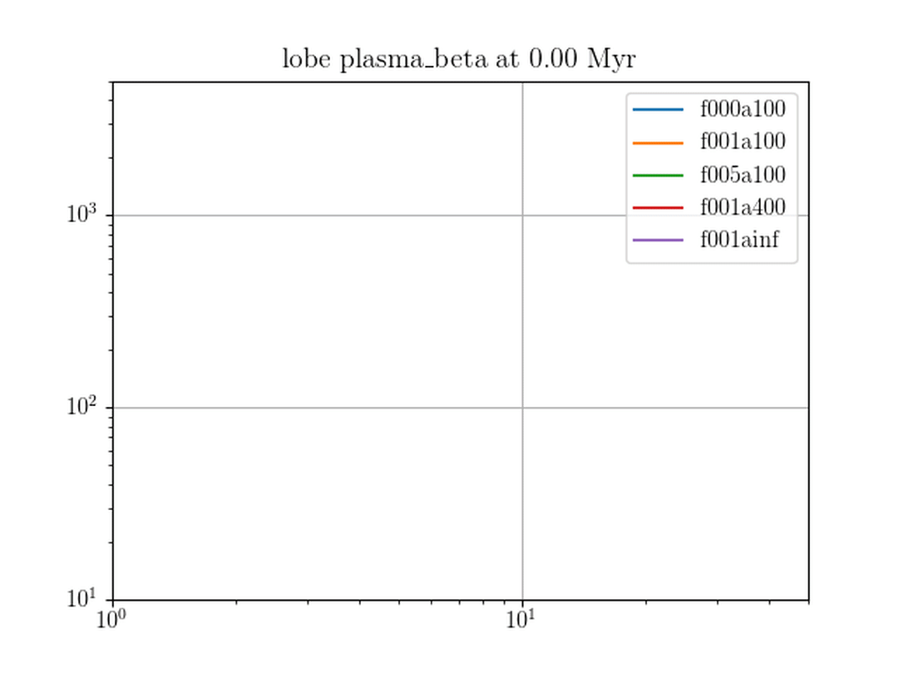
Higher B-field… Affecting lobe dynamics?
plasma beta $β=P_{thermal}/P_{magnetic}$
some dependency with magnetization?
consider lobe, more clear dependency
$$β$$
$$β$$
radius
radius

Slide 22
Depolarization
depolarization from different Faraday depth and intrinsic rotation
rotate $nπ+3/4π$
$$nπ$$
$$nπ+2/4π$$
$$nπ+1/4π$$
Assume aligned B-field (fixed polarization)
rotate $nπ+1/4π$
$$+$$
$$=$$

Slide 23
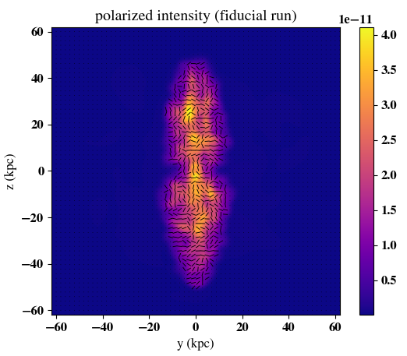
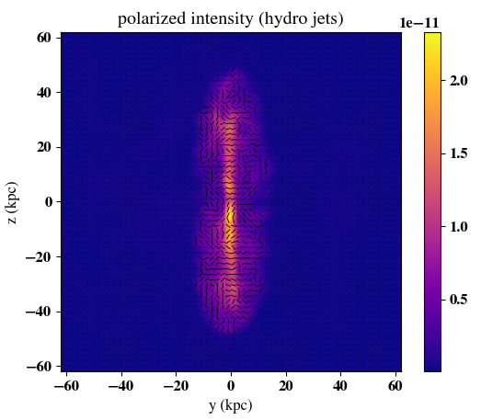
Synthetic polarized intensity at 1.4 GHz
$$n_{e,non-thermal}={10}^{-5}Tracer+{10}^{-6}n_{e}$$
$$n_{e,thermal}≈n_{e}$$
with E-vector

