Slide 1
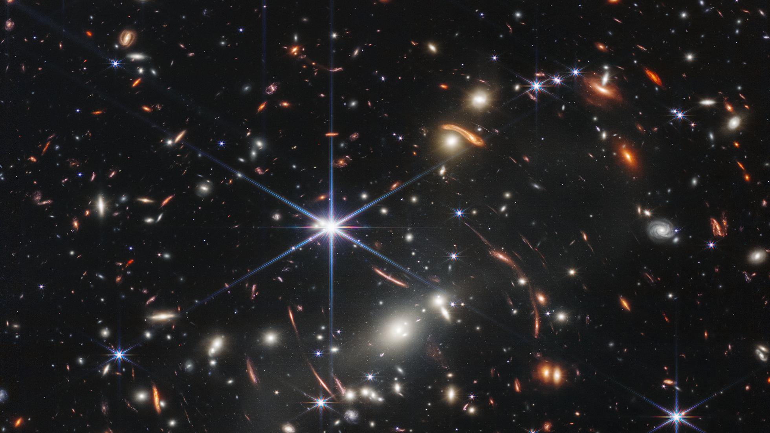
Discovery of a Population of Strong Galaxy-Galaxy Lensed Faint Dusty Star-forming Galaxies
ASROC Annual Meeting 2025
Ting-Kai Yang
Supervisor: Chian-Chou Chen (TC)
Zhen-Kai Gao; Bovornpratch Vijarnwannaluk; Li-Wen Liao; Wei-Hao Wang; Rajashree Bhuyan; Po-Feng Wu
Credits: NASA, ESA, CSA, STScI
Notes:
Today, I am going to present my project, which focuses on searching for strongly lensed faint dusty star-forming galaxies.

Slide 2
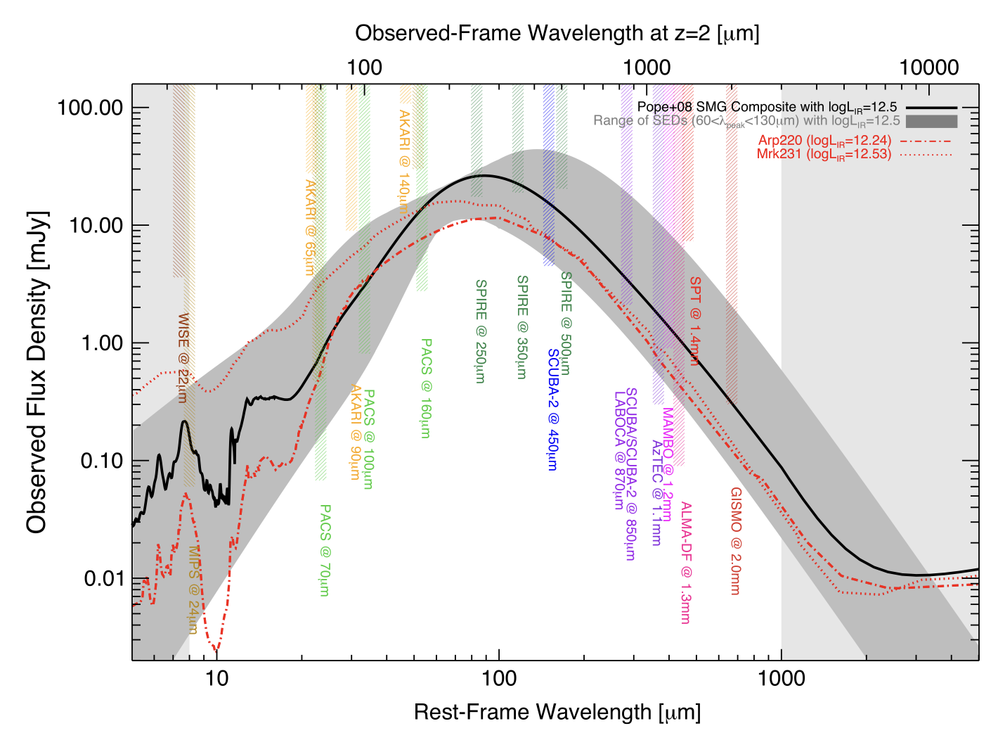
Dusty Star-forming Galaxies (DSFGs)
Observed-Frame Wavelength at z=2 [μm]
100
1000
10000
100.00
Dusty and high star formation rate
Bright in far-IR and submilimeter (Casey et al. 2014)
10.00
SCUBA-2
Observed Flux Density [mJy]
450μm
1.00
850μm
0.10
0.01
Casey et al. 2014
10
100
1000
Rest-Frame Wavelength [μm]
05/16/25
ASROC 2025 | Ting-Kai Yang
1
Notes:
Why we need to study the strongly lensed dusty galaxies? First, the foreground mass distribution can be studied with the strong lensing effect. More strongly lensed galaxies implies a greater amount of foreground mass.
Because DSFGs are located at redshift 2 and beyond, they have higher probability of aligning with other foreground galaxies.
Also, the strong lensing effect will let the galaxies become brighter, so we can study the faint sources with the magnified view.

Slide 3
Strong gravitational lensing
Credit: ALMA (ESO/NRAO/NAOJ), L. Calçada (ESO), Y. Hezaveh et al.
05/16/25
ASROC 2025 | Ting-Kai Yang
2
Notes:
Why we need to study the strongly lensed dusty galaxies? First, the foreground mass distribution can be studied with the strong lensing effect. More strongly lensed galaxies implies a greater amount of foreground mass.
Because DSFGs are located at redshift 2 and beyond, they have higher probability of aligning with other foreground galaxies.
Also, the strong lensing effect will let the galaxies become brighter, so we can study the faint sources with the magnified view.

Slide 4
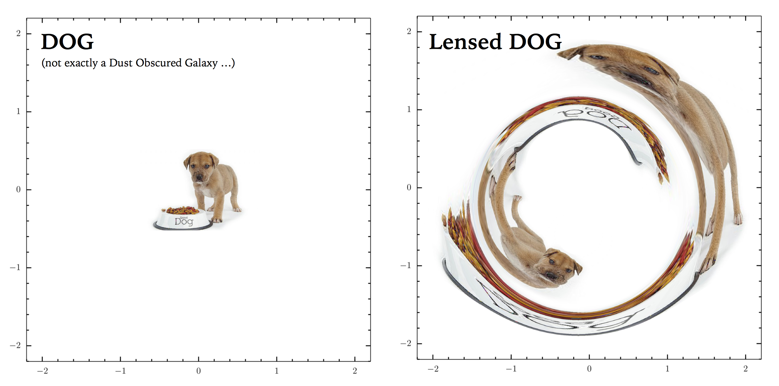
Why strongly lensed DSFGs?
Foreground mass distribution
Put constraints on the mass distribution in the Universe
DSFGs have higher probability aligning with other foreground galaxies
Probe into fainter source
Magnified view and detailed investigation of faint sources
Credits: Mattia Negrello
05/16/25
ASROC 2025 | Ting-Kai Yang
3
Notes:
Why we need to study the strongly lensed dusty galaxies? First, the foreground mass distribution can be studied with the strong lensing effect. More strongly lensed galaxies implies a greater amount of foreground mass.
Because DSFGs are located at redshift 2 and beyond, they have higher probability of aligning with other foreground galaxies.
Also, the strong lensing effect will let the galaxies become brighter, so we can study the faint sources with the magnified view.

Slide 5
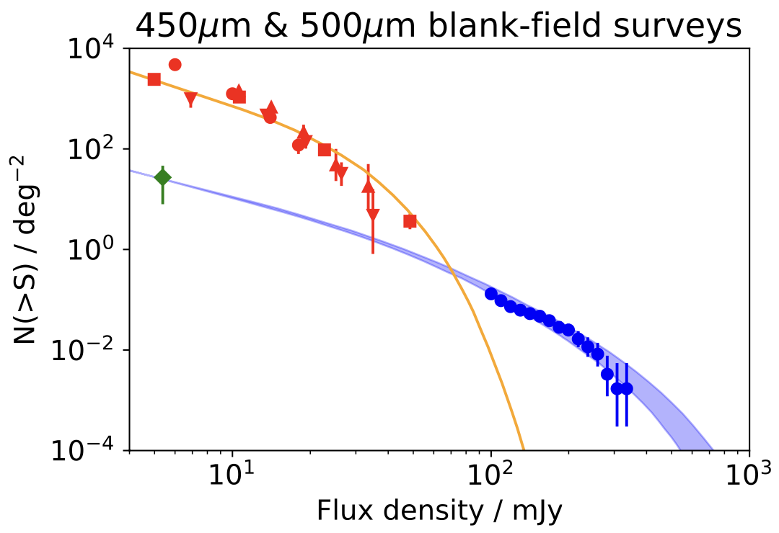
Number density model
Blue: strongly lensed DSFGs
Orange: unlensed DSFGs
Where we are interested
Pearson et al. 2024
05/16/25
ASROC 2025 | Ting-Kai Yang
4
Notes:
Here is the models of number density of DSFGs. The blue curve shows the strongly lensed number density, and the orange curve shows the unlensed. In previous submillimeter surveys, the strongly lensed DSFGs are found as the bright sources, shown in blue dots here, which puts good constraints on the bright end.
but model predicts that there is a population of strongly lensed faint DSFGs, so in this project, we aim to search for these strongly lensed faint DSFGs and compare the number density with the model.

Slide 6
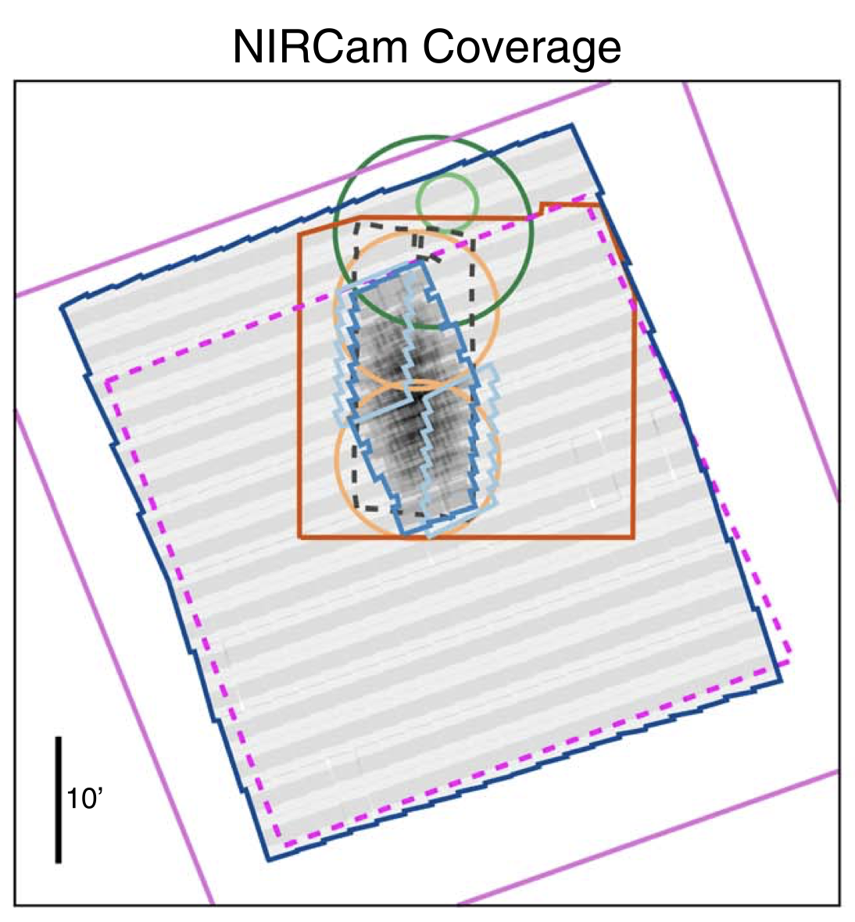
Imaging data
Casey et al. 2023
JWST NIRCam (PRIMER+COSMOS-Web)
~0.54 deg² in COSMOS field, ~256 arcmin² in UDS field
F115W, F150W, F277W and F444W
JCMT SCUBA-2
450- and 850-micron image (STUDIES, S2COSMOS, S2CLS, S2LXS, etc)
05/16/25
ASROC 2025 | Ting-Kai Yang
5
Notes:
To search for strong lensing structures, we need the high resolution imaging data from JWST.
Here is the imaging data we used. The first one is the COSMOS-Web and PRIMER data from JWST, which was taken by NIRCam in four bands.
To select the dusty galaxies, we used the SCUBA-2 450 and 850-micron images to confirm the submillimeter detection.

Slide 7
JWST Threshold Catalog
Detected in F444W – F150W map for searching red galaxies
RGB
Credits: Zhen-Kai Gao
05/16/25
ASROC 2025 | Ting-Kai Yang
6
Notes:
For the JWST catalogs, we derived a threshold catalog, which is detected in the difference map of F444W and F150W, this catalog is optimized for searching red galaxies. Because we are searching for the red arcs, which may be blended with the foreground in short wavelength. Also we measure the isophotal flux in the detected segment to better consider the color of the distorted galaxies.

Slide 8
DSFG samples
COSMOS field
STUDIES
COSMOS-Web
STUDIES 450-micron counterparts
ALMA, VLA or MIPS
JWST flux & color selection (Barger & Cowie 2023)
11,873 DSFGs in COSMOS field and 1,425 DSFGs in UDS field
High SNR in SCUBA-2 stacking analysis
Casey et al. 2023
We made RGB plots and visually identified strongly lensed morphologies
05/16/25
ASROC 2025 | Ting-Kai Yang
7
Notes:
To search for strongly lensed DSFGs, we select two samples of DSFGs, one is the STUDIES 450-micron counterpart, and the other sample is selected with the JWST flux and color selection. We select 12000 in COSMOS field and 1400 in UDS field.
Then we made RGB cutouts and visually identified the strongly lensed morphologies, such as the rings or arcs.

Slide 9
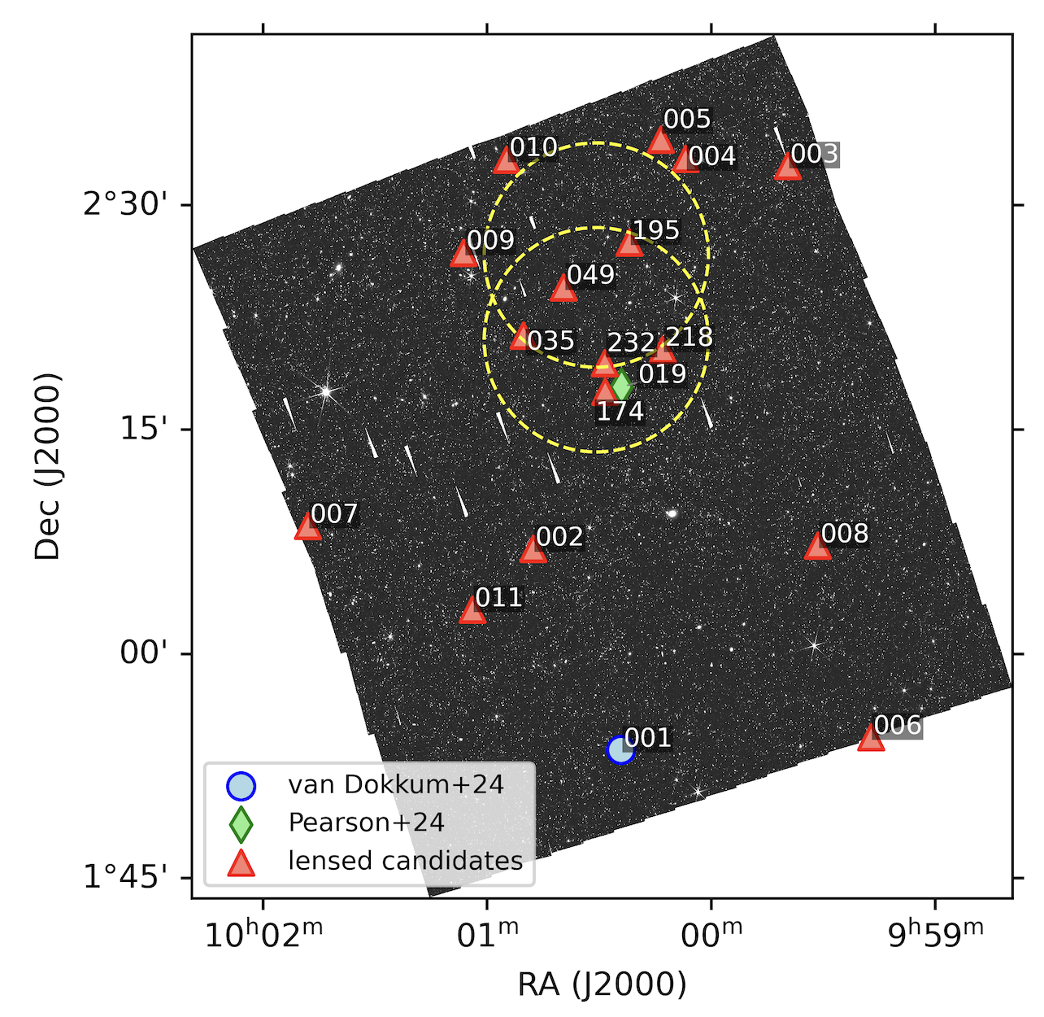
Results
We found 18 strongly lesned candidates in COSMOS field
No candidates found in UDS field
7 sources selected from STUDIES 450-micron counterparts
2 of them have been reported (Pearson et al. 2024, van Dokkum et al. 2024)
05/16/25
ASROC 2025 | Ting-Kai Yang
8
Notes:
As the result, we found

Slide 10
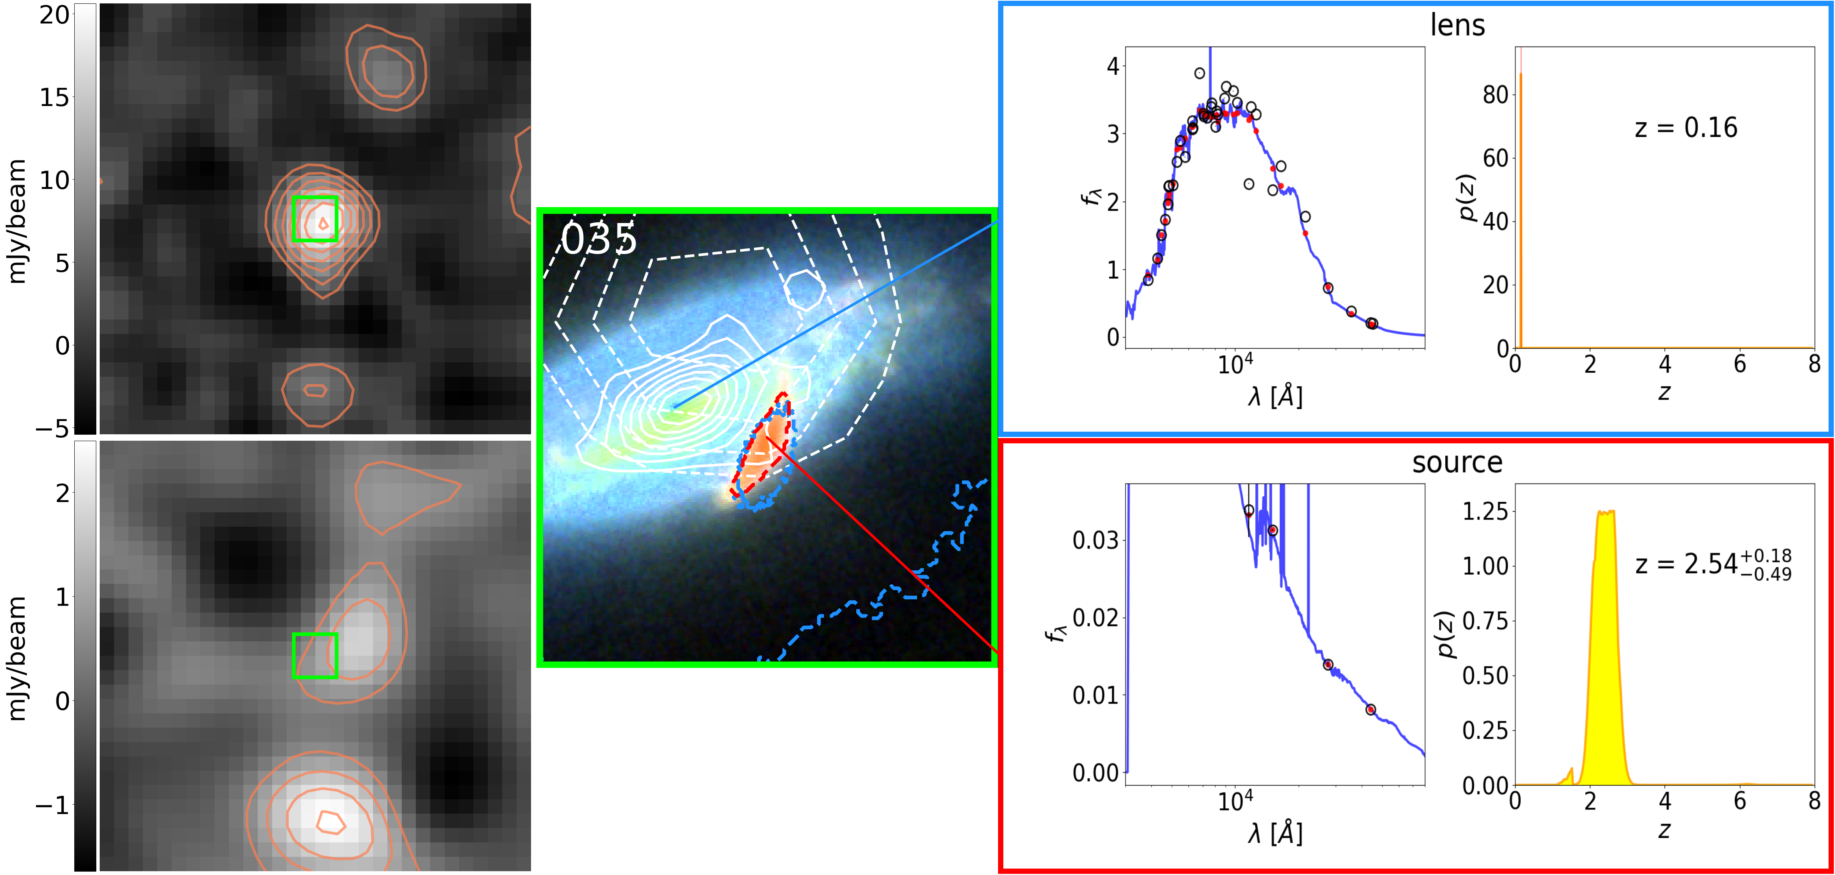
Photo-z
Photo-z generated with EAZY
Photometry
4 bands for sources (JWST)
36~38 bands for lenses (JWST+COSMOS2020)
Source photo-z is higher than the lens for all candidates, suggesting potential lensing.
05/16/25
ASROC 2025 | Ting-Kai Yang
9
Notes:
We estimated photometric redshifts, or photo-z, for our lenses and sources. We used EAZY to obtain the photo-z with EAZY templates. Here, we show three examples] the upper panel is the result for the lenses, and the lower is for the sources. In each plot, the left shows the SED fitting, and the right side shows the probability distribution. We applied only four bands from JWST to obtain photo-z of the sources, which cannot constrain the results very well. For the lenses, we have 36 to 38 bands, including the four from JWST and others from the COSMOS2020 catalog. We found that the photo-z of sources is higher than that of the lenses for all 11 candidates, indicating they can potentially be a lensing system.

Slide 11
Lens modeling
Lens mass distribution
Constructed model image
Light profiles
Observed data
Fitting process
Best fit model parameter
Magnification factor
We applied lens modeling with Lenstronomy (Birrer & Amara 2018 and Birrer et al. 2021)
05/16/25
ASROC 2025 | Ting-Kai Yang
10
Notes:
To ensure the strongly lensed nature of these candidates, we moved on to applying lens modeling to our sources. The code we used is Lenstronomy, developed by Birrer et al. I will briefly introduce the modeling here, and the details of the code are described in these three papers. In the modeling process of this code, we provide the image of the lensing system, given the mass distribution and light profile of both lens and source. The code reconstructs the image with the given models and finds the best-fit result of the model parameters through PSO and MCMC methods. With the result, we can calculate the magnification factor and lens mass.

Slide 12
Lens modeling
035 for example (SIE, μ = $2.5$)
13 candidates were confirmed as strongly lensed
05/16/25
ASROC 2025 | Ting-Kai Yang
11
Notes:
Here is an example of our fitting test. The left panel is the image data we input, the middle is the image constructed with the best-fit model parameters, and the right panel is the residual of the data and model. This one is fitting with SIE model, and the magnification is 2.5. We apply the modeling to the 18 candidates and found 13 of them are strongly lensed.

Slide 13
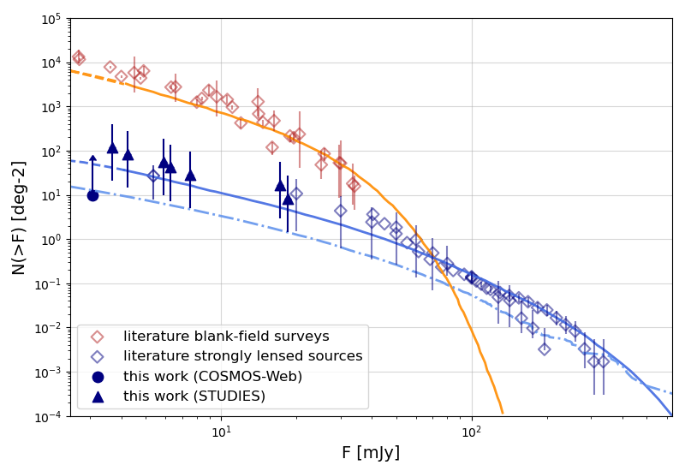
Compare to number density model
Blue solid: Negrello et al. 2017
Blue dashdot: Sedgwick et al. 2025
05/16/25
ASROC 2025 | Ting-Kai Yang
12
Notes:
We plot our result of the number density of strongly lensed DSFGs on the theoretical model. The blue triangle shows the STUDIES samples, and the blue dots show other red galaxies in COSMOS field. For the STUDIES samples, our result is consistent with the model prediction, indicating the existence of the faint strongly lensed population.

Slide 14
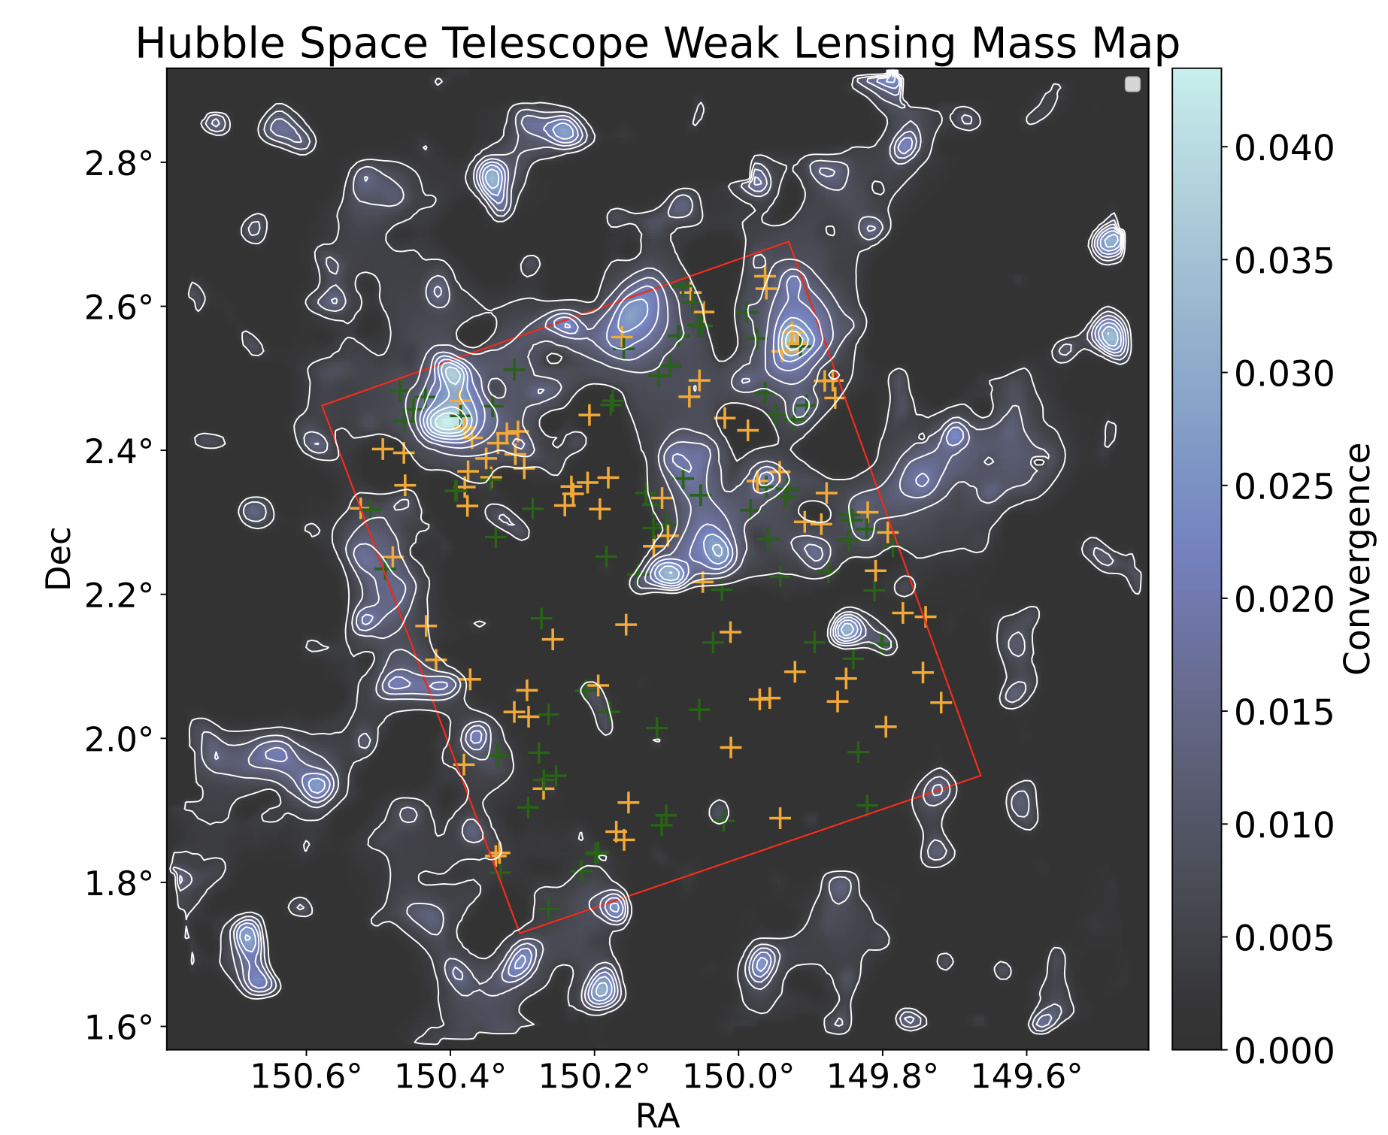
Field-to-field Variation
13 strongly lensed faint DSFGs in COSMOS field; none in UDS field
Higher convergence within STUDIES footprint
Nightingale et al. 2025
05/16/25
ASROC 2025 | Ting-Kai Yang
13
Notes:
Higher weak lensing convergence in STUDIES-COSMOS field

Slide 15
Summary
We searched for strongly lensed faint DSFGs using JWST imaging data
13 strongly lensed faint DSFGs were identified in COSMOS field, but no strongly lensed candidates found in UDS field, showing a field-to-field variation
Our observed result is consistent with the model predictions for strongly lensed DSFG number density, supporting the existence of a faint strongly lensed DSFG population
The lensing systems we found are expected to be detected with Euclid, more strongly lensed faint DSFGs may be discovered in the future
05/16/25
ASROC 2025 | Ting-Kai Yang
14

