Slide 1
Exploring Galactic Quenching with MaNGA
Comparative Analysis of Criteria and Insights into Quenching Mechanisms
Zi-Hua Ho
@ASROC2025
With
Lihwai Lin, Hung-Yu Jian, Bau-Ching Hsieh, Carlos López-Cobá (ASIAA),
Wen-Yen Wu (NTNU/ASIAA)
qaz@gapp.nthu.edu.tw

Slide 2
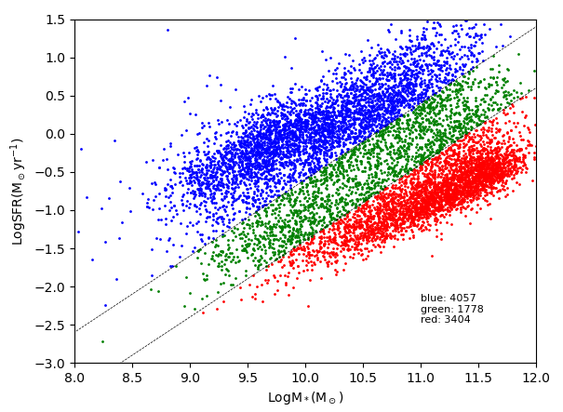
What is quenching?
Star-forming galaxies
Green valley galaxies
SFR ($\log_{10}M_{∗}/yr$)
Quenching
Quiescent galaxies
Stellar Mass $[\log_{10}M_{∗}(M_{⊙})]$
(Plotting from MaNGA DR17)
1
Introduction

Slide 3
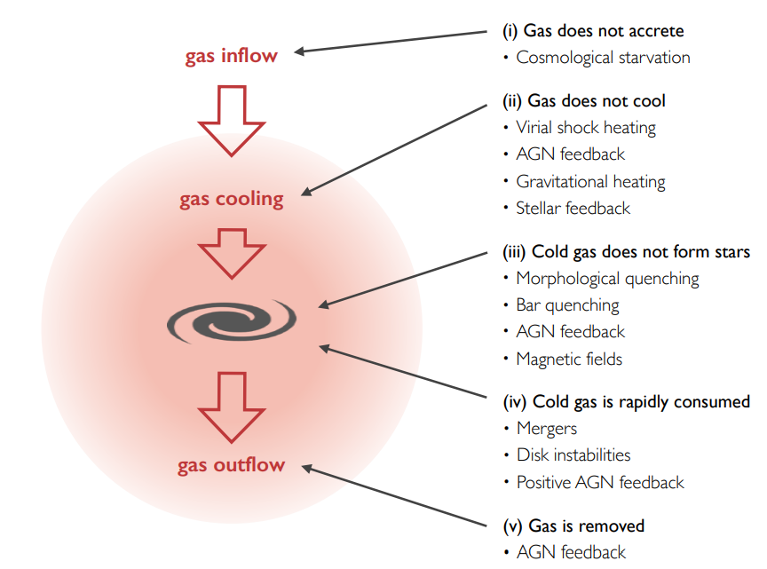
What can trigger quenching?
Inside-out quenching
Outside-in quenching
(Man & Belli 2018)
Any process that interrupts the star formation can quench galaxies
–– But it might leave distinct footprints
2
Introduction

Slide 4
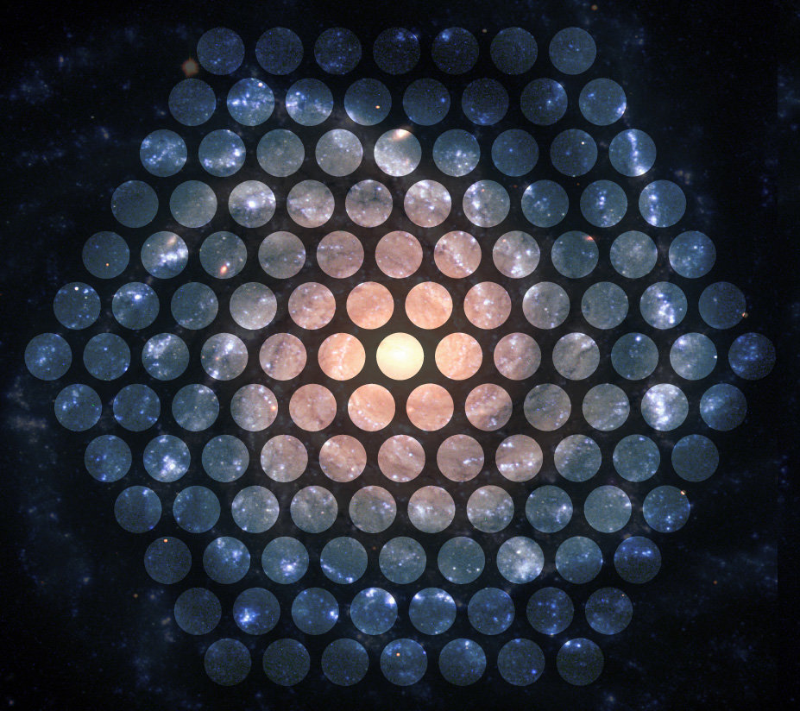
Game changer –– IFU
Credit: SDSS
MaNGA DR17
~ 10000 galaxies at 0.01 < z < 0.15
360 ~ 1030 nm with R ~ 2000
$M_{∗}≥{10}^{9}M_{⊙}$
17 IFUs that vary in diameter from 12'' (19 ﬁbers) to 32'' (127 ﬁbers)
Bundy et al. (2015)
3
Introduction

Slide 5
What is quenching exactly?
Hong et al. (2023) used $D_{n}4000$ to separate the quenched spaxels and star-forming spaxels
Colombo et al. (2020), Ellison et al. (2021), Kalinova et al. (2022), etc. used EW(Hα) for the classification.
Rathore et al. (2022) employed the sSFR to identify quenched regions
Corcho-Caballero et al. (2021) used EW(Hα) and the color index (g - r) to define regions at different quenching stages
Chen et al. (2019) and Cheng et al. (2024) use the HδA line and EW(Hα) to select the post-starburst (PSB) region as the quenched region
Lin et al. (2019) combine the LI(N)ER in the BPT diagnosis diagram with EW(Hα) to define the quenched region.
.
.
.
There are various ways to define quenched region!
4
Motivation

Slide 6
4 criteria
To know how the definition affect the result, we consider:
Region with low sSFR (log(sSFR) < -11)
(Pan et al. 2024)
Region with high $D_{n}4000$ ($D_{n}4000$ index > 1.45)
(Bluck et al. 2020)
Low-ionization (nuclear) emission-line region (LI(N)ER) from BPT diagram
(Lin et al. 2019)
Post-starburst (PSB) region selected by Hδ and EW(Hα)
(Chen et al. 2019) and (Cheng et al. 2024)
5
Method

Slide 7
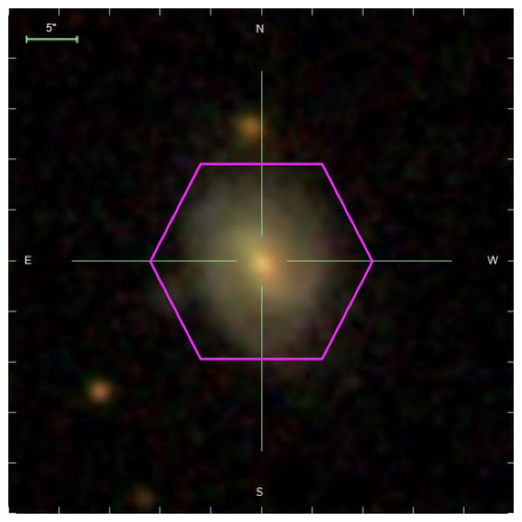
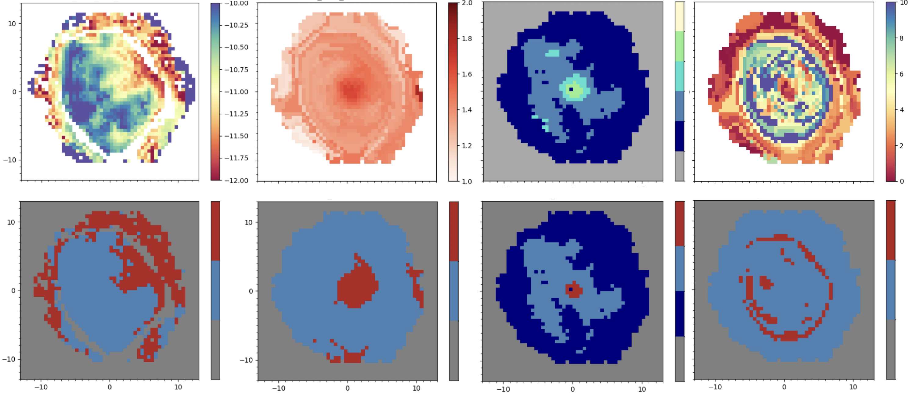
How do the criteria affect the result?
sSFR
$$D_{n}4000$$
LI(N)ER
PSB
9867-6101
arcsec
Non-quenched
Quenched
Unclassified
6
Method

Slide 8
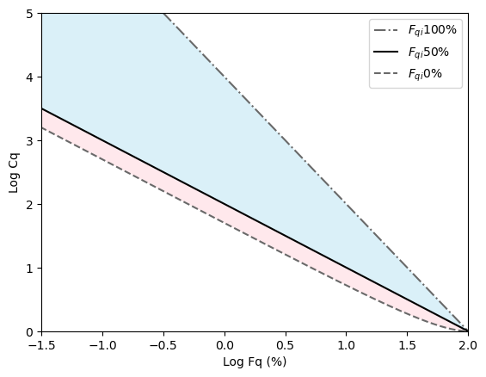
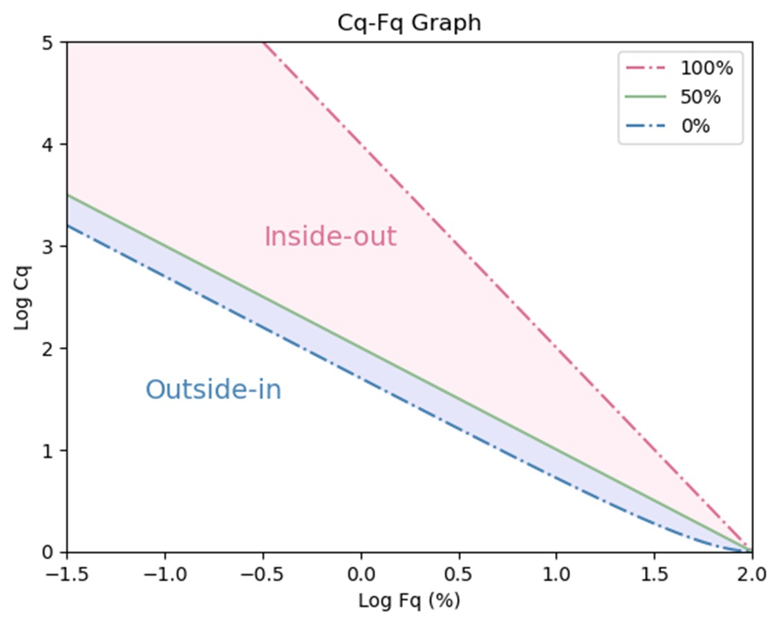
Inside-out and Outside-in quenching
$$F_{q}=\frac{N_{quenched}}{N_{all}}$$
Inside-out
$F_{q}$: quiescence
(quenched fraction)
Inside-out quenching
Log $C_{q}$
$$C_{q}=\frac{{\sum{r_{\text{all}}}}^{2}}{{\sum{r_{\text{quenched}}}}^{2}}$$
Inside-out
$C_{q}$:quenching concentration
(the concentration of quenched area)
log $F_{q}$ (%)
Outside-in quenching
(Lin et al. 2019)
7
Method

Slide 9
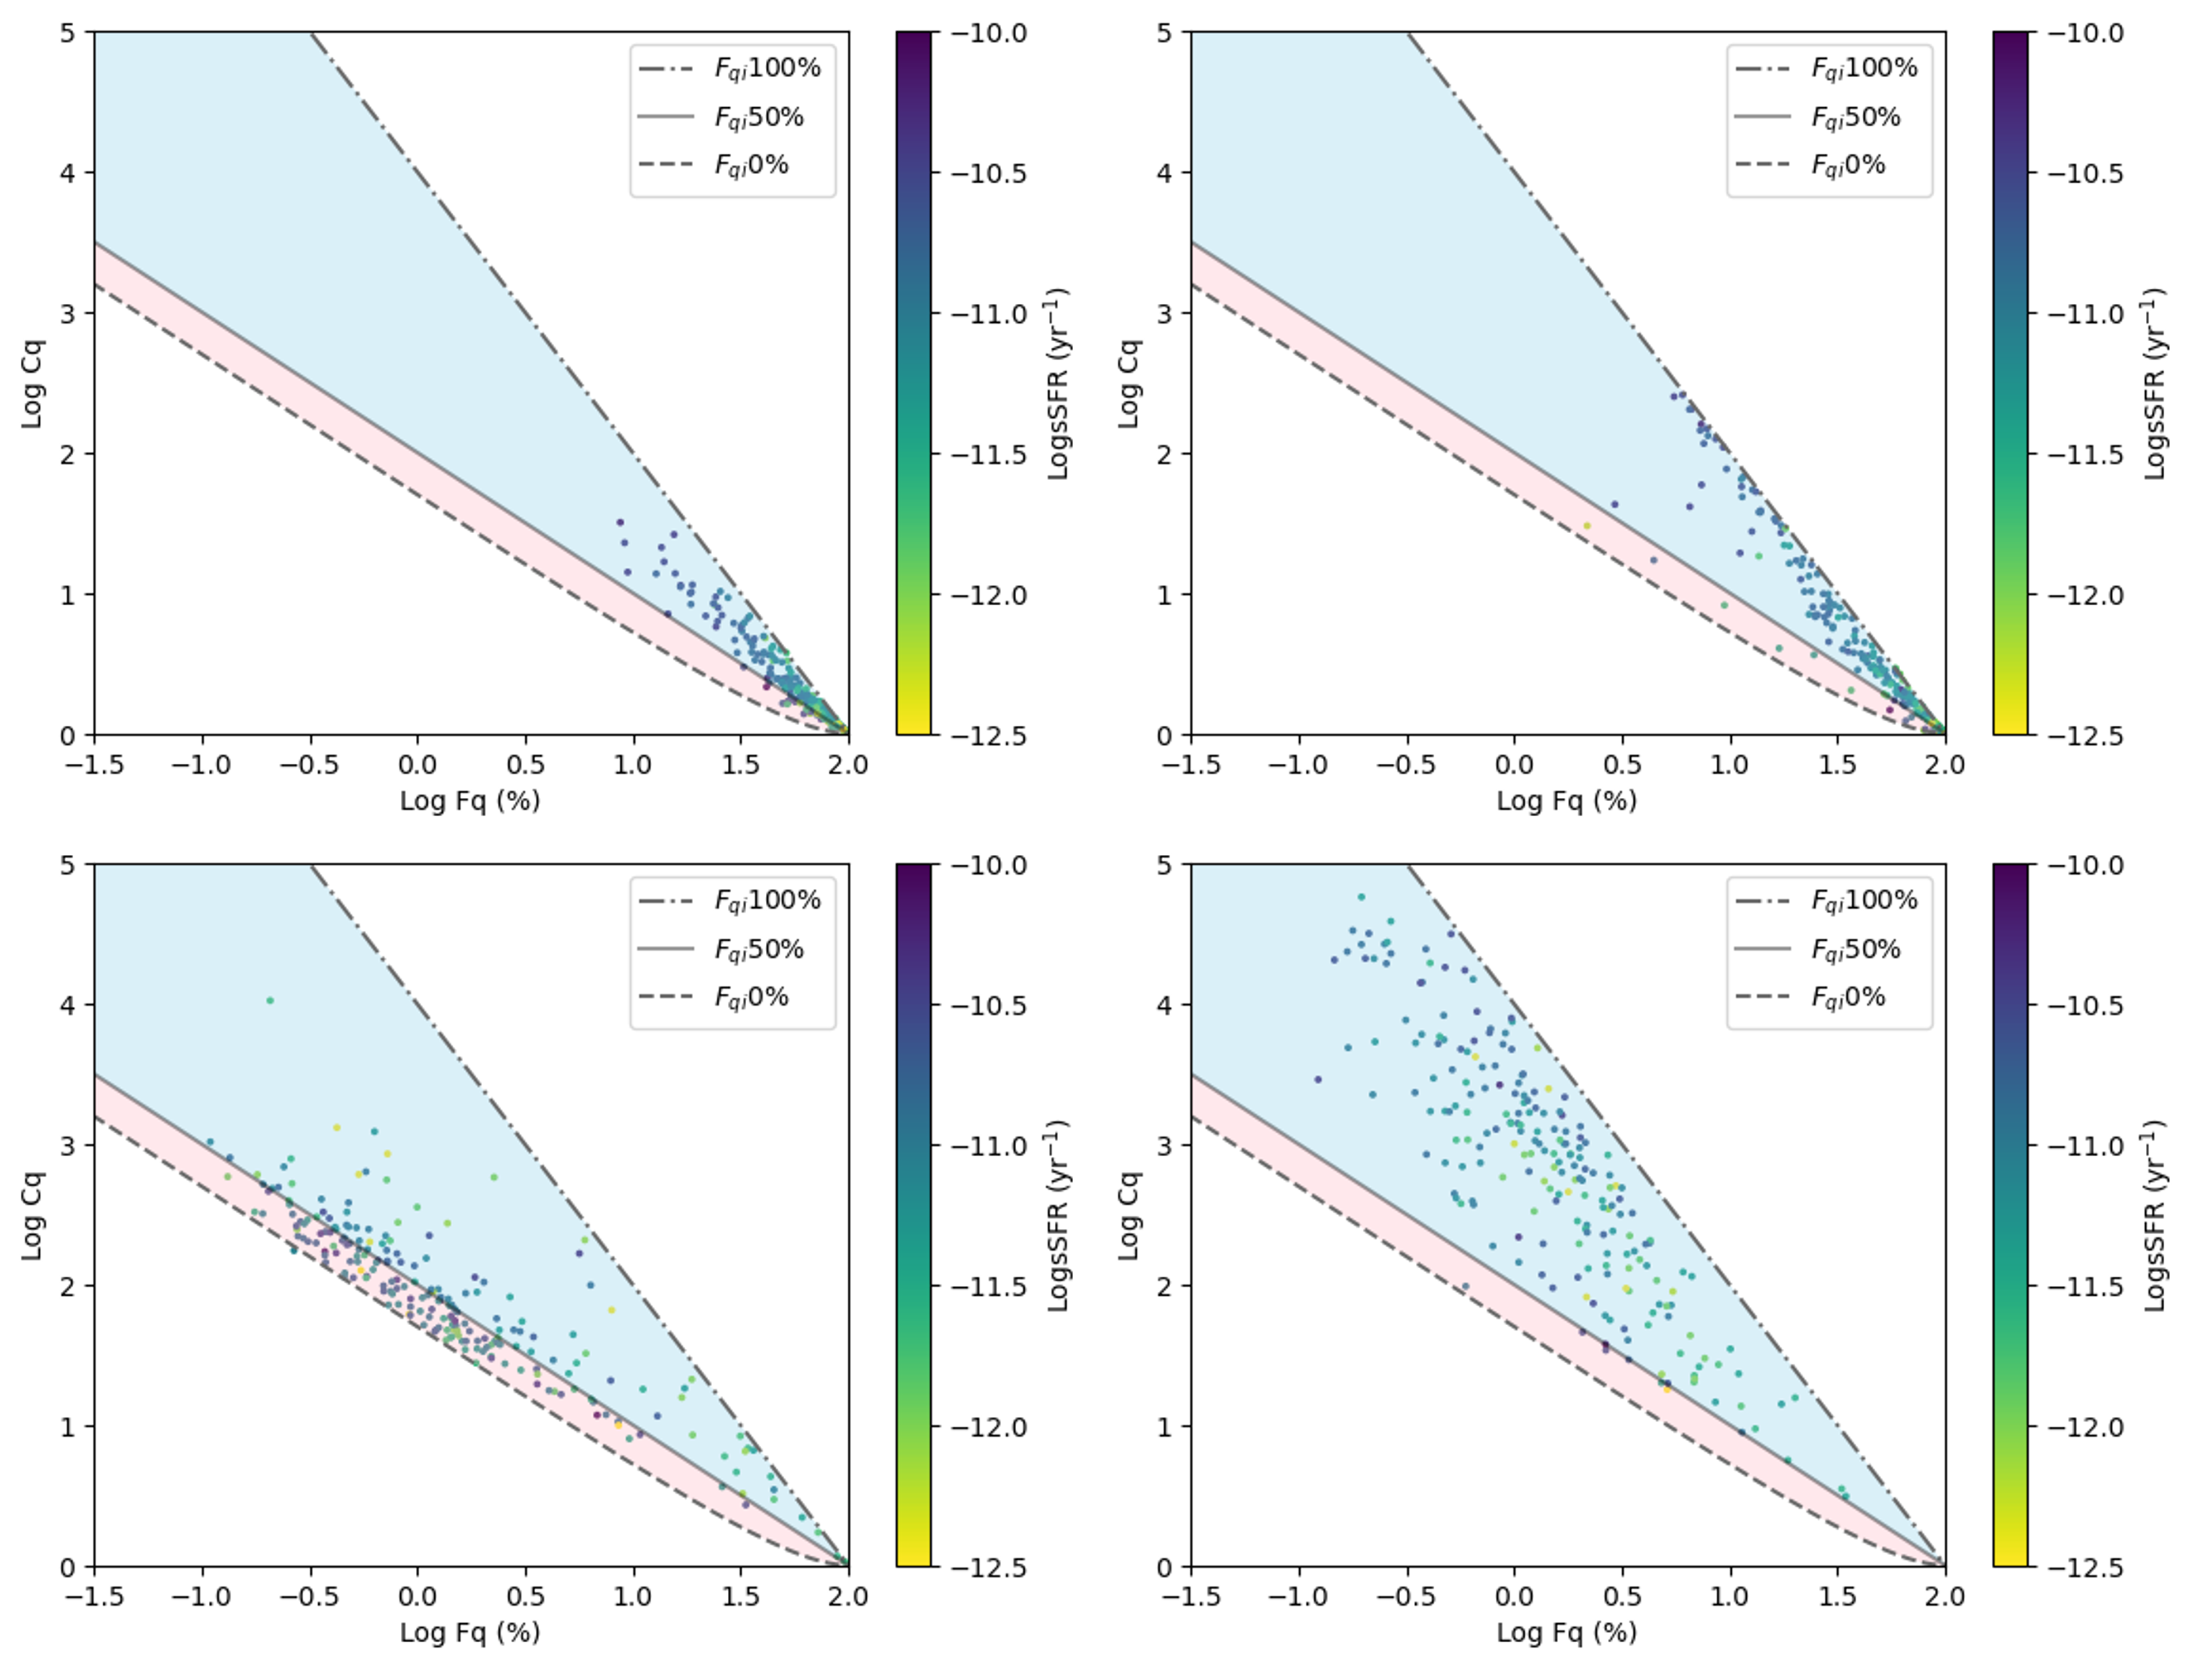
Overlapping galaxies
Inside-out
Outside-in
Global sSFR
sSFR
$$D_{n}4000$$
Log $C_{q}$
PSB
LI(N)ER
(Ho et al. in prep.)
log $F_{q}$ (%)
Result
8

Slide 10
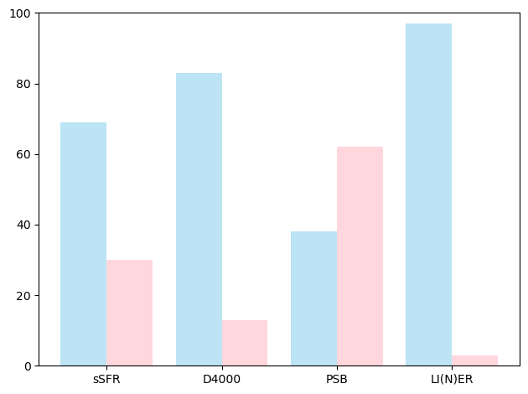
Overlapping galaxies
97%
83%
69%
62%
Quenching fraction (%)
38%
30%
13%
3%
sSFR
$$D_{n}4000$$
PSB
LI(N)ER
(Ho et al. in prep.)
9
Result

Slide 11
Overlapping galaxies
Same galaxies set, different quench modes?
sSFR
→ HII region or diffuse ionized gas
diverse origins
$$D_{n}4000$$
→ intermediate-age to old stars
wide range stellar populations
LI(N)ER
→ post-AGB stars (HOLMES)
(relatively) old stellar population
PSB
→ A-type, F-type stars
(relatively) young stellar population
Inside-out
Outside-in
Global sSFR
sSFR
$$D_{n}4000$$
Log $C_{q}$
PSB
LI(N)ER
(Ho et al. in prep.)
log $F_{q}$ (%)
Result
10

Slide 12
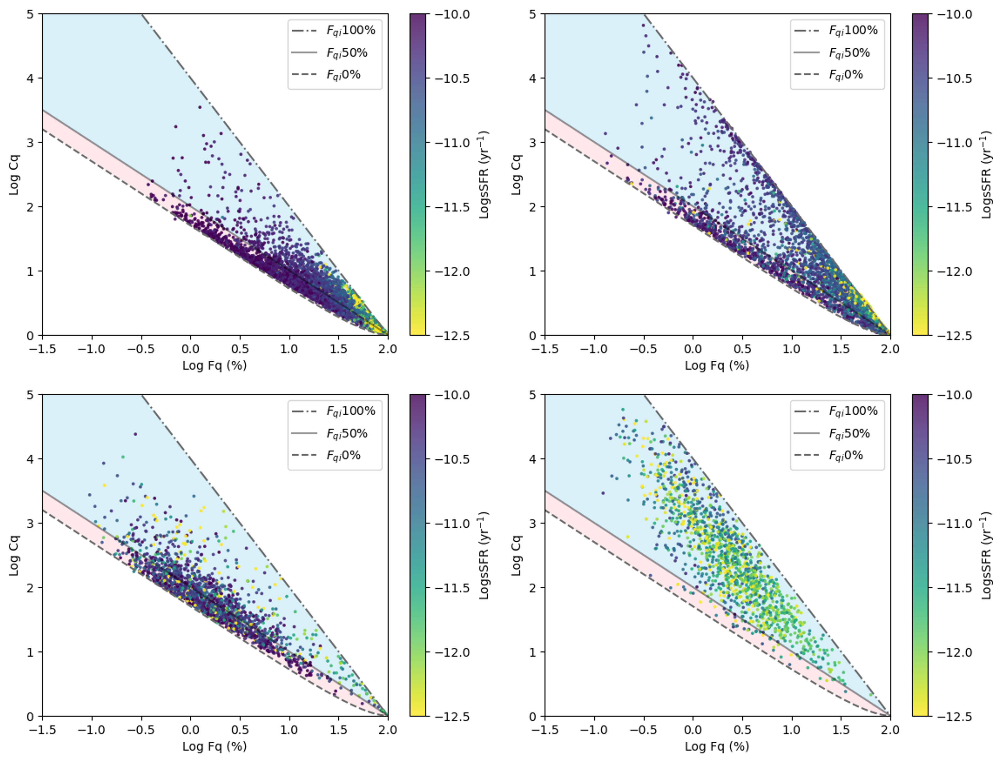
Full sample (~10000 galaxies)
Inside-out
Outside-in
Global sSFR
sSFR
$$D_{n}4000$$
Log $C_{q}$
PSB
LI(N)ER
(Ho et al. in prep.)
log $F_{q}$ (%)
Result
11

Slide 13
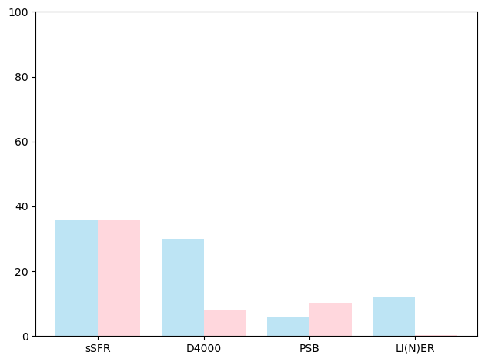
Full sample (~10000 galaxies)
Quenching fraction (%)
37%
36%
31%
10%
12%
8%
6%
0.3%
sSFR
$$D_{n}4000$$
PSB
LI(N)ER
12
Result

Slide 14
Full sample (~10000 galaxies)
Inside-out
Outside-in
Different criteria leads to different
→ selected galaxies/spaxels numbers
→ global sSFR distributions
→ quenching fraction
Global sSFR
sSFR
$$D_{n}4000$$
Log $C_{q}$
PSB
LI(N)ER
(Ho et al. in prep.)
log $F_{q}$ (%)
Result
13

Slide 15
Full sample (~10000 galaxies)
Inside-out
Outside-in
Different criteria leads to different
→ selected galaxies/spaxels numbers
→ level of strictness and timescales
→ global sSFR distributions
→ galaxy types
→ quenching fraction
→ sensitivity for different types of quenching
Global sSFR
sSFR
$$D_{n}4000$$
Log $C_{q}$
PSB
LI(N)ER
(Ho et al. in prep.)
log $F_{q}$ (%)
Result
14

Slide 16
Stellar mass dependence
(Ho et al. in prep.)
sSFR
$$D_{n}4000$$
PSB
LI(N)ER
Log $M_{halo}$ (12.5 ~ 14.5)
→ Central and high-mass satellite galaxies have higher inside-out quenching fraction in sSFR, $D_{n}4000$, LI(N)ER
15
Result

Slide 17
Stellar mass dependence
(Ho et al. in prep.)
sSFR
$$D_{n}4000$$
PSB
LI(N)ER
Log $M_{halo}$ (12.5 ~ 14.5)
→ In contrast, low-mass satellite galaxies have higher outside-in quenching fraction in sSFR, $D_{n}4000$, PSB
16
Result

Slide 18
Stellar mass dependence
For sSFR, $D_{n}4000$, LI(N)ER
→ Mass quenching plays important role in massive galaxies
→ Environmental quenching is more effective in low-mass galaxies
PSB shows no/weak dependence
→ PSB can only select galaxies in specific quenching stage
17
Result

Slide 19
Summary and Caveats
Criteria Biases
Different criteria highlight distinct properties, affecting the spatial distribution of quenched regions, favored quenching modes, global properties, etc.
Quenching fraction The sSFR, D4000, and LI(N)ER criteria are inside-out dominant, PSB criterion behaves comparably in full sample. The sSFR, D4000, and LI(N)ER criteria are inside-out dominant, PSB criterion is outside-in dominant in overlapping sample.
Caveat
Quenching mechanisms interact, necessitating multi-criteria analysis for a complete picture. Single-criterion analysis risks missing key aspects of quenching history.
qaz@gapp.nthu.edu.tw
18
Summary

Slide 20
Criteria for quenched region
sSFR:
log(sSFR) < -11
$D_{n}4000$:
$D_{n}4000>$ 1.45
PSB:
SNR > 10 (Hα and Hδ)
Hδ > 3
log(EW(Hα)) < 0.23Hδ - 0.46
LI(N)ER:
SNR cut (Hα, H$β$, [OIII], [NII])
EW(Hα) < -3 (Å)
(Cid Fernandes et al. 2011)
LINER region
(BPT diagnosis)
(Chen et al. 2019) and (Cheng et al. 2024)
All the non-quenched/quenched spaxels are satisfied with: $M_{⊙}>{10}^{6.5}$ and R/Re < 1.5
Back up

Slide 21
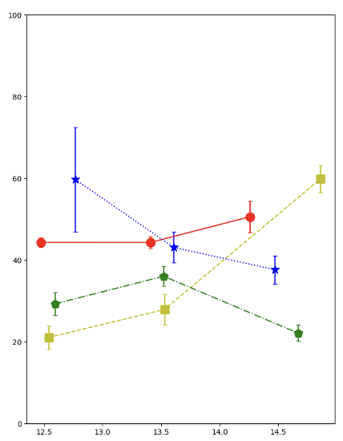
Fq Cq vs. gradient (discrepancy between sSFR and D4000)
FqCq
Gradient
inside-out quenching fraction
(Jain et al. in prep.)
Back up

Slide 22
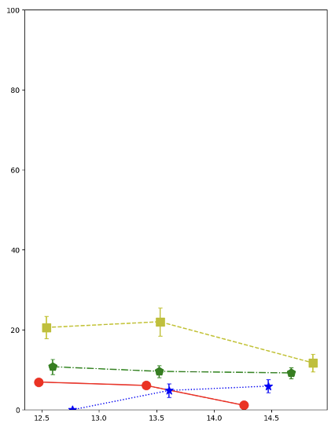
Fq Cq vs. gradient (discrepancy between sSFR and D4000)
FqCq
Gradient
outside-in quenching fraction
(Jain et al. in prep.)
Back up

