Slide 1
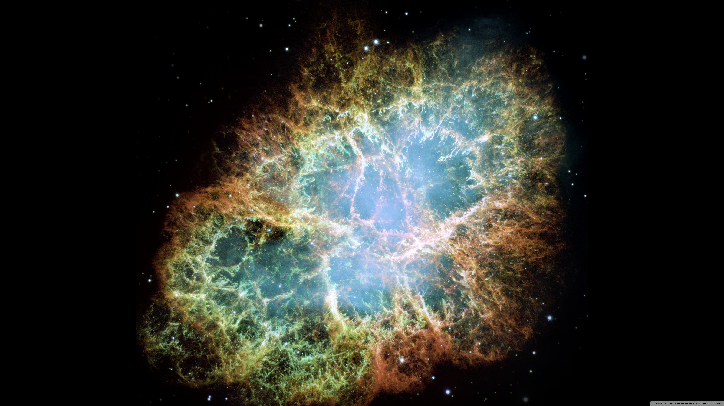
Anti-correlation between Flux and Photon Index of Hard X-ray Emission from The Crab
Koothodil Abhijith Augustine (Abhi/阿比), IoA, NTHU
Prof. Hsiang-Kuang Chang (張祥光), IoA, NTHU
Acknowledgement: Prof. Amy Yarleen Lien, The University of Tampa

Slide 2
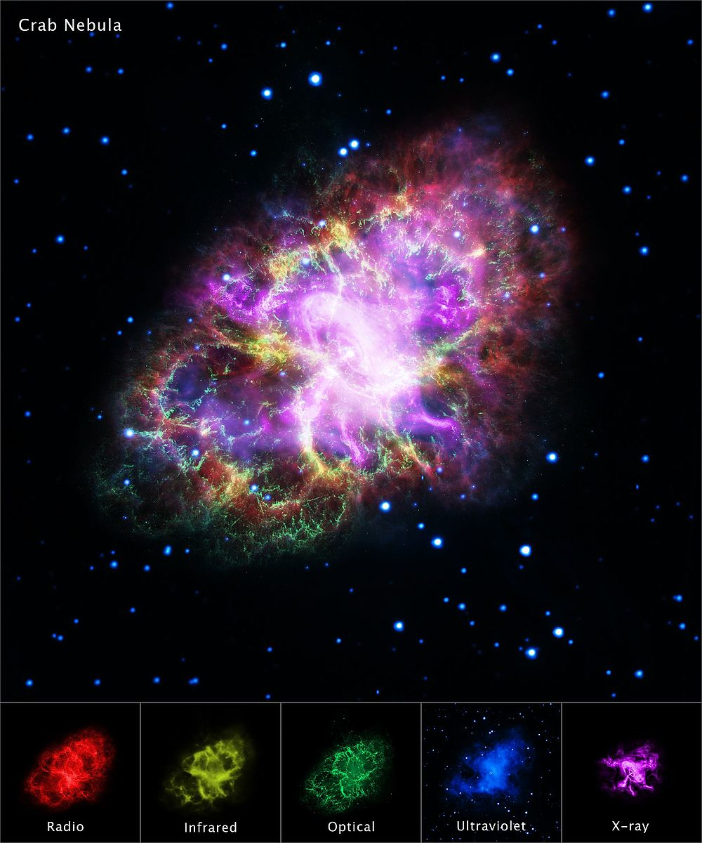
The Crab Nebula
A Pulsar Wind Nebula powered by the Crab pulsar (PSR B0531+21).
The X-Ray emission is mainly from the Nebula and is believed to be synchrotron radiation.
This synchrotron radiation from the PWN provides insights into particle acceleration, magnetic fields, and shock processes.
Introduction Data Analysis Results Discussion Conclusion abhijithaugustine007@gmail.com

Slide 3
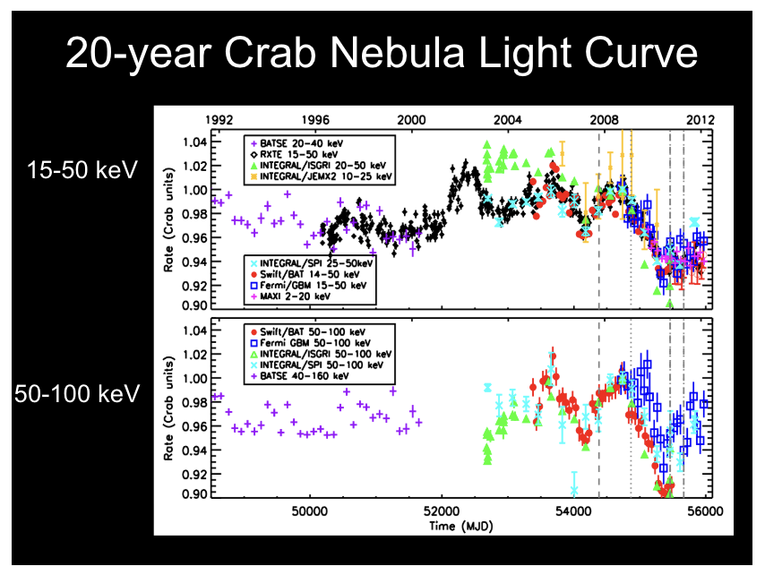
Previous long term observations
The Crab Nebula was surprisingly variable from 2001-2010, with less variability before 2001 and since mid-2010.
Study using BATSE, RXTE, INTEGRAL, Swift, MAXI and Fermi.
Long term evolution of the photon index hasn’t been studied before.
Credits : Colleen A. Wilson-Hodge (NASA/MSFC)
Introduction Data Analysis Results Discussion Conclusion abhijithaugustine007@gmail.com

Slide 4
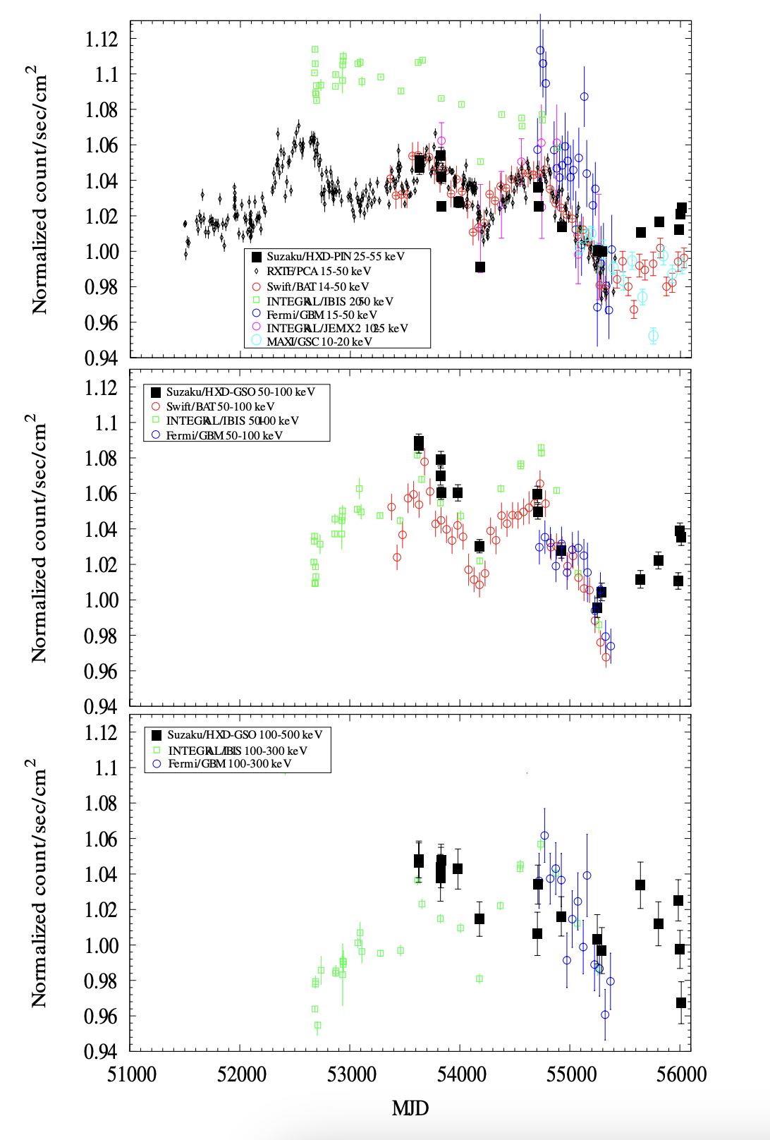
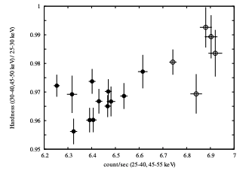
Previous studies
Results obtained by the Suzaku HXD confirmed flux variation reported by Wilson-Hodge et al. (2011)
T. Kouzu et al., A. Publ. Astron. Soc. Jap. 65, 74 (2013)
Introduction Data Analysis Results Discussion Conclusion abhijithaugustine007@gmail.com

Slide 5
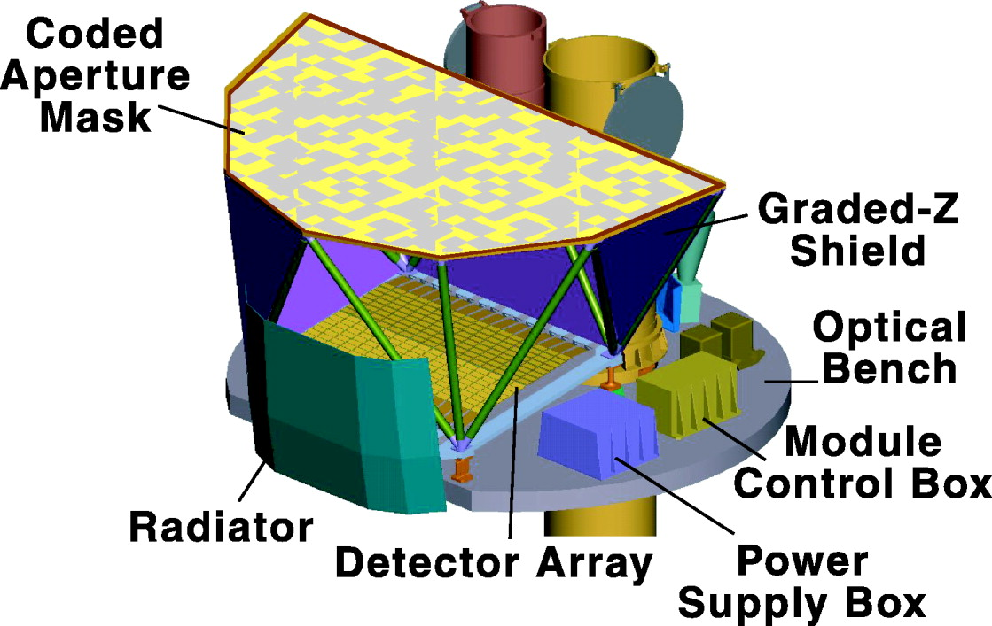
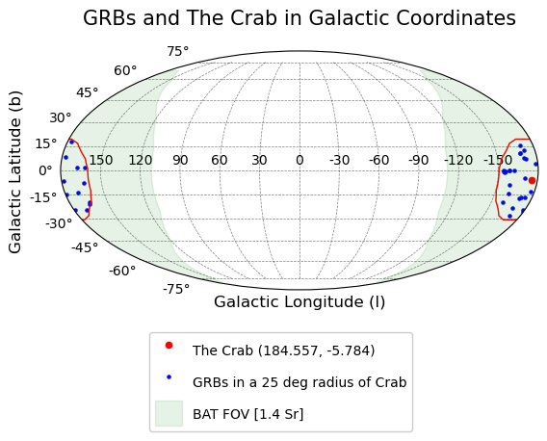
Swift BAT
Burst Alert Telescope (14-350 keV)
1.4 Sr ~ 4595.92 sq. deg FOV at 50% partial coding
Monitors GRBs and slews to the direction of the Burst to observe the GRB afterglow using XRT and UVOT.
Event data is stored only during GRB events.
We used a circle of radius 25° around the Crab to select the GRBs.
Credit : Swift BAT team
Introduction Data Analysis Results Discussion Conclusion abhijithaugustine007@gmail.com

Slide 6
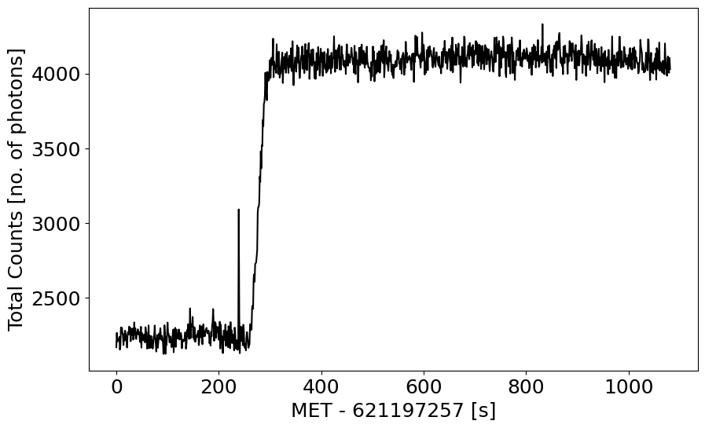
Good Lightcurves
The spacecraft slews towards the location of GRB
Every background subtracted light curve has 3 parts
  Pre-slew
  Slew
  Post-slew
Used background subtracted post-slew light curves for spectral analysis.
We got 38 good observations for ~18 years.
Post Slew
GRB
eg: GRB200907b, obsid : 00995004000
partial coding fraction : 0.97
Introduction Data Analysis Results Discussion Conclusion abhijithaugustine007@gmail.com

Slide 7
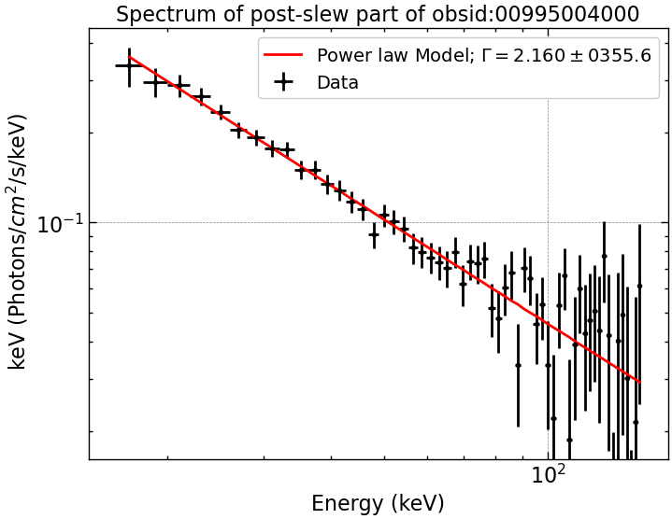

Spectral Analysis
Xspec
Power law pegged with normalization (15-150 keV)
A(E) = K$E^{−α}$
We obtained photon indices and flux from 38 observations.
Long term, i.e, from Feb. 2006 to August 2023.
Introduction Data Analysis Results Discussion Conclusion abhijithaugustine007@gmail.com

Slide 8
The table of observations
NO. | OBS_ID | GRB | DATE | START_TIME | STOP_TIME | GTI(S) | P_CODE | CHI-SQ | BINS | RED_CHI_SQ | GAMMA | GAMMA_ERR | FLUX | FLUX_ERR_LOWER | FLUX_ERR_UPPER | START_TIME_MJD
1 | 1182085000 | BURST (76.240, 19.561) | 2023-08-02 | 712652058 | 712652819 | 761 | 0.99 | 41.15 | 56 | 0.7348214286 | 2.13852 | 0.0331 | 1.97E-08 | 1.95E-08 | 2.00E-08 | 60158.27424
2 | 1125809000 | GRB220930A | 2022-09-30 | 686229335 | 686230096 | 761 | 0.79 | 45.96 | 56 | 0.8207142857 | 2.13678 | 0.039 | 2.08E-08 | 2.06E-08 | 2.12E-08 | 59852.45413
3 | 1104842000 | BURST (85.577, 14.033) | 2022-05-01 | 673127601 | 673128142 | 541 | 0.89 | 61.33 | 56 | 1.095178571 | 2.17741 | 0.0402 | 1.92E-08 | 1.90E-08 | 1.97E-08 | 59700.81522
4 | 1104692000 | GRB220430A | 2022-04-30 | 673019739 | 673020464 | 725 | 0.83 | 39.09 | 56 | 0.6980357143 | 2.16589 | 0.0384 | 1.82E-08 | 1.79E-08 | 1.85E-08 | 59699.5662
5 | 1090472000 | GRB211221A | 2021-12-21 | 661812587 | 661813504 | 917 | 0.64 | 46.85 | 56 | 0.8366071429 | 2.0319 | 0.0401 | 1.66E-08 | 1.64E-08 | 1.70E-08 | 59476.00736
6 | 1073893000 | GRB210919A | 2021-09-19 | 653704208 | 653705513 | 1305 | 0.98 | 50.56 | 56 | 0.9028571429 | 2.15861 | 0.0361 | 2.03E-08 | 2.00E-08 | 2.06E-08 | 59281.26387
7 | 1036227000 | GRB210308A | 2021-03-08 | 636878375 | 636879006 | 631 | 0.83 | 43.22 | 56 | 0.7717857143 | 2.11231 | 0.0401 | 2.07E-08 | 2.03E-08 | 2.11E-08 | 59257.17175
8 | 1032183000 | BURST (72.266, 7.269) | 2021-02-12 | 634796505 | 634796714 | 209 | 0.92 | 49.57 | 56 | 0.8851785714 | 2.10053 | 0.0542 | 2.03E-08 | 1.98E-08 | 2.09E-08 | 59099.77304
9 | 995004000 | GRB200907B | 2020-09-07 | 621197563 | 621198330 | 767 | 0.98 | 41.55 | 56 | 0.7419642857 | 2.16027 | 0.0356 | 1.92E-08 | 1.88E-08 | 1.94E-08 | 58757.70925
10 | 927345000 | BURST (86.368, -15.907) | 2019-10-01 | 591643520 | 591643826 | 306 | 0.74 | 47.5 | 56 | 0.8482142857 | 2.10183 | 0.0491 | 2.07E-08 | 2.03E-08 | 2.13E-08 | 58393.46597
11 | 865036000 | BURST (64.746, 15.213) | 2018-10-02 | 560172563 | 560173386 | 823 | 0.79 | 46.27 | 56 | 0.82625 | 2.14162 | 0.0353 | 2.05E-08 | 2.02E-08 | 2.08E-08 | 58348.51012
12 | 853882000 | BURST (104.225, 39.315) | 2018-08-18 | 556288438 | 556289202 | 764 | 0.81 | 42.88 | 56 | 0.7657142857 | 2.10534 | 0.036 | 2.09E-08 | 2.06E-08 | 2.12E-08 | 58218.3245
13 | 824063000 | BURST (95.957, 12.811) | 2018-04-10 | 545040372 | 545041162 | 790 | 0.9 | 54.34 | 56 | 0.9703571429 | 2.1665 | 0.0314 | 2.03E-08 | 2.00E-08 | 2.06E-08 | 58208.16615
14 | 820347000 | BURST (66.024, 13.398) | 2018-03-31 | 544162616 | 544163478 | 862 | 0.78 | 46.2 | 56 | 0.825 | 2.14501 | 0.0321 | 2.03E-08 | 2.01E-08 | 2.06E-08 | 57668.88191
15 | 716127000 | GRB161007A | 2016-10-07 | 497568482 | 497569322 | 840 | 0.77 | 66.49 | 56 | 1.187321429 | 2.20051 | 0.0309 | 1.93E-08 | 1.91E-08 | 1.96E-08 | 57624.96296
16 | 709765000 | BURST (80.088, 40.029) | 2016-08-24 | 493773929 | 493774724 | 795 | 1 | 65.67 | 56 | 1.172678571 | 2.16964 | 0.0338 | 1.86E-08 | 1.83E-08 | 1.88E-08 | 57595.0544
17 | 706052000 | BURST (98.821, -6.645) | 2016-07-26 | 491189425 | 491189662 | 237 | 0.96 | 41.55 | 56 | 0.7419642857 | 2.23112 | 0.0485 | 1.85E-08 | 1.80E-08 | 1.88E-08 | 57468.65257
18 | 680017000 | GRB160321A | 2016-03-21 | 480268640 | 480269499 | 859 | 0.84 | 60.9 | 56 | 1.0875 | 2.21914 | 0.0333 | 1.92E-08 | 1.89E-08 | 1.95E-08 | 57446.72135
19 | 676595000 | BURST (107.316, 26.932) | 2016-02-28 | 478373810 | 478374640 | 830 | 0.69 | 51.86 | 56 | 0.9260714286 | 2.20086 | 0.0323 | 1.97E-08 | 1.94E-08 | 2.00E-08 | 57391.46419
20 | 669319000 | GRB160104A | 2016-01-04 | 473599514 | 473600294 | 780 | 0.92 | 58.98 | 56 | 1.053214286 | 2.15229 | 0.0338 | 1.93E-08 | 1.90E-08 | 1.96E-08 | 57371.11509
21 | 667392000 | GRB151215A | 2015-12-15 | 471842002 | 471842261 | 259 | 0.78 | 44.48 | 56 | 0.7942857143 | 2.21821 | 0.055 | 1.87E-08 | 1.82E-08 | 1.92E-08 | 57276.76705
22 | 655262000 | GRB150911A | 2015-09-11 | 463689697 | 463691383 | 1686 | 0.82 | 54.64 | 56 | 0.9757142857 | 2.20003 | 0.0337 | 1.89E-08 | 1.86E-08 | 1.92E-08 | 57056.16204
23 | 629578000 | GRB150203A | 2015-02-03 | 444629440 | 444630550 | 1110 | 0.97 | 47.59 | 56 | 0.8498214286 | 2.20729 | 0.0273 | 1.94E-08 | 1.91E-08 | 1.96E-08 | 56945.37307
24 | 615399000 | GRB141015A | 2014-10-15 | 435057223 | 435057429 | 206 | 0.98 | 56.85 | 56 | 1.015178571 | 2.11208 | 0.0483 | 2.02E-08 | 1.97E-08 | 2.06E-08 | 56934.96189
25 | 614390000 | BURST (76.734, 12.820) | 2014-10-04 | 434157687 | 434158629 | 942 | 0.99 | 54.36 | 56 | 0.9707142857 | 2.07797 | 0.0281 | 2.05E-08 | 2.02E-08 | 2.07E-08 | 56777.84567
26 | 597722000 | GRB140430A | 2014-04-30 | 420583008 | 420583342 | 334 | 0.81 | 41.35 | 56 | 0.7383928571 | 2.12361 | 0.0455 | 2.10E-08 | 2.05E-08 | 2.15E-08 | 56653.18684
27 | 582184000 | GRB 131227A | 2013-12-27 | 409812342 | 409813139 | 797 | 0.79 | 38.05 | 56 | 0.6794642857 | 2.13443 | 0.0327 | 2.11E-08 | 2.08E-08 | 2.14E-08 | 56339.91633
28 | 548927000 | GRB130216A | 2013-02-16 | 382745764 | 382746696 | 932 | 0.97 | 43.19 | 56 | 0.77125 | 2.1158 | 0.0282 | 2.07E-08 | 2.04E-08 | 2.09E-08 | 56020.03441
29 | 519211000 | BURST (42.459, 40.466) | 2012-04-03 | 355107961 | 355108826 | 865 | 1 | 42.07 | 56 | 0.75125 | 2.17192 | 0.0293 | 1.87E-08 | 1.85E-08 | 1.89E-08 | 55665.30997
30 | 451343000 | GRB110414A | 2011-04-14 | 324459881 | 324460703 | 822 | 0.91 | 43.59 | 56 | 0.7783928571 | 2.19894 | 0.0337 | 1.84E-08 | 1.82E-08 | 1.87E-08 | 55663.30382
31 | 451191000 | GRB110412A | 2011-04-12 | 324286505 | 324287287 | 782 | 0.88 | 52.76 | 56 | 0.9421428571 | 2.23892 | 0.0353 | 1.90E-08 | 1.87E-08 | 1.92E-08 | 54700.86596
32 | 321376000 | GRB080822B | 2008-08-22 | 241131537 | 241132131 | 594 | 0.97 | 38.53 | 56 | 0.6880357143 | 2.17233 | 0.0312 | 2.04E-08 | 2.01E-08 | 2.07E-08 | 54565.04652
33 | 308812000 | GRB080409 | 2008-04-09 | 229397035 | 229397820 | 785 | 0.99 | 35.92 | 56 | 0.6414285714 | 2.16704 | 0.0279 | 2.03E-08 | 2.00E-08 | 2.06E-08 | 54544.70084
34 | 306793000 | GRB080319D | 2008-03-19 | 227639240 | 227640074 | 834 | 0.86 | 60.39 | 56 | 1.078392857 | 2.12722 | 0.0303 | 2.02E-08 | 2.00E-08 | 2.05E-08 | 54295.19692
35 | 284856000 | GRB070714B | 2007-07-14 | 206082021 | 206082933 | 912 | 0.66 | 48.32 | 56 | 0.8628571429 | 2.18374 | 0.0316 | 2.06E-08 | 2.04E-08 | 2.09E-08 | 54027.16887
36 | 181156000 | GRB060211B | 2006-02-11 | 161366179 | 161366417 | 238 | 0.94 | 39.15 | 56 | 0.6991071429 | 2.14105 | 0.0418 | 2.00E-08 | 1.96E-08 | 2.04E-08 | 53777.65225
37 | 181126000 | GRB060211A | 2006-02-11 | 161343253 | 161343552 | 299 | 0.57 | 49.34 | 56 | 0.8810714286 | 2.11705 | 0.0508 | 2.10E-08 | 2.05E-08 | 2.16E-08 | 53777.39112
38 | 180977000 | GRB060210 | 2006-02-10 | 161240391 | 161240632 | 241 | 0.58 | 43.16 | 56 | 0.7707142857 | 2.17486 | 0.0487 | 2.20E-08 | 2.15E-08 | 2.25E-08 | 53776.19646
Introduction Data Analysis Results Discussion Conclusion abhijithaugustine007@gmail.com

Slide 9
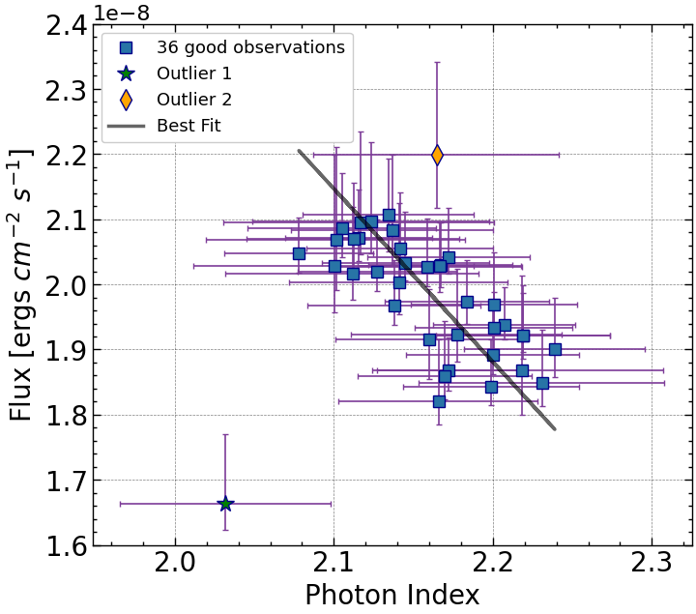

Photon Index vs Flux
Spearman’s rank correlation coefficient = -0.63 and p-value of 2.79${×10}^{−5}$
If both outliers are removed the Spearman’s rank correlation coefficient = -0.70 and p-value of 2.41$×{10}^{−6}$
Introduction Data Analysis Results Discussion Conclusion abhijithaugustine007@gmail.com

Slide 10
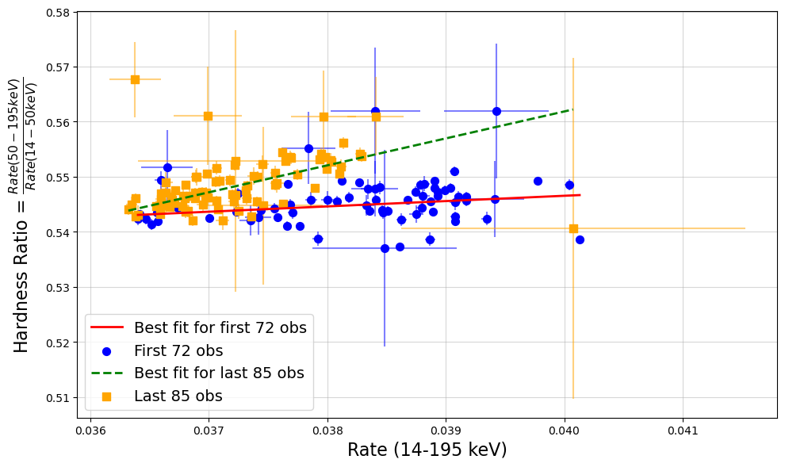
Hardness ratio plot
The Swift BAT 157-Month Hard X-ray Survey data.
The soft band (14–50 keV) and hard band (50–195 keV) were used to calculate the hardness ratio.
The Spearman’s rank correlation coefficients for the first and later observations are 0.26 (p = 0.03) and 0.56 (p ≈ 10−8).
Introduction Data Analysis Results Discussion Conclusion abhijithaugustine007@gmail.com

Slide 11
Discussions
The study finds a statistically significant anti-correlation between the hard X‑ray flux and the spectral power‑law photon index.
In simpler terms, when the Crab system becomes brighter in hard X‑rays, its spectrum becomes harder (i.e. the photon index is lower).
The anti-correlation is consistent with the long‐standing notion that the observed X‑ray emission is synchrotron radiation of shocked pulsar winds (in which electrons/positrons are accelerated to relativistic speeds through DSA).
Introduction Data Analysis Results Disussion Conclusion abhijithaugustine007@gmail.com

Slide 12
Discussions
We demonstrate that the Crab’s X‑ray flux is not constant but “flickers” over long timescales, with systematic variations that are closely linked to its spectral properties.
The results imply that the changes in the spectral index track alterations in the properties of the accelerated electron population within the PWN. This finding reinforces models of diffusive shock acceleration where variations in the magnetic field and shock conditions lead to the observed spectral changes.
Introduction Data Analysis Results Disussion Conclusion abhijithaugustine007@gmail.com

Slide 13
Conclusions and Future…
Anti-correlation between flux and photon index in 15-150 keV energy range has been established.
Do we see this correlation and cyclic dance between photon index and flux in other wavelengths as well?
Do we see this in other Pulsar Wind Nebulae?
See Augustine_2025_ApJ_981_173 for more details.
Introduction Data Analysis Results Discussion Conclusion abhijithaugustine007@gmail.com

Slide 14
Extra Slides
Introduction Data Analysis Results Discussion Conclusion Backups

Slide 15
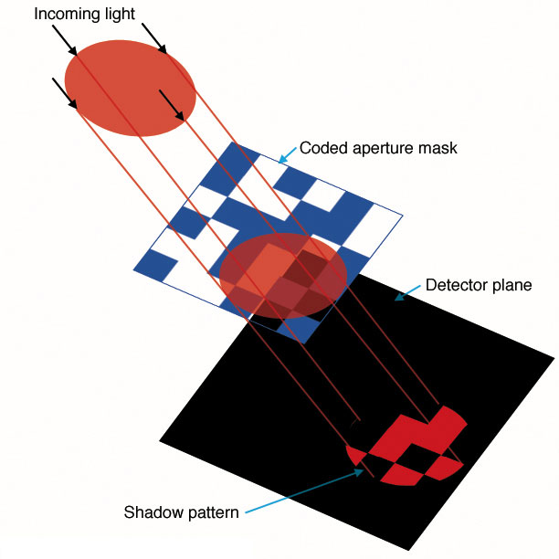
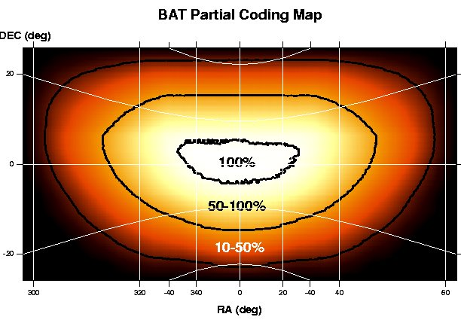
Swift BAT
Ray Tracing/ BKG substraction
Credit : NASA’s Imagine the Universe and Prof. Amy Lien
Introduction Data Analysis Results Discussion Conclusion Backups

Slide 16
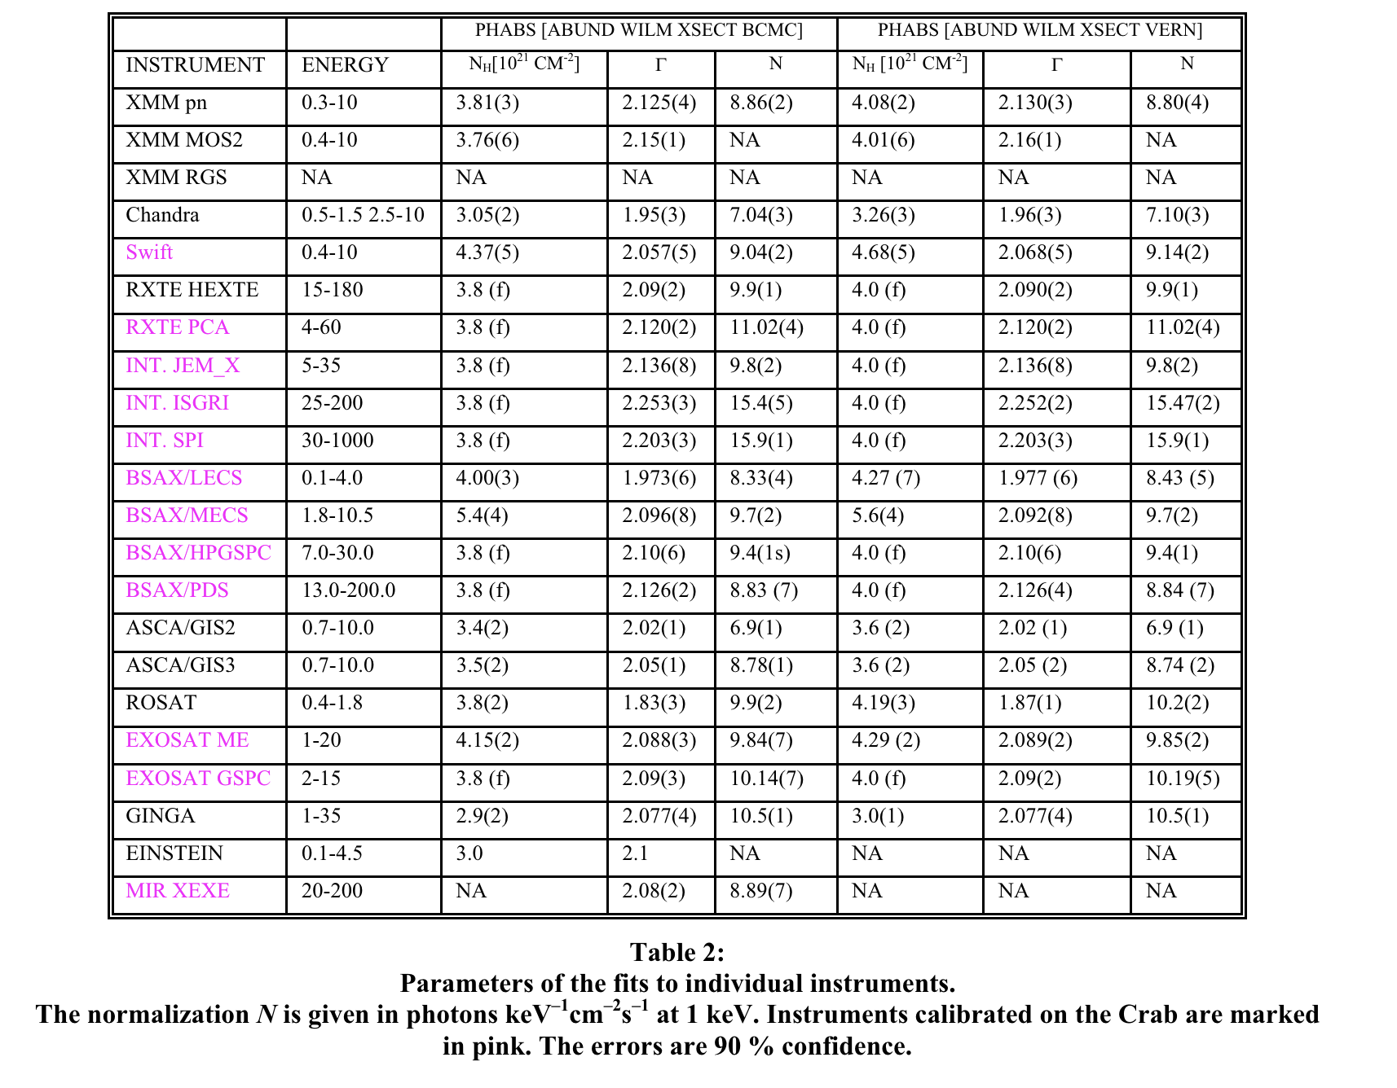
Kirsch at al., 2005 SPIE
Introduction Data Analysis Results Discussion Conclusion Backups

Slide 17
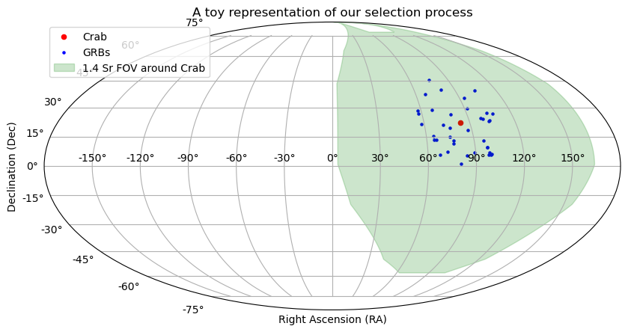
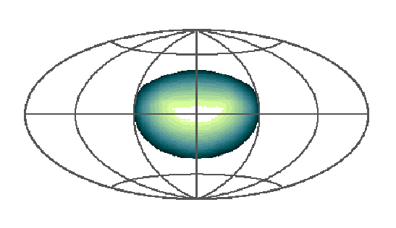
Swift BAT
The FOV of the BAT superimposed onto a Hammer-Aitoff projection of the sky.
Color represents the coding fraction with white indicating fully coded and blue indicating partially coded.
Barthelmy, et al. 2005, SSRv, 120 143
Introduction Data Analysis Results Discussion Conclusion Backups

Slide 18
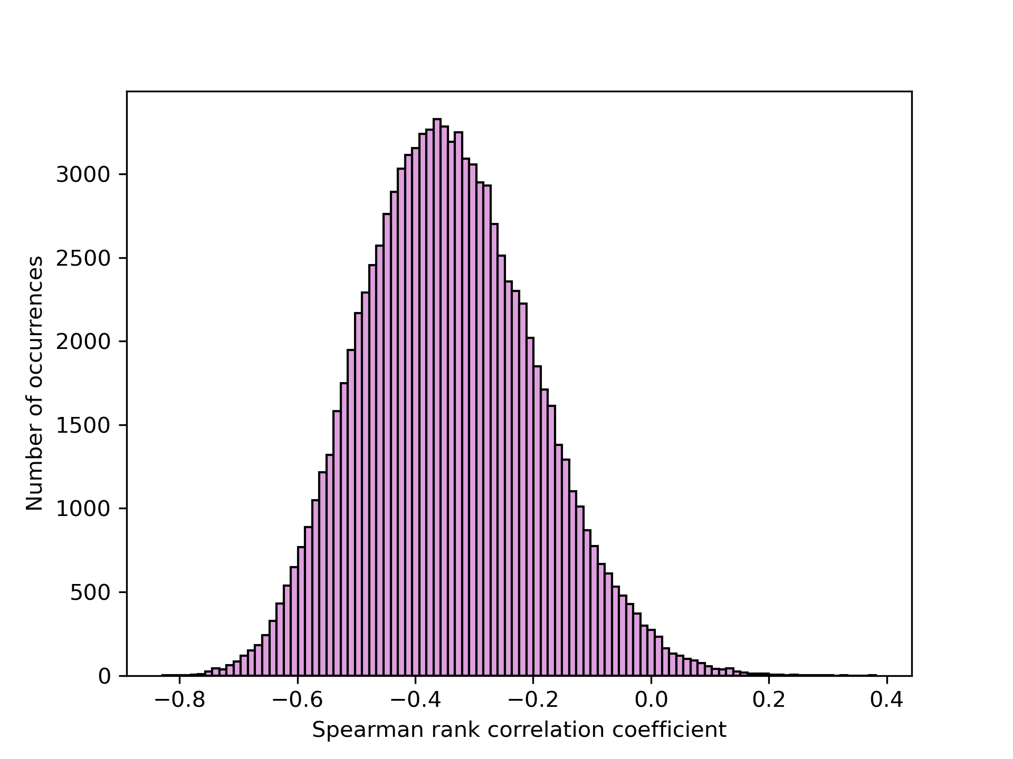
Spearman correlation coefficients from 100,000 Monte Carlo simulations
The mean Spearman correlation coefficient is at −0.34.
Introduction Data Analysis Results Discussion Conclusion Backups

