Slide 1
How Do Post-starburst Galaxies Quench? Analysis of Galaxy Merger
Min-Hsuan Chung 鍾旻璇
Po-Feng Wu 吳柏鋒

Slide 2
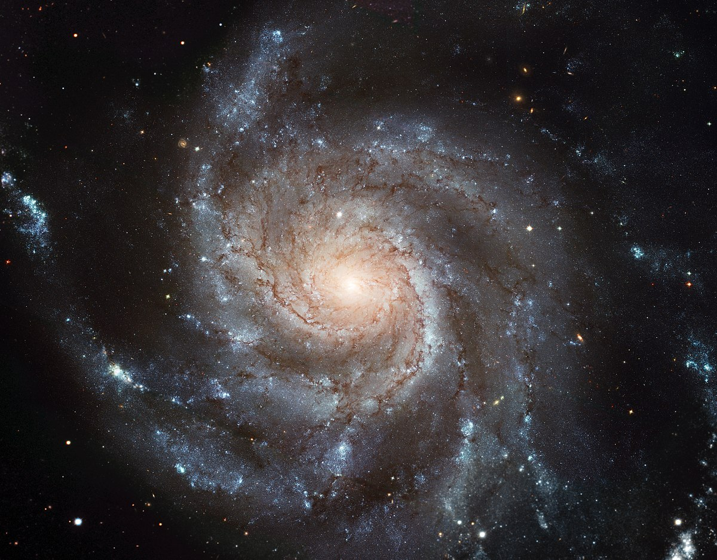
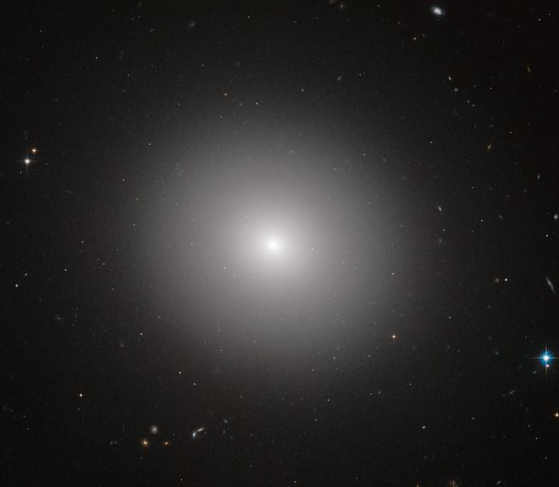
Post-starburst Galaxy (PSB)
Starburst
Post-starburst
SFR
Rapid
quenching
Star-formation
Queiscent
Evolution time
Rapid quenching galaxies: SFR decrease only in recent 100 Myr
The spectra dominated by type A star (E+A galaxy)
Notes:
Strong Balmer line

Slide 3
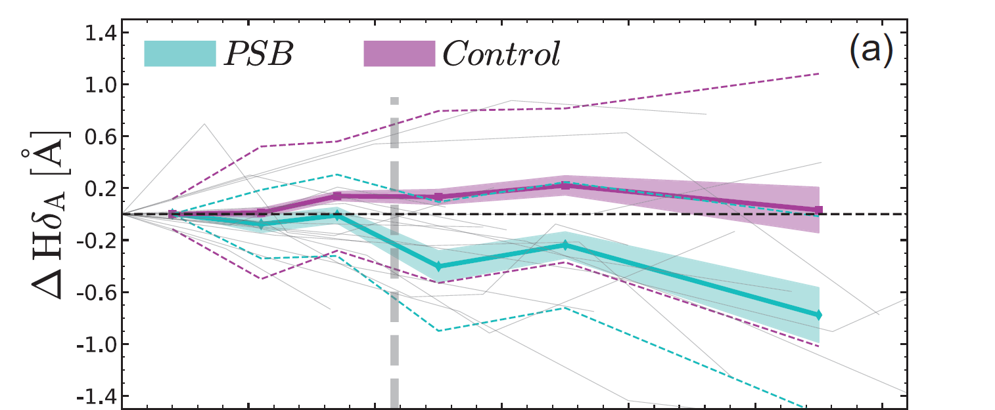
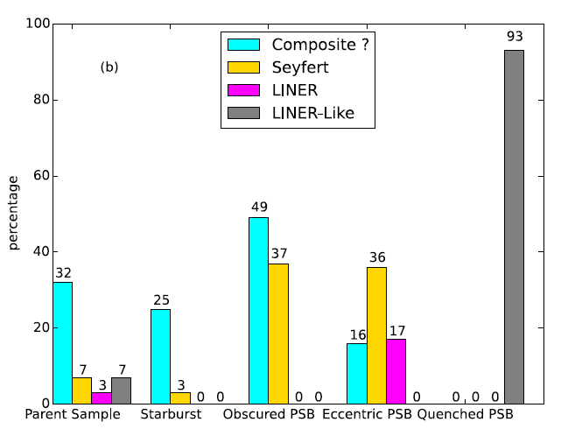
The opposite trend of H$δ_{A}$ of PSB than the control sample
(D’Eugenio et al., 2020)
PSB near starburst
Normal galaxies
PSB have higher fraction in AGN, and highest in near starburst.
(Yesuf et al., 2014)

Slide 4
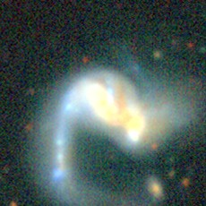
In this research ……
Understanding the quenching process of galaxies (0.01<z<0.1)
Take a look at inner evolution
The whole picture of evolution for the rapid quenching galaxy
Improve the understanding of the PSB near starburst
The relation between PSB and merger

Slide 5
Data and Sample
SDSS MaNGA DR17
Integral field units (IFU) for resolved spectrum
PSB in different phase (Yesuf et al. 2014)
End of
starburst
Obscured PSB
(OPSB)
3$Å<$ $−$EW${\left(Hα\right)}_{em}$ $≤$ 175$Å$, EW${\left(Hδ\right)}_{abs}$ $>$4$Å$
$f_{12μm}>$ 200 $f_{0.2μm}$, $f_{4.6μm}>$ 0.85 $f_{3.4μm}$
Control sample
Similar
EW${\left(Hα\right)}_{em}$
$M_{⋆}$
For each PSB sample selected
PSB
Fading PSB
(FPSB)
3$Å<$ $−$EW${\left(Hα\right)}_{em}≤$ 175$Å$, EW${\left(Hδ\right)}_{abs}>$4$Å$
NUV$−$G color and EW(H$δ$) $>$ 2$σ$
Quenched PSB
(QPSB)
$−$EW${\left(Hα\right)}_{em}<$ 3$Å$ , EW${\left(Hδ\right)}_{abs}>$ 4$Å$
Nearly
quiescence

Slide 6
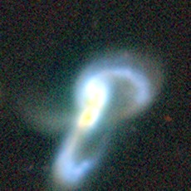
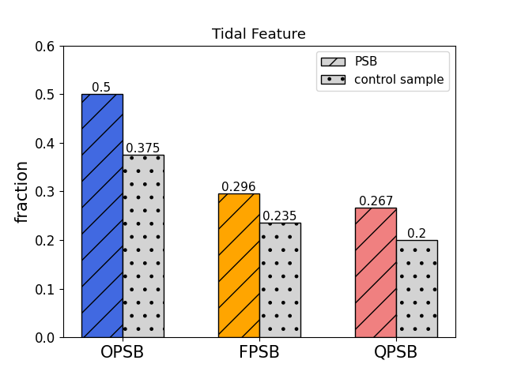
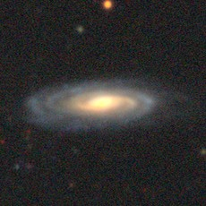
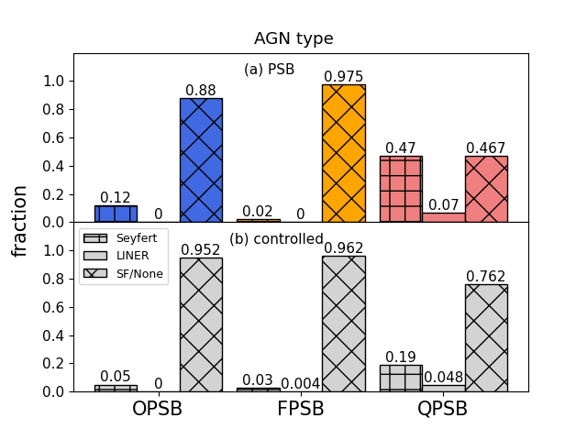
starburst
quiescent
Control sample
OPSB
FPSB
QPSB
The fraction of tidal feature is higher in PSB, and decreasing over time
QPSB have the highest fraction of Seyfert

Slide 7
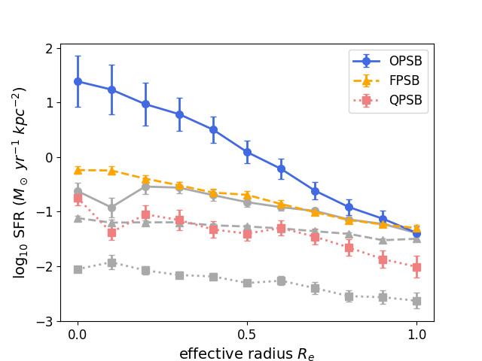
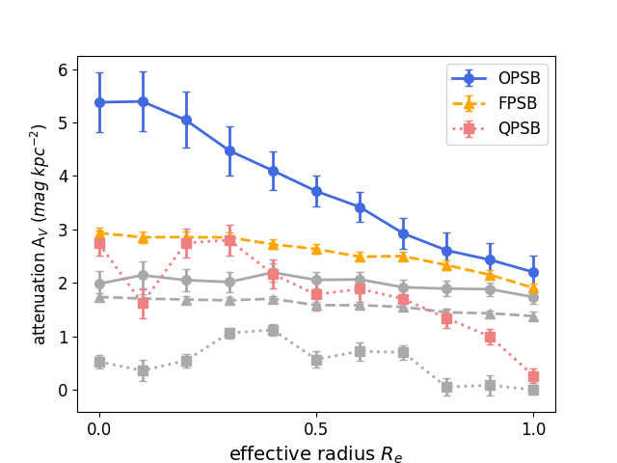
SFR and Av are decreasing over time
There is higher $A_{V}$ in the center of OPSB
There may be amount of gas gathered in center of OSPB
starburst
quiescent
Control sample
OPSB
FPSB
QPSB

Slide 8
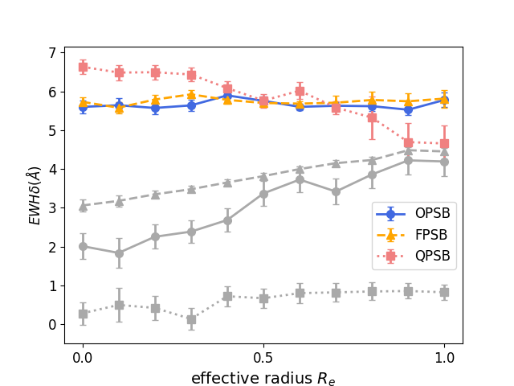
starburst
quiescent
Control sample
OPSB
FPSB
QPSB
There is a negative trend for QPSB which means the outside-in process of evolution
Normal galaxies present the inside-out process for evolution

Slide 9
Hopkins, et al. (2007)
Higher SFR in center
Gathering gas in center
Outside-in process
Higher fraction of tidal feature
starburst
quiescent
OPSB
FPSB
QPSB
Galaxy merger

Slide 10
Summary
The fraction of tidal features in PSB is higher than that in the control sample and decreases over time. However, QPSB has the highest fraction of Seyfert.
SFR and $A_{V}$ decrease over time and are higher in the center of OPSB. When near a starburst, a lot of gas may have gathered in the center.
There is an opposite trend in QPSB than control sample. It means PSB has an outside-in process for evolution.
Galaxy merger can cause galaxies rapidly quenching.

Slide 11
Thank you for your attention

