Slide 1

Simultaneous Multi-site, Multi-wavelength, and Multi-messenger Monitoring of the Nearby Red Dwarf GJ 3147
Tai, Chen-Yu ¹, Chen, Wen-Ping ¹, Tsai, AL ¹, Lalchand, B ¹, Sharma, T ¹,
Hu, SM ², Wu, H ³, Zheng, J ³, Zhou, AY³, Wei, JY³, Wang, J ³, Bai, JY ³ ,
Qian, SB ⁴,Zhu, LY ⁴, Liu, JZ ⁵ , Hojaev, A ⁶, Panwar, N⁷
¹ Institute of Astronomy, National Center University, Taoyuan City, Taiwan; ² Weihai Observatory, Shandong, China; ³ Xinglong Observatory, Hebie, China; ⁴ Gaomeigu Observatory, Lijiang, China; ⁵ Nanshan Observatory, Xinjiang, China; ⁶ Maidanak Observatory, Tashkent, Uzbekistan; ⁷ ARIES, Nainital, India
Email: m1129005@gm.astro.ncu.edu.tw

Slide 2
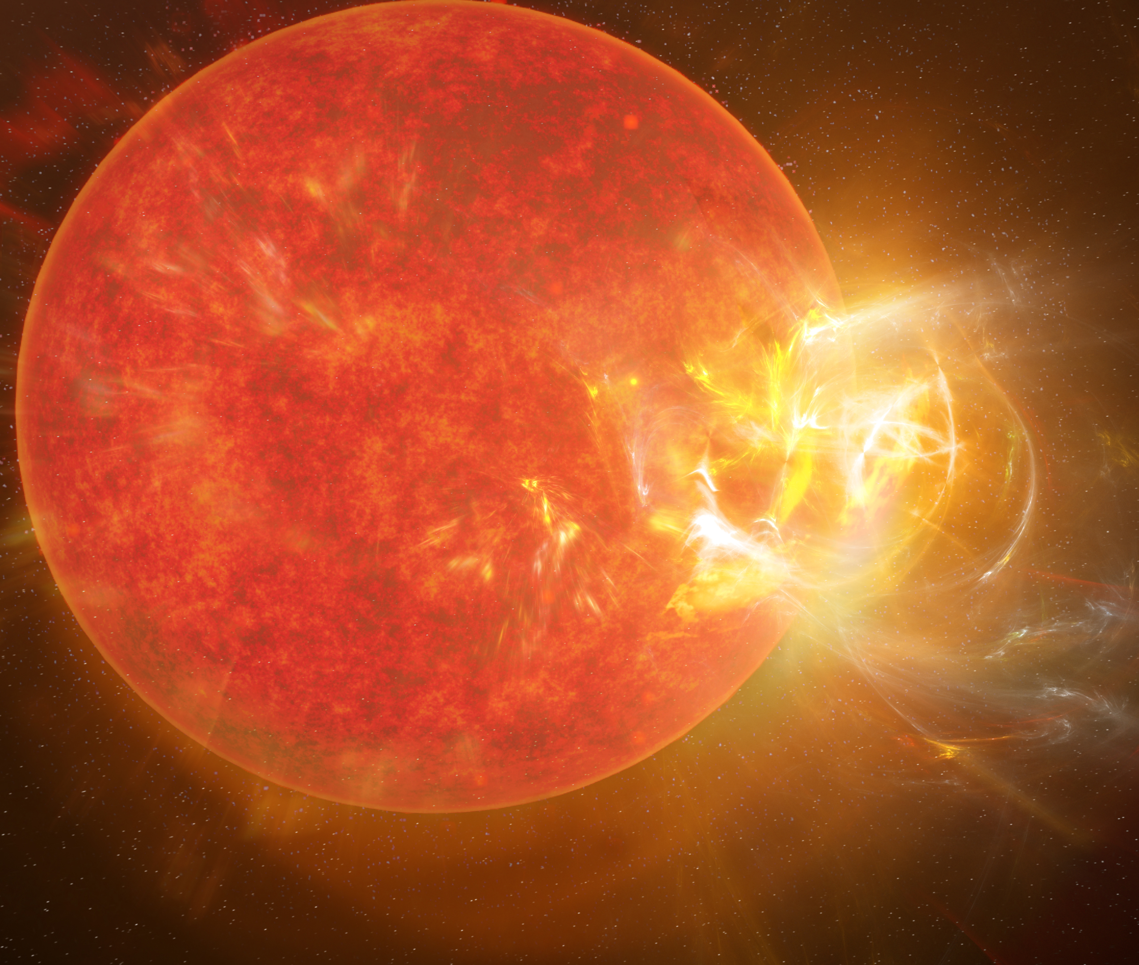
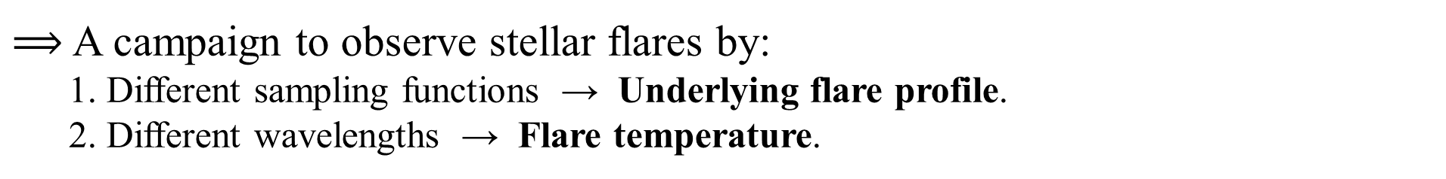
Stellar Flares
Reconnection of surface magnetic field lines can produce flares. (Benz and Güdel 2010)
Late M-type Stars:
low-mass, fully convective dynamos, and magnetically active
The detailed mechanism uncertain
We are interested in the heating and cooling processes of the stellar flares.
Credit: S. Dagnello, NRAO/AUI/NSF
$⟹$ A campaign to observe stellar flares by:
  1. Different sampling functions → Underlying flare profile.
  2. Different wavelengths → Flare temperature.

Slide 3
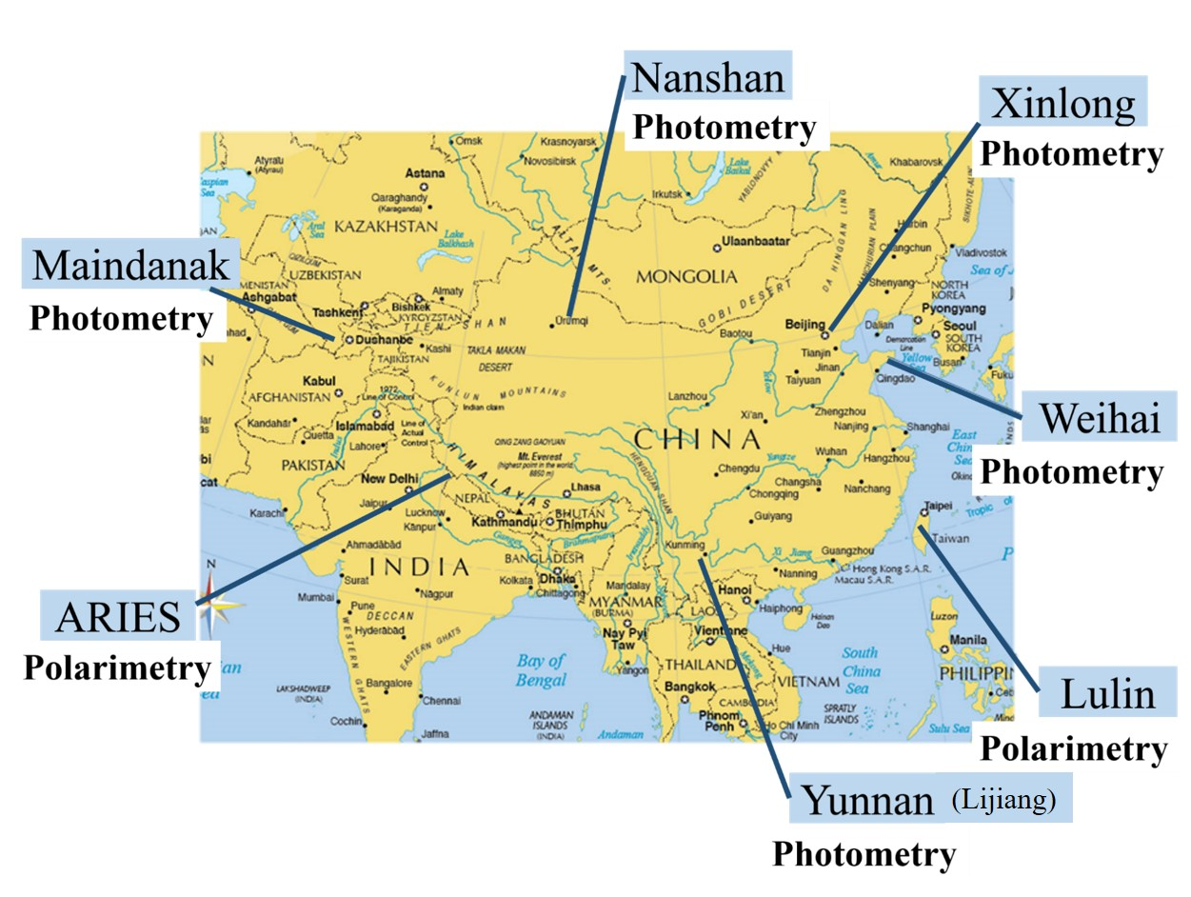
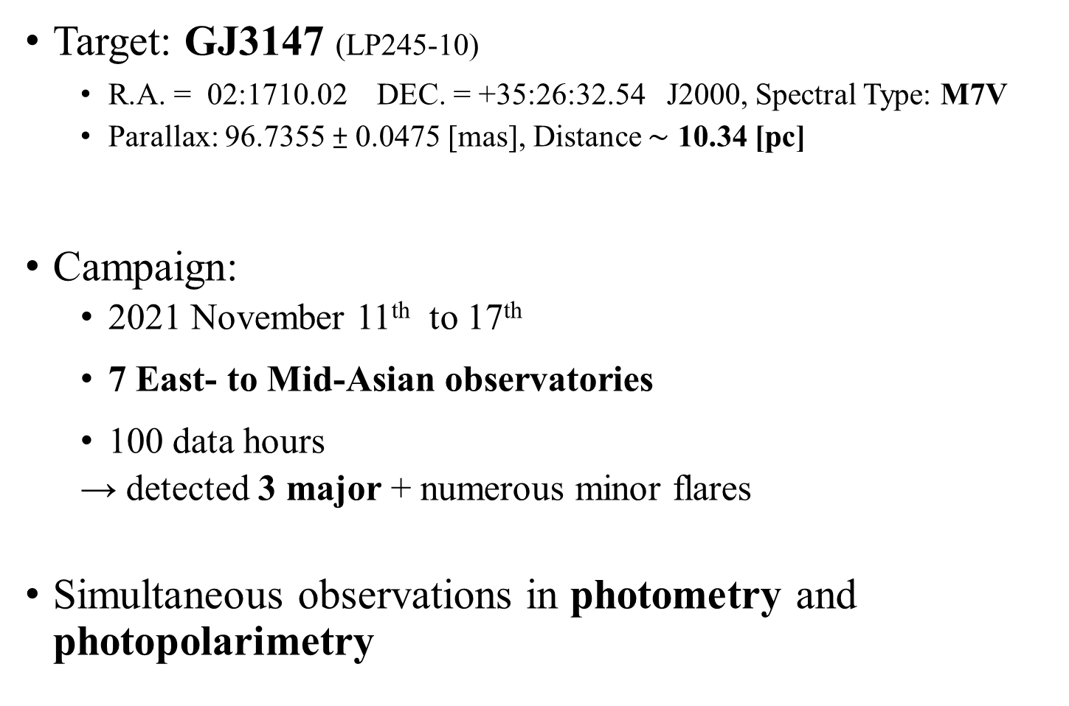
Monitoring Campaign
Target: GJ3147 (LP245-10)
  R.A. = 02:1710.02 DEC. = +35:26:32.54 J2000, Spectral Type: M7V
  Parallax: 96.7355 ± 0.0475 [mas], Distance $\sim$ 10.34 [pc]
Campaign:
  2021 November 11th to 17th
  7 East- to Mid-Asian observatories
  100 data hours
  → detected 3 major + numerous minor flares
Simultaneous observations in photometry and photopolarimetry
(Newton et al 2014)
1m
0.6m
0.6m
1m
1m
1m
0.7m

Slide 4
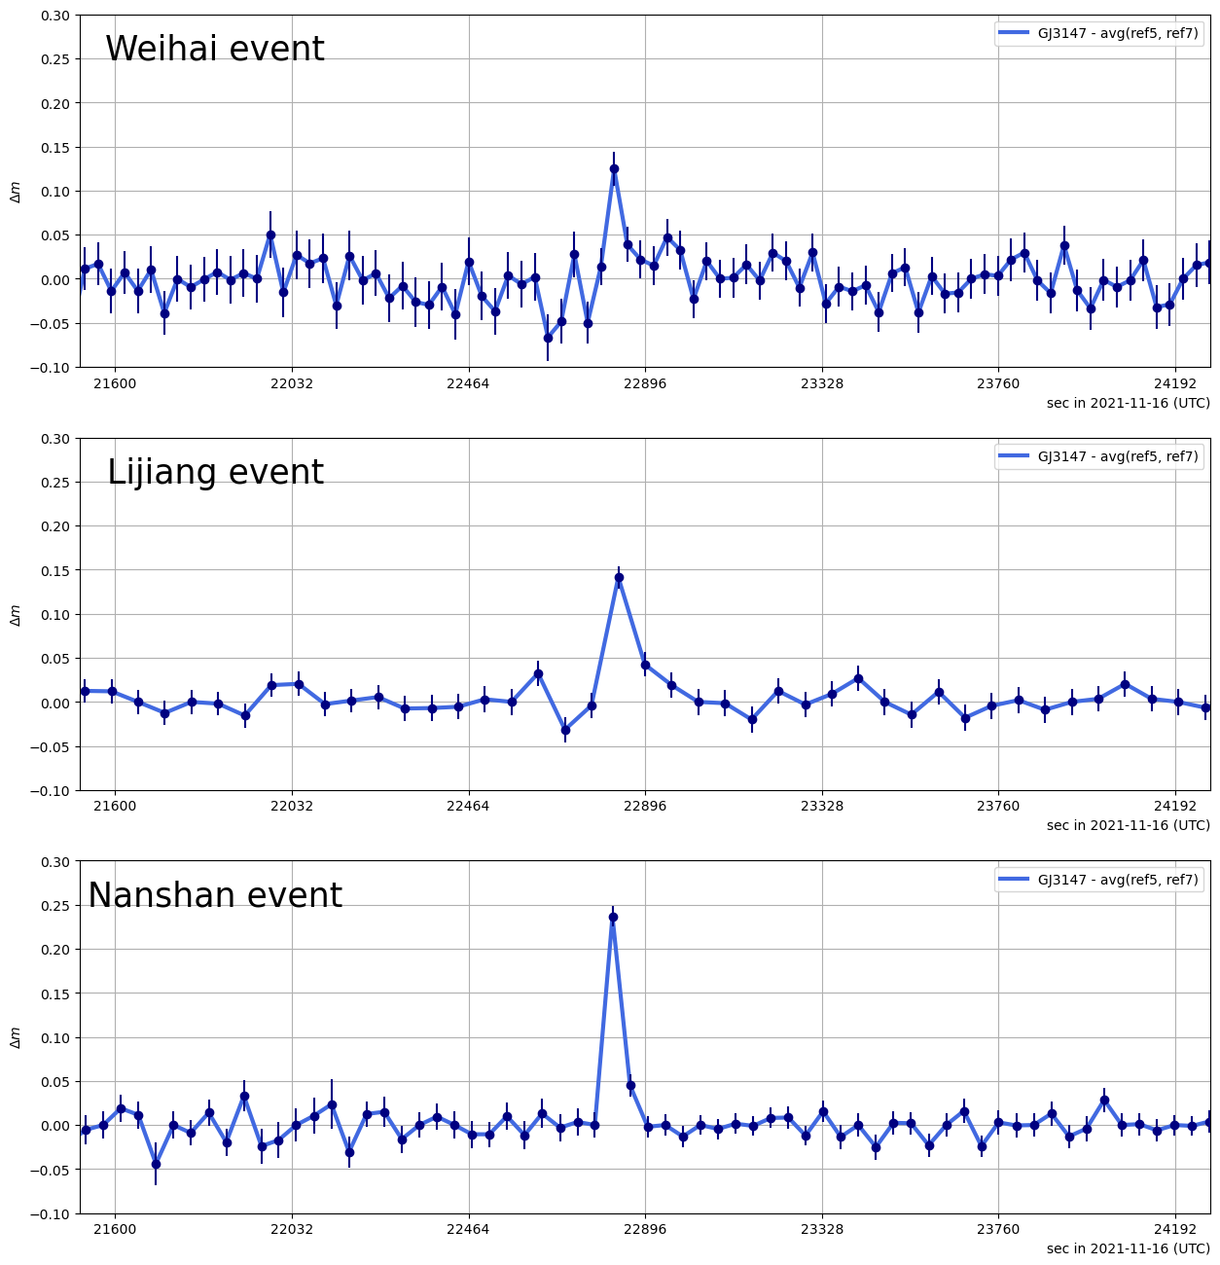
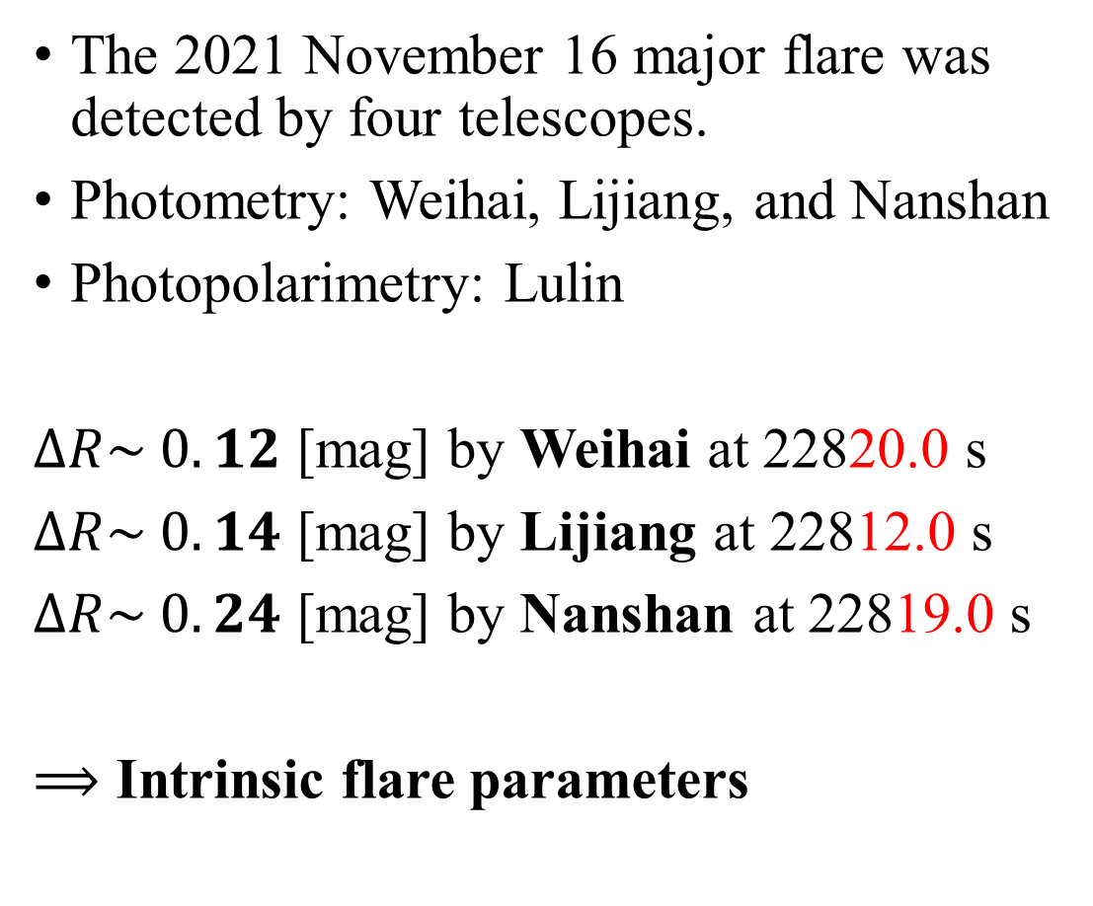
Detection of a giant flare
The 2021 November 16 major flare was detected by four telescopes.
Photometry: Weihai, Lijiang, and Nanshan
Photopolarimetry: Lulin
$ΔR\sim 0.12$ [mag] by Weihai at 22820.0 s
$ΔR\sim 0.14$ [mag] by Lijiang at 22812.0 s
$ΔR\sim 0.24$ [mag] by Nanshan at 22819.0 s
$⟹$ Intrinsic flare parameters

Slide 5
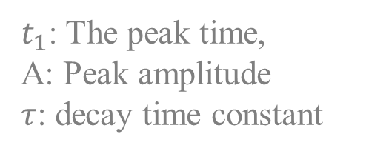
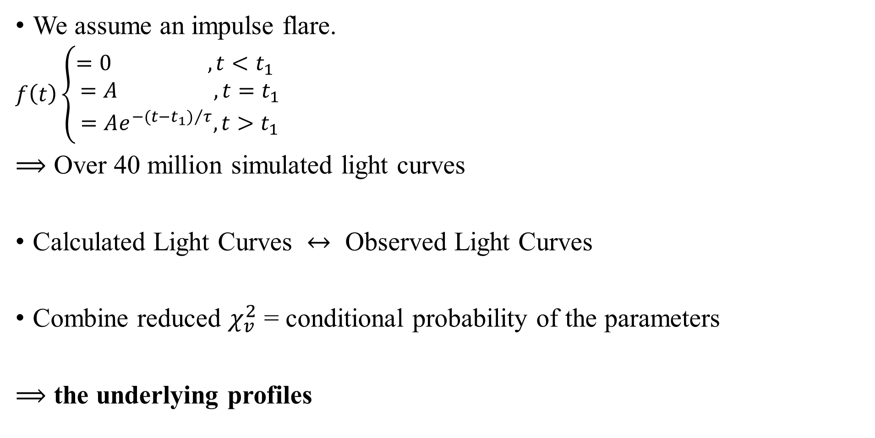
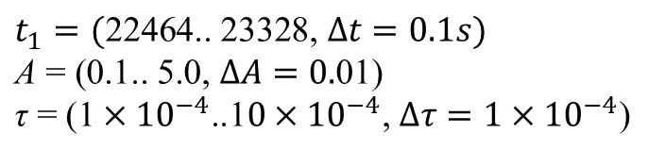
Derivation of the underlying profiles
We assume an impulse flare.
$f\left(t\right)\left\{\begin{aligned}=0 , t<t_{1} \\ =A ,t=t_{1} \\ =Ae^{{−(t−t_{1})}/τ}, t>t_{1}\end{aligned}\right.$
$⟹$ Over 40 million simulated light curves
Calculated Light Curves $↔$ Observed Light Curves
Combine reduced $χ_{v}^{2}$ = conditional probability of the parameters
$⟹$ the underlying profiles
$t_{1}$: The peak time,
A: Peak amplitude
$τ$: decay time constant
$t_{1}=(\text{22464.. 23328, }∆t=0.1s)$
$\text{A} \text{= (0.1.. 5.0, }∆A=0.\text{01}\text{)}$
$\text{τ}\text{ = (1}×{10}^{−4}\text{..1}0×{10}^{−4}\text{, }∆τ=\text{1}×{10}^{−4}\text{)}$

Slide 6
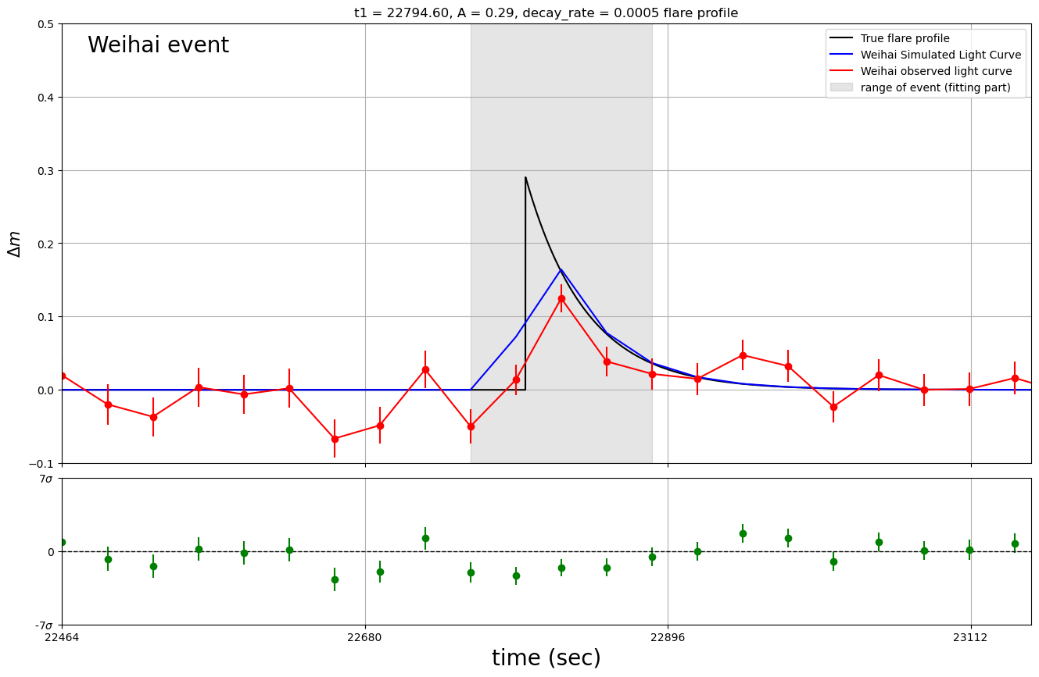
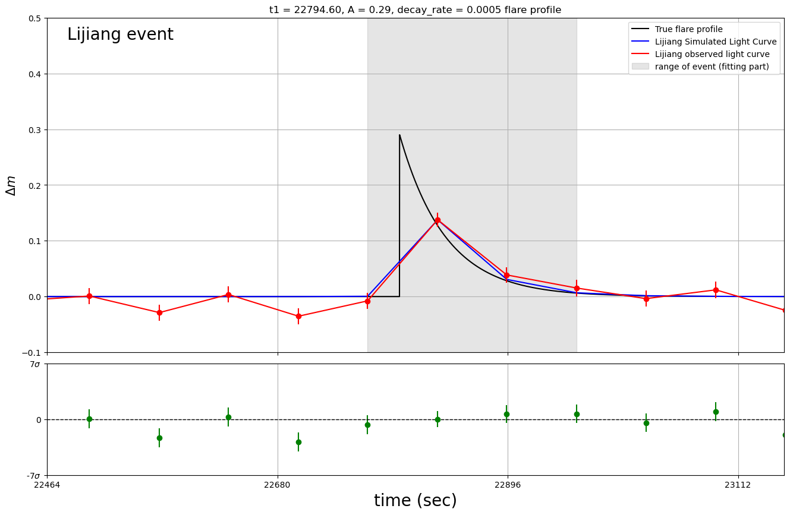
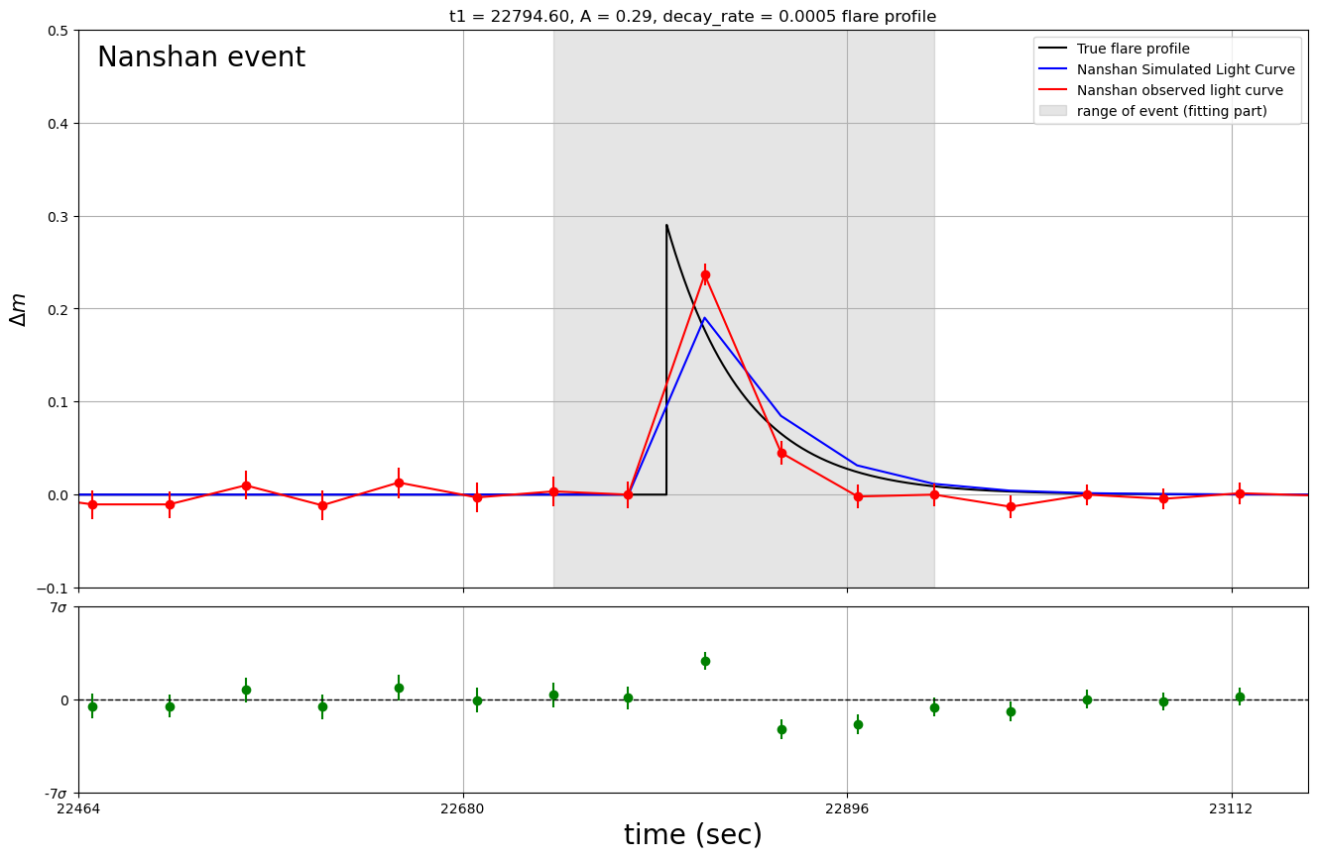
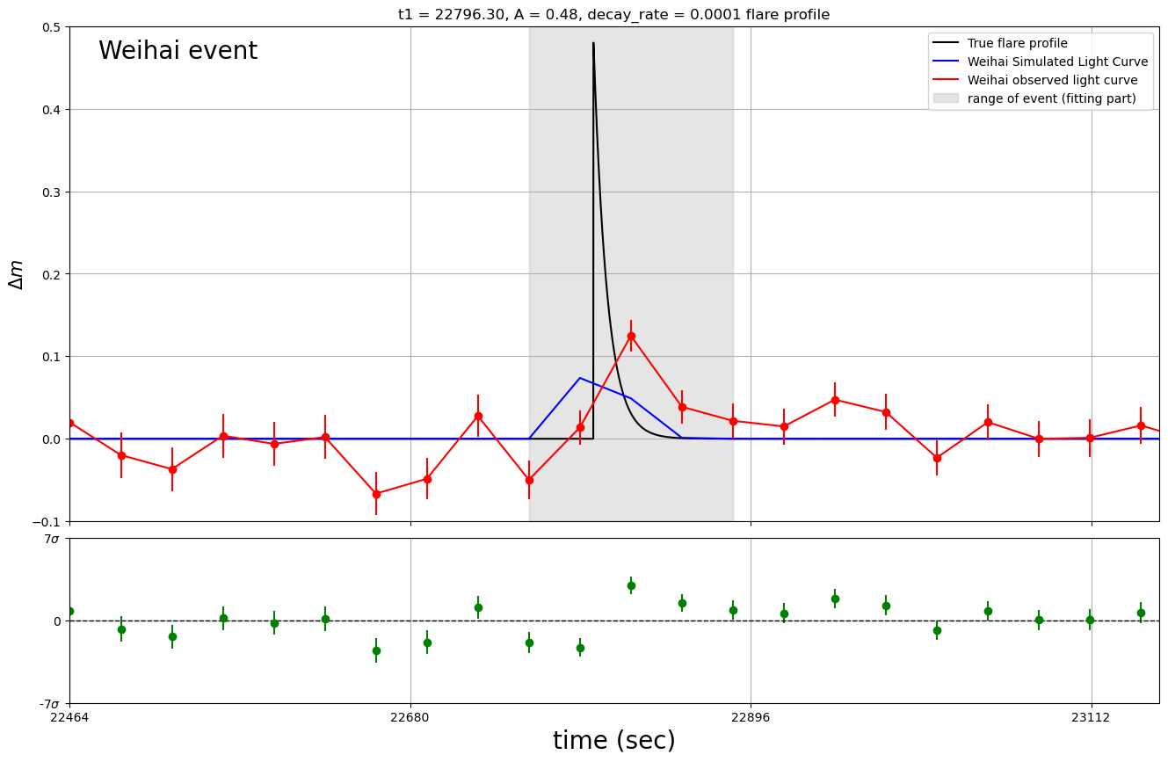
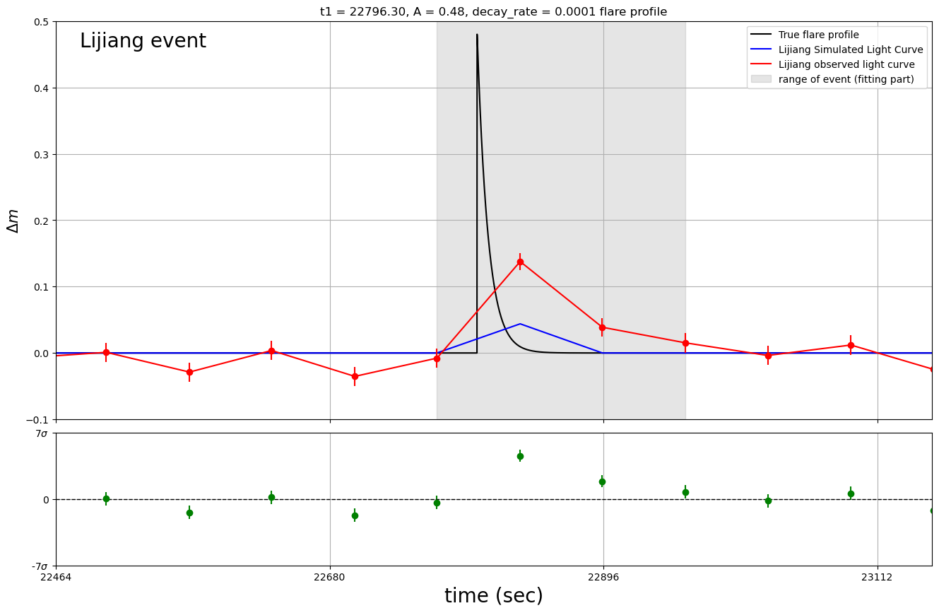
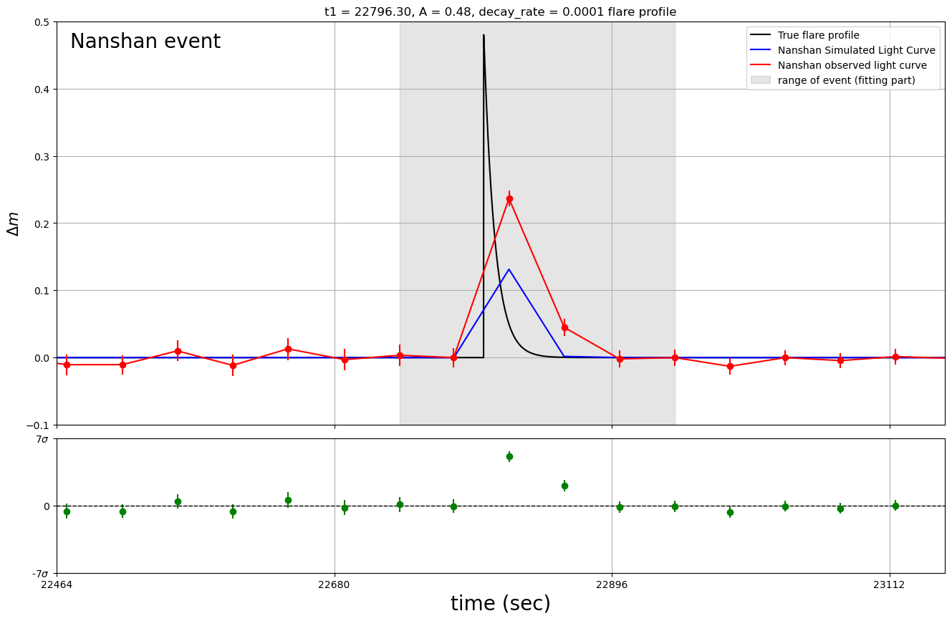






Best-fitting Profile vs. Poorly-fitting Profile
Best-fitting: $t_{1}=22794.6s, ΔA=0.29, τ=5∙{10}^{−4} (\tilde{χ_{v}^{2}}=1.649)$ Duration ~ 2 m 46 s
$$χ_{v}^{2}=2.289$$
$$χ_{v}^{2}=1.006$$
$$χ_{v}^{2}=1.948$$
Poorly-fitting: $t_{1}=22796.3s, ΔA=0.48, τ=1×{10}^{−4} (\tilde{χ_{v}^{2}}=4.213)$
$$χ_{v}^{2}=2.876$$
$$χ_{v}^{2}=8.026$$
$$χ_{v}^{2}=3.240$$

Slide 7
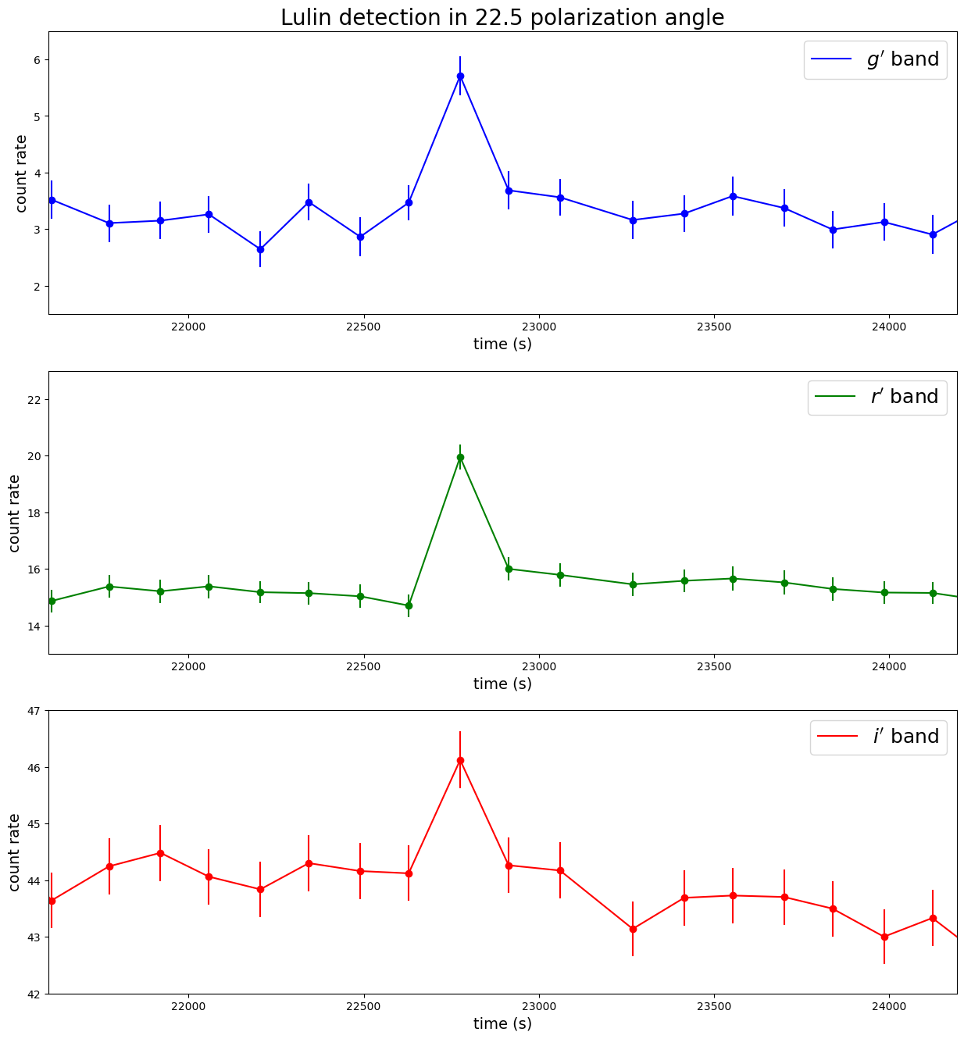
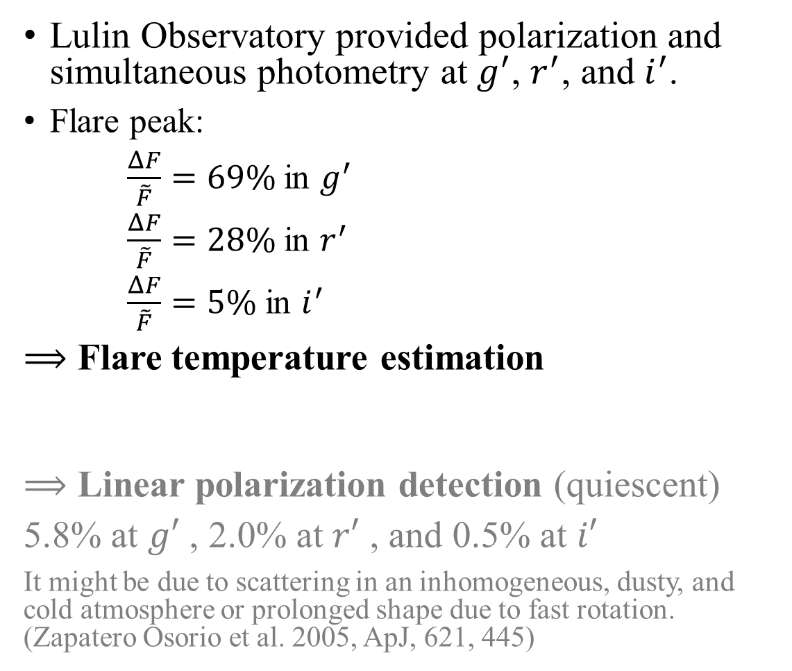
The Same Flare but with Photopolarimetry
Lulin Observatory provided polarization and simultaneous photometry at $g^{′}$, $r^{′}$, and $i^{′}$.
Flare peak:
$\frac{ΔF}{\tilde{F}}=69\%$ in $g^{′}$
$\frac{ΔF}{\tilde{F}}=28\%$ in $r^{′}$
$\frac{ΔF}{\tilde{F}}=5\%$ in $i^{′}$
$⟹$ Flare temperature estimation
$⟹$ Linear polarization detection (quiescent)
5.8% at $g′$ , 2.0% at $r′$ , and 0.5% at $i′$
It might be due to scattering in an inhomogeneous, dusty, and cold atmosphere or prolonged shape due to fast rotation. (Zapatero Osorio et al. 2005, ApJ, 621, 445)
Same sampling function = Same flux rate

Slide 8
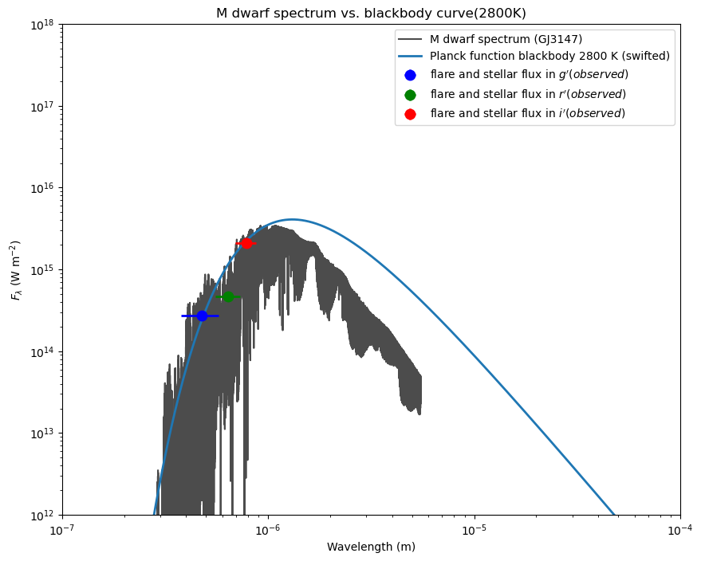
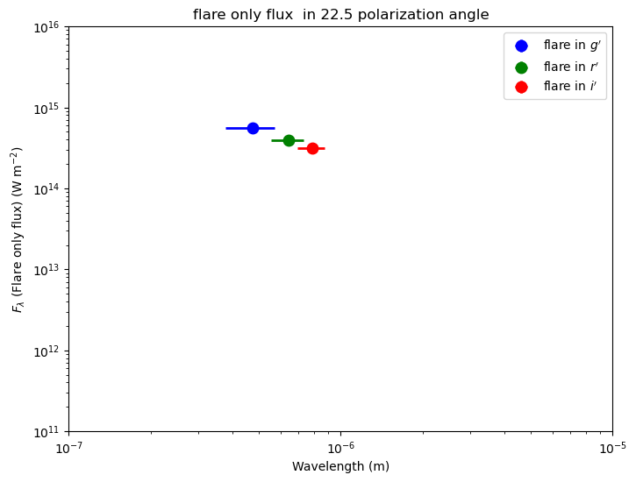
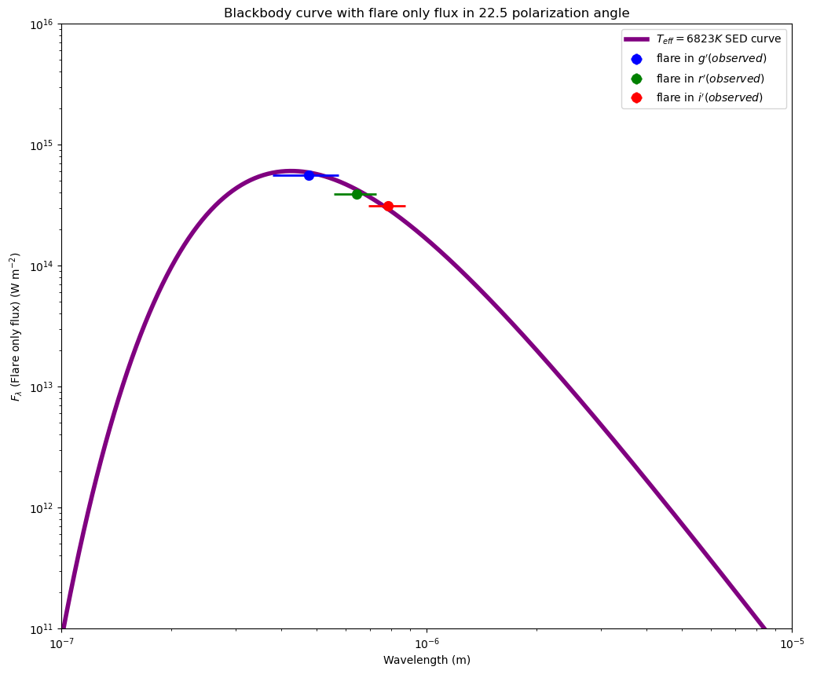
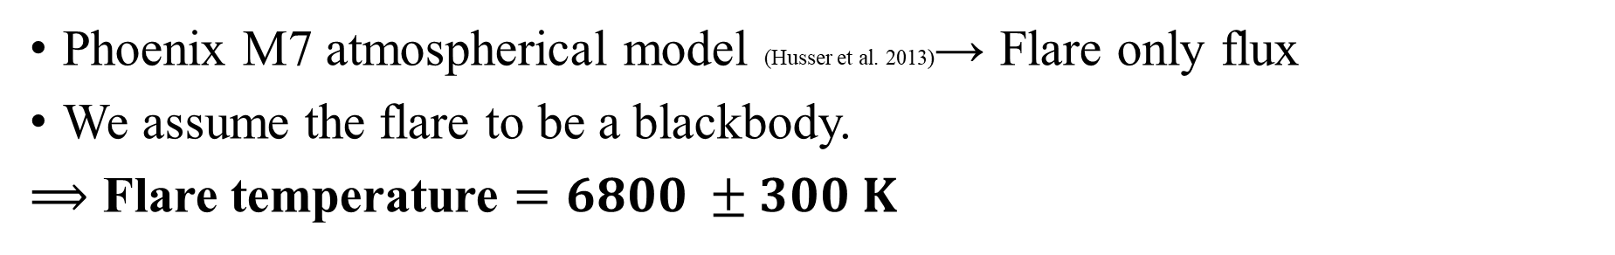
Flare Temperature Estimation
Phoenix M7 atmospherical model (Husser et al. 2013)→ Flare only flux
We assume the flare to be a blackbody.
$⟹$ Flare temperature $=6800 ±300 K$
Subtracting stellar flux

Slide 9
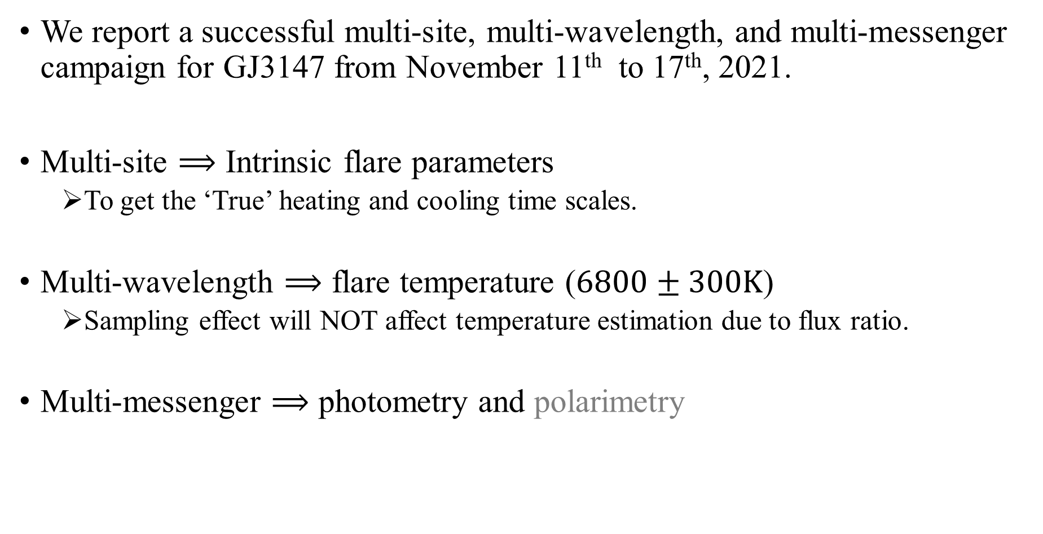
Conclusion
We report a successful multi-site, multi-wavelength, and multi-messenger campaign for GJ3147 from November 11th to 17th, 2021.
Multi-site $⟹$ Intrinsic flare parameters
  To get the ‘True’ heating and cooling time scales.
Multi-wavelength $⟹$ flare temperature ($6800±300K$)
  Sampling effect will NOT affect temperature estimation due to flux ratio.
Multi-messenger $⟹$ photometry and polarimetry

Slide 10

Backup slides
Combine Reduced $χ_{v}^{2}$of the Simulated Light Curves
Well-fitting parameters
Polarization Detection in Lulin
Spectrum Model Introduction

Slide 11
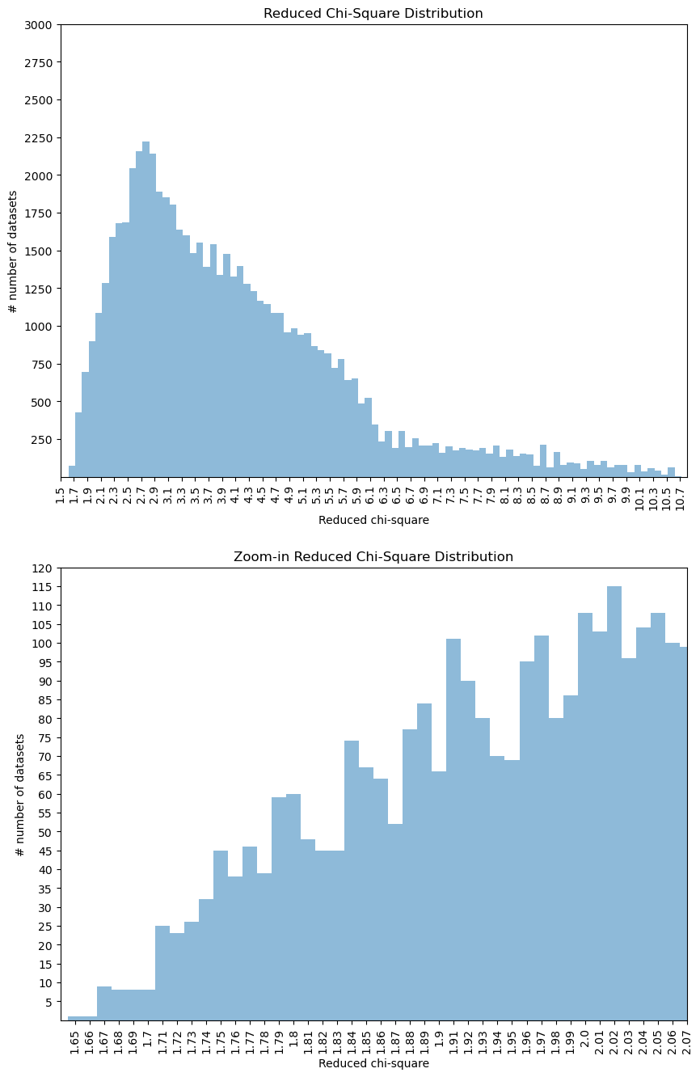
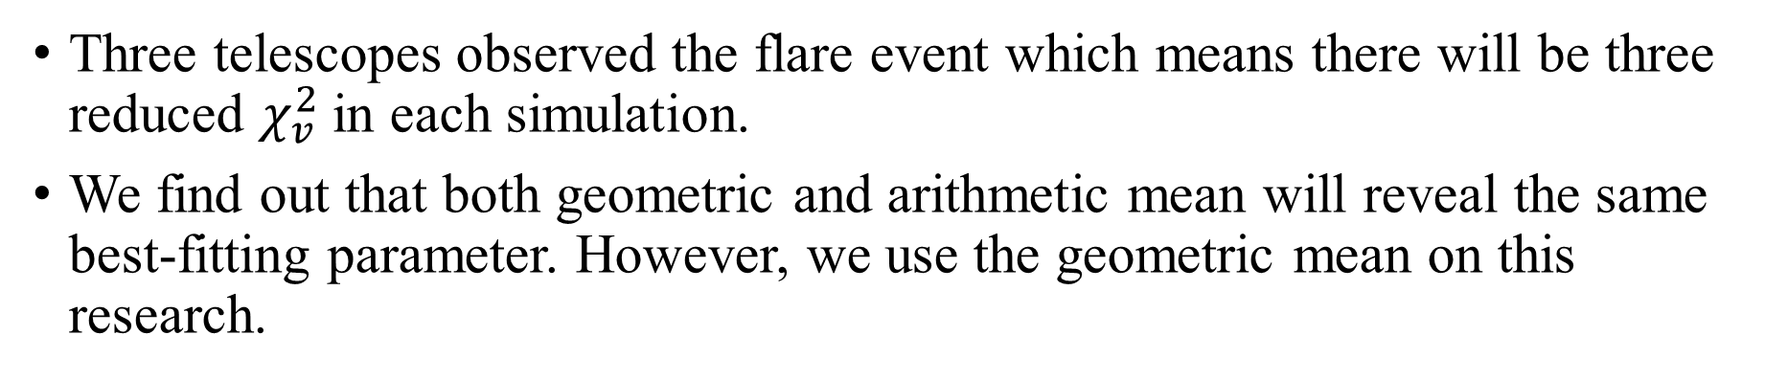
Combine Reduced $χ_{v}^{2}$of the Simulated Light Curves
Three telescopes observed the flare event which means there will be three reduced $χ_{v}^{2}$in each simulation.
We find out that both geometric and arithmetic mean will reveal the same best-fitting parameter. However, we use the geometric mean on this research.
25
1 1
9 8 8 8
total 35 light curves

Slide 12
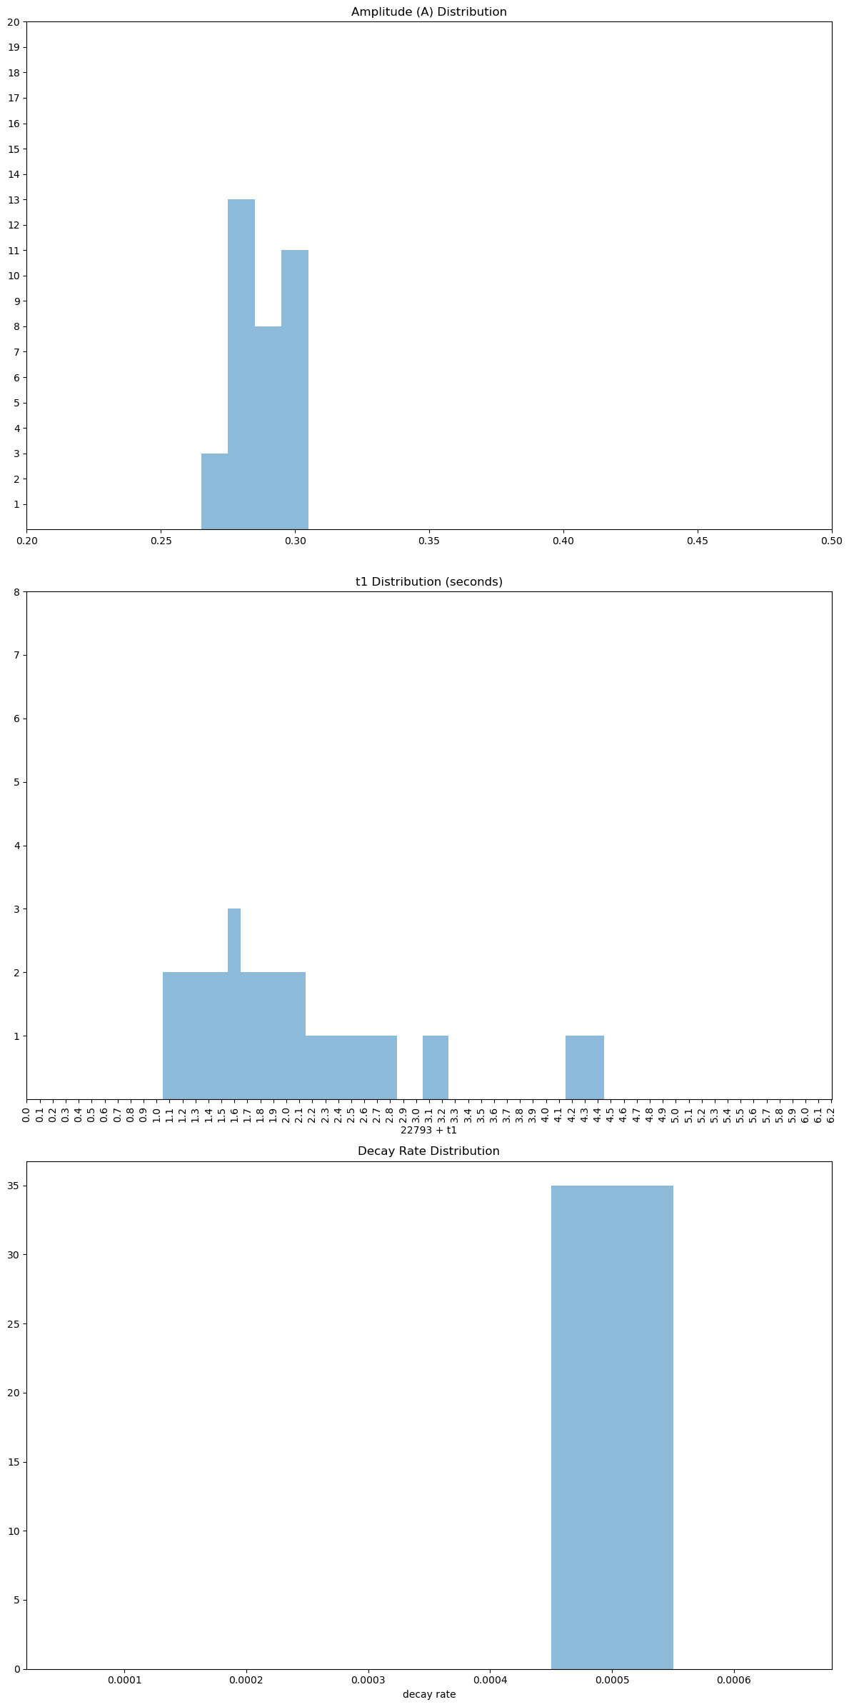
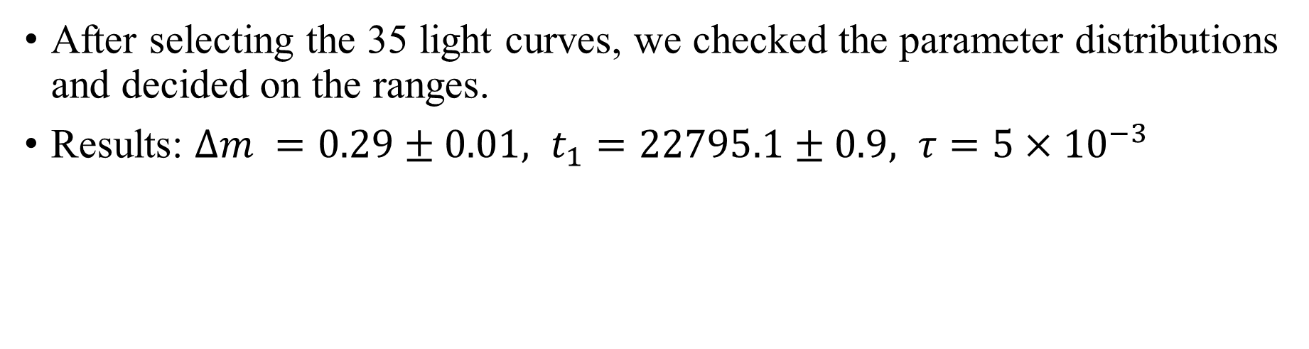
Well-fitting parameters
After selecting the 35 light curves, we checked the parameter distributions and decided on the ranges.
Results: $Δm =0.29±0.01, t_{1}=22795.1±0.9, τ=5×{10}^{−3}$
The histograms showed the distributions of $Δm$, $t_{1}$, and$τ$.

Slide 13
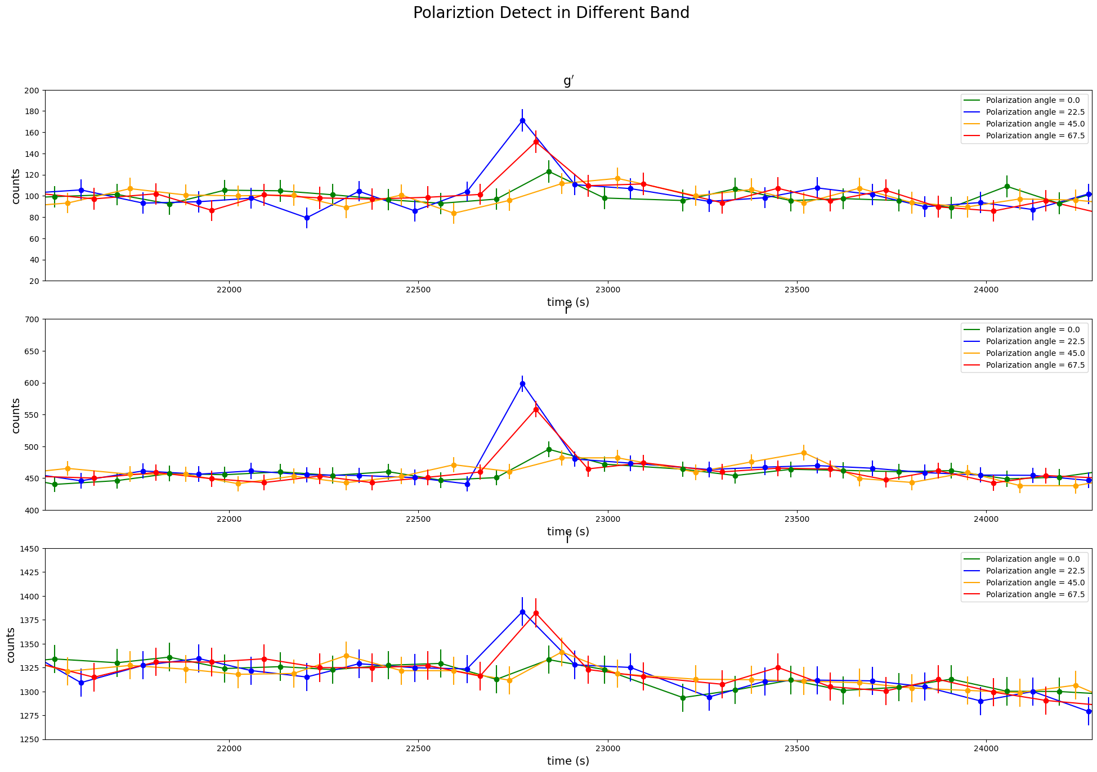
Polarization Detection in Lulin
In Lulin, the polarization detections weren’t simultaneous, so we can only detect the star polarization information in quiescent states.

Slide 14
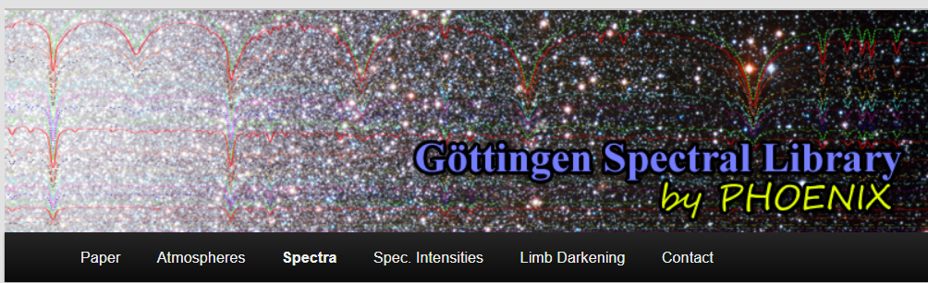
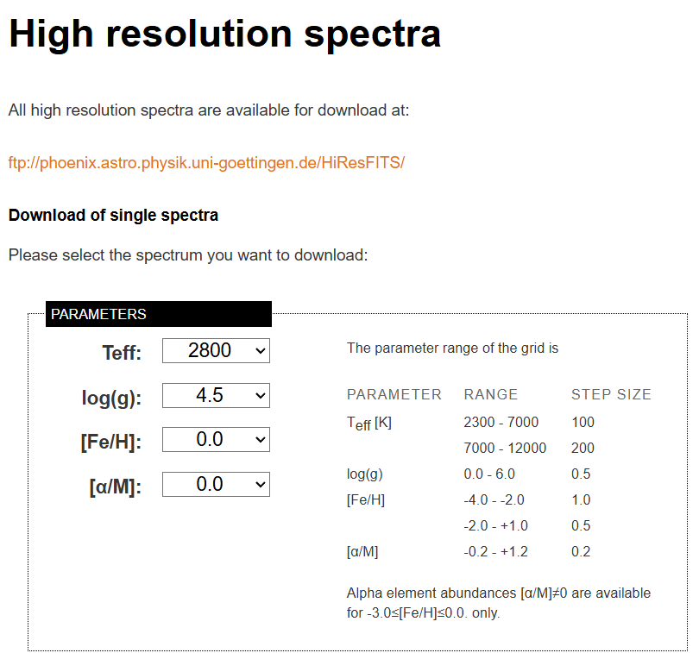
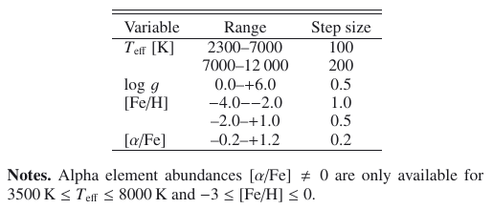
Spectrum Model Introduction
By Husser et al. from Germany.
In this model, they considered more newly discovered atomic and molecular lines. (like alpha elements eg.: Mg, Ti, Si, Ca, S)
The table below is the parameter space of the model.
We imported the parameters of GJ3147.

