Slide 1
Generalized Gauss's Law of Gravity with a Conserved and Re-distributed Field Flux of a Transition to Non-spherical Equipotential Surface
Te Chun Wang 王德峻;
Retired from high school
(tctedwang@yahoo.com)

Slide 2
Outline
Introduction: Gauss’s law and Field Flux Distributions with equipotential Gaussian surface
Background Observations: Flat rotation curve, Baryonic Tully-Fisher relation
Model: 1. Gravitational field flux Re-distribution with Cylindrical Gaussian surface
2. Cylindrical to Spherical transition of the Gaussian Surface
Structural Correlation Between Flux model, Rotation curve and Radial acceleration curve
Summary
A field flux picture with generalized Integral Gauss’s law of gravity is proposed for
solving mass discrepancy problem of disk galaxies.
Discussions:
Discussion 1: Field Flux converging, as the Gaussian surface resembles the structure, from 3D spherical
distribution to 2D cylindrical to 1D tube filament to mend the missing mass problem for larger scales
Discussion 2: The “Cylindrical to Spherical transition” may also occur in the time evolution of galaxies?
Discussion 3: Internal Instability of the Secular evolution of disk-shaped system

Slide 3
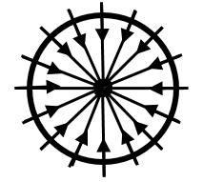

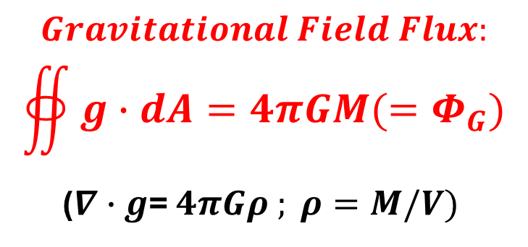

Gauss’s law and Field Flux Distributions
Gauss’s law :
The inverse square rule of Electromagnetism and Gravity :
field strength is defined by area density of the flux through a closed spherical surface containing the mass or electric source.
Newtonian field: g > 10⁻¹⁰ N/Kg ( m/s²)
$$Gravitational Field Flux:$$
$$∯{g∙dA=4πGM(=Φ_{G})}$$
($∇∙g$= $4πGρ ; ρ=M/V)$
Newtonian field:
Spherical Flux distribution
(2D schematics)
$$F=\frac{GMm}{r^{2}}$$
$$g=\frac{4πGM}{4πr^{2}}=\frac{GM}{r^{2}}$$
The inverse square dependence of the Gauss’s law of Gravity and the spherical distribution of the field flux through a Gaussian surface.
Isaac Newton
(1687)
Carl Friedrich Gauss
(1835)
(A non-relativistic field approach)
Conserved Gravitational Field
Flux Re-distribution

Slide 4
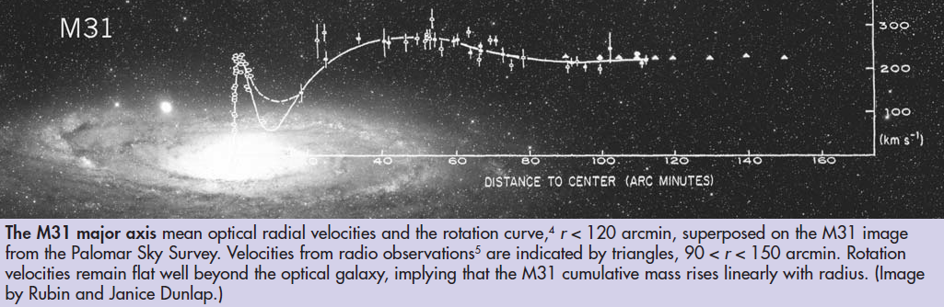
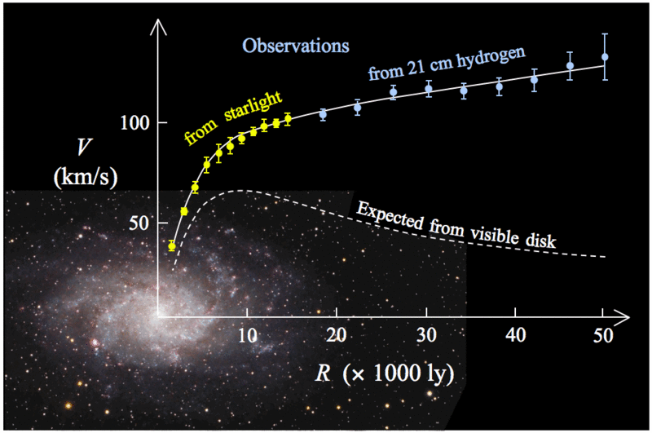

Background Experiments FACT I: Flat Rotation Curves
HSB: Flat Rotation Curves
Fig. 1. The rotation curve of Andromeda Galaxy (M31).
LSB: Rising Rotation Curves
v$∝\frac{1}{\sqrt{R}}$
Keplerian Rotation Curves
Fig. 2. The observed rotation curve of M33 and a predicted curve.
Ref.1. "Rotation of the Andromeda Nebula from a Spectroscopic Survey of Emission Regions", Rubin, Vera C.; Ford, W. Kent, Jr.,
The Astrophysical Journal, 159:379(1970).
Ref.2. “Seeing dark matter in the Andromeda Galaxy”, Vera Rubin, Physics Today, December 8(2006).
Notes:
Observations of the rotation curve of spiral galaxies showed that the curves do not decrease in the expected inverse square root relationship, as the dash line in Fig. 2., but are "flat", that is , outside of the central bulge the speed is nearly a constant, as the solid line in Fig. 1.
It is also observed that most low-surface-brightness galaxies (LSB galaxies) have a rotation curve that rises from the center to the edge.
The yellow and blue points with error bars in Fig. 2. is the Rotation curve of spiral galaxy M 33 (The lower dash line is a predicted curve from distribution of the visible matter.)

Slide 5
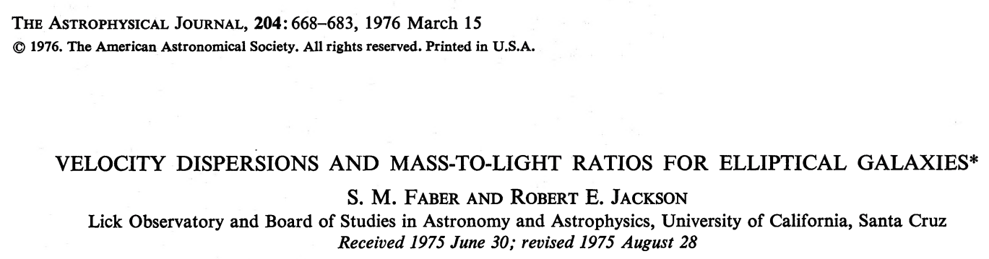
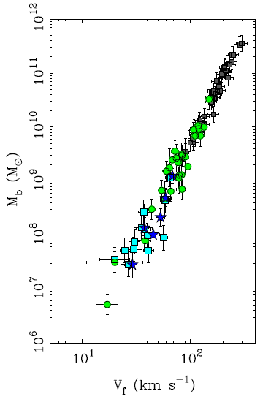
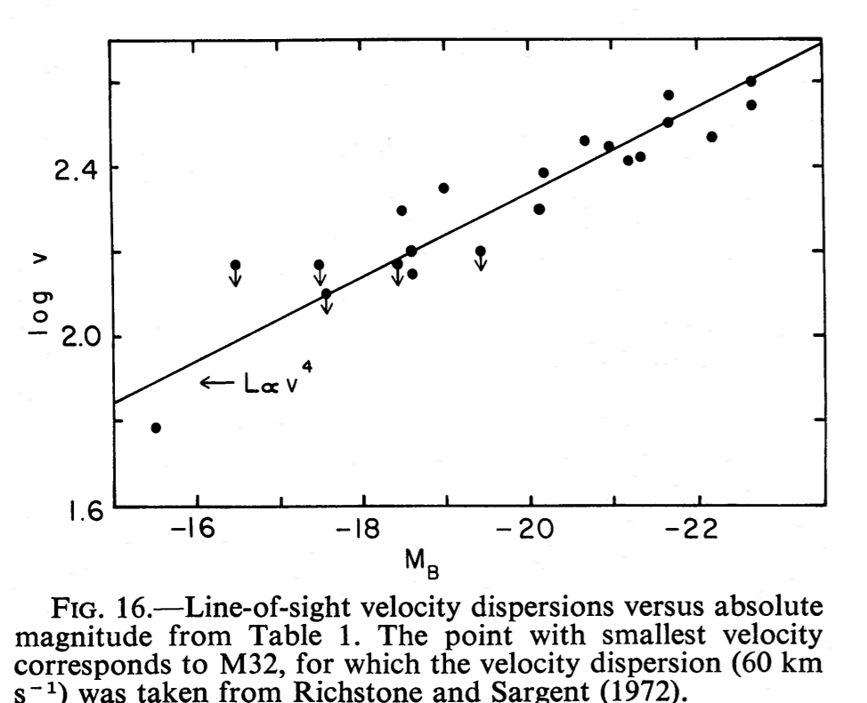

Background Experiments FACT II:
Baryonic Tully Fisher Relation and Faber Jackson Relation
“Baryonic mass proportional to the flat rotation velocity
to the power of approximately 4”, a direct relation between
the normal matter and the non-Newtonian dynamics.
$$M_{b}=A {V_{f}}^{4}$$
A=47$±4 M_{⊙}km^{−4}s^{4}$
~$0.95∗{10}^{20} Kg/{(m/s)}^{4}$
Fig.3 Baryonic(stars and gas) mass as a function of circular velocity.
Ref.3. “The Baryonic Tully-Fisher Relation of gas-rich galaxies as a test of ΛCDM and MOND”,
Stacy S. McGaugh, The Astronomical Journal, 143:40 (2012)

Slide 6
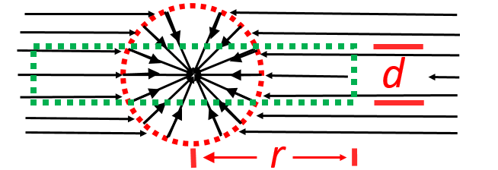
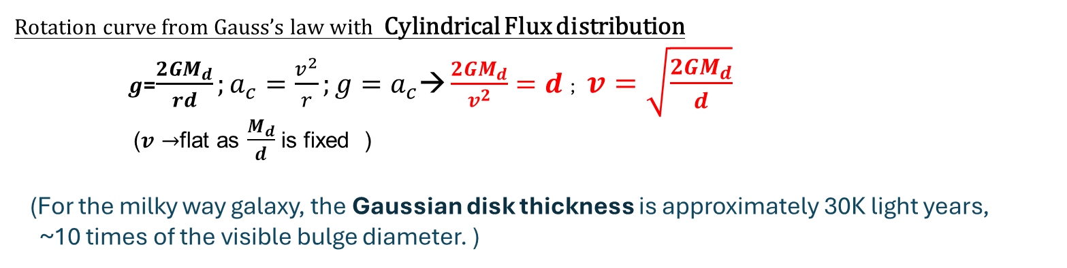

Model (Disk Galaxies)
Gaussian Disk of Gravitational Field Flux for Flat Rotation Curve
(Side view schematics of disk galaxy)
Cylindrical Flux distribution
$$g=\frac{4πGM_{d}}{2πrd}=\frac{2GM_{d}}{rd}$$
Red dot boundary: critical field strength $(g_{c}\sim {10}^{−10} N/Kg)$
$4πGM_{d}$ represents a fixed amount of gravitational Field flux entering the Gaussian disk
from the side wall, shown above as the green dot disk, with thickness d and radius r.
Rotation curve from Gauss’s law with Cylindrical Flux distribution
$g$=$\frac{2GM_{d}}{rd};a_{c}=\frac{v^{2}}{r};g=a_{c}\text{→}\frac{2GM_{d}}{v^{2}}=d$; $v=\sqrt{\frac{2GM_{d}}{d}}$
($v→$flat as $\frac{M_{d}}{d}$ is fixed )
(For the milky way galaxy, the Gaussian disk thickness is approximately 30K light years,
~10 times of the visible bulge diameter. )

Slide 7
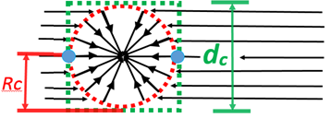


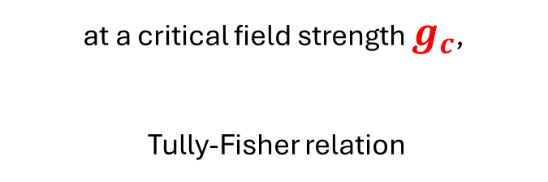
Model (Disk Galaxies)
Spherical to Cylindrical Transition of Flux Distribution for Tully-Fisher Relation
Spherical to cylindrical flux distribution transition
across the critical field:
at a critical field strength $g_{c}$,
Tully-Fisher relation
$dc$→2$R_{c}: disk flux 4πGM_{d}→total flux 4πGM;$
At $g_{c}$(red dot circle): $g_{c}=\frac{GM}{{R_{c}}^{2}}\sim \frac{4GM}{{dc}^{2}}=\frac{v^{4}}{GM}$
$$dc \text{→}\text{2}R_{c}$$
$( for disk:g\text{=}\frac{2GM}{Rd}=\frac{v^{2}}{R}→ thickness d=\frac{2GM}{v^{2}} )$
Flatness of the velocity,${v=v}_{f}$
$\text{→}M={\left(\frac{1}{Gg_{c}}\right)v_{f}}^{4}$ → Tully-Fisher Relation !
$(\frac{1}{Gg_{c}})$~${ 10}^{20} Kg/{(m/s)}^{4}$.
At the critical transition points, regions shown as red dots, the flux distribution experiences a spherical to cylindrical transition. The Tully-Fisher relation is proved valid according to this condition and the flatness of the velocity at extended radius as shown in blue spots.

Slide 8
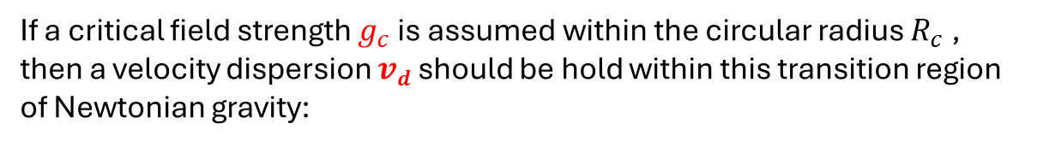


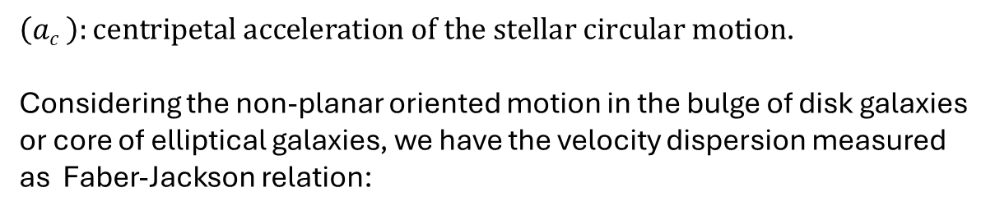
Model (Elliptical Galaxies/Disk Bulge)
For Faber-Jackson relation in centers of elliptical galaxies or core bulges of disk galaxies
If a critical field strength $g_{c}$is assumed within the circular radius $R_{c}$ , then a velocity dispersion $vd$ should be hold within this transition region of Newtonian gravity:
$$g_{c}2=g_{c} \frac{GM}{{R_{c}}^{2}}=\left(ac \right)2=\frac{{vd}^{4}}{{R_{c}}^{2}} → {vd}^{4}{=g}_{c}GM$$
$\left(ac \right):centripetal acceleration of the stellar circular motion$.
Considering the non-planar oriented motion in the bulge of disk galaxies or core of elliptical galaxies, we have the velocity dispersion measured as Faber-Jackson relation:
$${<v>}^{4}{=g}_{c}GM$$

Slide 9
Necessary mechanical properties of Gravitational flux lines
1. Flexibility:
For the flux lines to bend across the transition between Spherical and Cylindrical distribution.
2. Lateral repulsion
For the area density of flux lines to have a minimum to hold the spherical distribution, higher than this “critical Density g_{c}”, the flux lines would repel each other along the radial direction to form the spherical distribution.

Slide 10
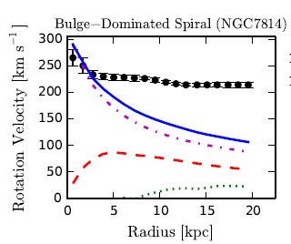


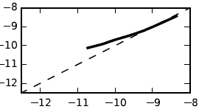

Spatial Correlation Between Flux model, Rotation curve and Radial acceleration curve
Flux Distribution
Rotation Curve
Radial Acceleration
$$g <{10}^{−10} N/Kg$$
Newtonian
Non-Newtonian

Slide 11
Discussion 1:
Field Flux converging, as the equipotential Gaussian surface resembles the spatial structure, from spherical distribution to cylindrical to 1D tube filament to mend the missing mass problem for larger scales.
For example, cluster of galaxies: Gaussian surface area reduction
( Field Flux converging from 3D spherical→ 2D cylindrical → 1D linear)
may further yield a lower value of the needed minimum cluster mass by modifying the Virial theorem 2T+V=0 of 1/r potential.
Discussion 2:
The “Cylindrical to Spherical transition” may also occur in the temporal evolution of galaxies?
Discussion 3:
Internal instability caused by
cylindrical to spherical transition of
flux distribution at Bulge boundary region
Gravitational field flux distribution evolution
Cylindrical flux distribution
Cylindrical flux distribution
With core Spherical flux distribution
Spherical flux distribution
Galactic Structural evolution
(Intrinsic) Instability
Disk
Disk with core bulge
Elliptical
11

Slide 12
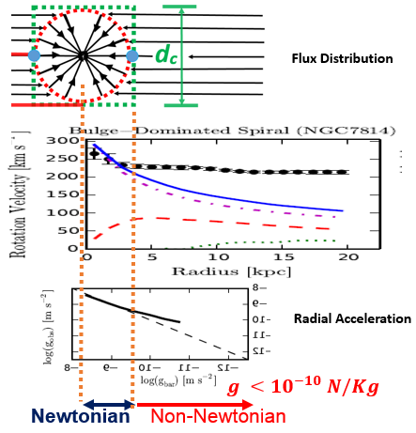

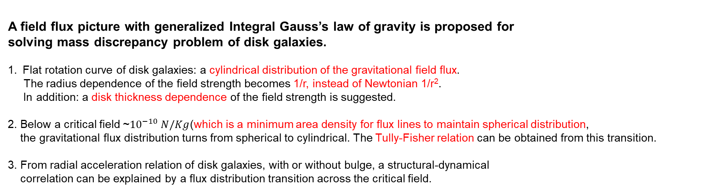


Summary
A field flux picture with generalized Integral Gauss’s law of gravity is proposed for
solving mass discrepancy problem of disk galaxies.
Flat rotation curve of disk galaxies: a cylindrical distribution of the gravitational field flux.
The radius dependence of the field strength becomes 1/r, instead of Newtonian 1/r².
In addition: a disk thickness dependence of the field strength is suggested.
2. Below a critical field ~${10}^{−10} N/Kg$(which is a minimum area density for flux lines to maintain spherical distribution,
the gravitational flux distribution turns from spherical to cylindrical. The Tully-Fisher relation can be obtained from this transition.
3. From radial acceleration relation of disk galaxies, with or without bulge, a structural-dynamical
correlation can be explained by a flux distribution transition across the critical field.
1
2
3
$$g\text{=}\frac{2GM}{Rd}=\frac{v^{2}}{R}→ d=\frac{2GM}{v^{2}}$$
$g_{c}=\frac{GM}{{R_{c}}^{2}}\sim \frac{4GM}{{dc}^{2}}=\frac{v^{4}}{GM}$
${v=v}_{f}$ $\text{→}M={\left(\frac{1}{Gg_{c}}\right)v_{f}}^{4}$
$g$=$\frac{2GM_{d}}{rd}=a_{c}=\frac{v^{2}}{r}\text{→}\frac{2GM_{d}}{d}=v^{2}$
$v=\sqrt{\frac{2GM_{d}}{d}}$ ($v→$flat @$\frac{{GM}_{d}}{d}$ fixed)

