Slide 1
Simulation studies of global resistive MHD accretion flows around spinning AGNs: the impact of resistivity on the MAD state
Md Ramiz Aktar
Institute of Astronomy, NTHU
ASROC 2025 Annual Meeting (ASROC-2025)
National Formosa University
16-18 May, 2025
(Ramiz, NTHU)

Slide 2
My collaborators
Prof. Kuo-Chuan Pan
Computational Explosive Astrophysics Group (CEAG)
Institute of Astronomy, NTHU, Taiwan
Prof. Toru Okuda
Hokkaido University, Japan
(Ramiz, NTHU)

Slide 3
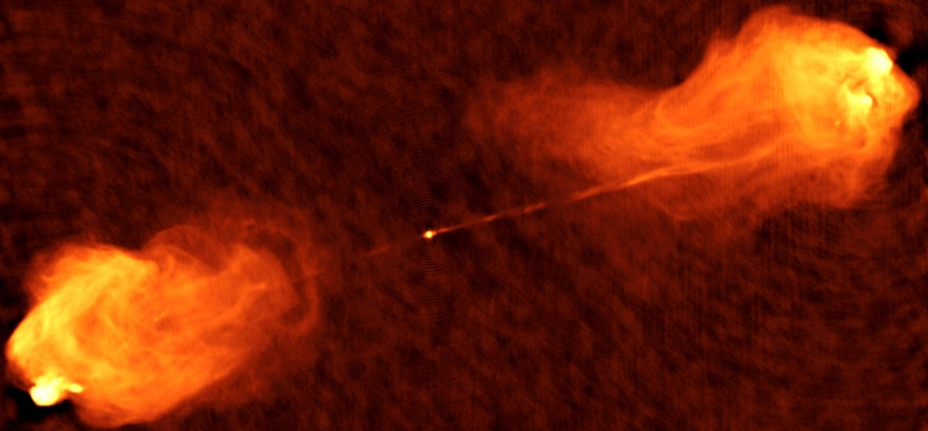
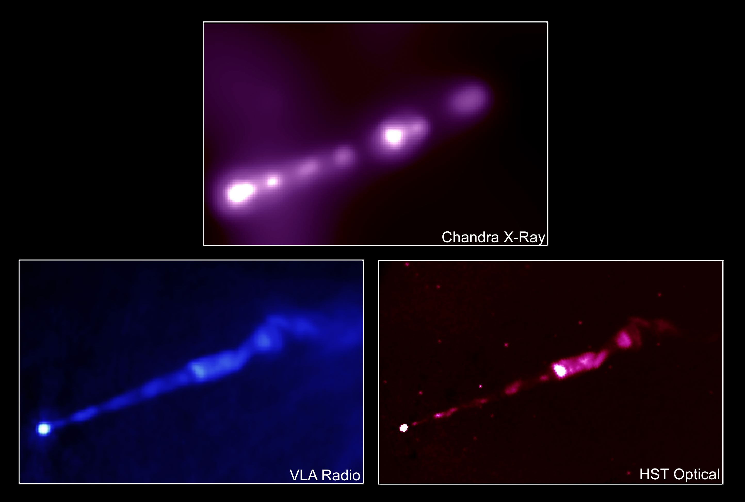
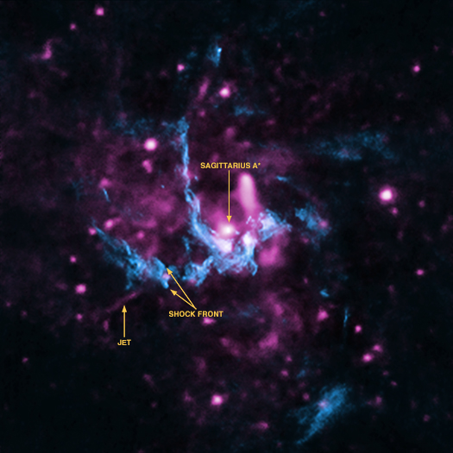
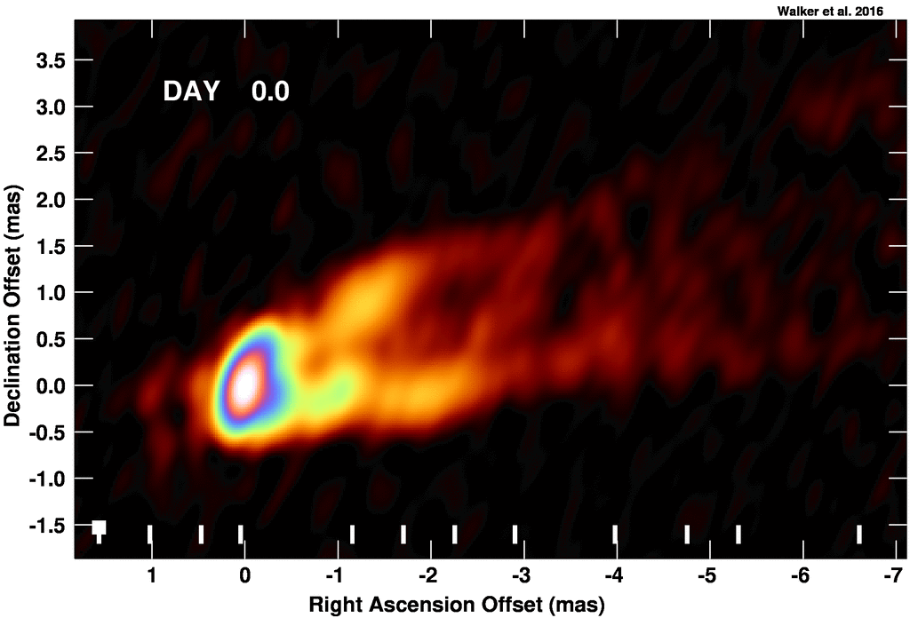
Observational images of AGN jets
Cygnus A
M87
Sgr A*
BH
Jet blobs
Courtesy: NRAO/AU
Courtesy: X-ray: NASA/CXC/MIT/H.Marshall et al.
Radio: F. Zhou, F.Owen (NRAO), J.Biretta (STScI)
Optical: NASA/STScI/UMBC/E.Perlman et al.
Courtesy: X-ray: NASA/CXC/UCLA/Z.Li et al;
Radio: NRAO/VLA
Highly relativistic jets have been observed for M87
(Junior + 1999).
However, there is no consensus about the evidence of relativistic jets for Sgr A*. radio flares
Sgr A* shows episodic X-ray and near-infrared flares that are detected roughly on a daily basis (Neilsen+ (2013, 2015); Ponti+2015; Fazio+ 2018; Boyce+2019)
Courtesy:Walker + 2018
(Ramiz, NTHU)

Slide 4
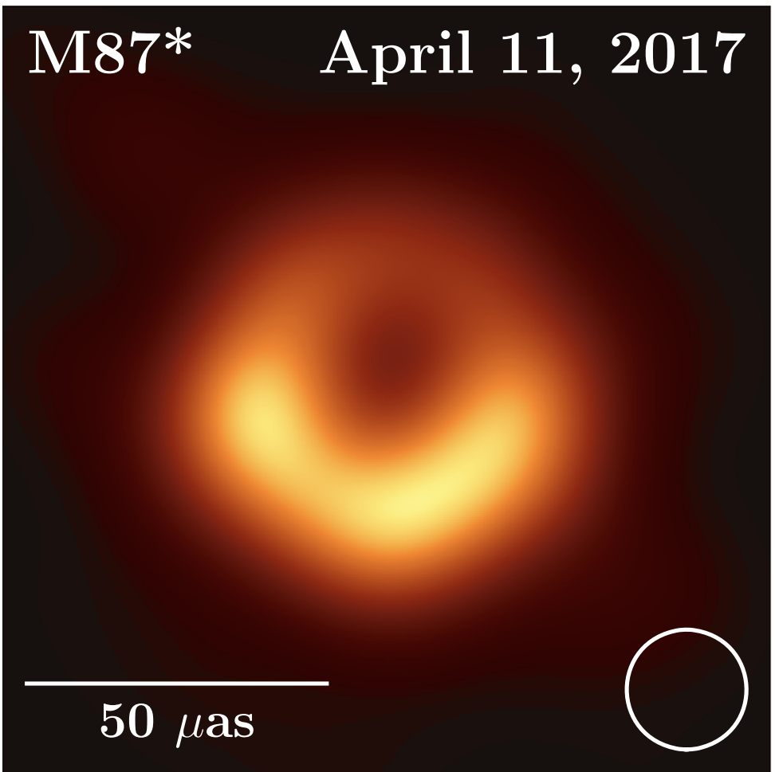
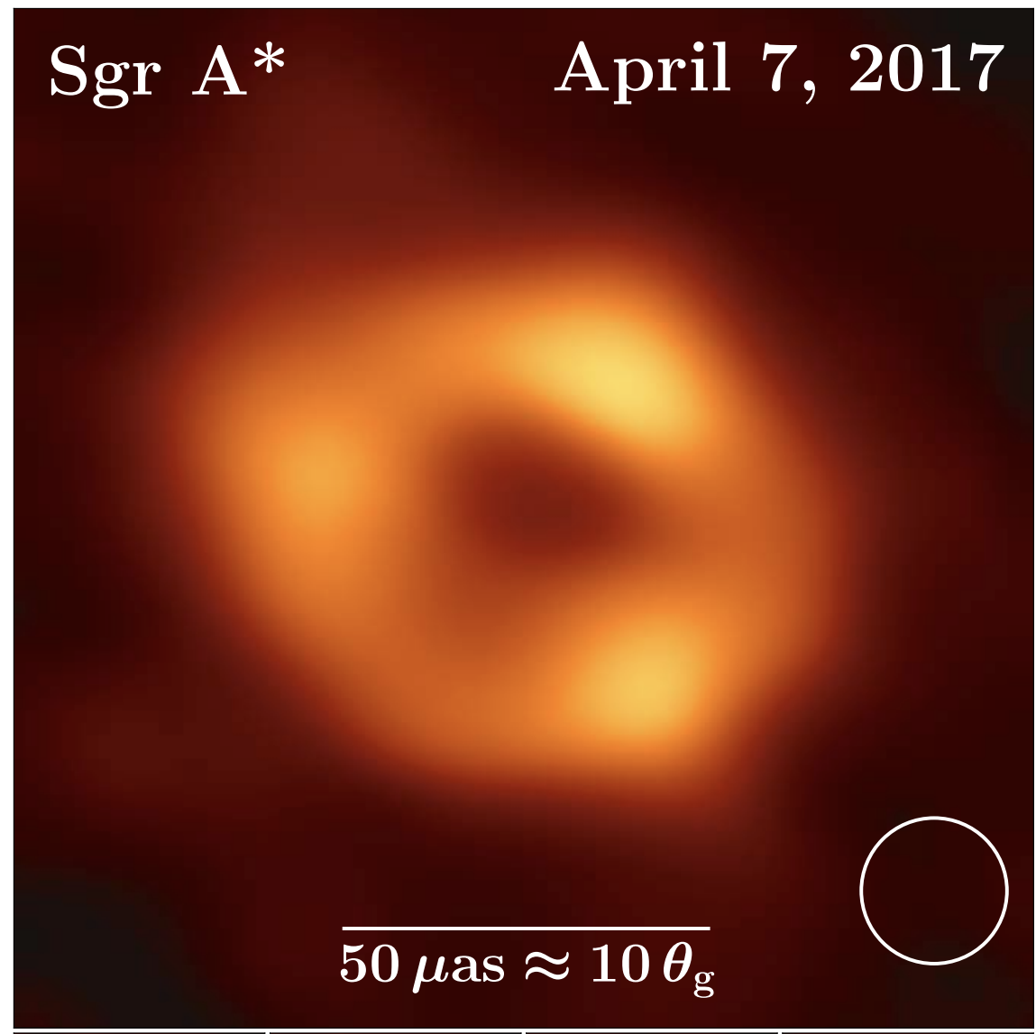
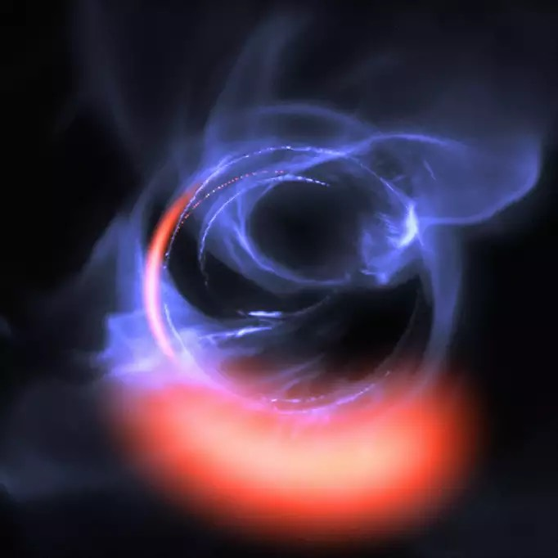
Magnetically Arrested Disk (MAD)
In recent years, one of the interesting and important accretion states has been explored in highly
magnetized accretion flows around the black hole
MAD (Magnetically Arrested Disk) state (Narayan + 2003; Igumenshchev 2008).
In a highly magnetized flow, the magnetic flux accumulates near the black hole horizon;
magnetic pressure increases; resist further increase of mass accretion rate.
Recently, MAD state is confirmed in M87 (EHT Collaboration + 2019, 2021, 2022) and
Sgr A* (GRAVITY Collaboration + 2019, 2020).
M87
SgrA*
Clumps of gas swirling at a speed of $∼0.3c$
Flaring events
Polarized image
EHT Collaboration + (2019, 2021, 2022)
GRAVITY Collaboration + 2018
(Ramiz, NTHU)
Magnetic field lines

Slide 5
MAD parameter
To examine the magnetic state, we need to investigate the amount of magnetic flux accumulated at the horizon.
In general, we define a dimensionless normalized magnetic flux threading to the black hole horizon, known as MAD parameter.
MAD parameter is defined as follows (Tchekhovskoy + 2011, Narayan + 2012)
2D Model
3D Model
$${\overset{·}{ϕ}}_{acc}=\frac{\sqrt{4π}}{2\sqrt{{\overset{·}{M}}_{acc}}}∫|B_{r}|_{R=R_{in}}dz,$$
$${\overset{·}{ϕ}}_{acc}=\frac{\sqrt{4π}}{2\sqrt{{\overset{·}{M}}_{acc}}}∫∫|B_{r}|_{R=R_{in}}dzdϕ$$
In Gaussian units
where, the mass accretion rate
where, the mass accretion rate
$${\overset{·}{M}}_{acc}=-2π∫ρ(r,z)rv_{r}dz$$
$${\overset{·}{M}}_{acc}=-∫∫ρ(r,z,ϕ)rv_{r}dzdϕ$$
${\overset{·}{ϕ}}_{acc}≳50$ MAD state.
${\overset{·}{ϕ}}_{acc}<50$ ‘Standard And Normal Evolution (SANE)’ state.
(Ramiz, NTHU)

Slide 6
Simulation Model
We consider resistive MHD (Res-MHD) flow around spinning AGNs.
We adopt PLUTO code for our simulation (Mignone + 2007).
https://plutocode.ph.unito.it/
We consider the uniform magnetic resistivity in the flow, ranging from 0.1 to 0.
In this work, we do not consider any explicit radiation transport in the flow.
In this work, the gravitational effect around a spinning black hole is modeled using effective Kerr potential proposed by Dihingia +2018.
(Ramiz, NTHU)

Slide 7
Governing Equations (Res-MHD)
We adopt cylindrical coordinates $(r,ϕ,z)$.
Here, the total pressure,
$$\frac{∂ρ}{∂t}+∇⋅(ρv)=0$$
$$P_{t}=P_{gas}+\frac{E^{2}+B^{2}}{2}$$
$$\frac{∂(ρv)}{∂t}+∇⋅(ρvv-BB)+∇P_{t}=-ρ∇Φ$$
Total energy:
$$\frac{∂E}{∂t}+∇⋅[(E+P_{t})v-(v.B)B+ηJ×B]=-ρv.∇Φ$$
$$E=\frac{P_{gas}}{γ-1}+\frac{1}{2}ρv^{2}+\frac{1}{2}B^{2}$$
$$\frac{∂B}{∂t}+∇×(-v×B+ηJ)=0$$
Here, the resistive tensor is assumed to be diagonal as $η≡diag(η_{x1},η_{x2},η_{x3})$.
The electric current density is defined as $J=∇×B$.
(Mignone + 2007)
(Ramiz, NTHU)

Slide 8
Equilibrium initial Torus Set up
The density distribution of the torus is obtained by considering constant angular momentum flow
$$Φ^{eff}\left(r,z,a_{k},λ\right)+\frac{Γ}{Γ-1}\frac{P_{gas}}{ρ}=C$$
The density distribution inside the torus is
$$ρ={\left[\frac{Γ-1}{KΓ}\left(C-Φ^{eff}\left(r,z,a_{k},λ\right)\right)\right]}^{\frac{1}{Γ-1}}$$
(Aktar + 2023, 2024)
where,
$$K=\frac{Γ-1}{Γ}\left[C-Φ^{eff}\left(r_{max},0,a_{k},λ\right)\right]\frac{1}{ρ_{max}^{Γ-1}}$$
The density distribution outside the torus:
$$ρ_{atm}=ρ_{floor}r^{-3/2}$$
$$P_{atm}=P_{floor}r^{-5/2}$$
where,
$$ρ_{floor}={10}^{-6}$$
where,
$$P_{floor}={10}^{-8}$$
(Ramiz, NTHU)

Slide 9
Initial magnetic field configuration
We consider a poloidal magnetic field configuration following Hawley & Krolik (2002).
The initial magnetic field is set by considering a toroidal component of vector potential as
$$A_{ϕ}=B_{0}[ρ(r,z)-ρ_{min}]$$
where, the $B_{0}$ is the normalized initial magnetic field strength. $ρ_{min}$ is the minimum density in the torus.
$$β_{0}=\frac{2P_{gas}}{B_{0}^{2}}$$
Plasma-beta parameter
(Aktar + 2023, 2024)
(Ramiz, NTHU)

Slide 10
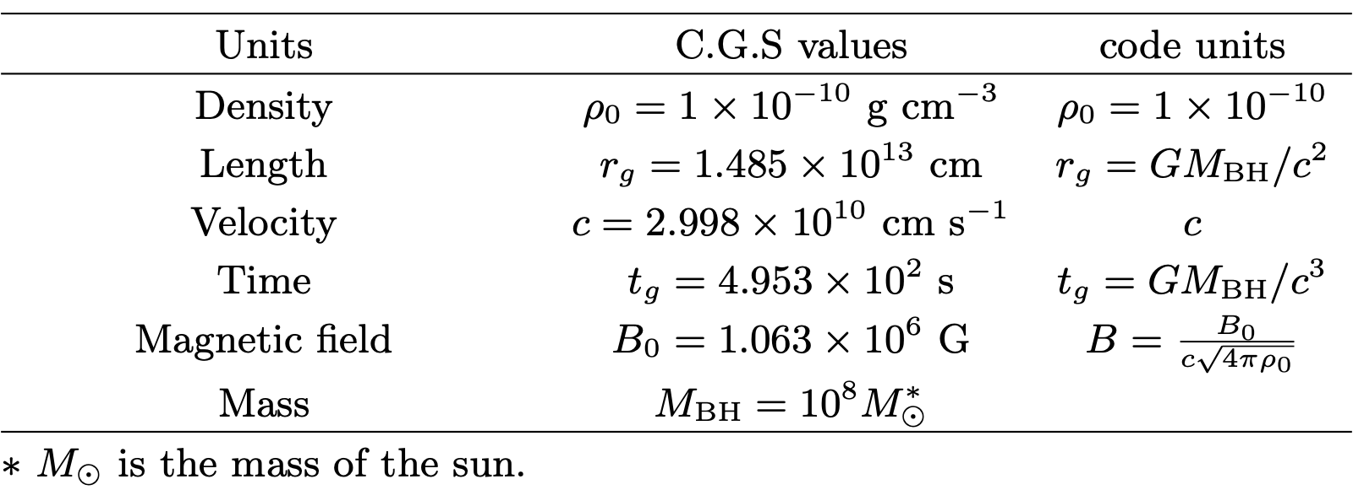
Initial and boundary condition
We consider the inner edge of the torus $r_{min}=20r_{g}$ and the maximum pressure location at $r_{max}=40r_{g}$.
The minimum density in the torus is $ρ_{min}=0.1ρ_{max},whereρ_{max}=ρ_{0}.$
We consider the computational domain:
2D model: $1.5r_{g}≤r≤200r_{g}$ and $-200r_{g}≤z≤200r_{g}$.
3D model: $1.5r_{g}≤r≤200r_{g}$ , $-200r_{g}≤z≤200r_{g}$ and $0≤ϕ≤2π$
(Aktar + 2023, 2024)
(Ramiz, NTHU)

Slide 11
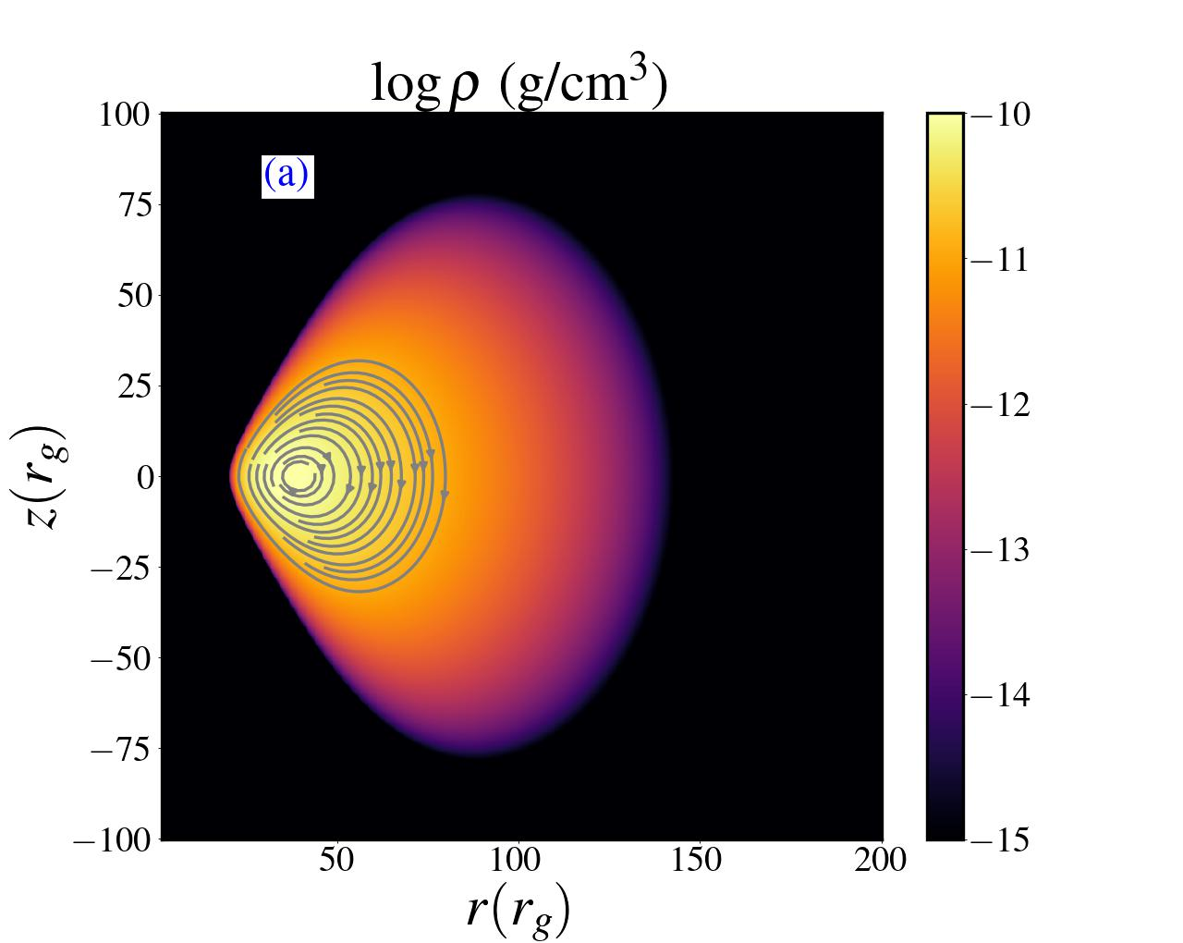
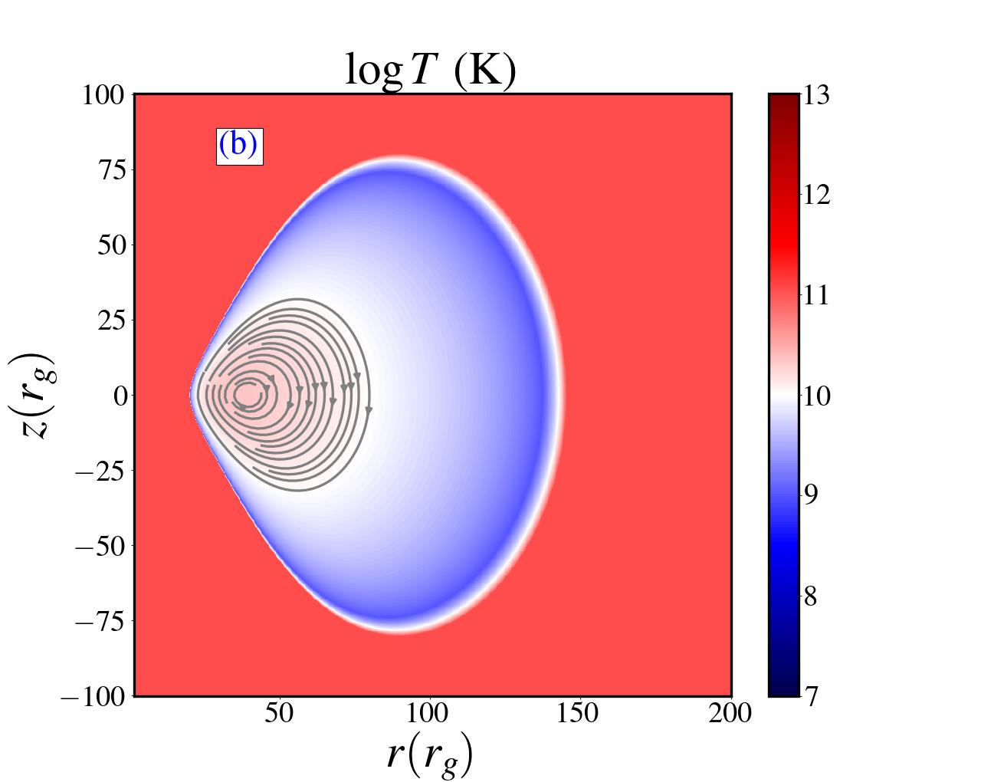
Initial equilibrium Torus
Aktar, Pan & Okuda; ApJ (under review)
(Ramiz, NTHU)

Slide 12
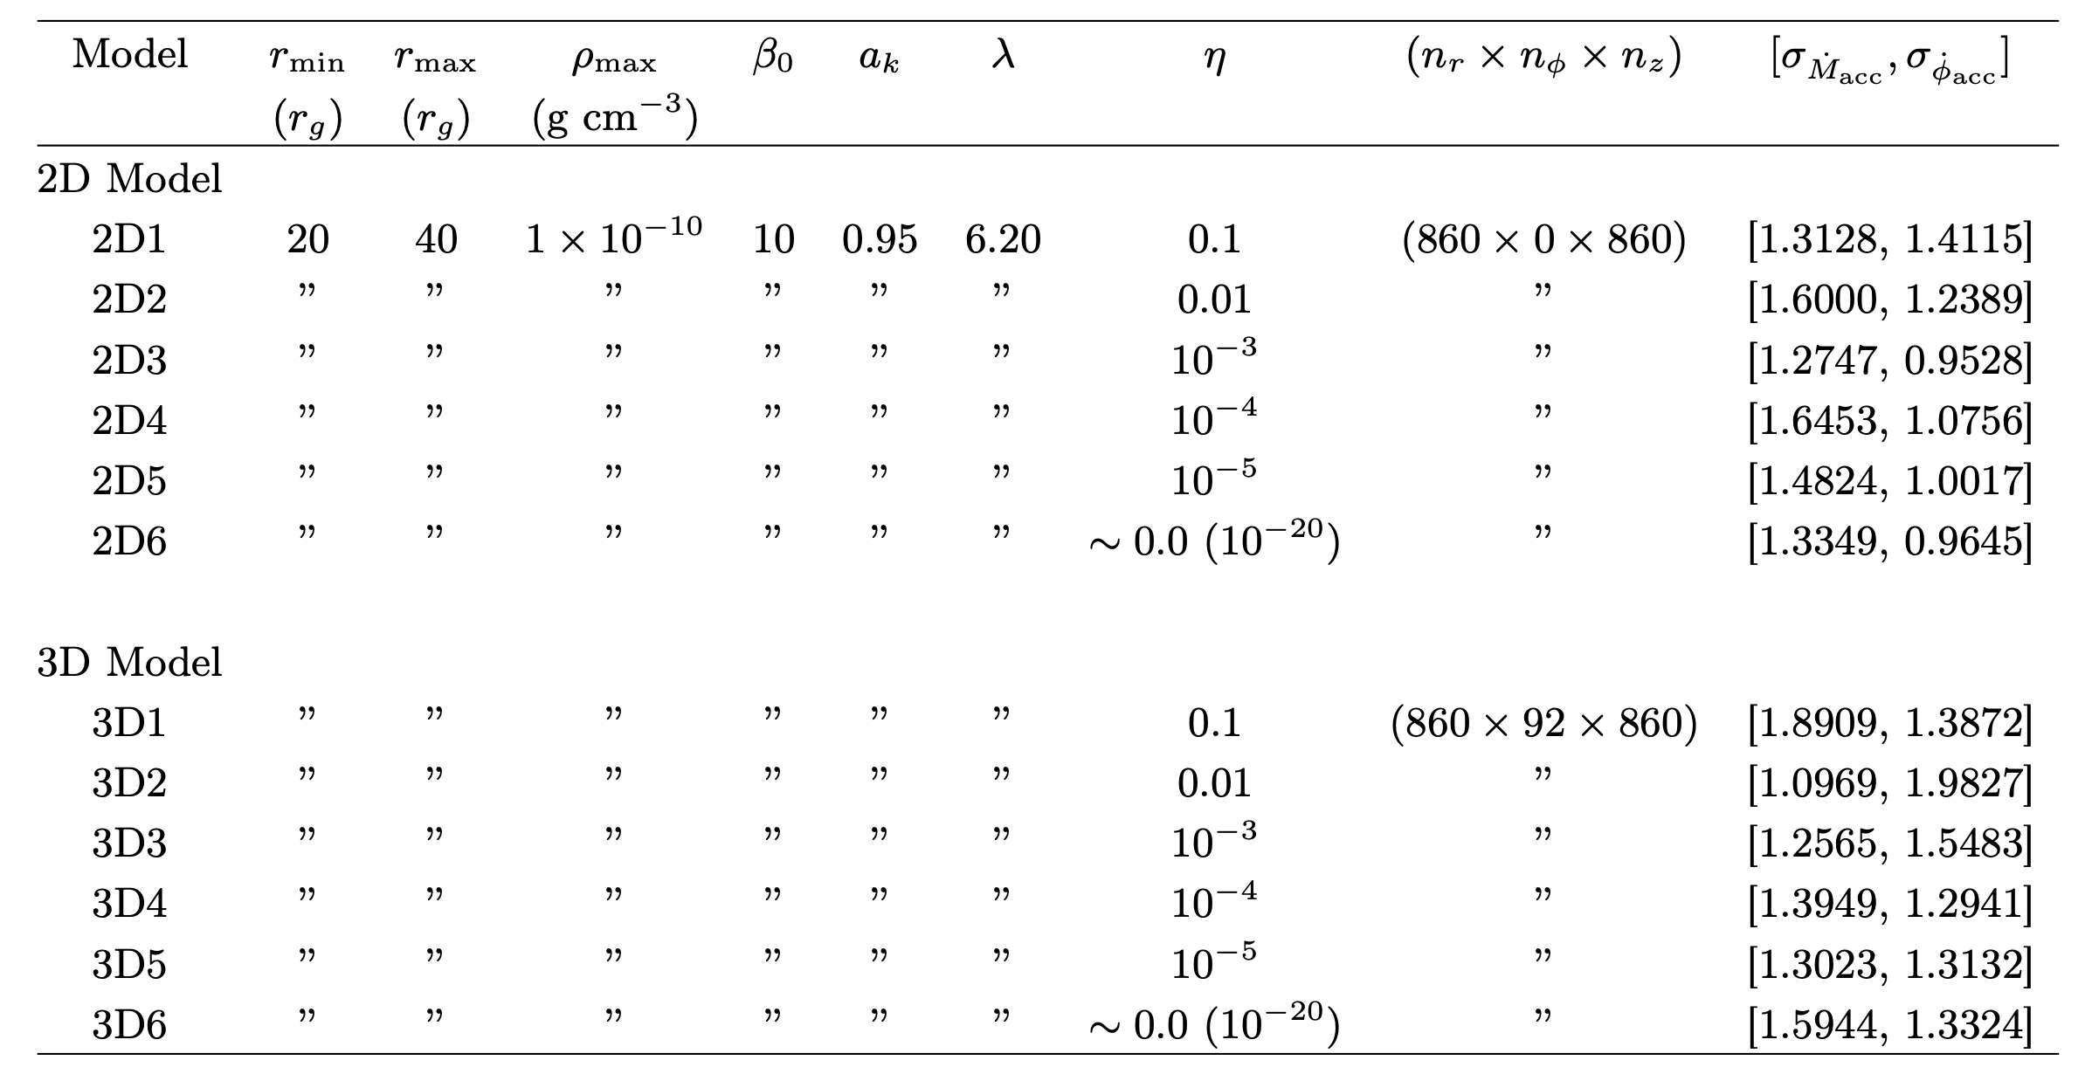
All simulation models
Our simulation model could achieve higher spatial resolutions than GRMHD simulations for a given computing resource.
Aktar, Pan & Okuda; ApJ (under review)
(Ramiz, NTHU)

Slide 13
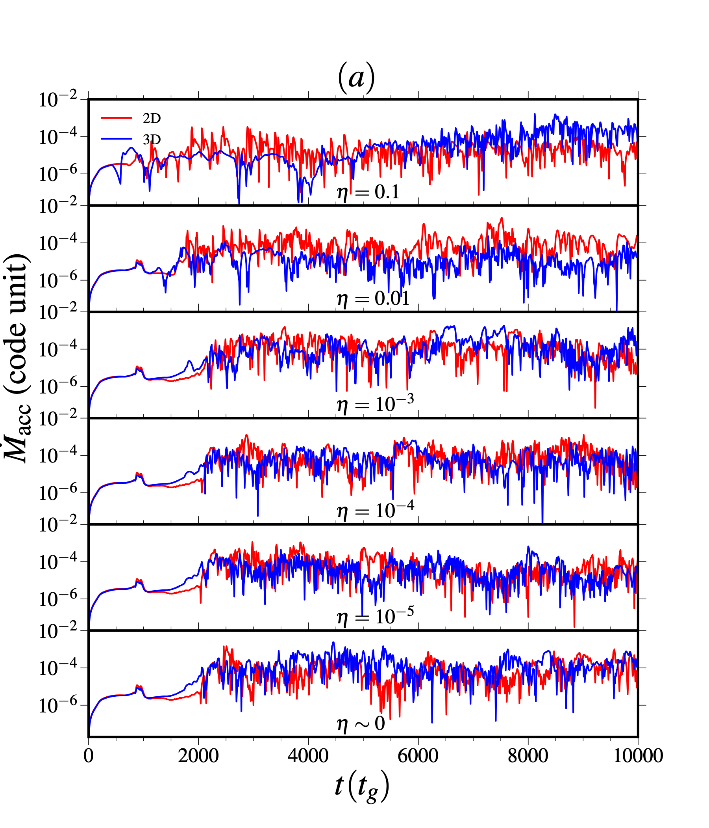
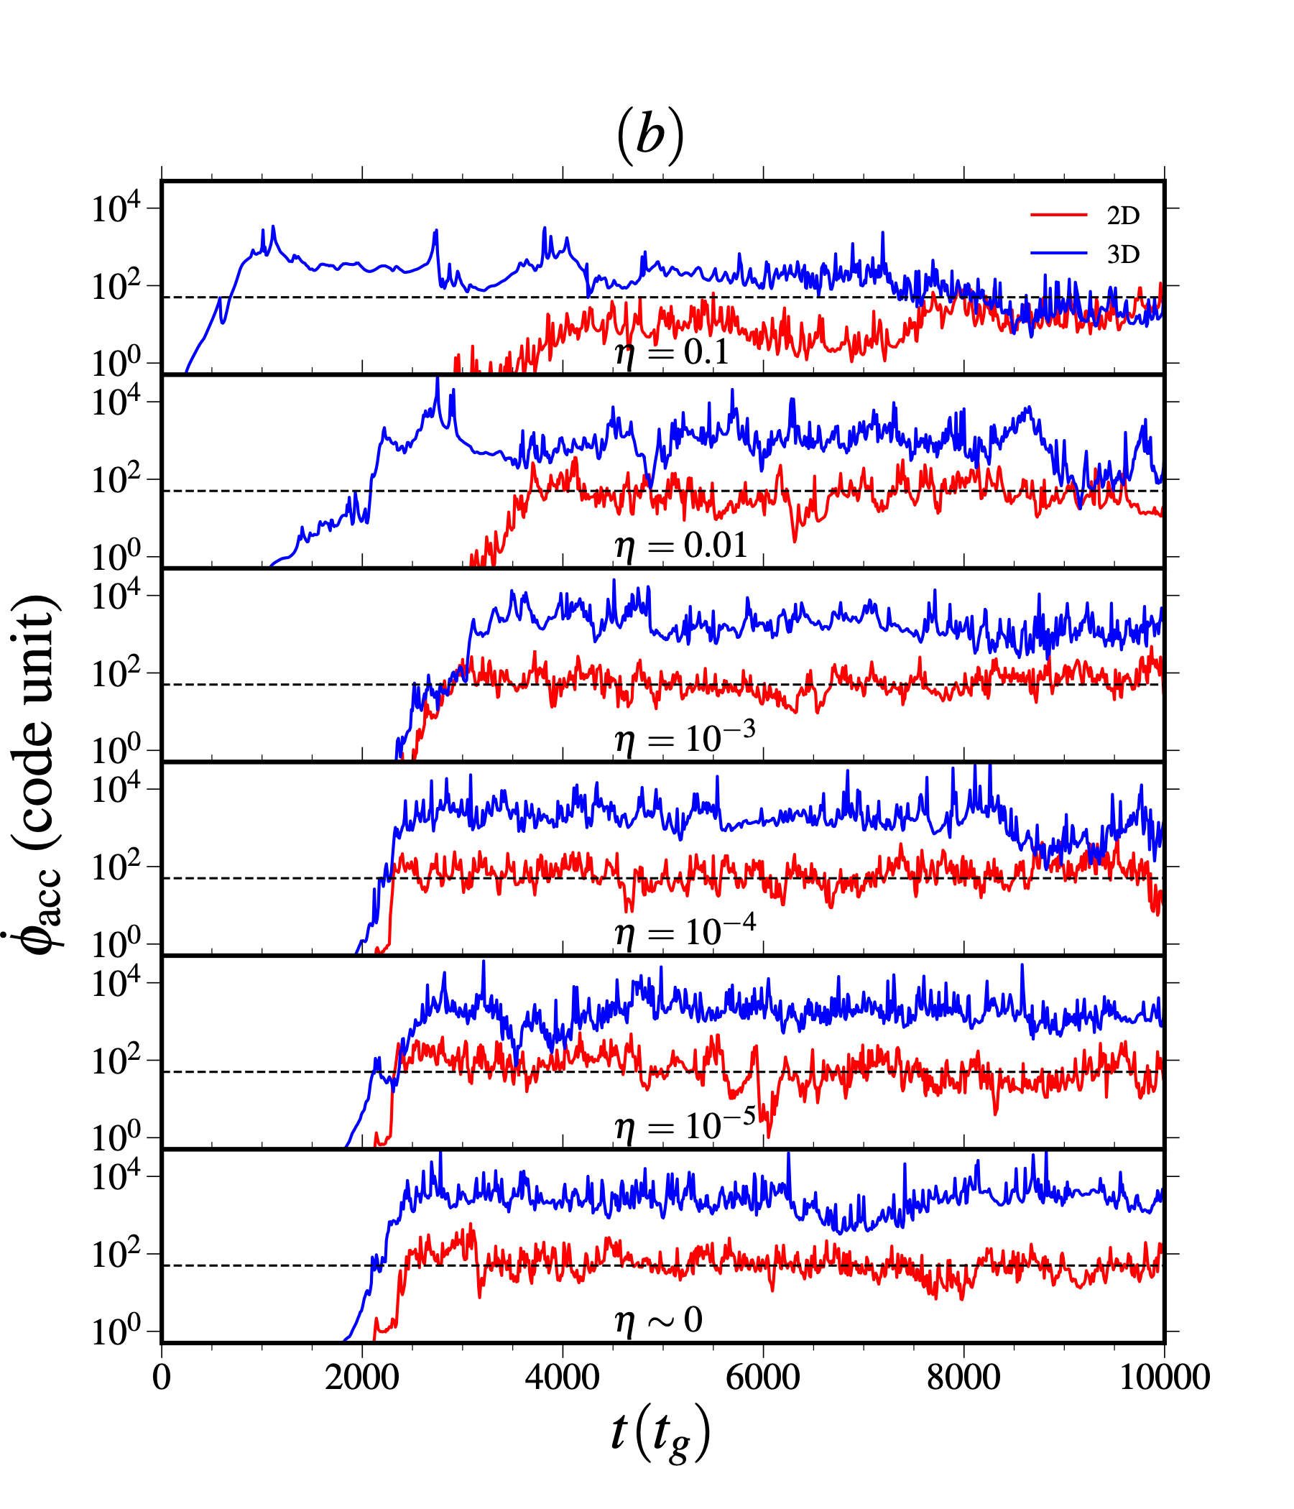
Comparison of 2D and 3D model
$${\overset{·}{Φ}}_{acc}=50$$
Mass accretion rate
MAD parameter
Mass accretion rate deviates for 3D model from 2D after initial time $t≥1000t_{g}$
due to non-axisymmetric effects.
We observe flux eruptions events.
All the models belong to MAD state.

Slide 14
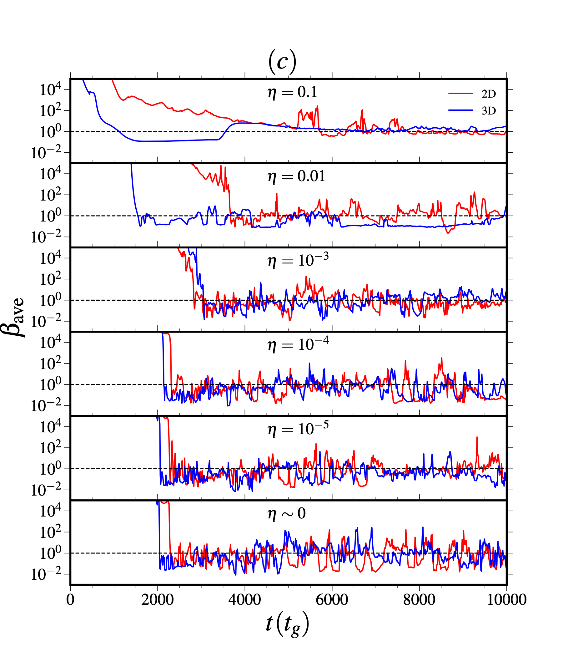
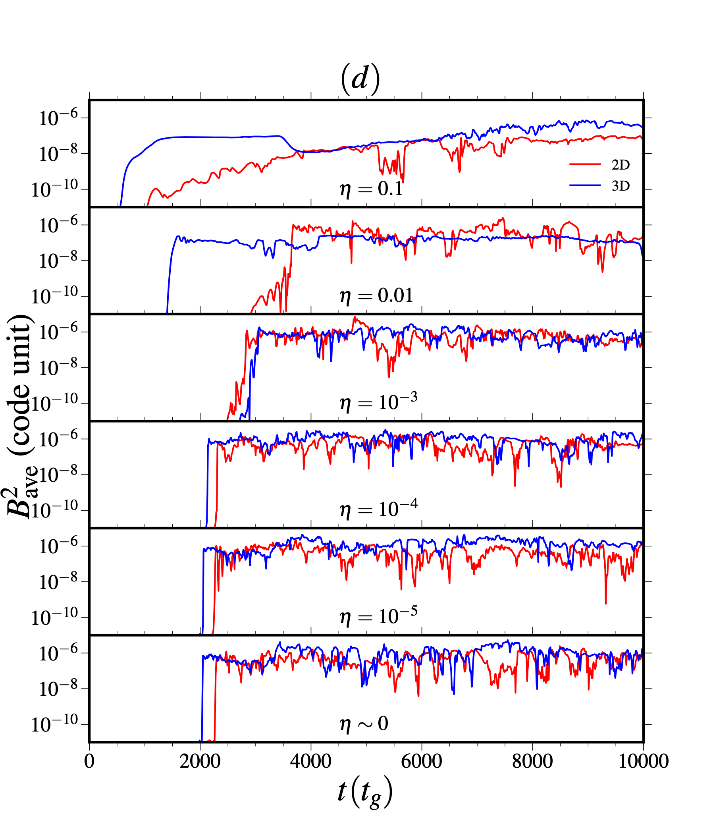
Alternate way to identify MAD state
$$β=\frac{2P_{gas}}{B^{2}}$$
Average plasma-beta
Magnetized energy
$$β=1$$
MAD state: $β_{ave}≲1$
magnetic pressure $≲$ gas pressure

Slide 15
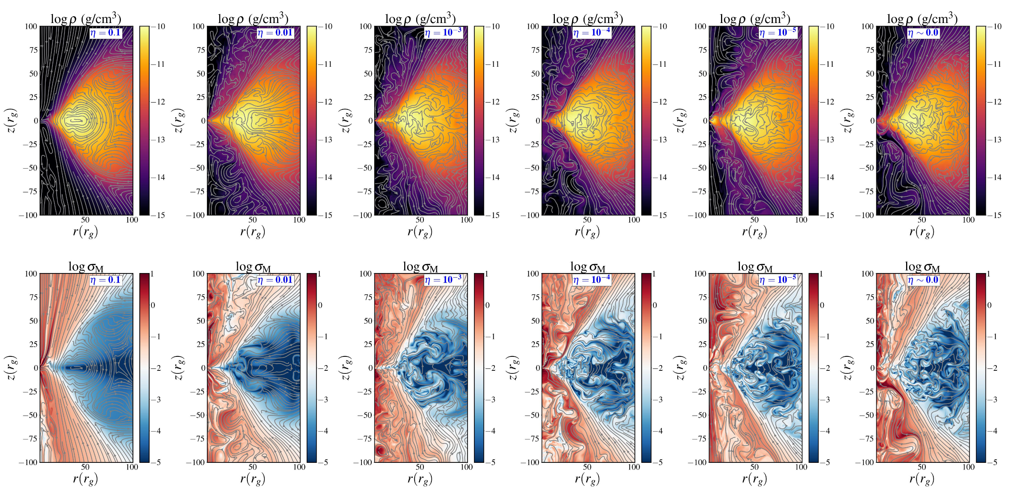
2D flow: density and magnetization distribution
$$t=8500t_{g}$$
$$σ_{M}=\frac{B^{2}}{ρ}$$
Reduce MRI turbulence in the higher resistive flow.
magnetization parameter is notably high in the jet region $σ_{M}≥10$.
(Ramiz, NTHU)

Slide 16
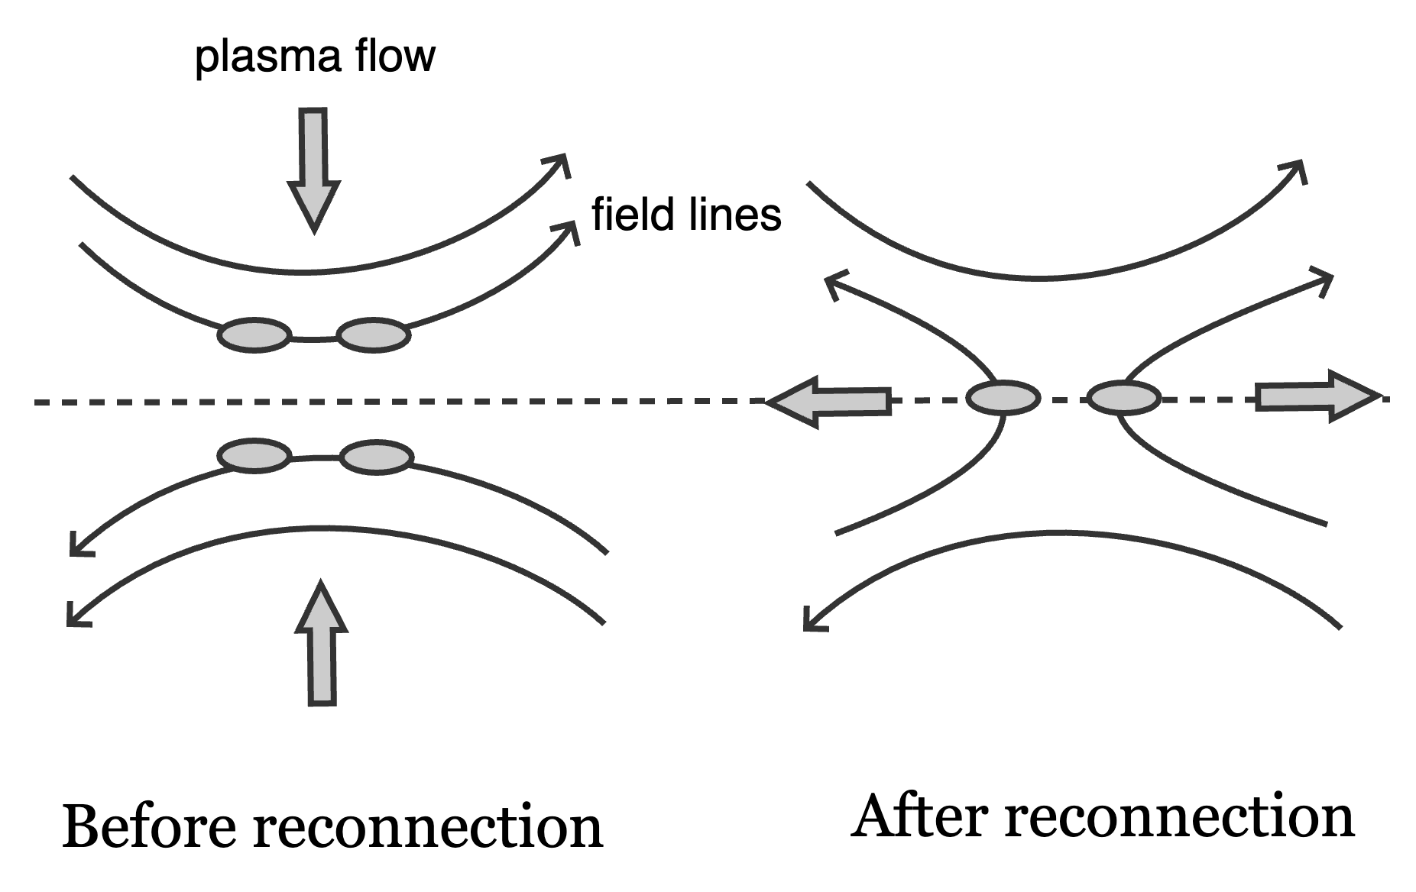
Magnetic Reconnection: Plasmoid formation
In a plasma, oppositely directed magnetic field lines are forced together when they get close enough the field lines can break and reconnect converting magnetic energy into kinetic energy and heat.
If the reconnection mechanism speeds up the plasma becomes unstable small and isolated regions of magnetic flux (plasmoids) are formed.
Schematic diagram of magnetic reconnection
(Ramiz, NTHU)

Slide 17
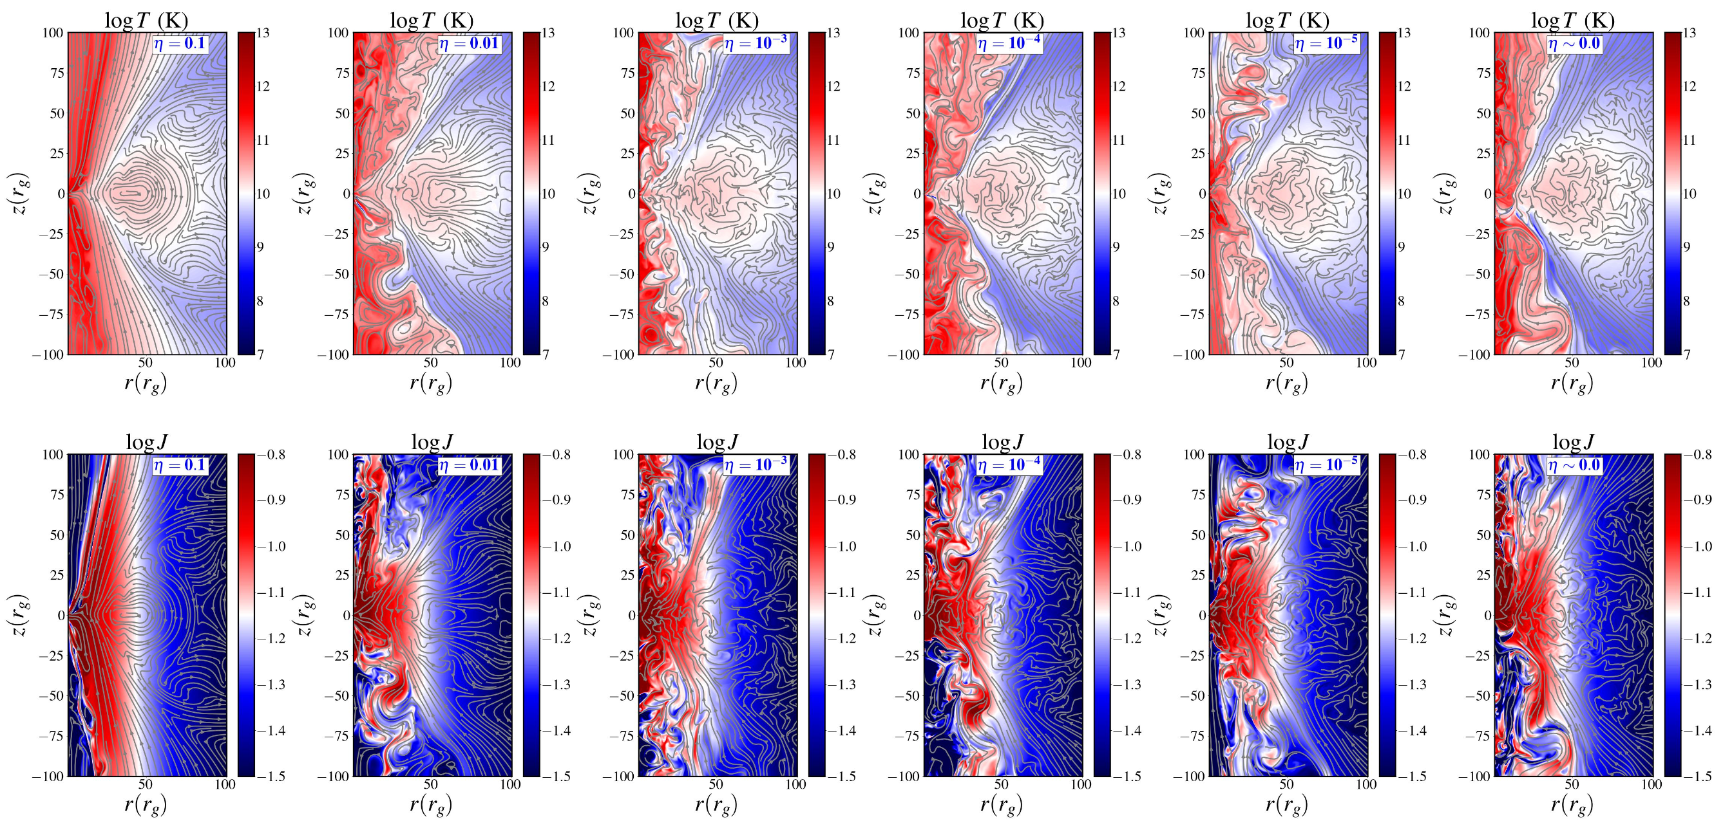
2D flow: temperature and current density distribution
$$t=8500t_{g}$$
plasmoids
Plasmoids are formed in low resistive flow $η≤{10}^{-2}$
Ripperda + (2020, 2022)
Current density is very high near the horizon for MAD state.
(Ramiz, NTHU)

Slide 18
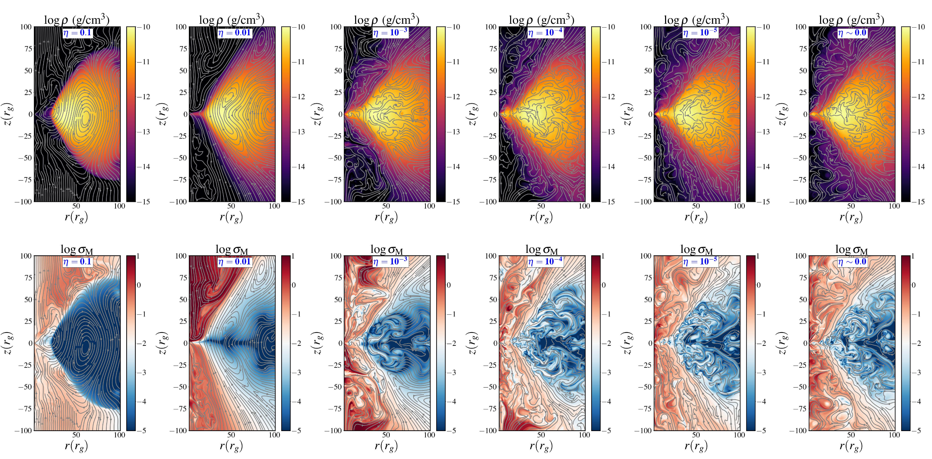
3D flow: density and magnetization distribution
$$t=8500t_{g}$$
$$ϕ=0$$
(Ramiz, NTHU)

Slide 19
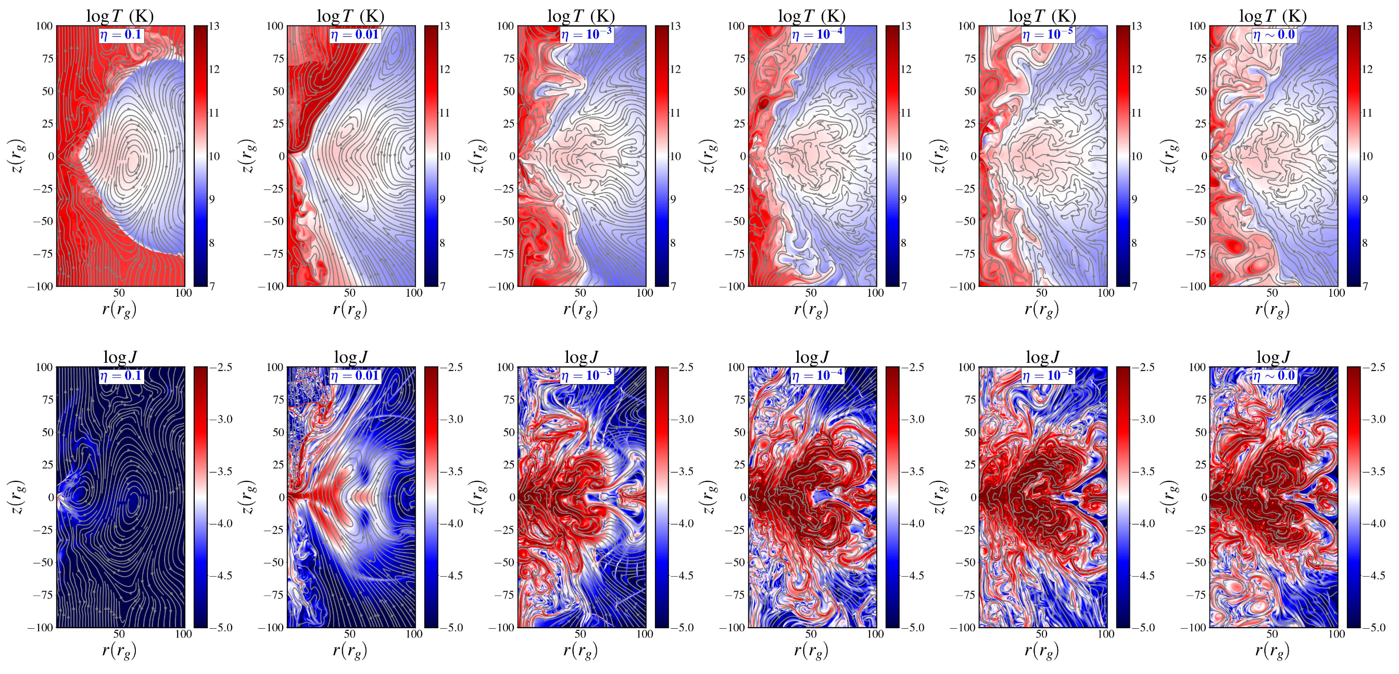
3D flow: temperature and current density distribution
$$t=8500t_{g}$$
(Ramiz, NTHU)

Slide 20
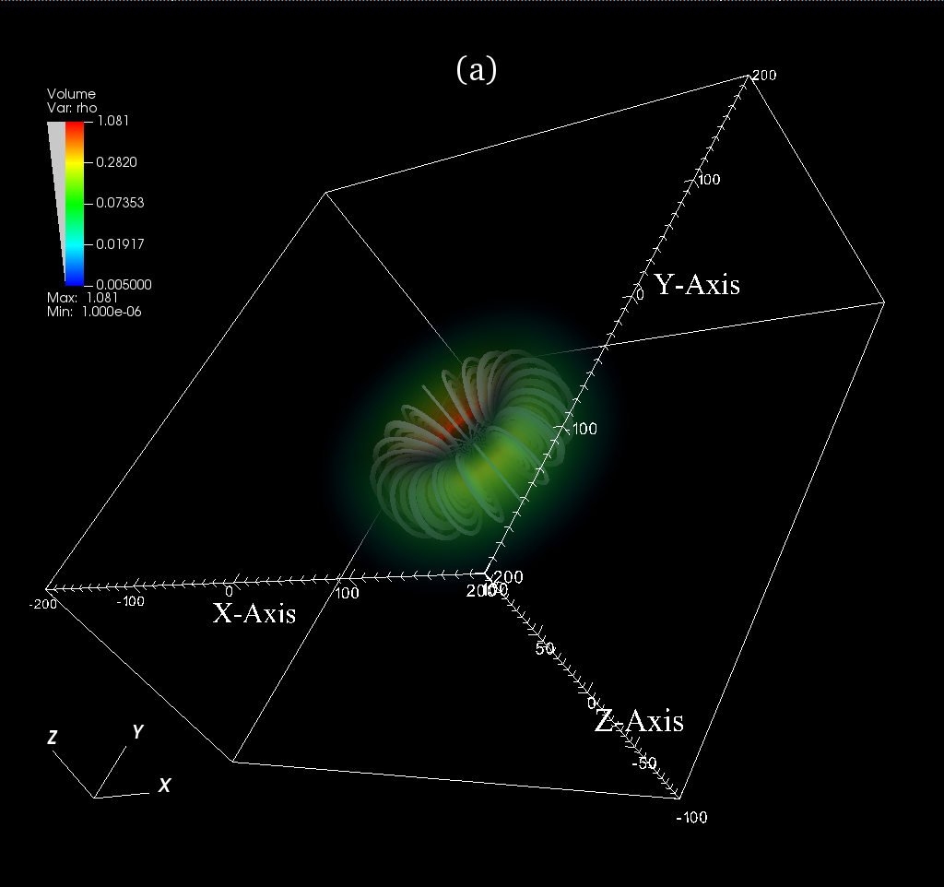
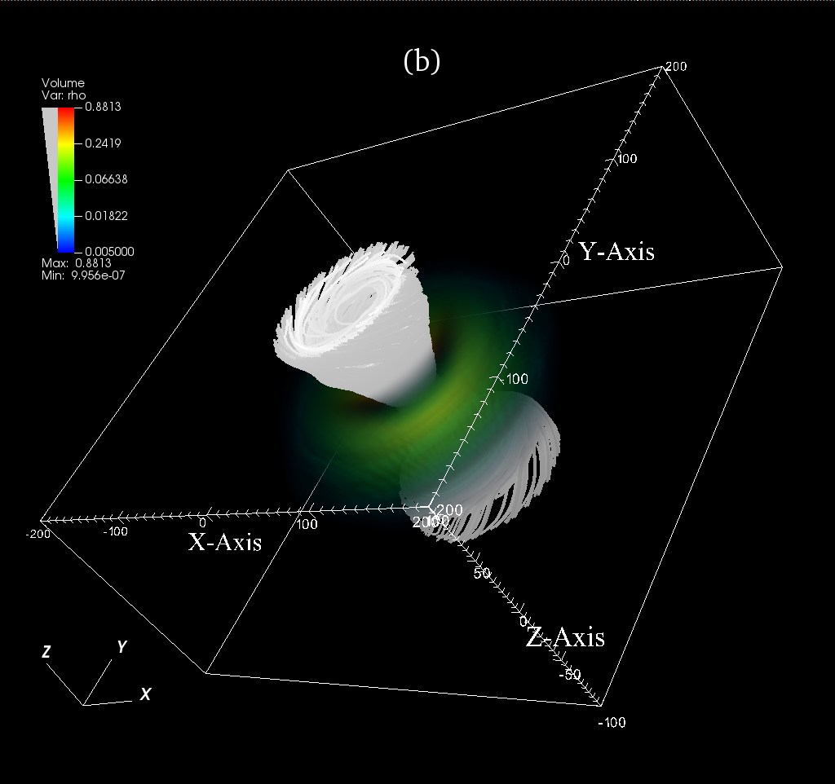
3D flow: magnetic field distribution
$$t=0t_{g}$$
$$t=8500t_{g}$$
(Ramiz, NTHU)

Slide 21
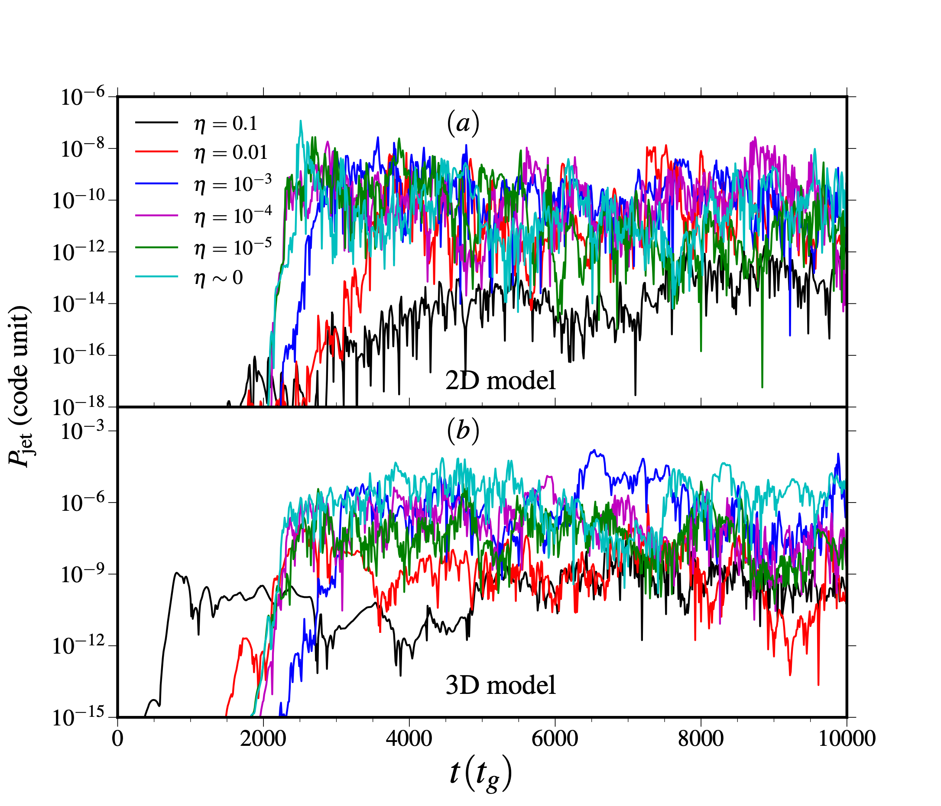
Jet power vs resistivity
Blandford & Zjanek (1977): BZ jet power:
Jet power is given by the eq (Tchekhovskoy + 2010, 2011):
$$P_{jet}=κϕ_{acc}^{2}Ω_{H}^{2}$$
Where, $κ$ depends on the geometry of the magnetic field.
$Ω_{H}=\frac{a_{k}}{2r_{H}}$; $r_{H}=1+\sqrt{1-a_{k}^{2}}$; $a_{k}$ is the spin of BH.
In our model $P_{jet}$ is only dependent on $ϕ_{acc}^{2}$ ; as $a_{k}$ is constant.
The average jet power is roughly two order of magnitude higher for low-resistivity flows compared to high-resistivity flows.
Vourellis + (2019)
Our simulation results reveal that jet power is significantly higher in low-resistivity flows compared to high-resistivity flows.
(Ramiz, NTHU)

Slide 22
Summary & Conclusions
We investigated the effect of resistivity on accretion flow dynamics (Res-MHD) around spinning AGNs.
We observed that MRI turbulence is reduced significantly for high resistivity flow.
We observed indications of plasmoid formations in low-resistivity flow compared to high-resistivity flow.
Our findings suggest that low-resistivity models produce higher power jets compared to those with higher resistivity.
We requires extreme resolution and adaptive mesh refinement (AMR) to effectively resolve thin current sheets and plasmoids in our models.
We will investigate plasmoid formation in resistive accretion flow. Possible explanation of flaring events in SgrA*!
(Ramiz, NTHU)

Slide 23
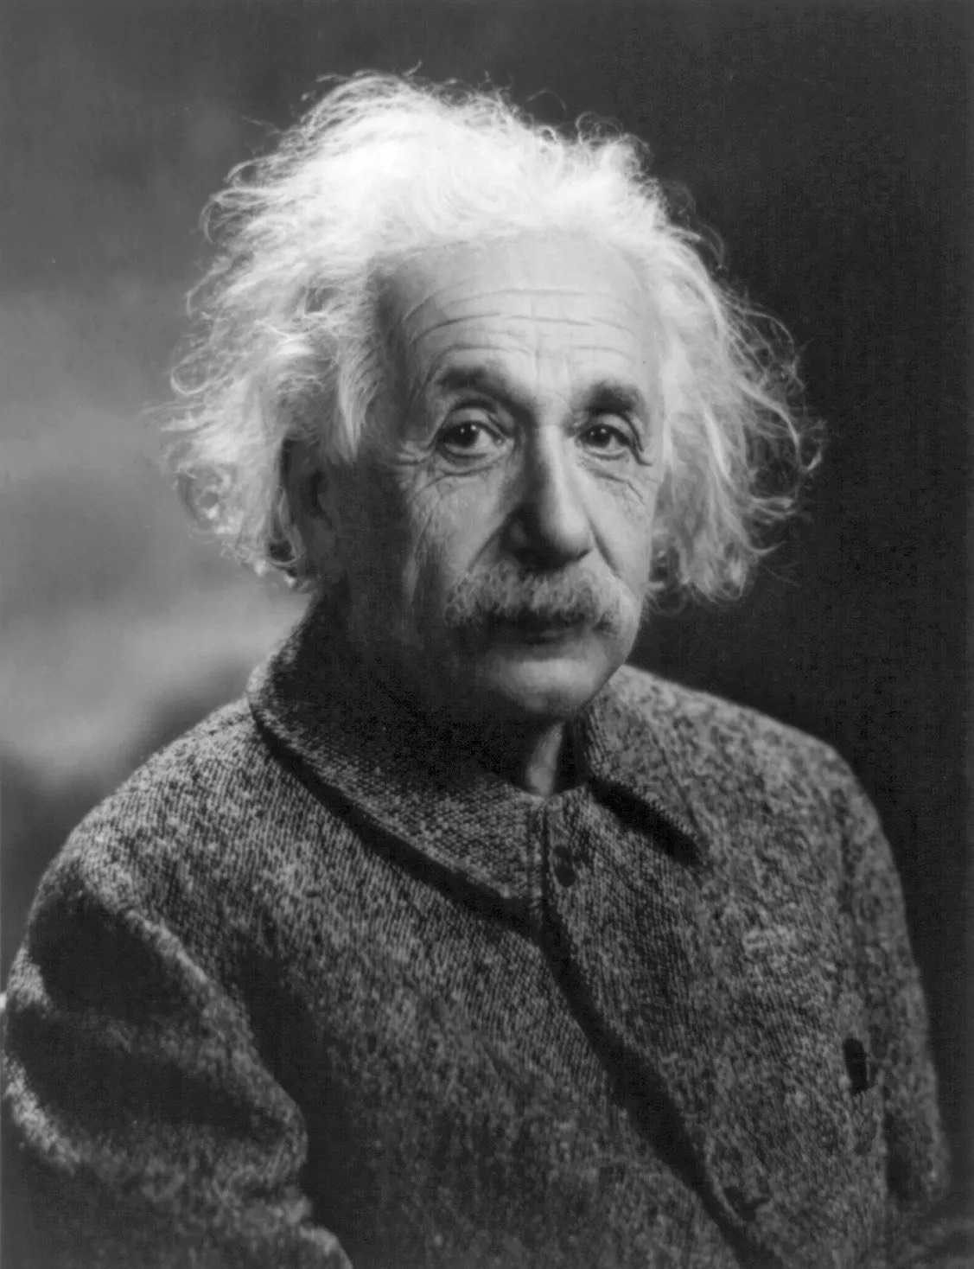
MAD vs SANE!
Unique $≡$ MAD
Normal $≡$ SANE
Thanks!
(Ramiz, NTHU)

