Slide 1
Brown dwarf number density in the JWST COSMOS-Web field
Amos Y.-A. Chen
Tomo Goto, Cossas K.-W. Wu, Chih-Teng Ling, Seong Jin Kim,
Simon C.-C. Ho, Ece Kilerci, Yuri Uno, Terry Long Phan,
Yu-Wei Lin, Tsung-Ching Yang, Tetsuya Hashimoto
Accepted for publication in Publications of the Astronomical Society of Australia

Slide 2
Brown Dwarfs
${}_{}^{1}H$ fusion
6000 K
(BDs)
${}_{}^{2}H$ fusion
<2500 K
${}_{}^{7}{Li}$ fusion
Credit: Wikipedia
Notes:
Not massive enough for Hydrogen fusion.
But it can still ignite deuterium fusion. Some massive ones can even have Lithium fusion.
They are the bridge between stars and planets.
Finding more brown dwarfs can help us improve the understanding of the low mass end of the IMF.

Slide 3
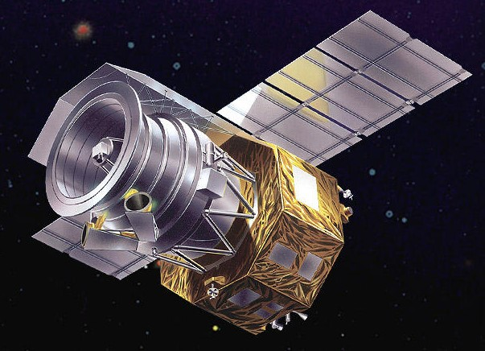
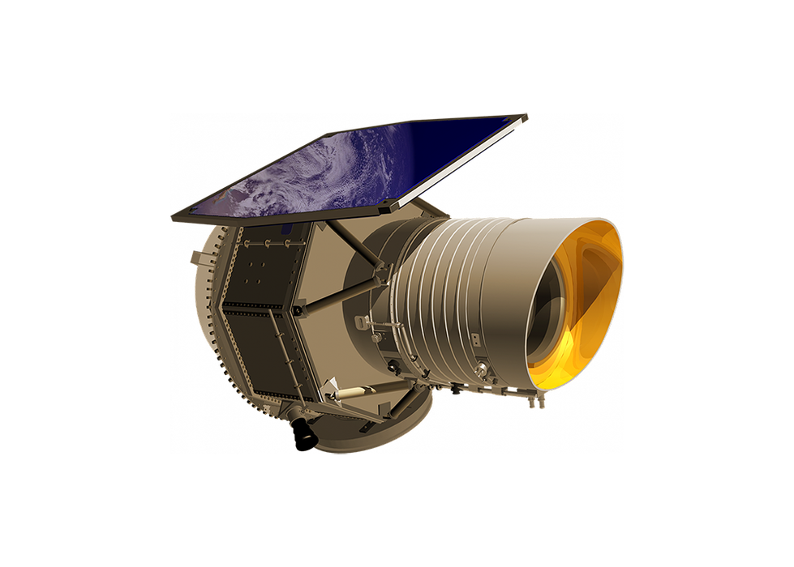
Motivation
Sketch of different surveys in the side view of the Milky Way.
WISE
AKARI
Previous search radius $\sim 20$pc
Position of our Sun
ESA
Notes:
animation, enlarge circle, color
Previous IR surveys found hundreds of brown dwarfs in the neighbourhood of our solar system.
The typical distance of brown dwarfs identified by AKARI and WISE is around 20 pc.

Slide 4
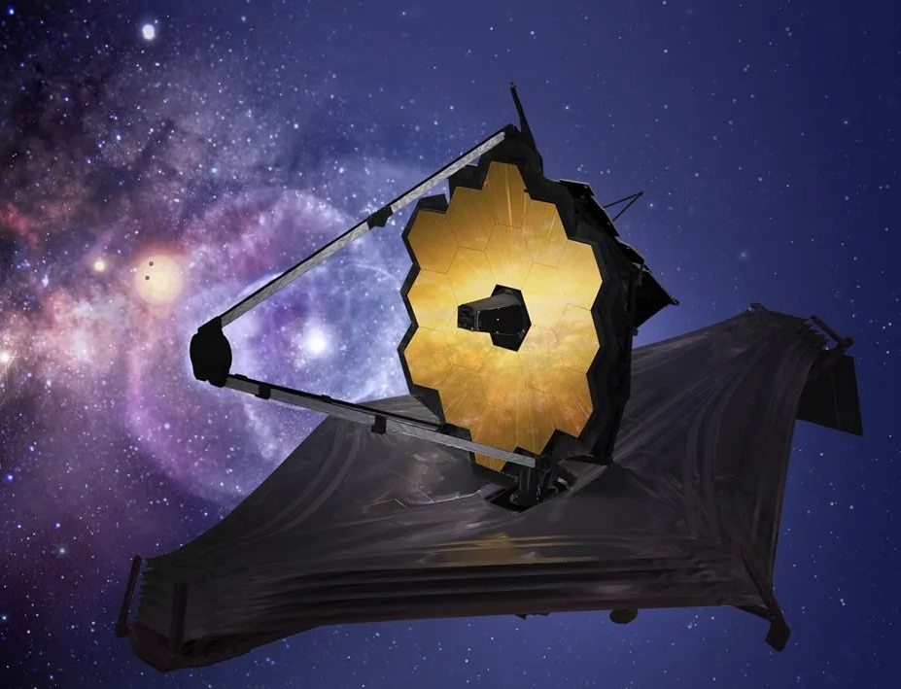
Motivation
JWST
Sketch of different surveys in the side view of the Milky Way.
Our search radius,
$\sim 4$ kpc
Position of our Sun
ESA
Notes:
animation, enlarge circle, color
Previous IR surveys found hundreds of brown dwarfs in the neighbourhood of our solar system.
The typical distance of brown dwarfs identified by AKARI and WISE is around 20 pc.

Slide 5
Motivation
JWST
Notes:
With powerful JWST, we can find BDs at kpc scales, even those BDs outside the thick disk.
This means we are able to probe the BD density in the galaxy scale.

Slide 6
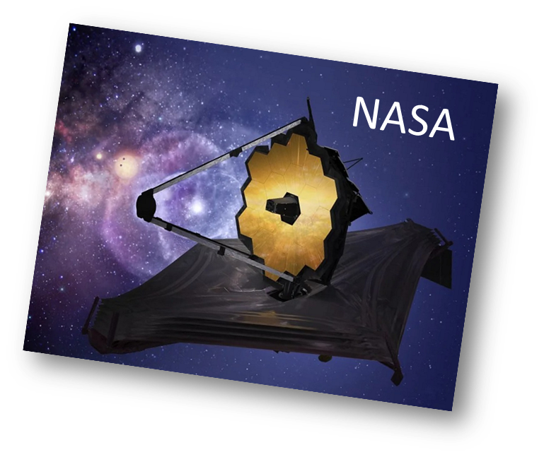
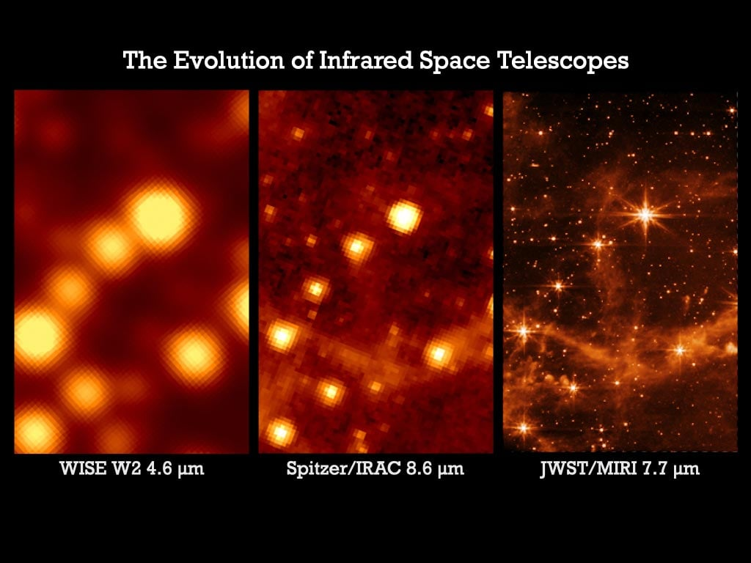
James Webb Space Telescope
JWST
Near Infrared Camera:
$1∼5 μ$m
6.5-meter mirror
Resolution:
$30$ mas
Credit: Andras Gaspar

Slide 7
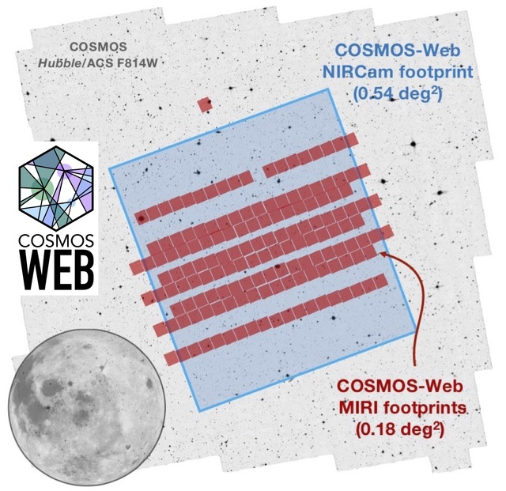
COSMOS-Web field
Brown Dwarfs are rare: a large field is needed!
4 NIRCam filters: $1∼4μm$
COSMOS-Web DR0.5 is 9 times larger than the CEERS field. Expect to find lots of brown dwarfs!
Credit: COSMOS-Web webpage
Notes:
show ceers, bd is rare
Cycle 1 JWST treasury program
It is the largest JWST survey field covered with 4 near IR filters.
We downloaded the public data release 0.5, which contains half of the total footprints.
DR0.5 is 9 times larger than other JWST deep field surveys, like ceers and jades.

Slide 8
Method
JWST catalog
113,456
Color criteria
$→$120
Point source criteria
$→$43
SED best-fit with BD models
Cross-match with COSMOS2020
Spectral Energy Distribution (SED)
new BD candidates
Notes:
Process of the sample selection.
start from 4um, crossmatch to make catalog

Slide 9
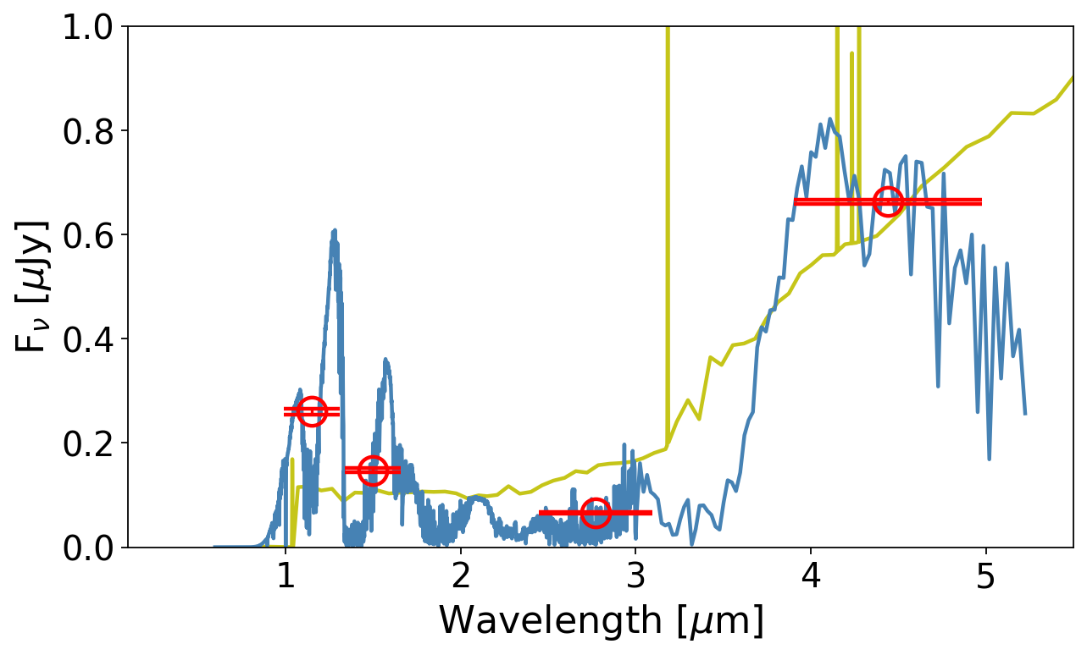
Spectrum properties
Galaxy SED model
Observed flux
Flux [$μ$Jy]
BD SED model
Notes:
Why color, speed and easy.
Here I show how colour selections work.

Slide 10
Spectrum properties
Low effective temperature
Galaxy SED model
Flux [$μ$Jy]
BD SED model
Notes:
Why color, speed and easy.
Here I show how colour selections work.

Slide 11
Spectrum properties
Galaxy SED model
Faint in optical
Flux [$μ$Jy]
BD SED model
Notes:
Why color, speed and easy.
Here I show how colour selections work.

Slide 12
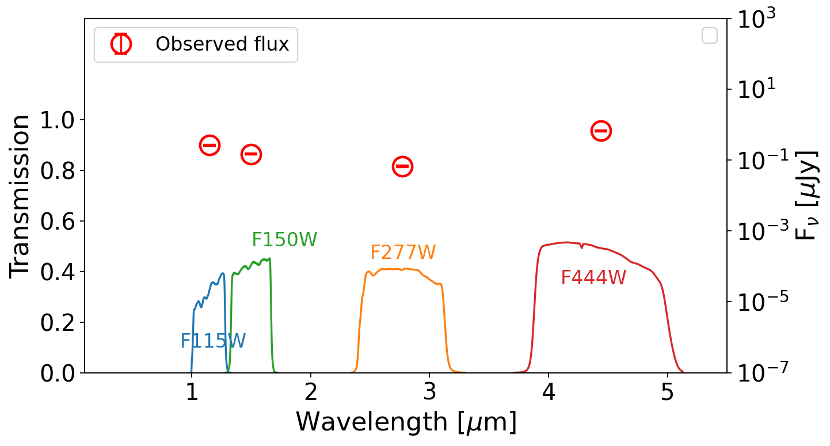
Selection Criteria: Colors
Notes:
Add cartoon explanation
We set the colour criteria based on 3 BD models.

Slide 13
Selection Criteria: Colors
Notes:
Add cartoon explanation
We set the colour criteria based on 3 BD models.

Slide 14
Method
JWST catalog
113,456
Color criteria
$→$120
Point source criteria
$→$43
SED best-fit with BD models
Cross-match with COSMOS2020
new BD candidates
Notes:
Process of the sample selection.
start from 4um, crossmatch to make catalog

Slide 15
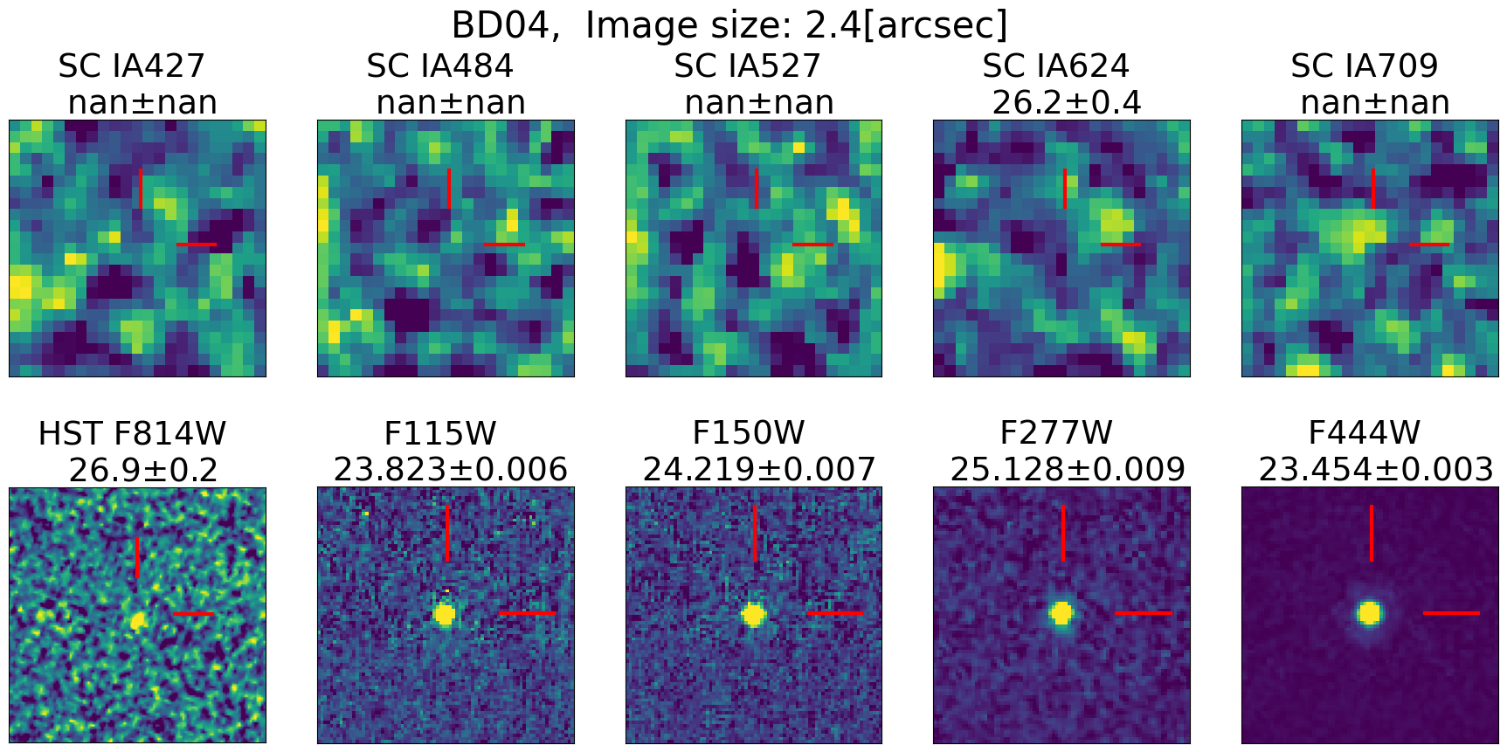
Cross-match with COSMOS2020 catalog
SUBARU/SC
HST/ACS
JWST/NIRCam
Notes:
After removing extended sources, we cross-match the selected sources with the COSMOS2020 catalogue.
Increase photometry data points (Subaru and HST) and remove known galaxies.
2 galaxies with Subaru detections are removed.
3 most brightest candidates are detected by HST, and we measure their proper motions ranging from 12~17 km/s

Slide 16
Cross-match with COSMOS2020 catalog
An example of a source matched with a galaxy.

Slide 17
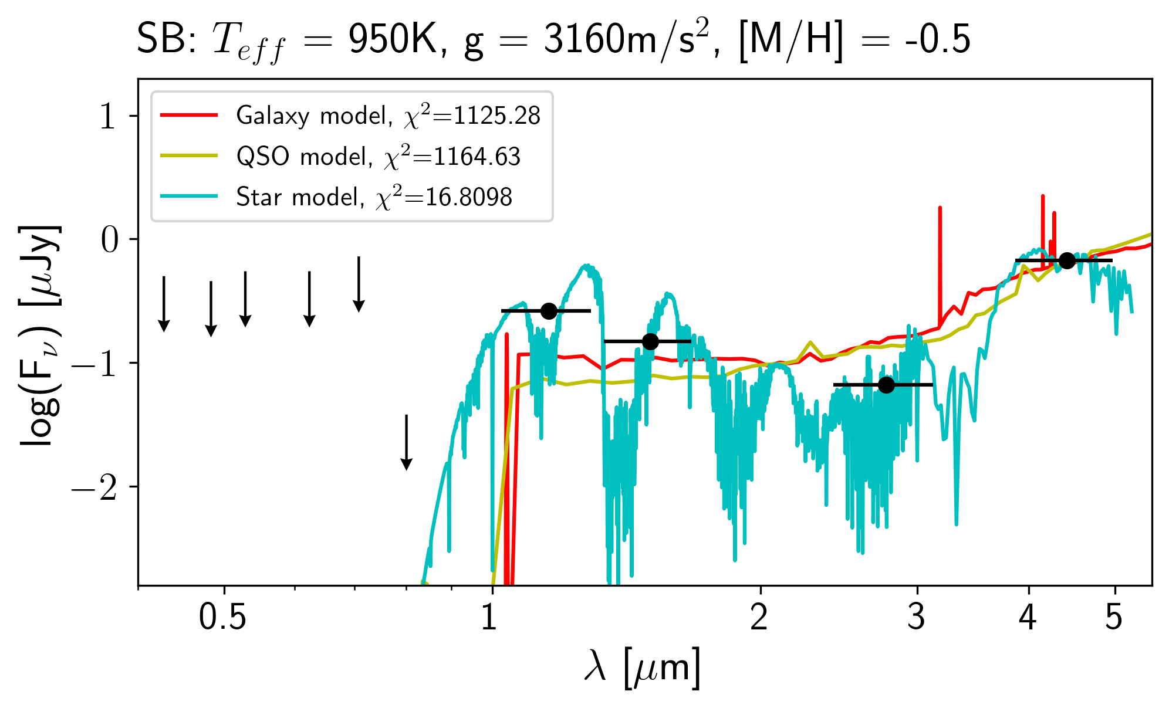
Cross-match with COSMOS2020 catalog
JWST/NIRCam
Subaru
HST/ACS
Notes:
Then we conduct SED fittings with Lephare, a SED fitting software. Those best fitted with 3 BD models over the galaxy models are BD candidates.
For most sources, we fit with 10 photometric points.

Slide 18
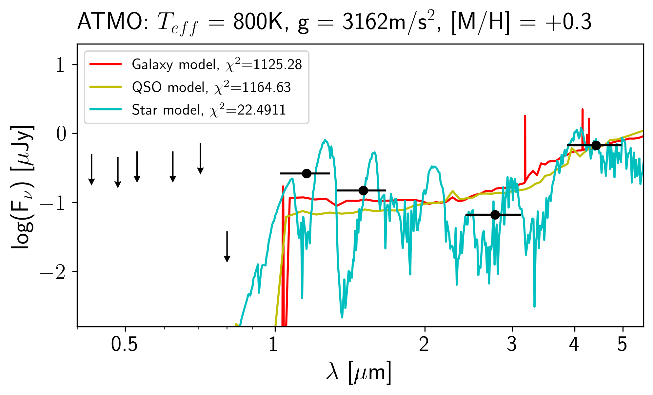
Cross-match with COSMOS2020 catalog
JWST/NIRCam
Subaru
HST/ACS
Notes:
Then we conduct SED fittings with Lephare, a SED fitting software. Those best fitted with 3 BD models over the galaxy models are BD candidates.
For most sources, we fit with 10 photometric points.

Slide 19
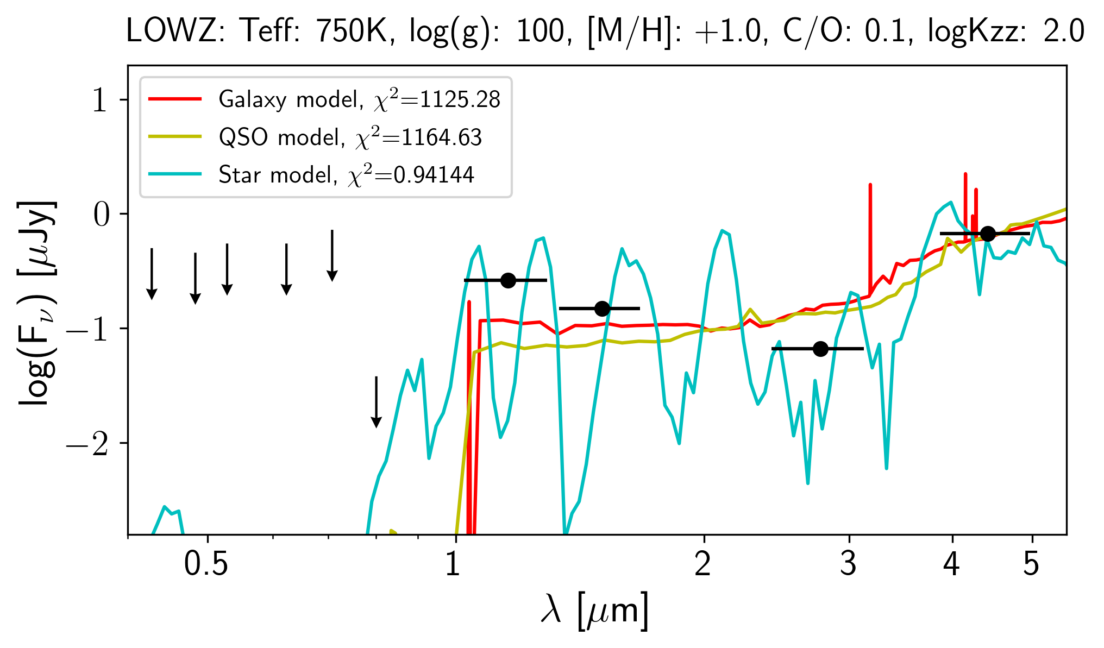
Cross-match with COSMOS2020 catalog
JWST/NIRCam
Subaru
HST/ACS
Notes:
Then we conduct SED fittings with Lephare, a SED fitting software. Those best fitted with 3 BD models over the galaxy models are BD candidates.
For most sources, we fit with 10 photometric points.
10 sources removed by SED fitting.

Slide 20
Method
JWST catalog
113,456
Color criteria
$→$120
Point source criteria
$→$43
SED best-fit with BD models
Cross-match with COSMOS2020
27 new BD candidates
Notes:
Process of the sample selection.
start from 4um, crossmatch to make catalog

Slide 21
Notes:
compare the colors
explain temperatue?
700 one

Slide 22
Notes:
serveal convincing sed
temp histogram

Slide 23
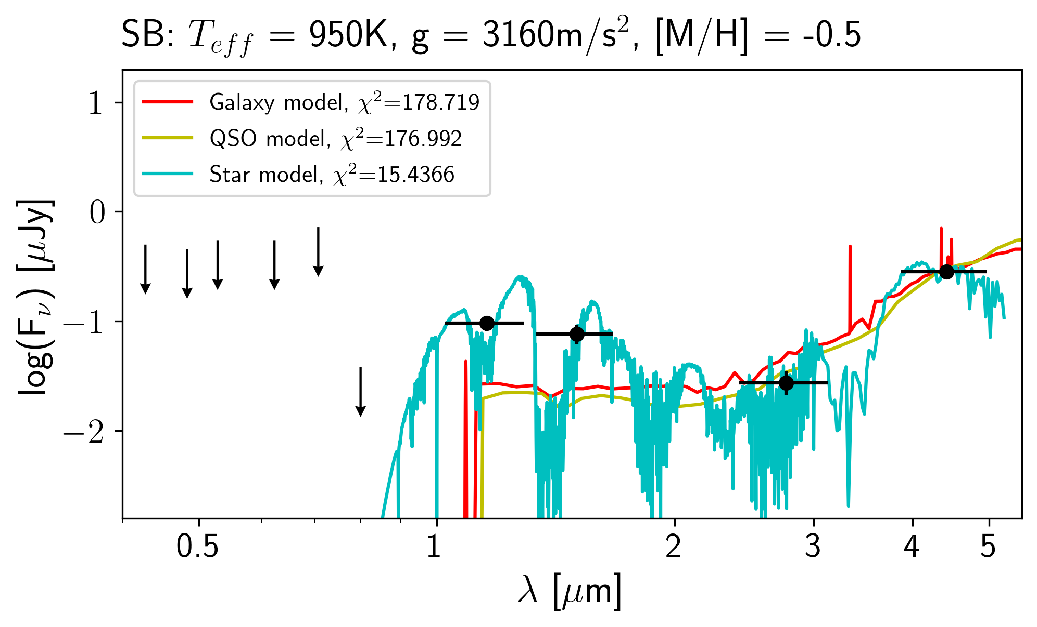
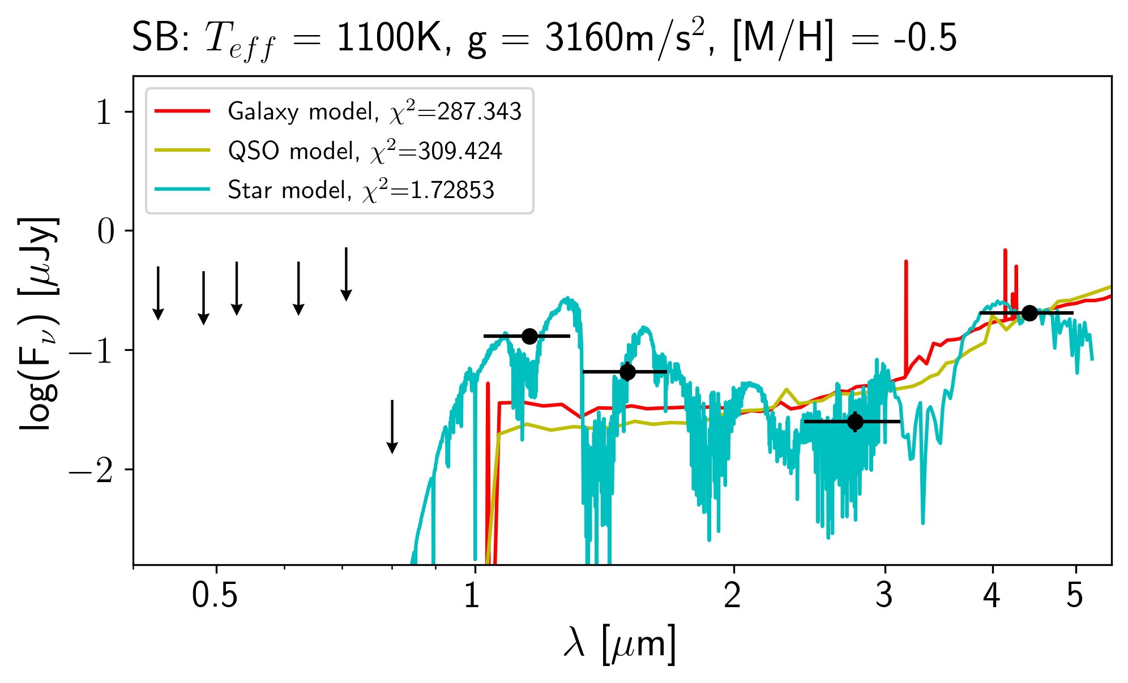
Results

Slide 24
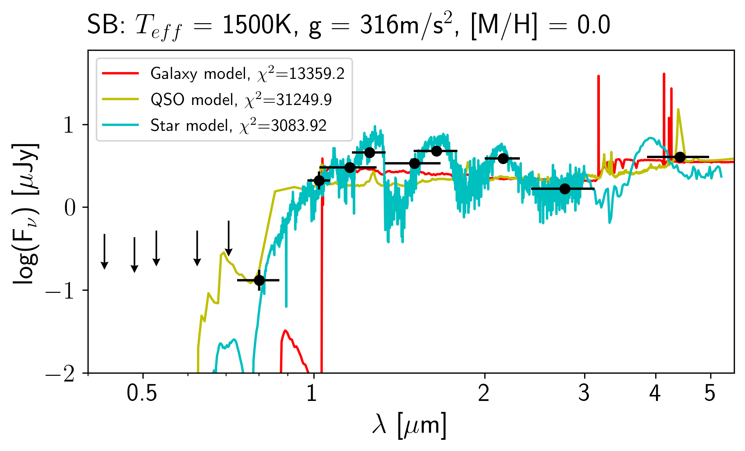
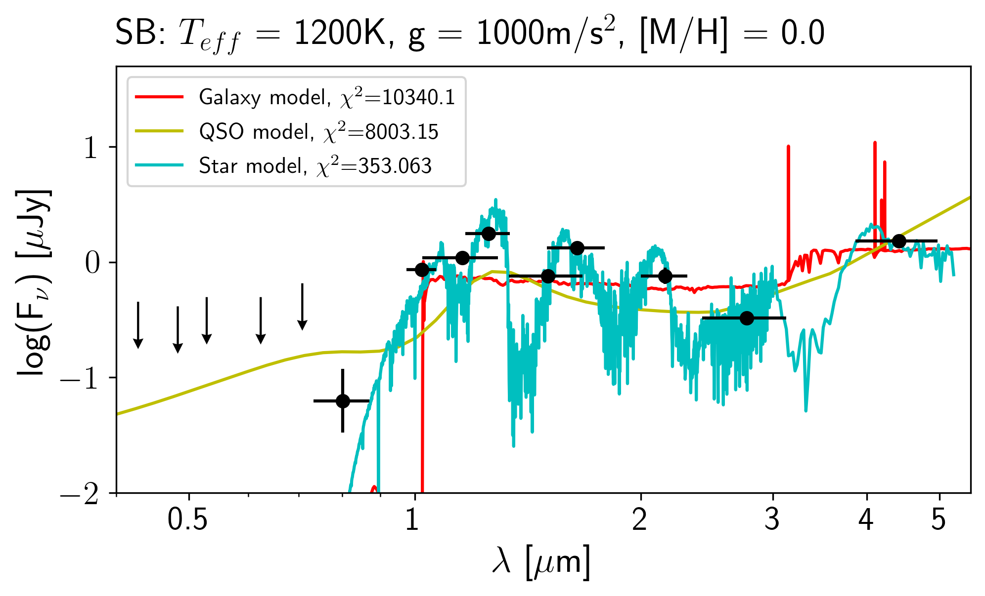
Results

Slide 25
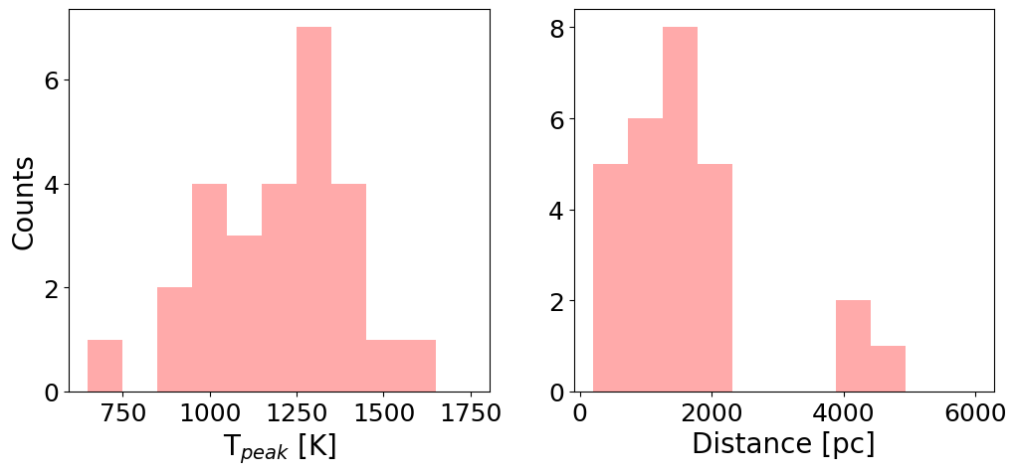
Results

Slide 26
Results
BDs found before 2021
Distances$∼20$ pc.
WISE
Notes:
1.1 um
legend box
emphasize cosmos field

Slide 27
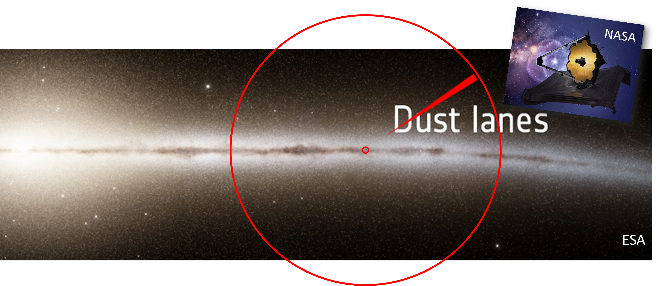
COSMOS-Web field
COSMOS-Web field
JWST

Slide 28
Results
JWST found BDs
Distances up to $4400$ pc.
JWST
WISE
Notes:
1.1 um
legend box
telescope image

Slide 29
Summary
We found 27 new distant BD candidates. Most previous searches found BDs within a range of 20 pc. We found BDs at 470~4400 pc!
We are able to probe the BD distribution even out of the galactic thick disk.
JWST spectroscopic follow-up is necessary.

Slide 30
Backups

Slide 31
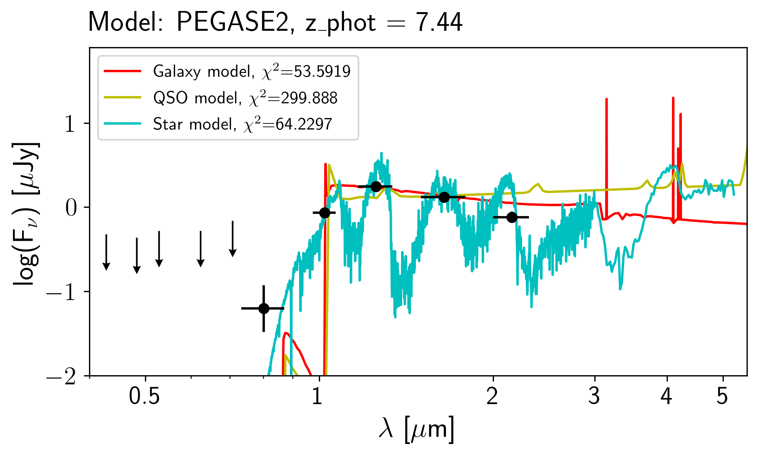
Cross-match with COSMOS2020 catalog
HST/ACS
UltraVISTA
JWST/NIRCam
Classified as a galaxy in COSMOS2020.
Notes:
The top 3 brightest candidates were also detected by Uvista.
With 9 band detections, it is obvious that they are brown dwarfs.
It is worth noticing that without JWST observations, one source was classified as a galaxy in the COSMOS2020.

Slide 32
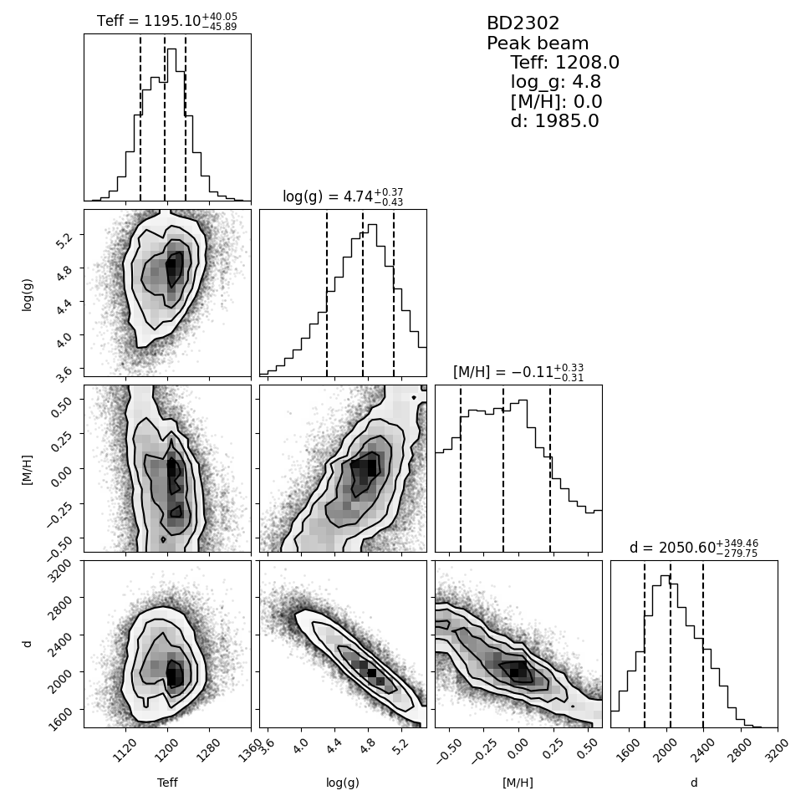
MCMC fittings

Slide 33
Selection Criteria: Point sources
SExtractor parameters
CLASS_STAR
FLUX_RADIUS
SPREAD_MODEL

Slide 34
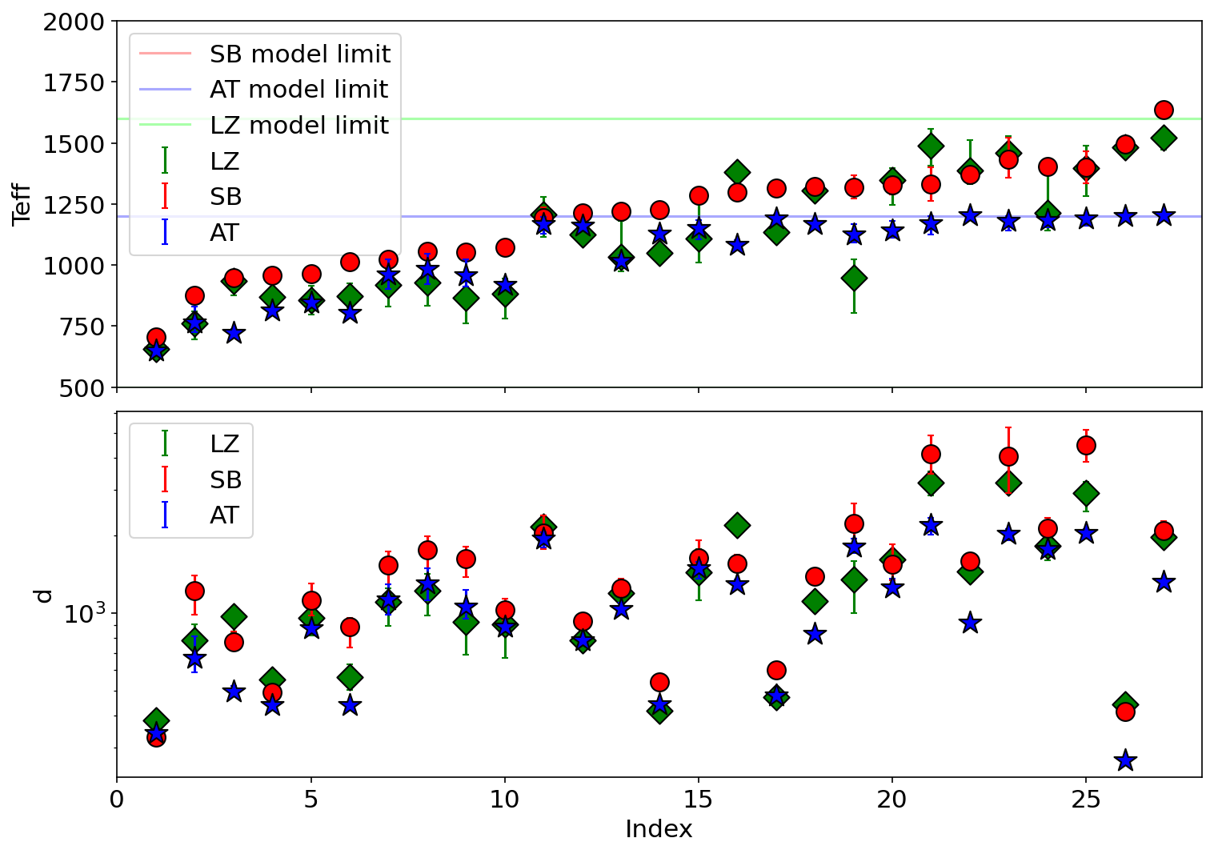
Results
3 Brown Dwarf models used for SED and MCMC fitting:
LOWZ
Sonora-Bobcat
ATMO2020++

Slide 35
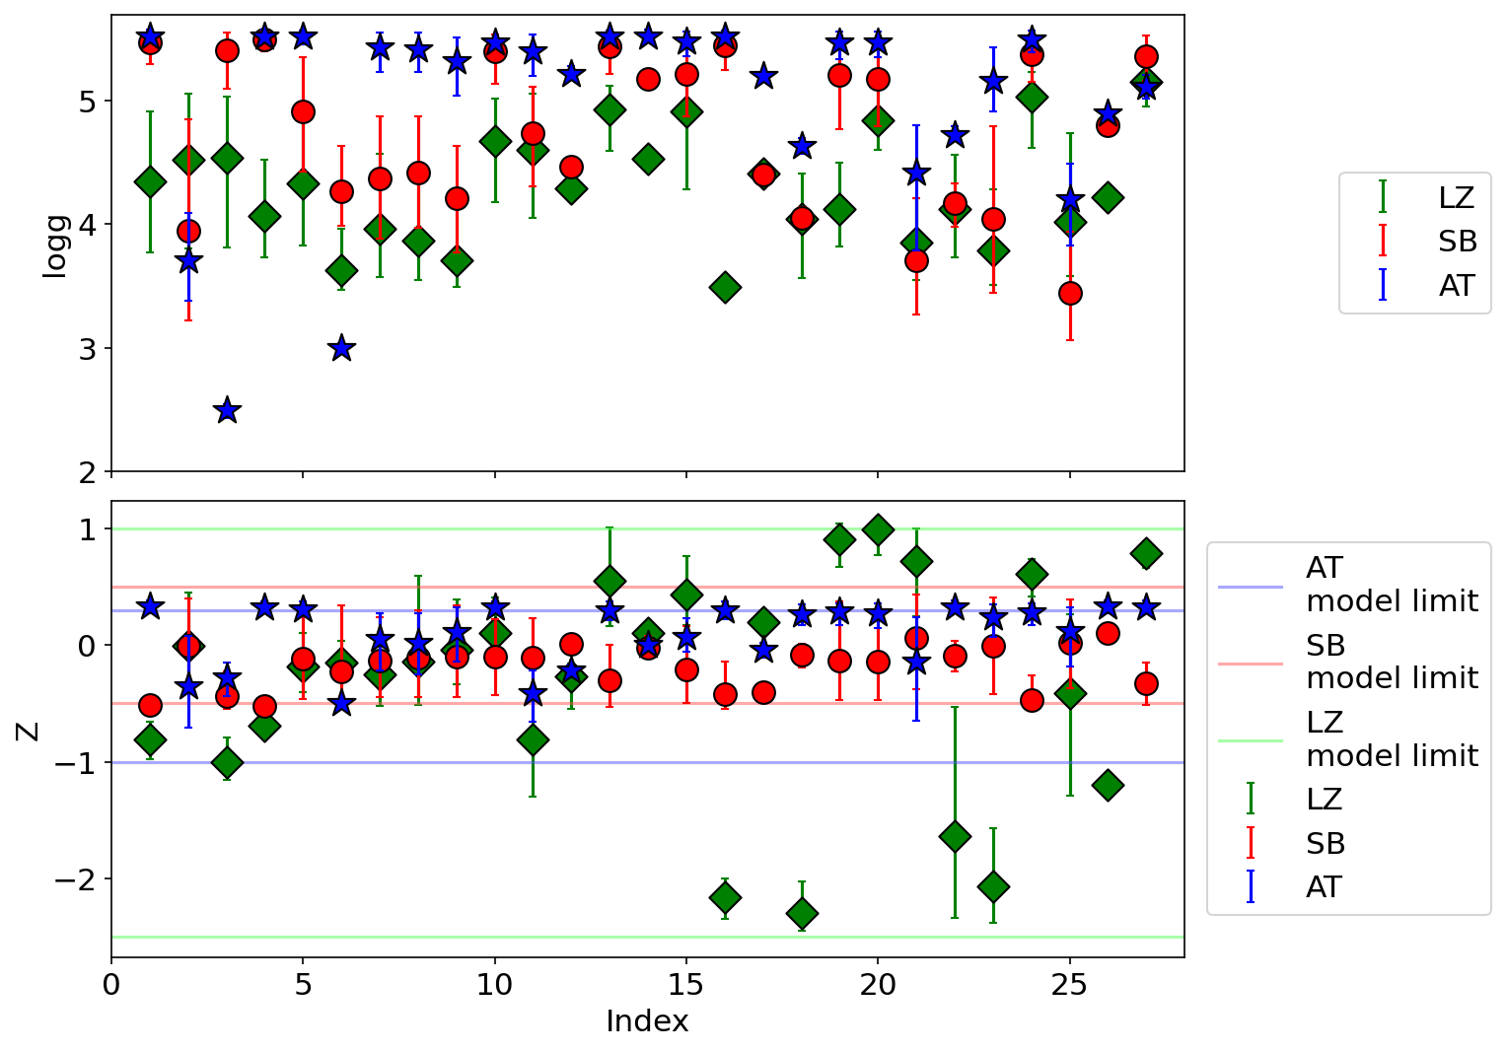
Results
3 Brown Dwarf models used for SED and MCMC fitting:
LOWZ
Sonora-Bobcat
ATMO2020++

Slide 36
Stellar distribution model
Local BD density

Slide 37
Mass function
?
Number of stars
Brown Dwarf mass range
Mass of the star [$M_{⊙}$]
Notes:
simple figure.

Slide 38
Mass function
Source: Wikipedia
$$N×dm$$
Number of stars in $m+dm$
Mass of the star [$M_{⊙}$]

Slide 39
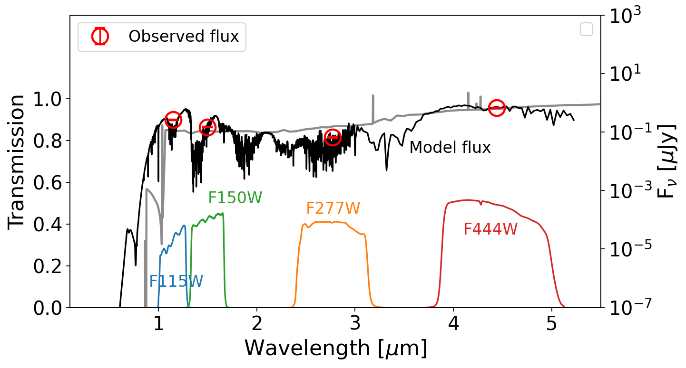
Spectrum properties
Observed flux
Galaxy SED model
BD SED model
Flux [Jy]
Transmission
Notes:
Why color, speed and easy.
Here I show how colour selections work.

Slide 40
Spectrum properties
Low effective temperature
Flux [Jy]
Transmission
Notes:
Filters. Observations. SED. Absorptions. V-shaped SED. galaxies.

Slide 41
Spectrum properties
Faint in optical
Flux [Jy]
Transmission
Notes:
No optics. Similar to high-z galaxies.

