Slide 1



Machine Learning on Gravitational Wave Sky Localization: GW-SkyLocator
Chih-Yi Chang¹, Jheng-Min Chen², Chayan Chatterjee³, Lupin C. C. Lin⁴, Yi-Sheng Huang⁴, Albert Kong¹, Yi Yang²
¹National Tsing Hua University, Taiwan. ²National Yang Ming Chiao Tung University, Taiwan. ³Vanderbilt University, USA. ⁴National Cheng Kung University, Taiwan.
Notes:
Author, cooperator , institute

Slide 2
Outline
Multi-Messenger Astronomy
Data Generation
Machine Learning Method
Result
Summary & Future Work

Slide 3
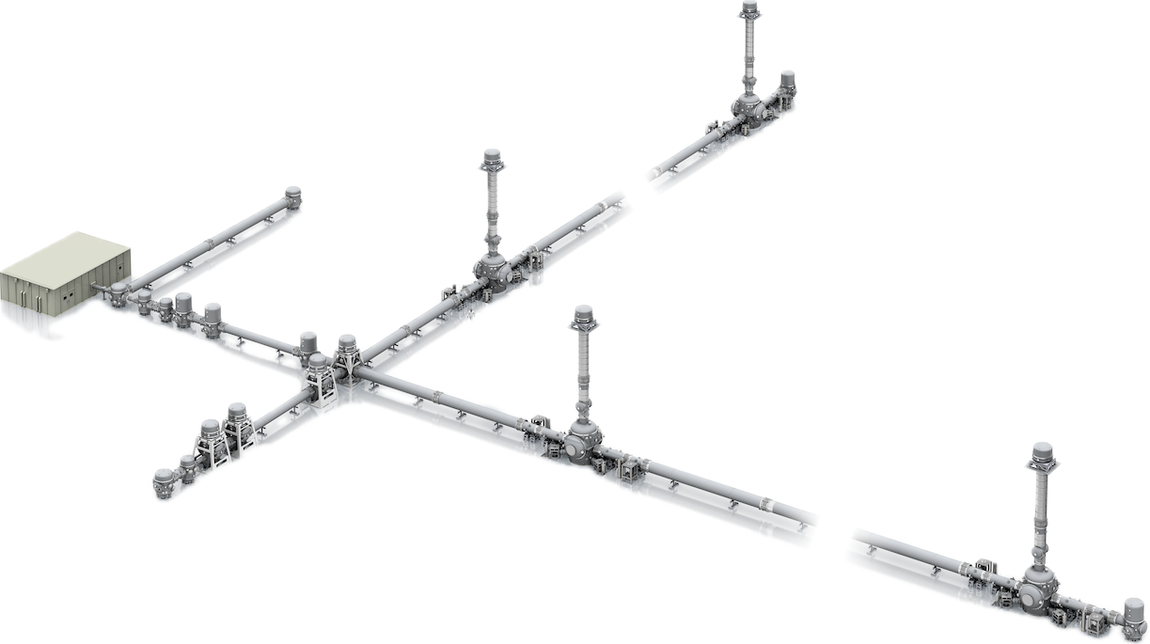
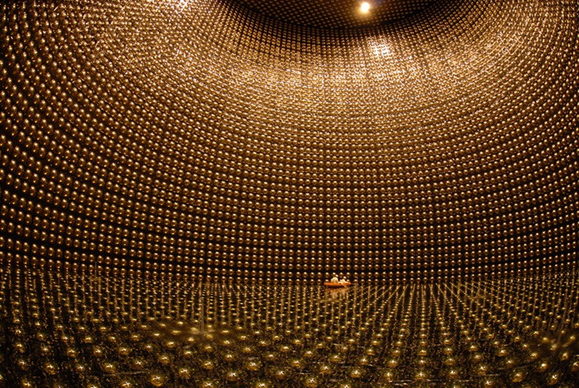
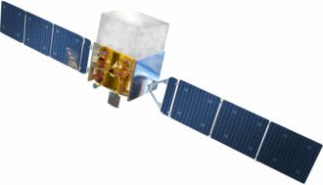
Motivation
Multi-Messenger Astronomy
Gravitational Wave
Neutrino
EM wave
Notes:
Multi-messenger astronomy =>BNS event => sky localization => low latency or negative latency
GW170817

Slide 4
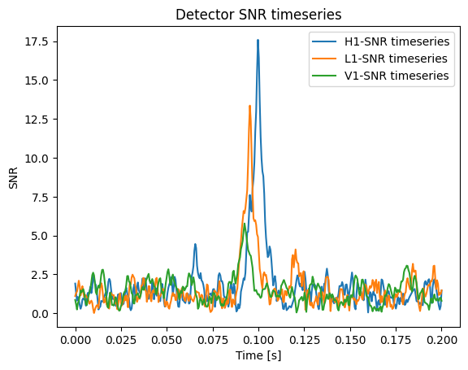
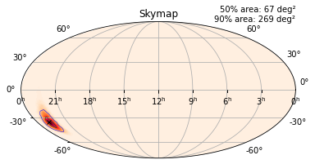
GW-SkyLocator
Gravitational Wave
Rapid Parameters Estimation
Bayestar
GW-SkyLocator
Dingo
Notes:
Pipeline output => low latency search pipeline => skymap output
Give the advantage or special of gw-skylocator and difference of ML and byestar

Slide 5
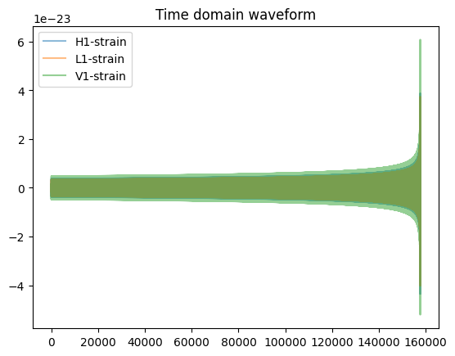
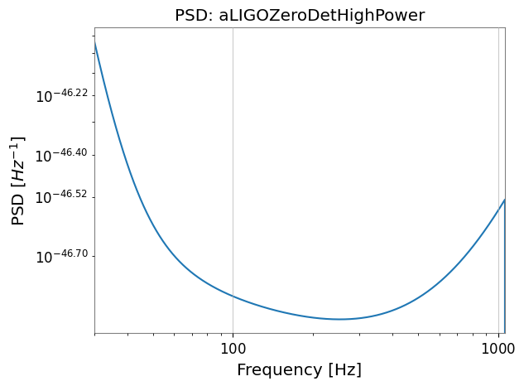

Data generation
Sample parameters
Time domain CBC waveform
Detector waveforms
Matched
filtering
$$Projection$$
Detector strain
Final SNR timeseries
Detector PSD
Detector background noise
Template waveform

Slide 6
Consistency check
The parameter space is the same as the prior distribution
For the larger SNR timeseries, the maximum peak is at the same time as the injection time
The time difference between different detectors is smaller than light travel time.

Slide 7
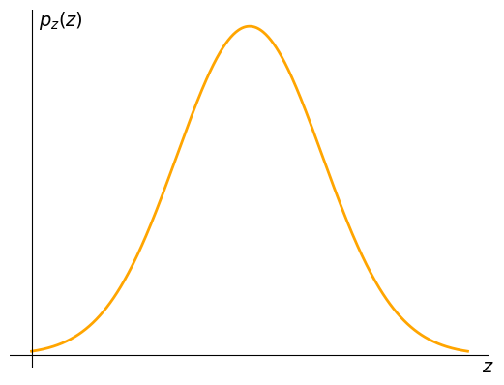
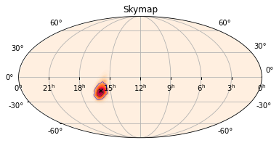
Method
SNR
Timeseries
model Architecture
Real part:
Amplitude ratio
Time difference
Imag part:
Phase difference
Dense layer
Dense layer
Dense layer
Dense layer
Feature Vector
Normalizing
flow
Notes:
Definition of loss function

Slide 8
Method
SNR
Timeseries
model Architecture
Real part:
Amplitude ratio
Time difference
Imag part:
Phase difference
Preprocess
Dense layer
Dense layer
Dense layer
Dense layer
Feature Vector
Normalizing
flow
Notes:
Definition of loss function

Slide 9
Method
SNR
Timeseries
model Architecture
Real part:
Amplitude ratio
Time difference
Imag part:
Phase difference
Dense layer
Dense layer
Dense layer
Dense layer
Feature Vector
Normalizing
flow
Notes:
Definition of loss function

Slide 10
Method
SNR
Timeseries
model Architecture
Real part:
Amplitude ratio
Time difference
Imag part:
Phase difference
Dense layer
Dense layer
Dense layer
Dense layer
Distribution Transformation
Feature Vector
Normalizing
flow
Notes:
Definition of loss function

Slide 11
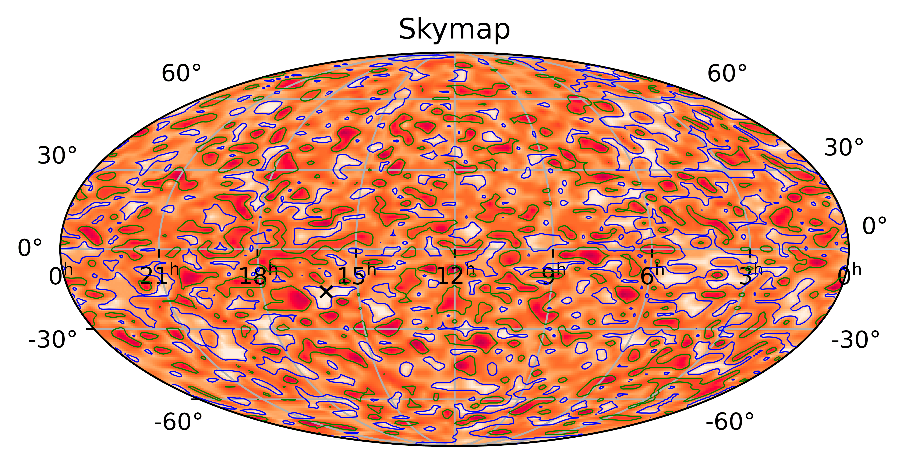
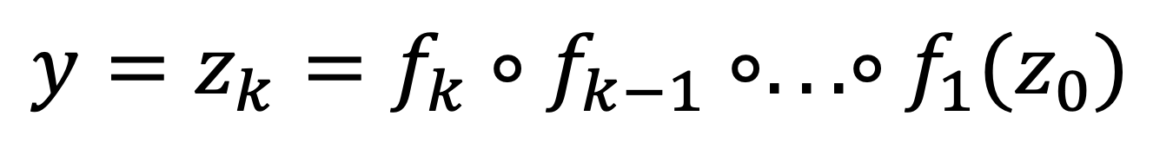
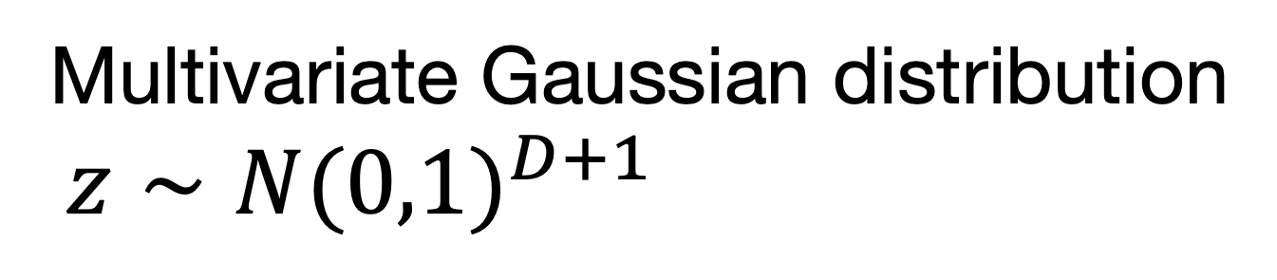
Method
Decoder: normalizing flow
Multivariate Gaussian distribution
$z∼N(0,1)^{D+1}$
$$y=z_{k}=f_{k}∘f_{k−1}∘...∘f_{1}(z_{0})$$
Notes:
Show the animation of nf about how to transform distribution
Detail of variable

Slide 12
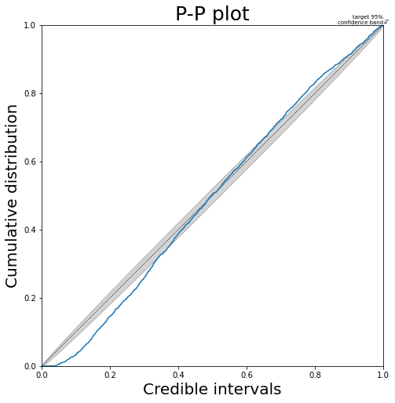
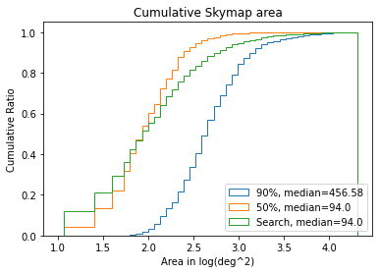
Result
Simulated BNS event
Notes:
P-P plot label, character can be larger
Provide more details by description
Why the bias exist.

Slide 13
Summary & Future work
The machine learning method can achieve the low-latency search
Problem:
Bias in low credible intervals: uncertainty of distribution is too small
Tune the parameter of the model
Modify model architecture
Change loss function
Future work:
Get a good result on GW170817
Increase more detector
Negative latency search

Slide 14
Board Number: 76

Slide 15
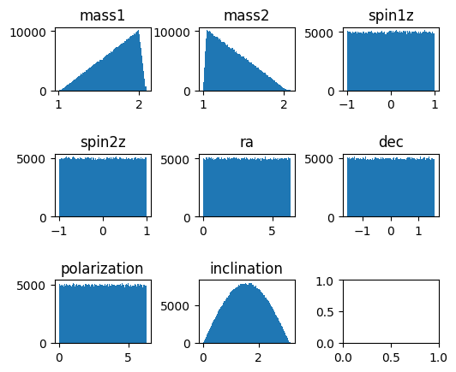
Apppendix
Parameter Space

