Slide 1
Two Possible Optical--X-Ray Anti-Correlations of PSR J1023+0038
Ka-Yui Au,^{1★} Kwan-Lok Li,¹ Albert K. H. Kong,² Jumpei Takata,³ Chung-Yue Hui,⁴ Lupin C. C. Lin¹
¹Department of Physics, National Cheng Kung University, Tainan City 70101, Taiwan ²Institute of Astronomy, National Tsing Hua University, Hsinchu 30013, Taiwan ³Department of Astrophysics, School of Physics, Huazhong University of Science and Technology, Wuhan 430074, People’s Republic of China
⁴Department of Astronomy and Space Science, Chungnam National University, Daejeon 34134, Republic of Korea

Slide 2
Outline
Introduction
Motivation
Results

Slide 3
Millisecond Pulsars (MSPs)
Actually evolve from long spin period to short spin period.
A recycling scenario: MSPs were in binaries with a donor star. The accretion from the companion in the binary system transfers the angular momentum to accelerate the spin period and turn off the pulsar activities.
We call it a Low-Mass X-ray Binary (LMXB) like system (or claim accretion-powered state).
Accreting pulsar binary (https://point-of-no-23.livejournal.com/1161561.html)

Slide 4
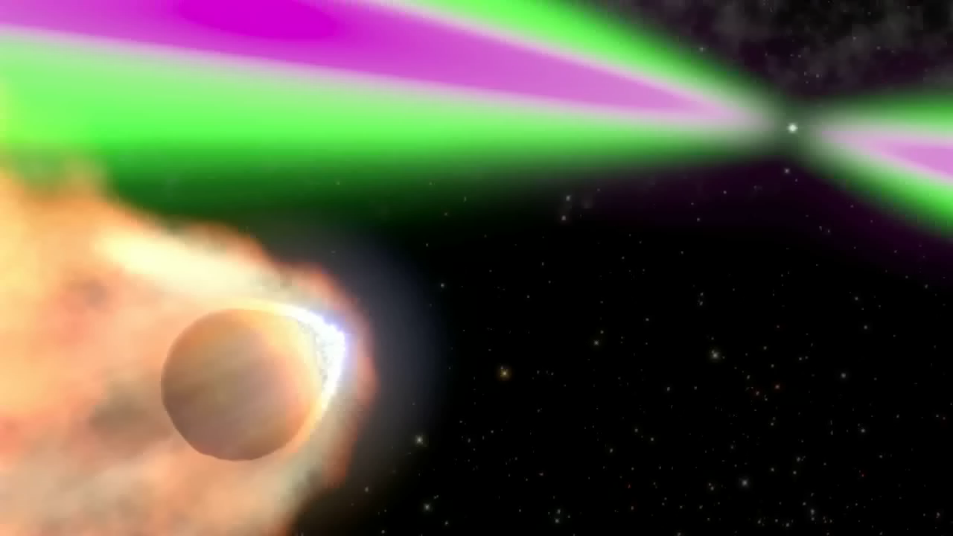
Spider Pulsar properties (rotation-powered state)
In binary
Short orbital period (< 1 day)
Low mass companion (> 0.1 solar mass for redback; < 0.1 solar mass for blackwidow)
Usually have non-thermal X-ray/γ-ray counterparts (𝐿_{0.1-10keV} ≈ 10³² erg s⁻¹; 𝐿_{0.1-100GeV} ≈ 10³³ erg s⁻¹)
From Fermi team

Slide 5
LMXB accretion-powered state
?
Spider Pulsar
rotation-powered state

Slide 6
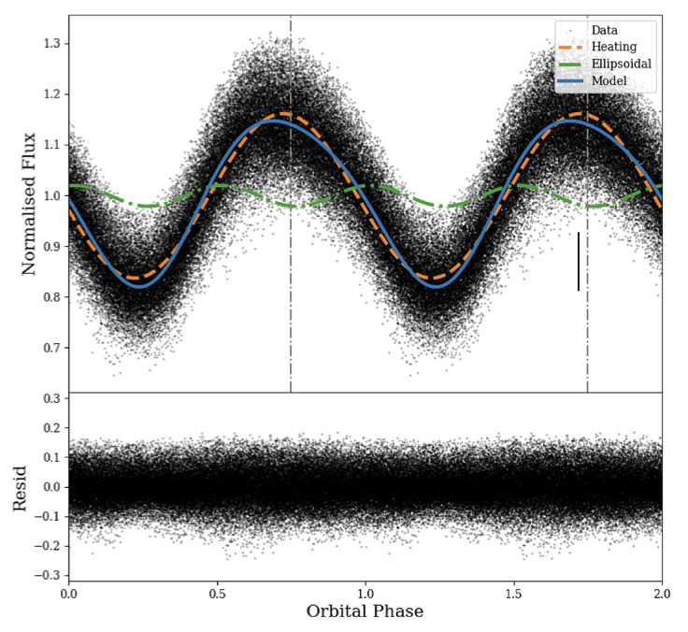
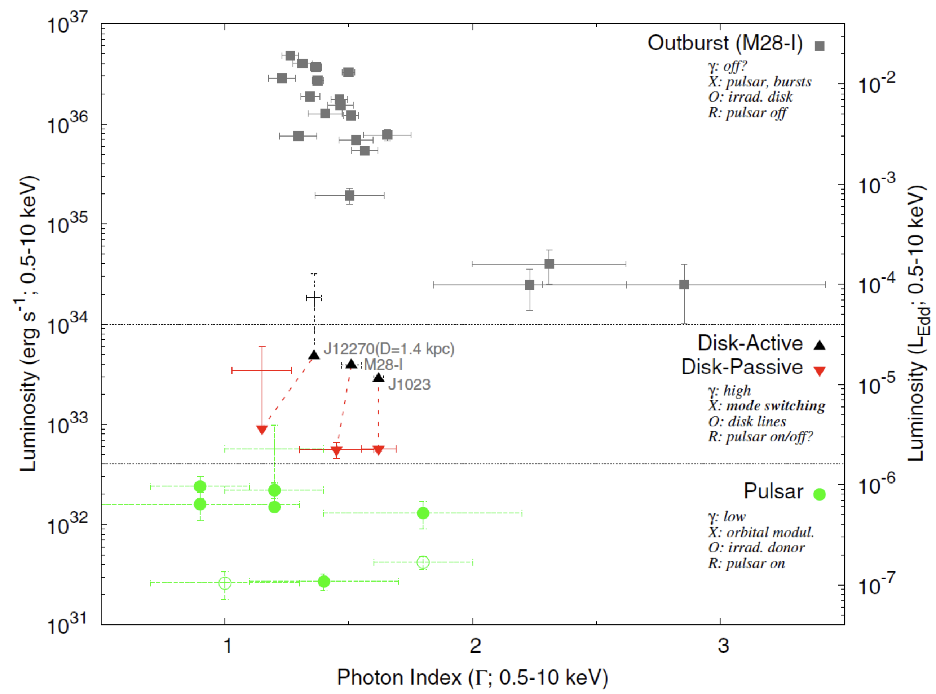
PSR J1023+0038
One of the three transitional MSPs (tMSPs; the other two are PSR J1227–4853, PSR M28-I)
In binary (P ~ 4.75 hr), and shows a pulsar heating domain optical orbital light curve
Before 2013: radio pulsar state (redback) After mid-June 2013: sub-luminous disc state
Have an accretion disk
The pulsar is still active at least sometimes
Mode switching in X-ray emission (high/low mode)
X-ray luminosity-photon index plot
(M.Linares et al. 2014, ApJ, 795, 72)
Optical orbital light curve of J1023
(Kennedy et al. 2018, MNRAS, 477, 1120)

Slide 7
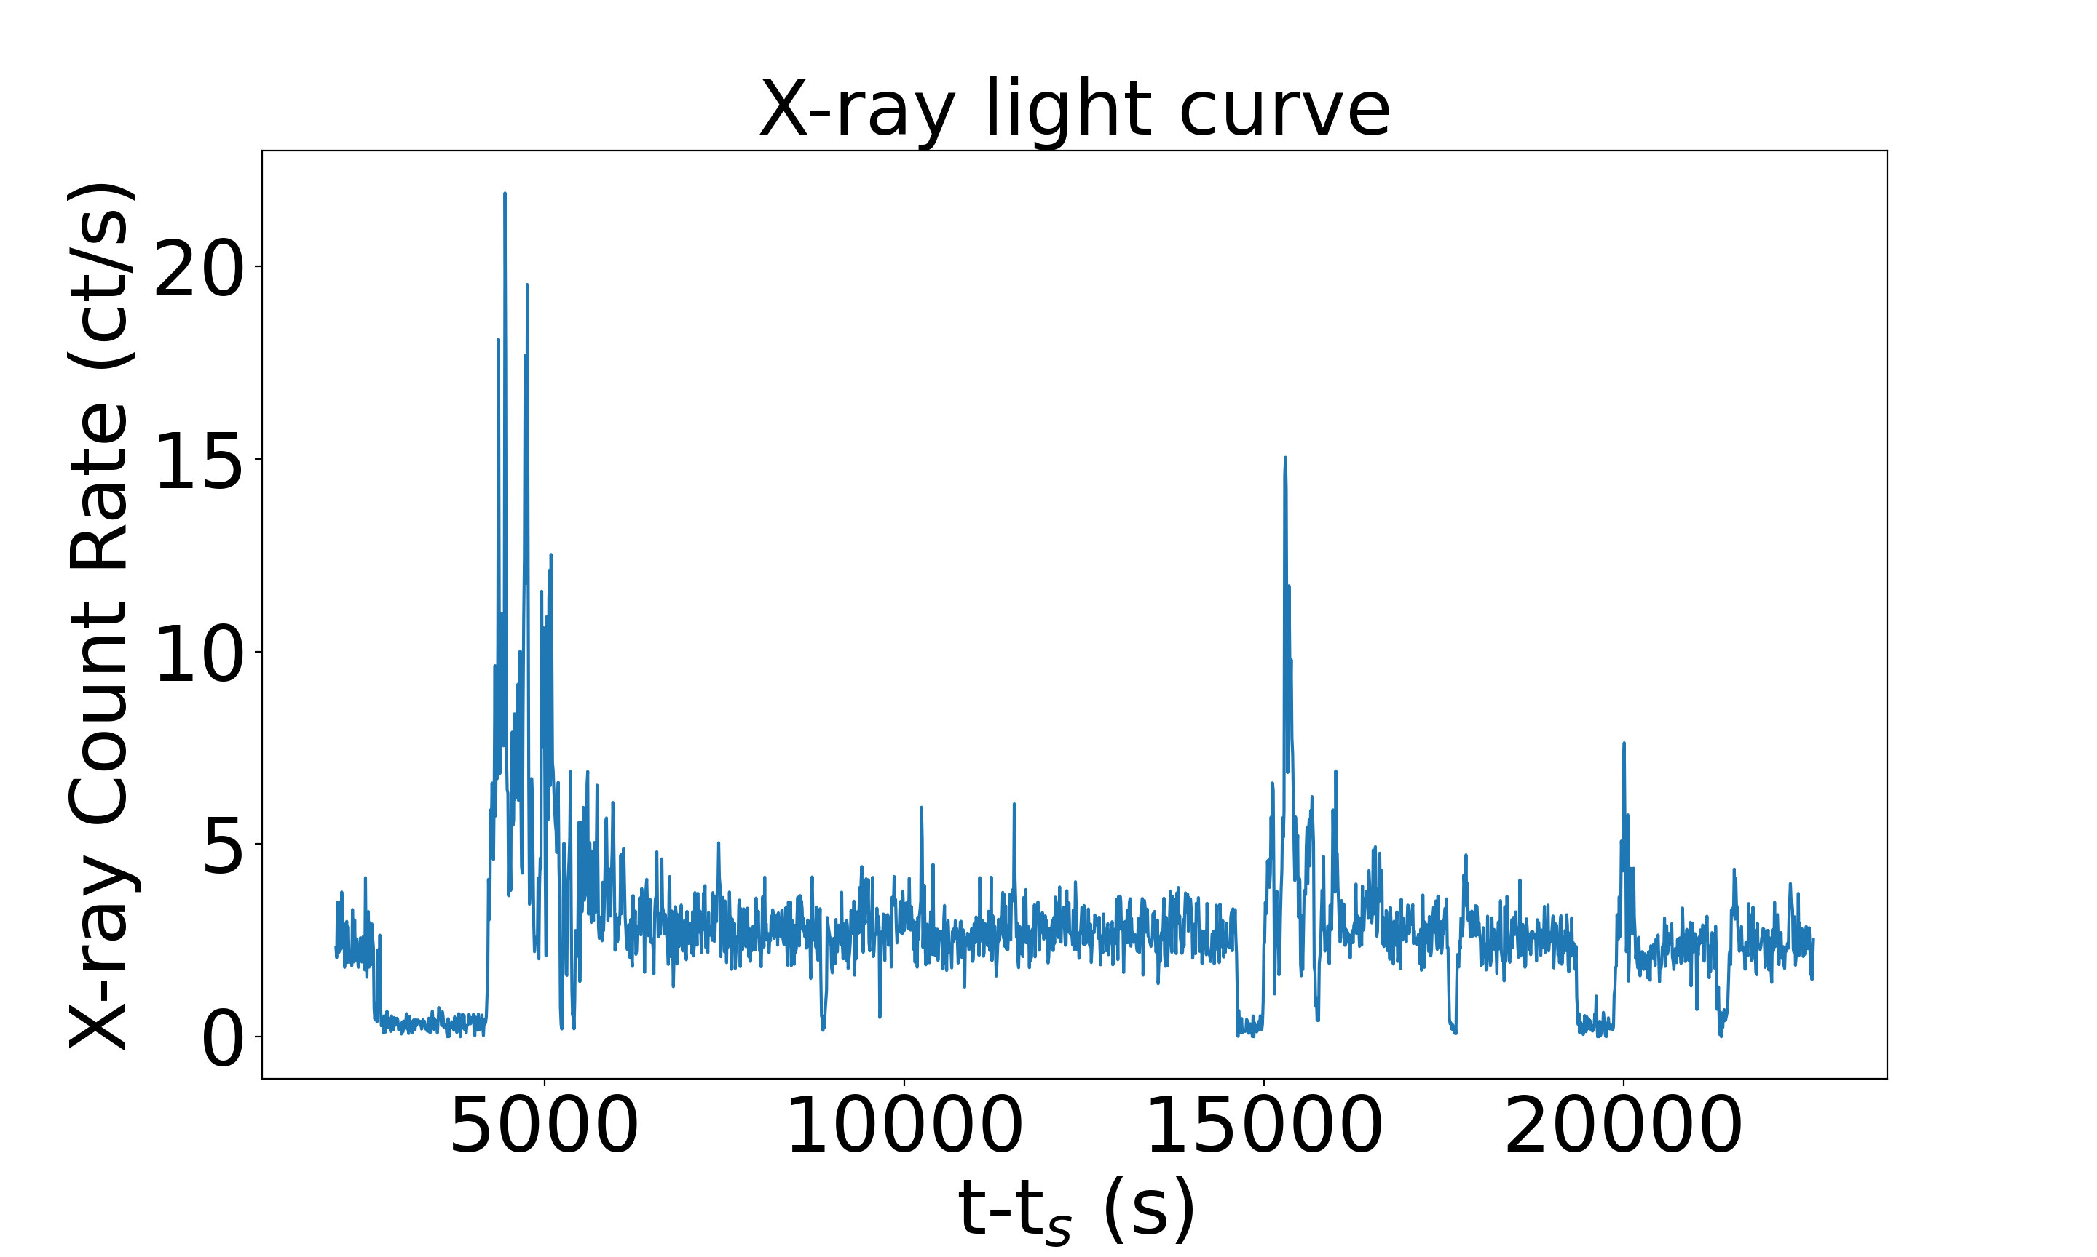
The mode switching in X-ray band
High mode:
Low mode:
Flare mode:
L_{0.1-10keV} ~10³³ erg s⁻¹
~10³² erg s⁻¹
~10³⁴ erg s⁻¹
Clean transition between the high/low modes in ~10s timescale

Slide 8
Motivation
Find the heating sources → Understand the redback structure/emission mechanism.
Positive Correlation or leading relationship in redback between X-ray and Optical modulation (e.g., PSR J1048+2339 and PSR J2215+5135).
Applying the same idea in J1023 → Some hints to understand its structure/emission mechanism.
J1023 was a redback and also shows a similar pulsar heating domain optical orbital light curve.
Maybe the X-ray/optical emissions are positively related in J1023?

Slide 9
First anti-correlation
18 X-ray/B-band simultaneous XMM-Newton observations (all in sub-luminous disc state)
Quantify the pulsar heating effect (optical modulation amplitude, MA) and X-ray emission (several ways, etc., non-low-mode occurrence rate)

Slide 10
First anti-correlation
Non-low-mode occurrence rate = $\frac{\text{(}\text{high} \text{mode} \text{duration}\text{ + }\text{flare} \text{mode} \text{duration}\text{)}}{\text{total} \text{duration}}$

Slide 11
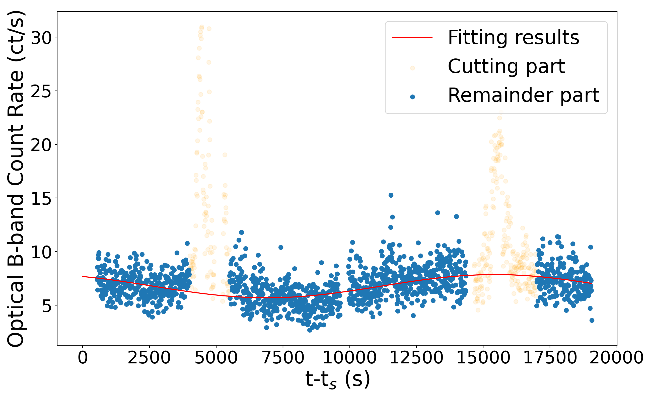
First anti-correlation

Slide 12
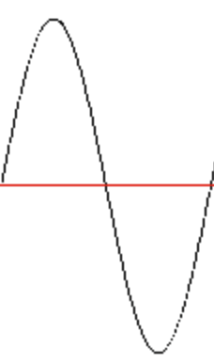
First anti-correlation
~ 3σ

Slide 13
Second anti-correlation

Slide 14
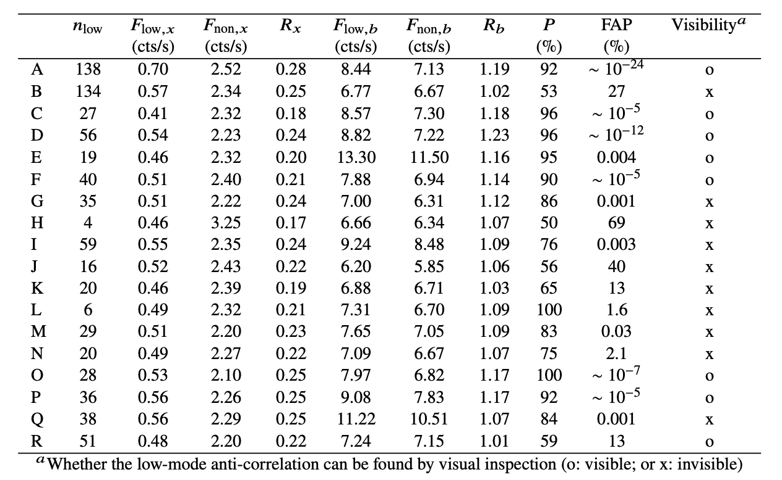
Second anti-correlation

Slide 15
Conclusion
A possible anti-correlation between the optical MA and X-ray emission
A low-mode anti-correlation exists between the EPIC and OM data in some XMM-Newton observations

Slide 16
Thank you for your attention!

Slide 17
γ-ray and MA

Slide 18
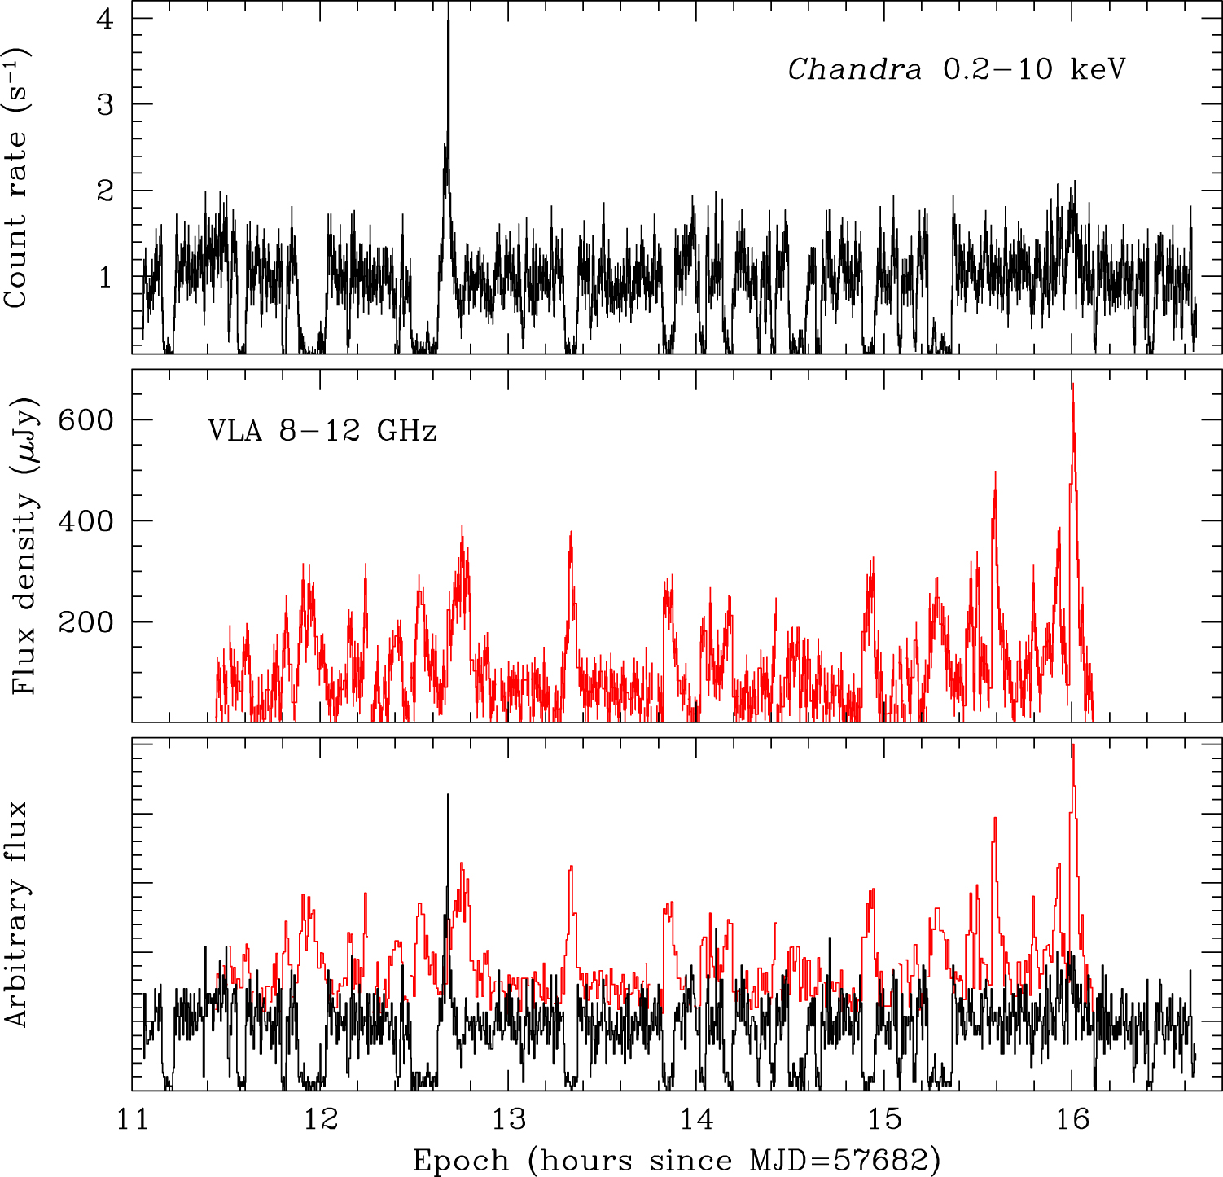
Radio-X-ray anti-correlation
From Bogdanov S., et al., 2018, ApJ, 856, 54

