Slide 1
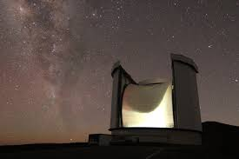
The JCMT BISTRO Survey:
Magnetic Fields Associated with
a Network of Filaments in
the Massive Star-forming Region Onsala 2
ASROC 2025 Annual Meeting
Meng-Zhe Yang (NTHU)
Hao-Yuan Duan (TAM)
Shih-Ping Lai (NTHU)
BISTRO team

Slide 2
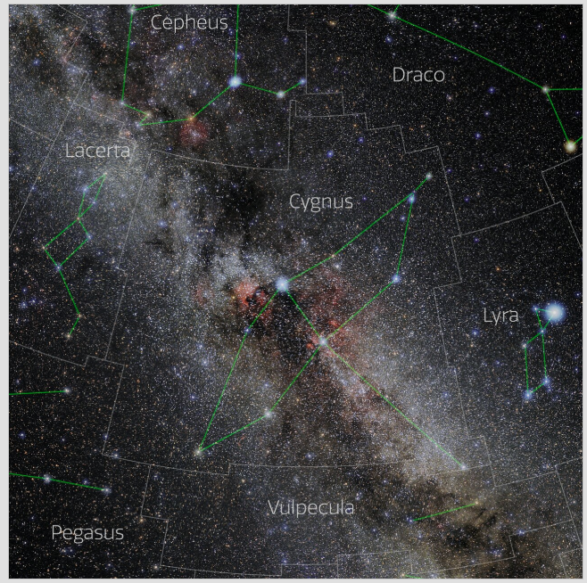
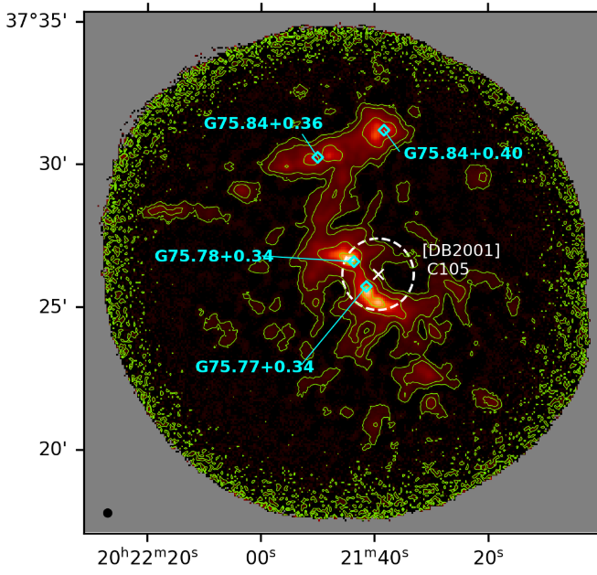
Onsala 2
Credit:
E. Slawik/NOIRLab/NSF/AURA/M. Zamani
~3.8 kpc

Slide 3
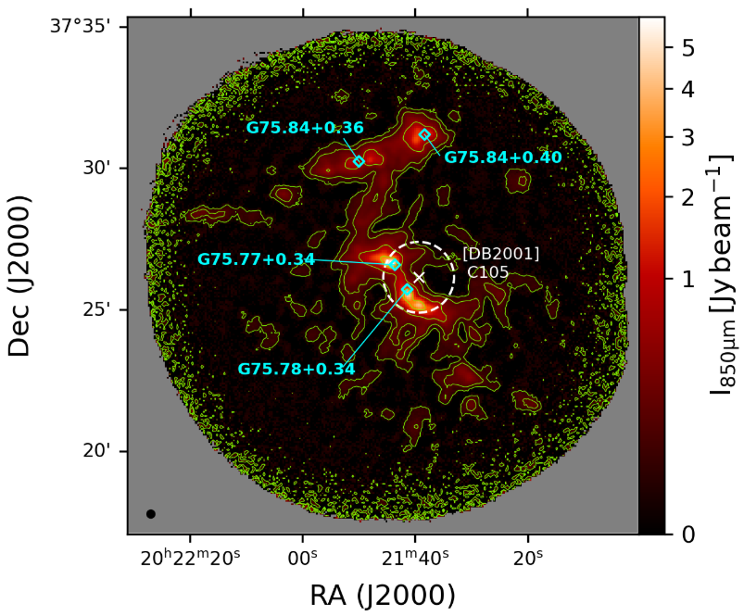
HII Region:
G75.84+0.36
G75.84+0.40
G75.78+0.34 (Ultra-compact HII)
G75.77+0.34 (Compact HII)
Open Cluster
Berkeley 87
Infrared Star Cluster
[DB2001] CL05

Slide 4
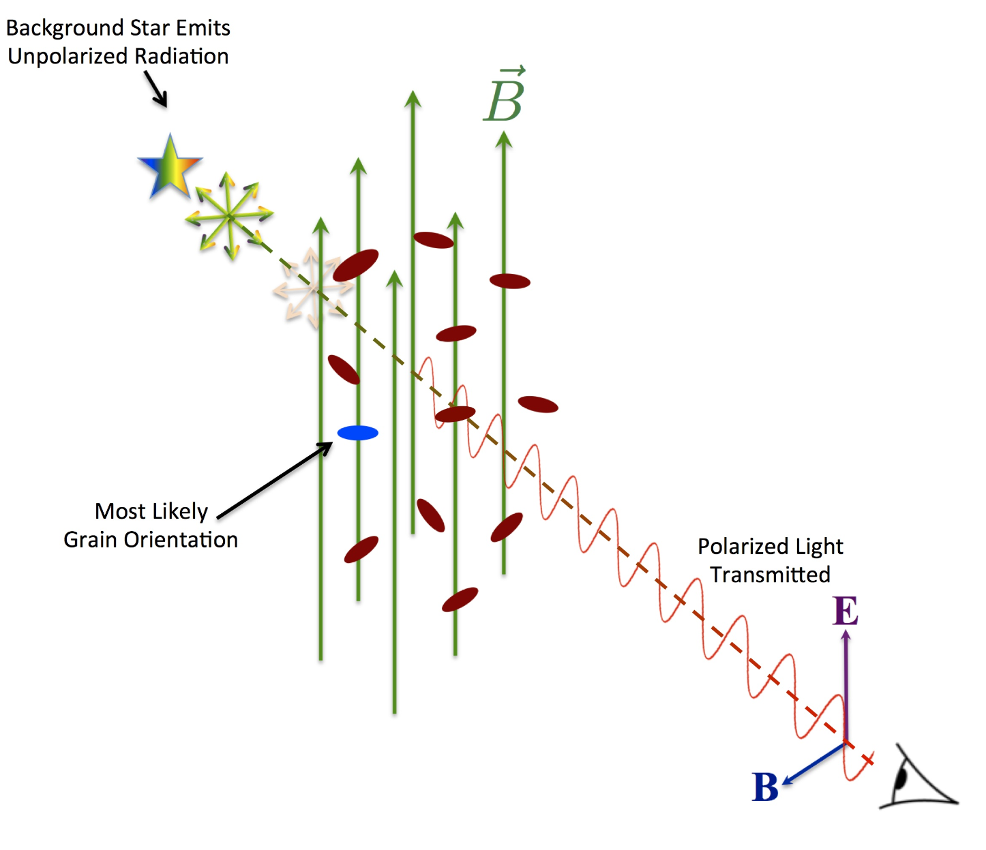
Magnetic Field Measurement
Magnetic Field Morphology
Magnetic Field Strength
Davis-Chandrasekhar-Fermi
Assume the energy equilibrium between turbulence kinetic energy and perturbed magnetic energy.
(Davis 1951; Chandrasekhar & Fermi 1953)
ρ: mass density
σν: non-thermal velocity dispersion
σθ: angular dispersion
Q’: dimensionless factor of order unity (Q’~0.28 with 50% uncertainty from Lie et al. 2022)
The total magnetic field strength is estimated by the statistical approximation described in Crutcher (2004):
https://bgandersson.net/grain-alignment
Notes:
, which corrects for the bias in magnetic field strength on scales smaller than the beam

Slide 5
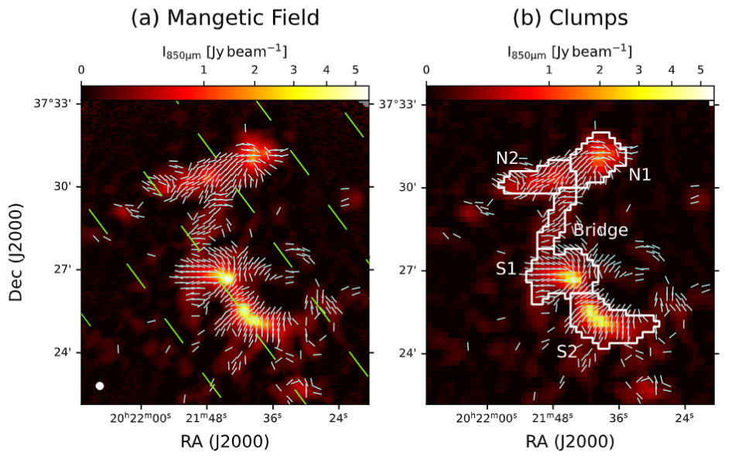
Magnetic Field Morphology
from JCMT BISTRO Polarization
Identified Clump using FellWalker algorithm
Data Selection
I/DI>10
PI/DPI>3
Notes:
5mins

Slide 6
Magnetic Field Strength
Davis-Chandrasekhar-Fermi Method
Volume Desity, ρ
Angular Dispersion, σθ
Non-thermal Velocity Dispersion, σν
(Davis 1951; Chandrasekhar & Fermi 1953)
(Crutcher 2004)

Slide 7
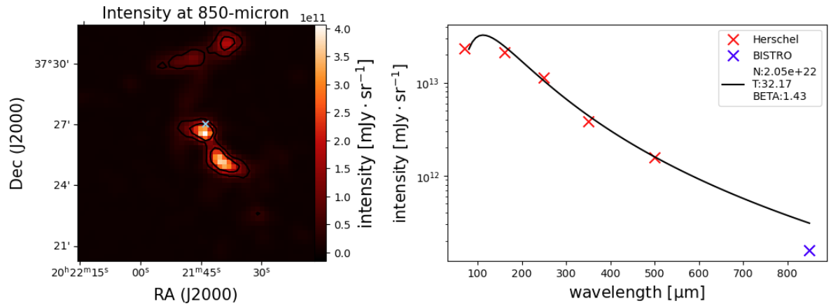
Volume Density - SED fitting
Herschel data at
70μm, 160μm, 250μm, 350μm, and 500μm.

Slide 8
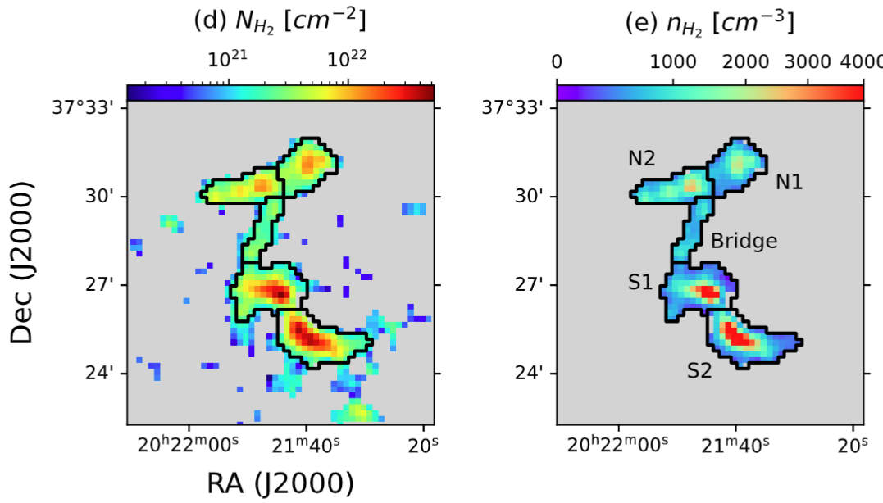
Volume Density - Structure Thickness
Cylinder Structure
=> Infer LOS thickness with 50% uncertainty

Slide 9
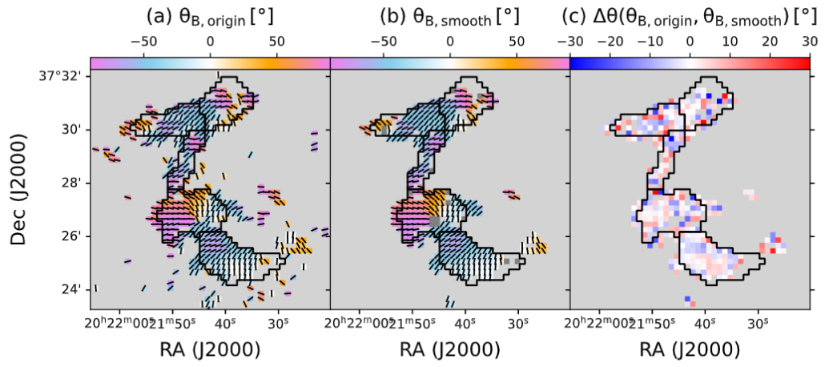
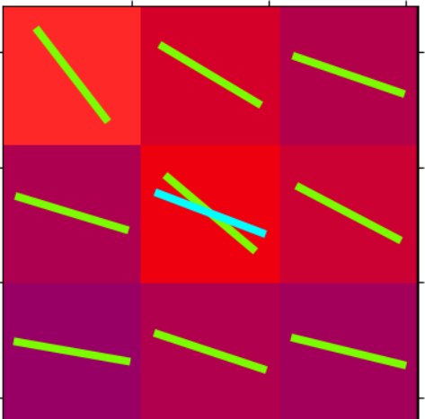
Angular Dispersion - Unsharp Masking Method
(Pattle et al. 2017)
Boxcar Average
Notes:
add 3x3 boxcar average as a sample

Slide 10
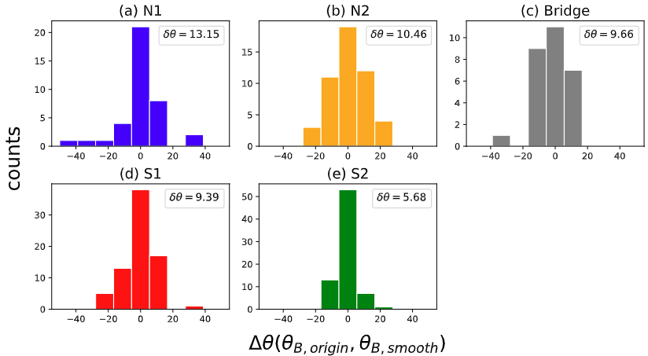
Angular Dispersion - Unsharp Masking Method
(Pattle et al. 2017)
Notes:
add 3x3 boxcar average as a sample

Slide 11
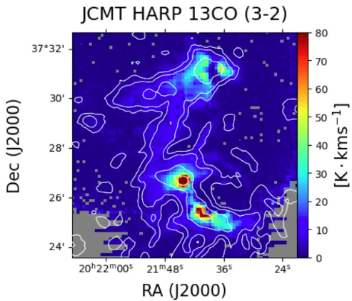
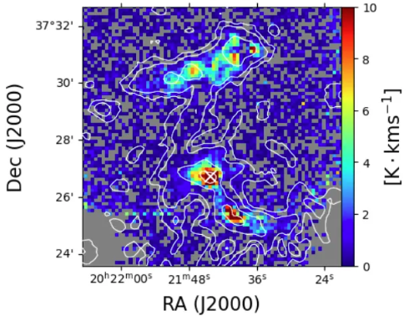
Velocity Dipsersion - linewidth of gas emission

Slide 12
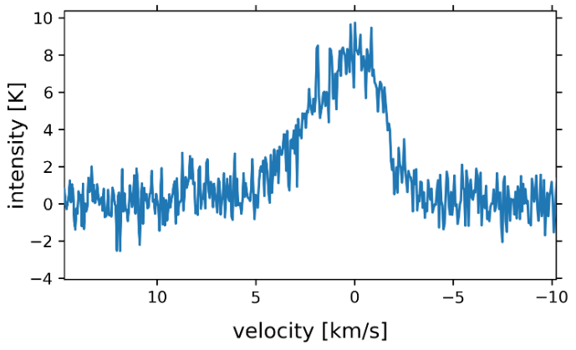
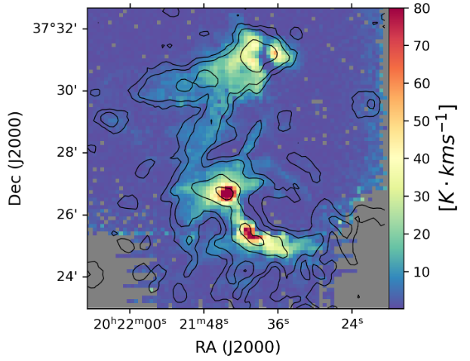
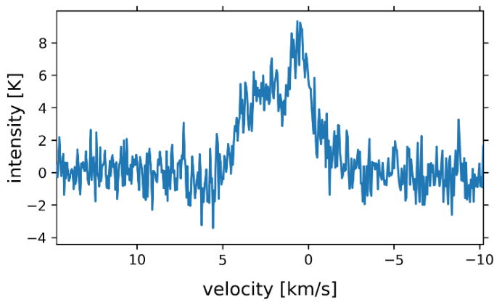
Velocity Dipsersion
model 1: 1 negative and 1 positive Gaussian peaks.
model 2: 1 negative and 2 positive Gaussian peaks.

Slide 13
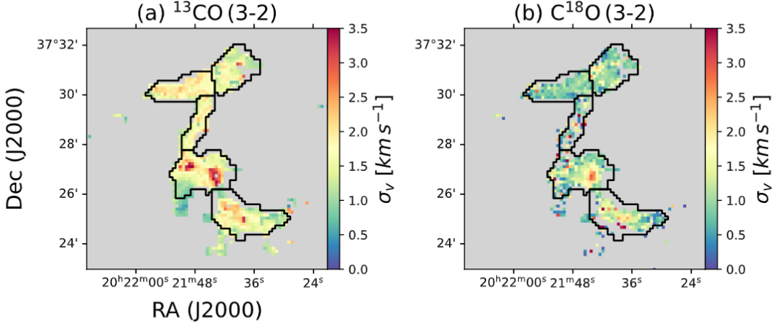
Velocity Dispersion
- Multiple-Gaussian Fitting
Non-thermal Component

Slide 14
DCF Estimation
 | N1 | N2 | Bridge | S1 | S2
n(H2) | 790.8 ± 60.7 | 1037.6 ± 79.4 | 671.5 ± 58.8 | 970.8 ± 82.4 | 1286.4 ± 106.71
σθ | 13.2 ± 1.1 | 10.5 ± 0.9 | 9.7 ± 1.4 | 9.4 ± 0.7 | 5.7 ± 0.5
σv(13CO) | 1.61 ± 0.01 | 1.82 ± 0.03 | 1.72 ± 0.01 | 1.80 ± 0.01 | 1.57 ± 0.01
σv(C18O) | 1.13 ± 0.02 | 0.92 ± 0.02 | 1.5 ± 0.06 | 1.38 ± 0.02 | 1.82 ± 0.14
B_POS(13CO) | 42.2 ± 21.4 | 68.7 ± 35.0 | 56.6 ± 29.5 | 73.2 ± 37.2 | 121.5 ± 61.9
B_tot(13CO) | 53.7 ± 27.3 | 87.5 ± 44.5 | 72.0 ± 37.5 | 93.2 ± 47.3 | 154.7 ± 78.8
B_POS(C18O) | 29.6 ± 15.0 | 34.7 ± 17.7 | 51.0 ± 26.7 | 57.7 ± 29.3 | 118.4 ± 60.4
B_tot(C18O) | 37.7 ± 19.1 | 44.2 ± 22.5 | 64.9 ± 34.0 | 73.5 ± 37.3 | 150.8 ± 76.8

Slide 15
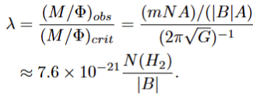
Mass-to-flux Ratio
Energy Budgets
 | N1 | N2 | Bridge | S1 | S2
λ(σv,13CO) | 1.24 ± 0.63 | 1.24 ± 0.64 | 1.18 ± 0.62 | 1.36 ± 0.69 | 1.09 ± 0.56
MA(σv,13CO ) | 0.62 ± 0.05 | 0.50 ± 0.04 | 0.46 ± 0.06 | 0.45 ± 0.03 | 0.27 ± 0.02
β(σv,13CO ) | 0.03 ± 0.03 | 0.01 ± 0.01 | 0.01 ± 0.01 | 0.01 ± 0.01 | < 0.01
λ(σv,C18O ) | 1.76 ± 0.90 | 2.46+/-1.25 | 1.31 ± 0.69 | 1.72 ± 0.87 | 1.12 ± 0.57
MA(σv,C18O) | 0.62 ± 0.05 | 0.50+/-0.04 | 0.46 ± 0.06 | 0.45 ± 0.03 | 0.27 ± 0.02
β(σv,C18O ) | 0.07 ± 0.07 | 0.05+/-0.05 | 0.02 ± 0.02 | 0.01 ± 0.02 | < 0.01

Slide 16
Alfvén Mach number
Plasma β
Energy Budgets
 | N1 | N2 | Bridge | S1 | S2
λ(σv,13CO) | 1.24 ± 0.63 | 1.24 ± 0.64 | 1.18 ± 0.62 | 1.36 ± 0.69 | 1.09 ± 0.56
MA(σv,13CO ) | 0.62 ± 0.05 | 0.50 ± 0.04 | 0.46 ± 0.06 | 0.45 ± 0.03 | 0.27 ± 0.02
β(σv,13CO ) | 0.03 ± 0.03 | 0.01 ± 0.01 | 0.01 ± 0.01 | 0.01 ± 0.01 | < 0.01
λ(σv,C18O ) | 1.76 ± 0.90 | 2.46+/-1.25 | 1.31 ± 0.69 | 1.72 ± 0.87 | 1.12 ± 0.57
MA(σv,C18O) | 0.62 ± 0.05 | 0.50+/-0.04 | 0.46 ± 0.06 | 0.45 ± 0.03 | 0.27 ± 0.02
β(σv,C18O ) | 0.07 ± 0.07 | 0.05+/-0.05 | 0.02 ± 0.02 | 0.01 ± 0.02 | < 0.01

Slide 17
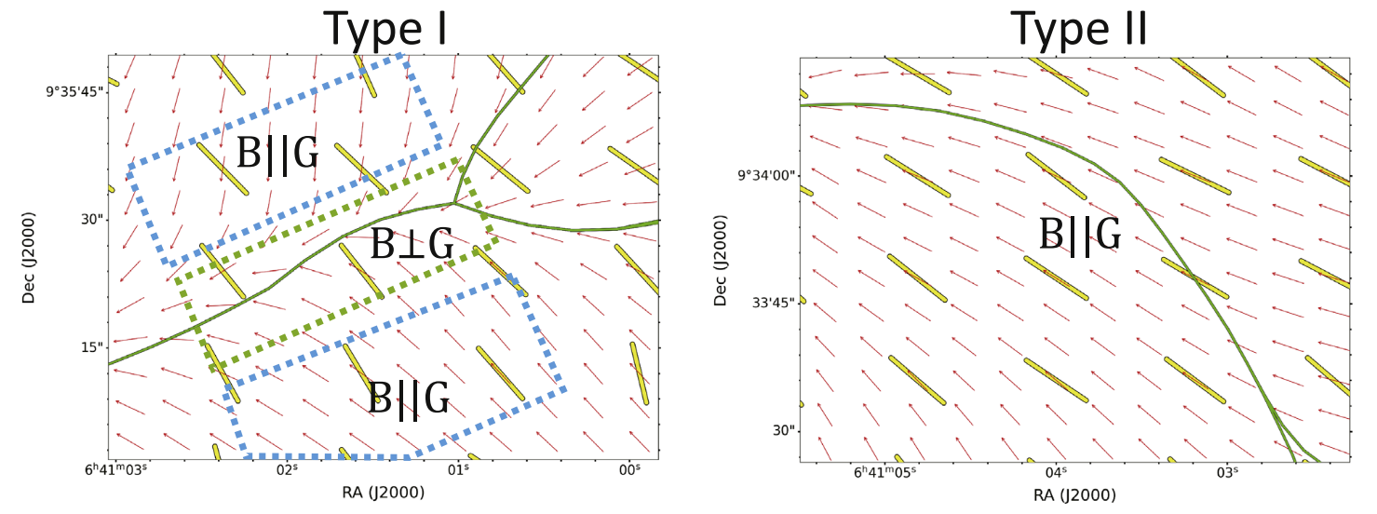
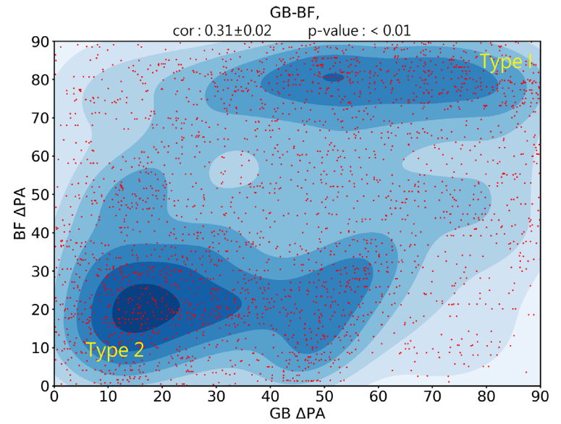
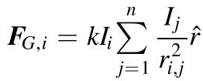
Different Type of
Filament
According Wang et al. 2024
Type I filament is perpendicular to the magnetic field with local gravity transitioning from parallel to perpendicular to the magnetic field from the outside to the filament ridge.
Type II filament is parallel to the magnetic field and local gravity.
Identify filamentary skeleton using package tool of DisPerse.
Gravity Field using the function:
(Kernel Density Estimation)

Slide 18
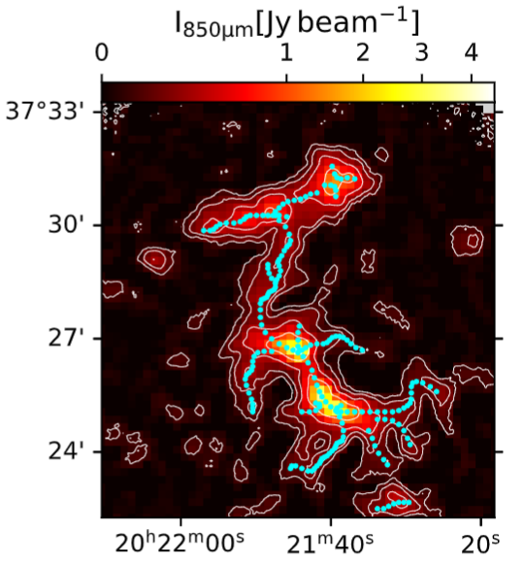
Different Type of
Filament
According Wang et al. 2024
Type I filament is perpendicular to the magnetic field with local gravity transitioning from parallel to perpendicular to the magnetic field from the outside to the filament ridge.
Type II filament is parallel to the magnetic field and local gravity.
Identify filamentary skeleton using package tool of DisPerse.
Gravity Field using the function:

Slide 19
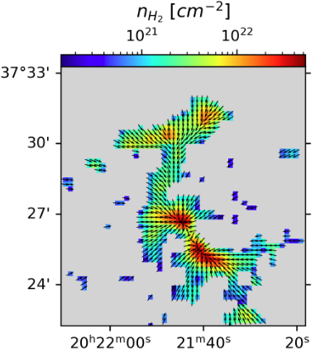
Different Type of
Filament
According Wang et al. 2024
Type I filament is perpendicular to the magnetic field with local gravity transitioning from parallel to perpendicular to the magnetic field from the outside to the filament ridge.
Type II filament is parallel to the magnetic field and local gravity.
Identify filamentary skeleton using package tool of DisPerse.
Gravity Field using the function:

Slide 20
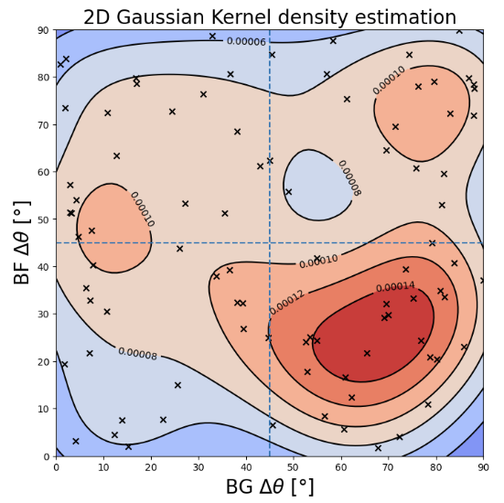
Kernel Density Estimation
BG vs. BF
(Wang et al. 2024)

Slide 21
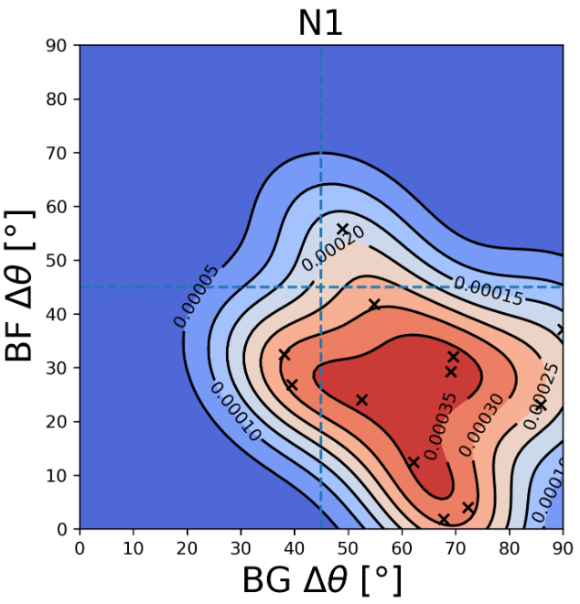
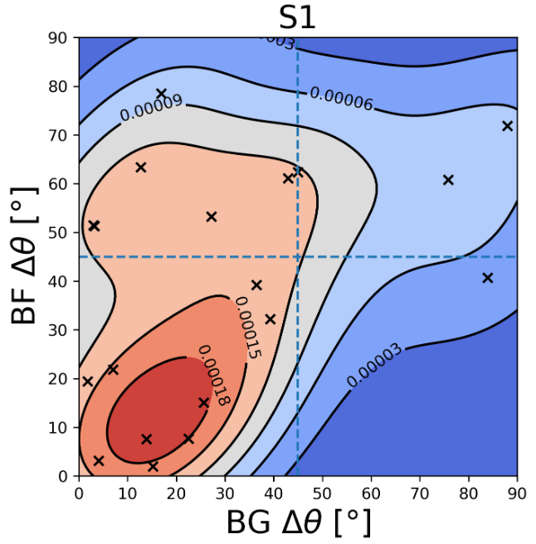
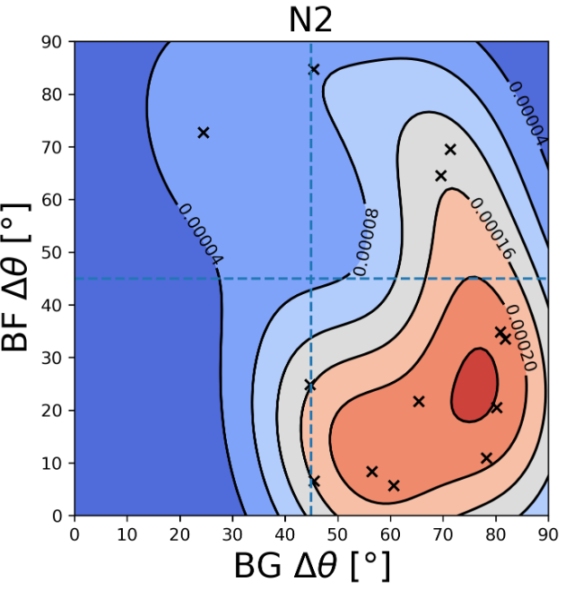
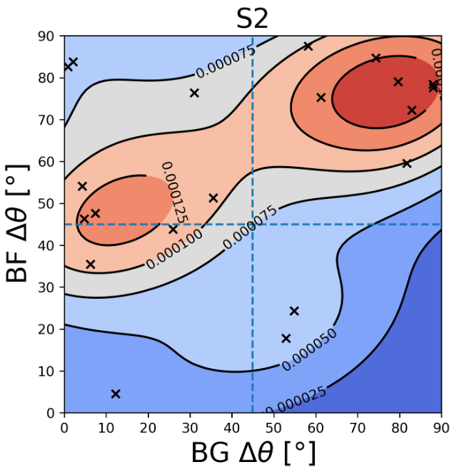
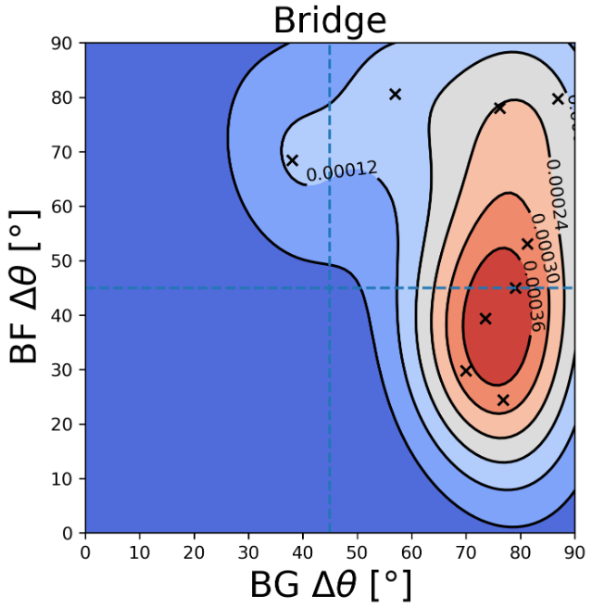
Molecular Outflow
G75.78NE (G75.78+0.34): Observed by CO (1-0) (Shepherd & Churchwell 1996; Shepherd et al. 1997) and HCN (1-0) (Riffel et al. 2010).
G75.78SW (G75.77+0.34):
Traced by HCN (1-0)

Slide 22
Summary
The magnetic field morphology is highly ordered, with the angular dispersion of roughly 10°.
In ON2, the magnetic turbulence is sub-Alfv´enic, and the magnetic fields are more dominant than thermal pressure. Additionally, the mass-to-flux ratios are all close or even slightly higher than 1, indicating the trans-critical to super-critical environment.
The filament structure does not match the Type I or Type II classifications proposed in previous studies. The local magnetic field morphology may be influenced by outflows near the UC H II region, while the local gravitational field may be affected by nearby structures.

Slide 23
Backup

Slide 24
Energy Budgets
 | N1 | N2 | Bridge | S1 | S2
λ(σv,13CO) | 1.24 ± 0.63 | 1.24 ± 0.64 | 1.18 ± 0.62 | 1.36 ± 0.69 | 1.09 ± 0.56
MA(σv,13CO ) | 0.62 ± 0.05 | 0.50 ± 0.04 | 0.46 ± 0.06 | 0.45 ± 0.03 | 0.27 ± 0.02
β(σv,13CO ) | 0.03 ± 0.03 | 0.01 ± 0.01 | 0.01 ± 0.01 | 0.01 ± 0.01 | < 0.01
λ(σv,C18O ) | 1.76 ± 0.90 | 2.46+/-1.25 | 1.31 ± 0.69 | 1.72 ± 0.87 | 1.12 ± 0.57
MA(σv,C18O) | 0.62 ± 0.05 | 0.50+/-0.04 | 0.46 ± 0.06 | 0.45 ± 0.03 | 0.27 ± 0.02
β(σv,C18O ) | 0.07 ± 0.07 | 0.05+/-0.05 | 0.02 ± 0.02 | 0.01 ± 0.02 | < 0.01

Slide 25
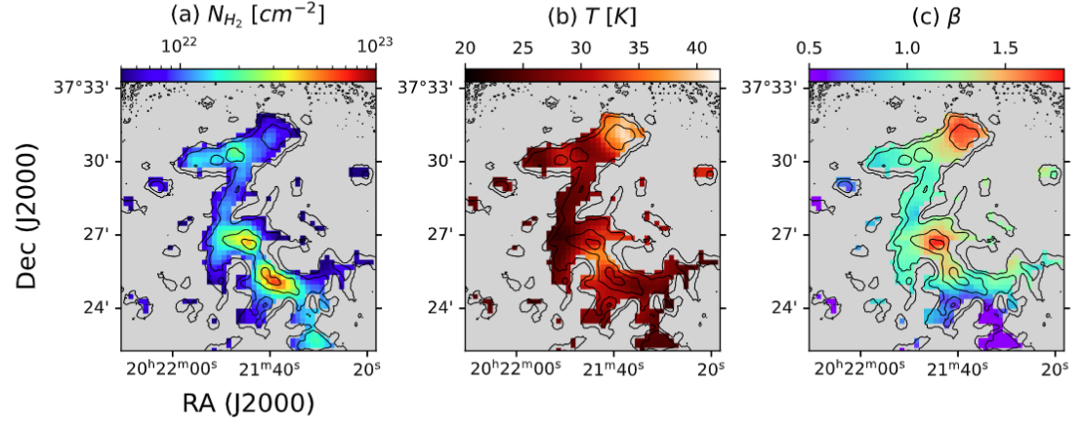
Fitting the Spectral Energy Density

