Slide 1
Phenomenology of Neutrino-Dark Matter Interaction in DSNB and AGN
Po-Yan Tseng (NTHU)
Yu-Min Yeh a.k.a. Corn Yeh (NTHU)
June 25-27, 2025
The Future is Whispering

Slide 2
DM-Neutrino Interaction
Neutrino Sources
- Diffuse Supernova Neutrino Background (DSNB)
- Active Galactic Nuclei (AGN)
Neutrino flux detector
- Super-K and future DUNE/Hyper-K
- IceCube
$$E_{ν}∼𝒪(MeV)$$
$$E_{ν}∼𝒪(TeV)$$
Notes:
We first introduce the DM-neutrino interaction and show the different energy dependence of scattering cross section.
Then we talk about two different neutrino sources, the diffuse supernovae neutrino background, which emits neutrinos with energy around MeV scales, and the active galactic nuclei, which emits neutrinos with energy around TeV scales.
And we consider the present Super-Kamiokande and future DUNE/Hyper-Kamiokande experiments to set limits on DM-neutrino interaction.
For AGN we consider the neutrino flux measured at IceCube and set constraint on DM mass and scattering cross section.

Slide 3
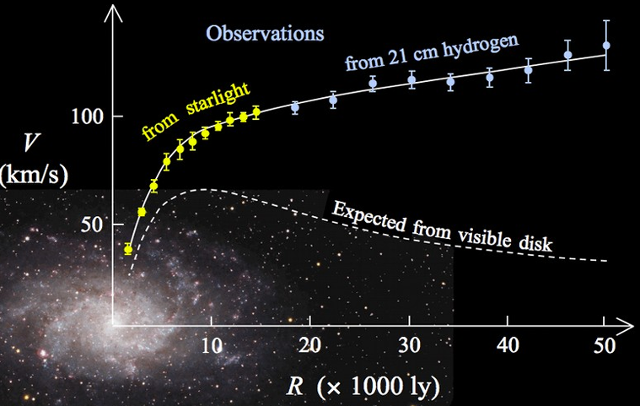
DM-Neutrino Interaction
Dark Matter is yet identified from particle physics, but they can be inferred from the cosmological observations. For example, the galaxy rotation curve,…
.
Notes:
Dark Matter is yet identified from particle physics, but they can be inferred from the cosmological observations. For example, the galaxy rotation curve,
the rotation velocities are expected to decrease away from the galaxy center. But the observation are completely opposite.
This implies that there may be a lot of non-luminous matter (dark matter) in the outskirts of the galaxy.

Slide 4
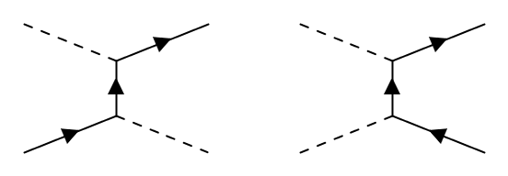
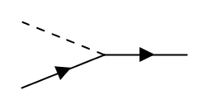
DM-Neutrino Interaction
In the limit $m_{F}≫m_{φ}≥m_{f}$
$φ (≠φ^{∗})$ scattered via u-channel
C.Boehm, P.Fayet: Nucl.Phys.B 683 (2004) 219-263
Hypothetical $νφ$ coupling
$νφ$ scattering
$φφ^{∗}$ annihilation
Notes:
Many observations have been proposed to study the imprints of fundamental interaction between DM and Standard Model particles.
In our work we take the dark matter to be a non-self conjugate scalar, and consider the hypothetical interaction where the scalar DM couples to neutrinos through a fermionic mediator F, and y is the coupling constant.
From the calculation of Boehn and Fayet, in the limit m_F much greater than m_phi and m_phi >= the SM fermion, the non-self conjugate DM is scattered via u-channel. So we can construct the Feynman diagram of nu-phi scattering and the phiphi annihilation from this vertex.

Slide 5
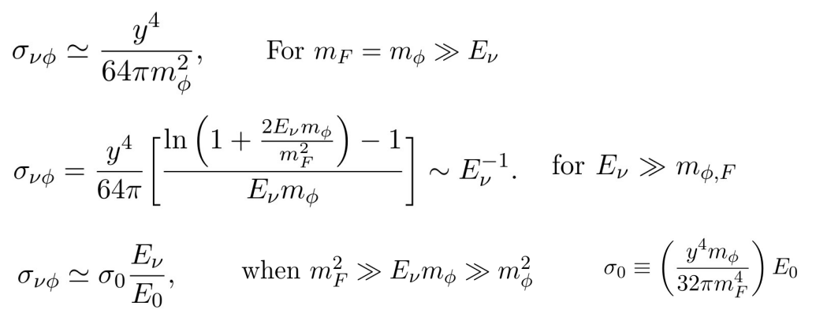
DM-Neutrino Interaction
The cross section exhibit different dependent on neutrino energy:
heavy mediator limit
Notes:
Next we calculate the scattering cross section of nu-phi scattering, and the cross section exhibits different dependence on neutrino energy.
For example, when the neutrino energy is much smaller than the DM mass and mediator mass, the cross section is proportional to Enu square.
But when the neutrino energy is much greater than the m_phi and m_F, the cross section becomes inverse proportional to E_nu. The low energy neutrino flux is more applicable in this limit.
The third one is the heavy mediator limit, where m_F square much larger than E_nu times m_phi and E_nu is much greater than m_phi.
In this case the cross section is proportional to E_nu, and we factor out E_nu and define the rescale cross section sigma_0.
We adopt this kinematic region to the analysis of AGN.

Slide 6
DM-Neutrino Interaction
To quantify the flux attenuation from neutrino sources, we calculate the transmittance T , defined as the ratio of the received and the emitted flux
$ν$FATE:1706.09895
input: $σ, dσ/dE,χ$
$$\frac{dΦ}{dχ}\left(E_{ν}^{′}\right){=−σ}_{νφ}Φ+\int_{E_{ν}^{′}}^{∞}{{dE}_{ν}\frac{{dσ}_{νφ}}{{dE}_{ν}^{′}}\left({E_{ν}→E}_{ν}^{′}\right){Φ(E}_{ν})}$$
DM column density along $ν$ path
neutrino scattering out of beam direction
down-scattering of high-energy neutrinos
Notes:
Since the neutrinos are scattered by the DM, we expect the neutrino flux might be attenuated. To quantify the flux attenuation from neutrino sources, we calculate the transmittance T , which is defined as the ratio of the received and the emitted flux. T can be written as the exponential to the power of minus tau
tau is the optical depth and it can be obtained by solving the cascade equation.
chi is the DM column density along the neutrino path.
The first term on the right-hand side characterize the neutrino scattering out of the beam direction, and the second term is the down-scattering of neutrino from high incident energy E_nu to low scattered energy E’_nu.
We use the public code nuFATE to calculate the attenuation of neutrino flux.
nuFATE requires cross section, differential x section, and DM column density as the input parameters, and we include our nu-phi cross section and diff x section into nuFATE.

Slide 7
Neutrino Sources
Notes:
Next we introduce the neutrino sources we considered.

Slide 8
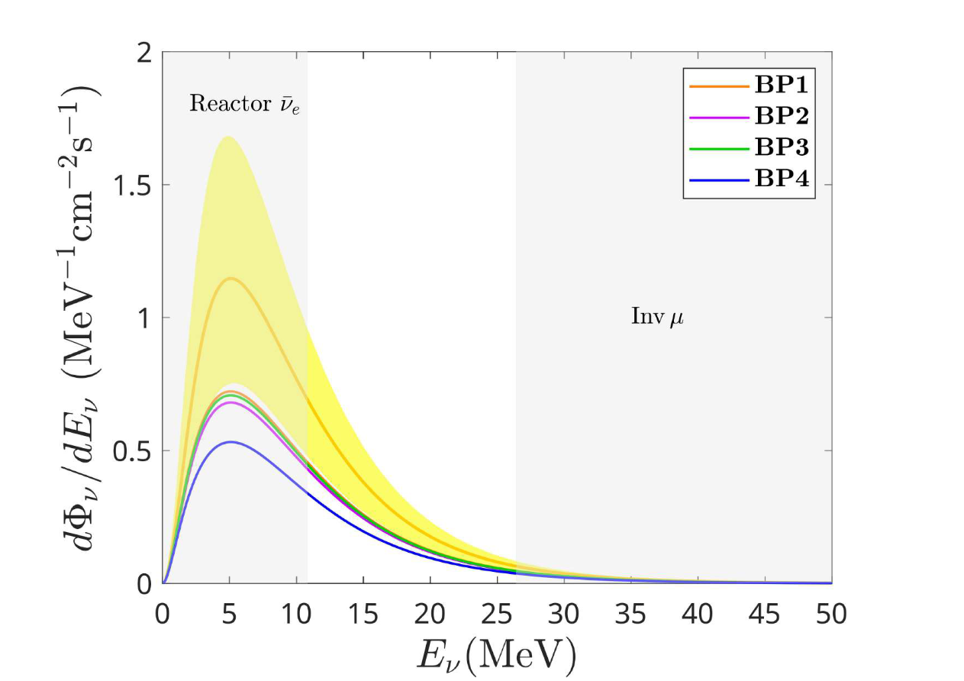
DSNB
$ν_{e}$ flux with $T_{ν}=6.6$ MeV
The DSNB is the flux of isotropic neutrino and antineutrino from core-collapse supernovae (CCSN)
neutrino distribution from supernovae
CCSN rate from cosmic star formation
arxiv: 2412.08537
Notes:
The diffuse supernovae neutrino background is the flux of isotropic neutrino and antineutrino from core-collapse supernovae.
It neutrino spectrum is a convolution of the redshifted neutrino distribution from supernovae with the rate of core-collapse supernovae from SFRH.
This is the electron neutrino flux with T_nu=6.6 MeV. The yellow band is the uncertainty of DSNB flux, and it arise from the uncertainty of analytic fitting of SF parameter. The yellow curve is the flux from the fiducial fitting parameter.
The neutrino energy between 12-26 MeV is not overwhelm by the background reactor antielectron neutrino and the neutrinos from inverse muon decay, and the DSNB flux in this range is expected to be detectable.

Slide 9
DSNB
We include our hypothetical DM-neutrino interaction by inserting the transmittance into neutrino flux.
$$χ=\int_{0}^{z_{max}}{\frac{(ρ_{DM}/m_{φ}) {(1+z)}^{3}}{H(z)}dz, ρ_{DM}=1.27GeV m^{−3} }$$
Notes:
We include our hypothetical DM-neutrino interaction by inserting the transmittance into the convolution of F_nu and rate of CCSN. For DSNB we use the extragalactic averaged DM density to calculate DM column density.

Slide 10
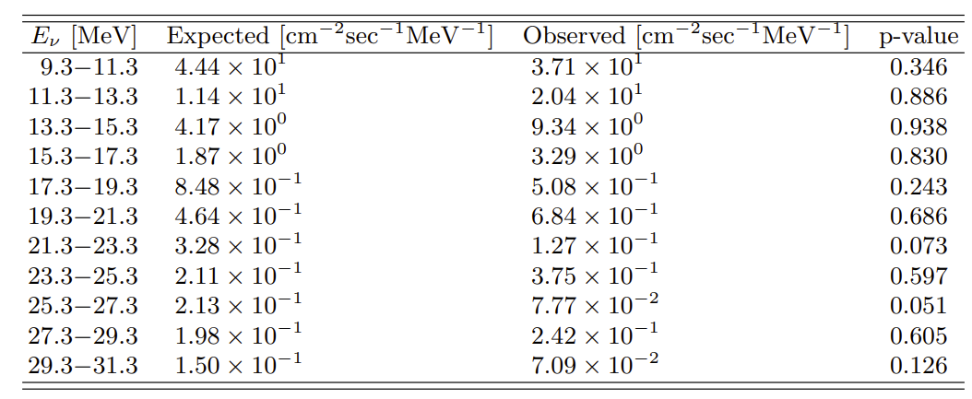
DSNB
For the detection of DSNB, we consider the Super-K and DUNE experiments. The Super-K detects the ${\overline{ν}}_{e}$ via the inverse beta decay (IBD): ${\overline{ν}}_{e}+p→e^{+}+n$. The SK-IV data shows the excess of the observation over the background expectation.
Super-Kamiokande Collaboration: arXiv:2109.11174
Notes:
For the detection of DSNB, we consider the Super-K and DUNE experiments.
The Super-K detects the ${\overline{ν}}_{e}$ via the inverse beta decay.
The SK-IV data shows the excess of the observation event over the background expectation event.
This table from the Super-K collaboration shows the expected background neutrino flux and the observed flux, and the total observed flux is larger than the expected background flux.
The neutrino energy is given by the positron energy plus the threshold of IBD.

Slide 11
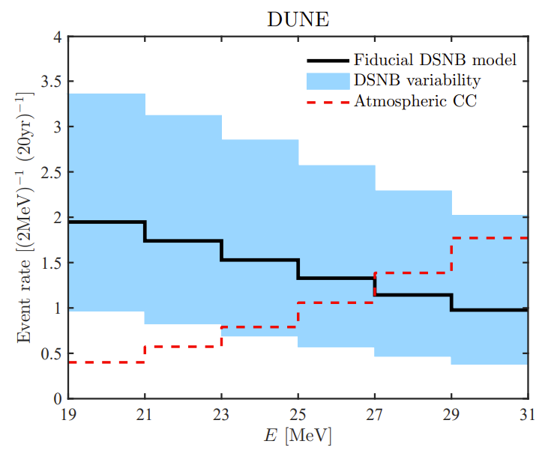
DSNB
The DUNE experiment is based on the charged current interaction of liquid argon and low energy electron neutrino: $ν_{e}+^{40}Ar→e^{−}+^{40}K^{∗}$
arxiv:1804.03157
Notes:
And the other is the DUNE experiment.
The DUNE experiment is based on the charged current interaction of liquid argon and low energy electron neutrino.
The neutrino is absorbed by argon and creates an electron and a potassium in excited state, and the neutrino energy can be calculated from the energy conservation, where E_x is the excitation energy, and m^g represent the ground state mass. T_K is the recoil energy of K and is neglected for low energy neutrino. And we also calculate the neutrino argon cross section explicitly.
For the background of the DUNE experiments, we consider the charged current interaction of atmospheric neutrinos, which is given by the red histogram in this plot

Slide 12
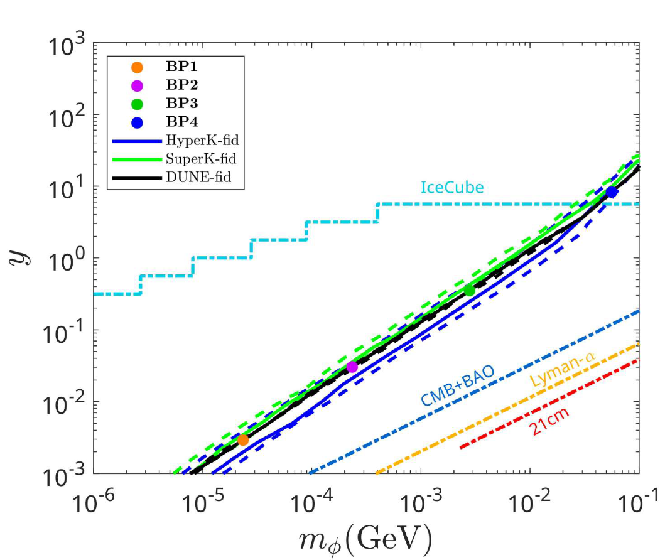
DSNB
$$m_{F}/m_{φ}=1.1$$
$2σ$ sensitivity
$ν_{e}$ flux with $T_{ν}=6.6$ MeV
400kton-yrs for DUNE
359kton-yrs for Super-K
3.8Mton-yrs for Hyper-K
arxiv: 2412.08537
arxiv: 2412.08537
Notes:
We calculate the event number from DUNE and Super/Hyper-K using the attenuated DSNB flux and the cross section of neutrino argon interaction and the inverse beta decay.
We assume 400kton-yrs exposure for DUNE, and the exposure of Super-K is given by 359kton-yrs, and the Hyper-K exposure is anticipated to achieve 8.4 times more than Super-K, which is around 3.8Mton-yrs.
Combining the background events, the observed events, and the DSNB events, we can calculate the deviation of the expected event number and the observed event number by the Poisson likelihood, where the expected event number is the sum of the background and DSNB event number.
By varying the DM mass and coupling constant y, we calculate the two sigma sensitivity of DSNB. In this figure we set the ratio of m_F and m_phi to be 1.1. The black, green, blue lines represents the limits of DUNE, Super-K, and Hyper-K, respectively
Since DSNB emits neutrino with few MeV energy, the cross section exihibits two different dependence on mphi and mF. In both cases the cross section is inversely proportional to the DM mass and mediator mass.
So the coupling must increase as mphi get larger. The dashed lines indicates the uncertainty of the SFR parameters.
We select four benchmark points on the DUNE sensitivity, and their attenuated flux can be distinguished from the unattenuated DSNB flux and produce the detectable suppression signal in the open energy region.

Slide 13
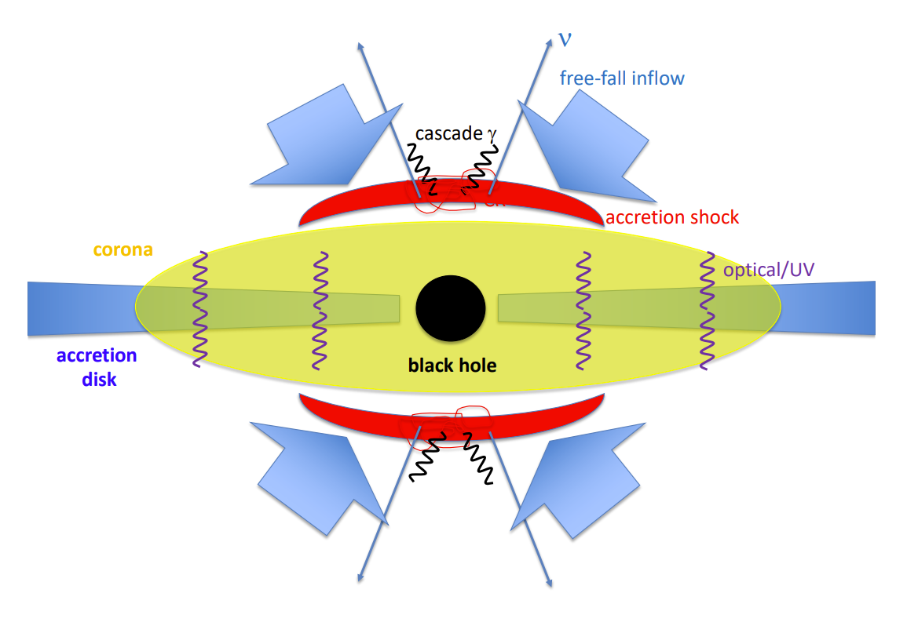
AGN
$p+γ$ or $p+p$ $→π^{±,0}→e^{±},ν,γ$
The AGN are sources of high energy ($𝒪(TeV)$) neutrinos. The neutrinos are generated from the decay of high energy pion.
arxiv:2202.03381
Notes:
Another source is the AGN. The AGN are sources of high energy ($𝒪(TeV)$) neutrinos.
It is powered by the center supermassive black hole, and the high energy pion are created in the corona region around the black hole from the proton-photon or proton-proton interactions, and the subsequent pions decay create electrons, positrons, photons, and high energy neutrinos.

Slide 14
AGN
NGC: 1.5 – 15 TeV
TXS: 40 – 4000 TeV
IceCube Collaboration arxiv: 2211.09972
Notes:
In our work we consider two different AGNs, the NGC 1068 and TXS 0506+056.
The icecube collaboration have detected the high energy neutrino flux from the NGC 1068 and TXS 0506+056. For NGC, it produces neutrinos with energy 1.5 to 15 TeV, and TXS produces neutrinos with energy 40 to 4000 TeV.

Slide 15
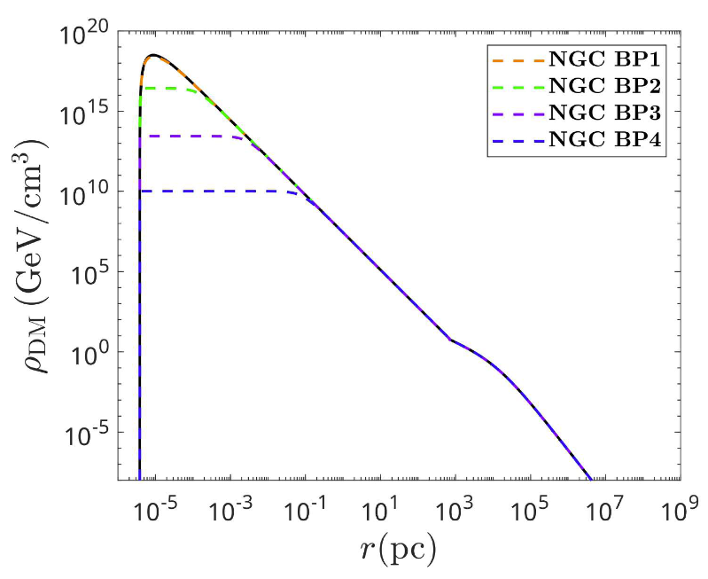
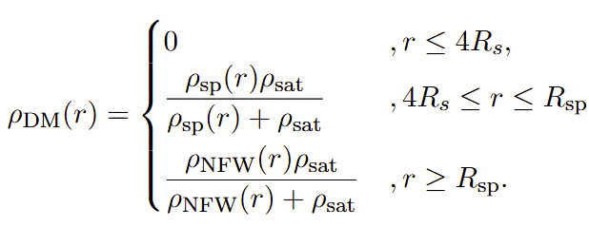
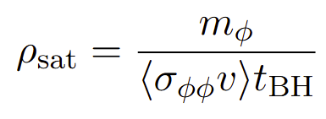
AGN
Black solid line:
no $φφ^{∗}$ annihilation
$$ρ_{DM}=ρ_{sp}$$
To constraint the DM-neutrino scattering, we consider the DM density profile around the SMBH to be the spike-form, and include the DM self annihilation.
The DM density decreases
as $σ_{φφ}$ gets larger
$$ρ_{DM}=ρ_{NFW}$$
$$4R_{s}$$
size of the spike
Notes:
To constraint the DM-neutrino scattering, we consider the DM density profile around the SMBH to be the spike-form,
and include the DM self annihilation.
This is the density of DM around the SMBH. rho_sp is the spike density, and R_sp is the size of the spike. rho_sat comes from the DM annihilation, which is inverse proportional to annihilation cross section.
This is the density profile of NGC 1068. The black solid line is the density without DM annihilation. In this case the annihilation cross section is negligible, and the rho_sat becomes infinity, and rho_DM=rho_sp.
The spike of the DM density is removed by the DM annihilation when the annihilation cross section gets larger. The inner radius is taken to be 4 times of Schwarzschild radius and outside the spike radius, we take the usual NFW profile.

Slide 16
AGN
For AGNs emitting high-energy neutrinos, we adopt the kinematic region such that the cross section is proportional to neutrino energy:
$$NGC: \hat{γ}=3.2$$
$$TXS: \hat{γ}=2$$
Notes:
For AGNs emitting high-energy neutrinos, we adopt the kinematic region such that the cross section is proportional to neutrino energy. Here we take both m_F and the rescale energy to be 10 TeV.
The event number from AGN is given by the integral of effective area from the IceCube detector times the power law spectrum of neutrino, where the best fitting power of NGC is 3.2 and TXS is 2.

Slide 17
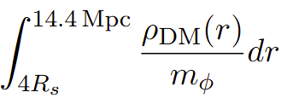
AGN
1.4Gpc
To give constraints on $m_{φ}$ and $σ_{0}$, we set a lower limit $Q$ to the ratio of scattered/unscattered event number
calculate $χ$ using $ρ_{DM}$, then calculate transmittance from $ν$FATE.
IceCube observed ${79}_{−20}^{+22}$ events from NGC 1068. 90% C. L. limit requires at least 46 events. So we set Q=0.5.
2 events for TXS. 90% C. L. limit requires at least 0.1 events. So we set Q=0.05.
Notes:
To give constraints on m_phi and sigma_0, we set a lower limit $Q$ to the ratio of scattered/unscattered event number. For NGC the IceCube observed 79 event excess with uncertainty plus 22 and -20 events. So the 90 CL limit requires at least 46 events and we set Q=0.5.
For TXS, two events is observed at IceCube . So the 90 CL limit requires Q=0.05.
And we calculate the column density using the spike density and then calculate the transmittance from the nuFATE.
These are the column density for NGC and TXS. NGC is located at 14.4 Mpc from earth, the redshift negligible. TXS is a much more distant source, it locates at 1.4 Gpc from earth. So the redshift effect is included.

Slide 18
AGN
when $m_{φ}≳0.1 MeV$ , annihilation becomes significant to reduce $ρ_{DM}$, $σ_{0}$ increases to compensate the decrease in $ρ_{DM}$.
TXS is less sensitive to DM annihilation than NGC, since $E_{ν}^{TXS}≫E_{ν}^{NGC}$.
without DM annihilation
$m_{φ}$ light enough, DM annihilation is negligible.
Notes:
This is the constraint of m_phi and sigma_0. The red line is for NGC and the blue is for TXS. The red dashed is the NGC constraint without the DM annihilation.
When m_phi is light enough, the red solid and the dashed line overlap, so the DM annihilation is negligible.
When $m_{φ}≳0.1 MeV$ , the annihilation becomes significant to reduce $ρ_{DM}$, so $σ_{0}$ increases to compensate the decrease in $ρ_{DM}$.
And the TXS constraints is less sensitive to the DM annihilation than the NGC, since the neutrino energy from TXS is much higher than that of NGC, the coupling constant y must be smaller to prevent the intense scattering.

Slide 19
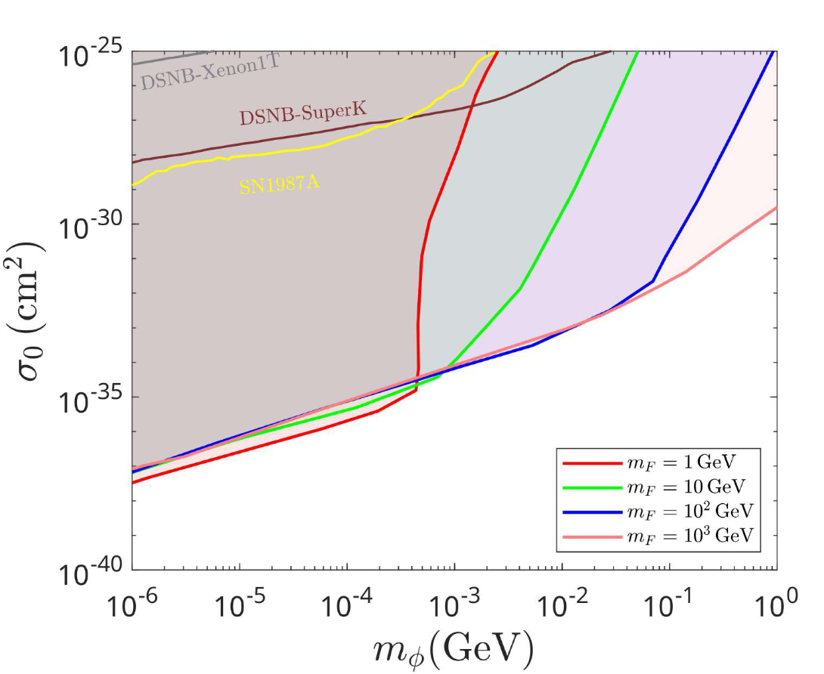
AGN
higher $E_{ν}$, higher $y$
Weaker constraints.
$$σ_{νφ}∝E_{ν}→σ_{νφ}∝E_{ν}^{−1}$$
NGC 1068
TXS 0506+056
Notes:
For comparison, we calculate the constraint without assuming heavy mediator limit and we set m_F to go from 1 to 1000 GeV.
We see that when m_F gets lighter, the constraints on sigma_0 becomes weaker,
because the dependence on energy of scattering cross section changes from E_nu to inverse of E_nu. So for TXS, it emits neutrino with higher energy, the cross section grows faster when m_F becomes smaller.

Slide 20
Summary
We consider $νφ$ interaction mediated by a fermionic particle $m_{F}$.
The cross section exhibits different energy dependence, especially under heavy mediator limits, $σ_{νφ}∝E_{ν}$.
The neutrinos are scattered by DMs during their propagation to earth, resulting in attenuations to their flux. By comparing to the experiment data, we set limits on DM-neutrino interactions via these attenuated flux.
Notes:
We consider an interaction between scalar DM and neutrino mediated by a fermionic particle.

Slide 21
END

