Slide 1
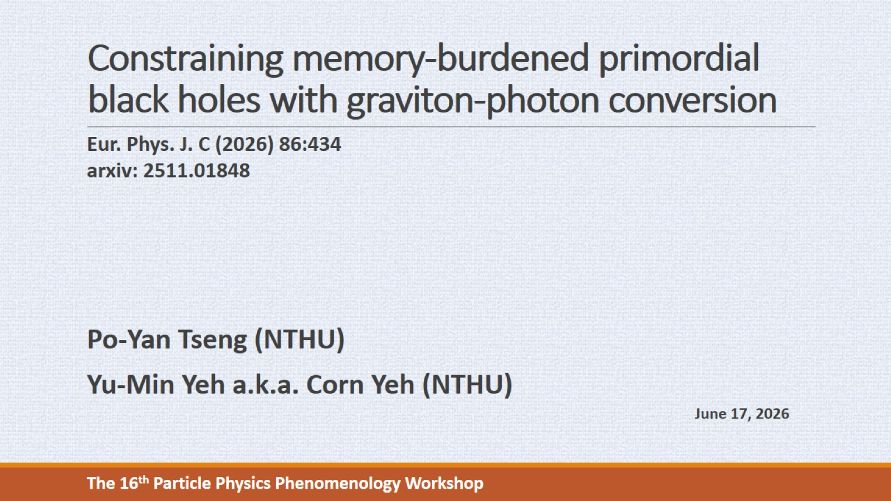
Constraining memory-burdened primordial black holes with graviton-photon conversion
Notes:
Today I’m going to talk about constraint on PBH by considering memory burden effect, and graviton-photon conversion.

Slide 2
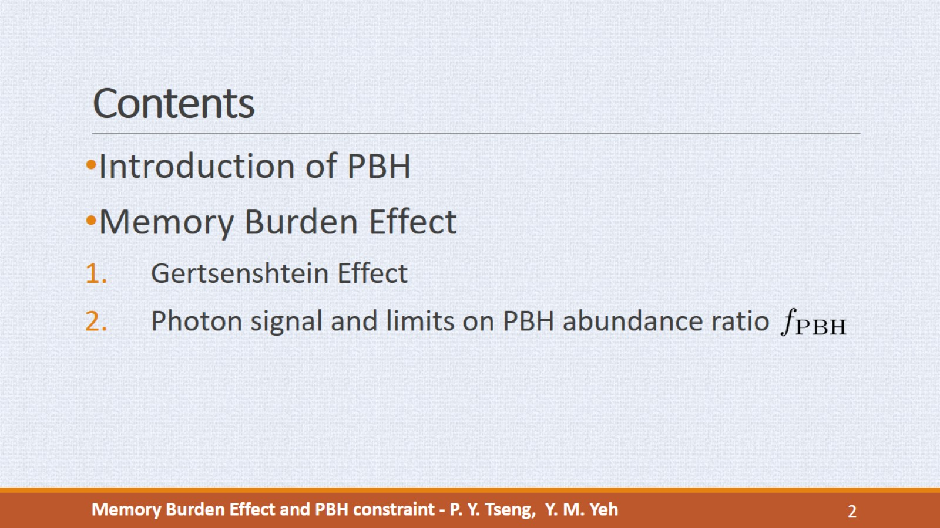
Contents
Notes:
In this talk I’ll briefly introduce the PBH, memory burden effect, and the graviton photon conversion. Then I’ll show the constraint on the PBH abundance ratio obtained from the PBH emission.

Slide 3

Notes:
Let’s start from the introduction of PBH

Slide 4
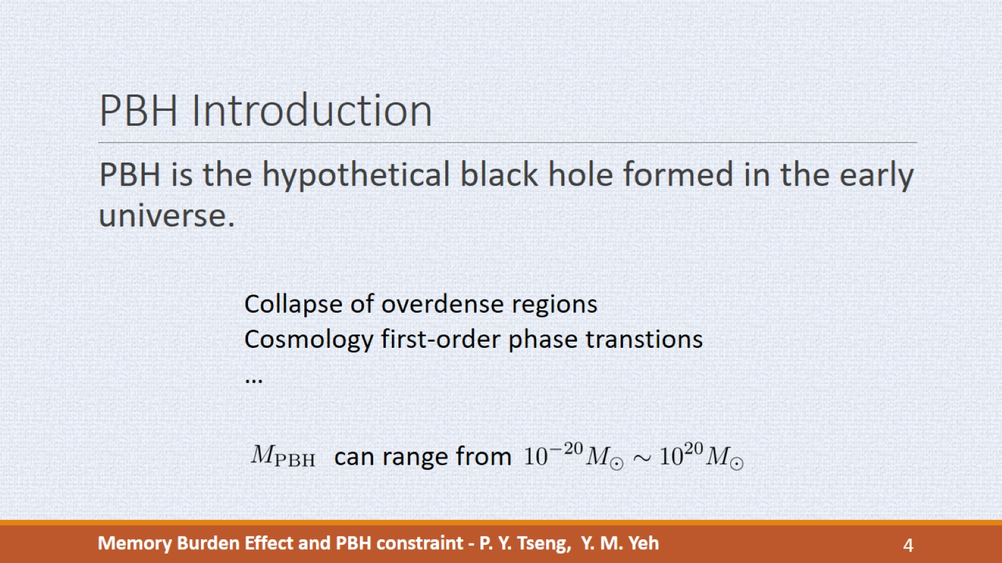
PBH Introduction
Notes:
PBH is the hypothetical black hole formed at the early universe and can be regarded as the dark matter candidate. (It is different from the usual BH that is formed by the collapse of dying stars.) PBH can be produced, for example, from the collapse of overdense regions in the early universe, or from the cosmology FOPT, which occur through the formation of bubbles, and the bubble collision can produce PBH.
(The typical mass of a usual BH is over a solar mass. )
The PBH mass from different model can range from 10^{-20} to 10^{20} times of solar mass, and we can use different signals produced from PBH to constrain the ratio between PBH and total DM.
For example, this is the plot of abundance ratio verses the PBH mass. For light PBH, we use the Hawking radiation spectrum to set limits. For heavier mass, the radiation is suppressed, so we may consider gravitational lensing, or gravitational waves from merging PBHs.

Slide 5
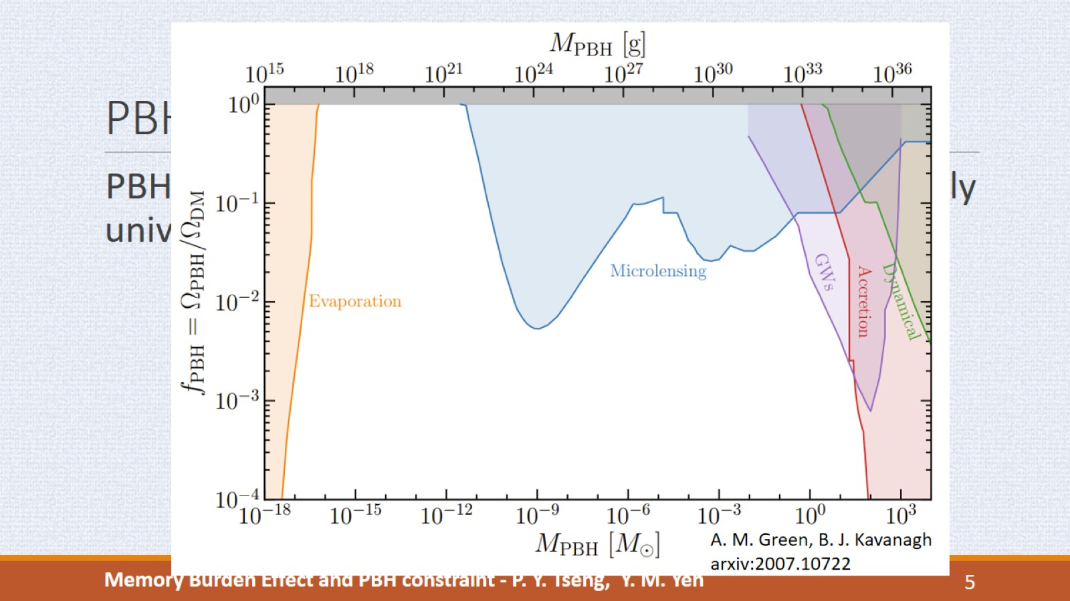
PBH Introduction
Notes:
For example, this is the plot of abundance ratio verses the PBH mass. For light PBH, we use the Hawking radiation spectrum to set limits. For heavier mass, the radiation is suppressed, so we may consider gravitational lensing, or gravitational waves from merging PBHs.
In this work we focus on constraining the PBH abundance within the mass range 10^4~10^17g by the photon spectrum from hawking radiation. For the semi-classical radiation, the PBH lighter than 10^{15} grams completely evaporated before today. But a novel quantum effect called ``memory bunden’’ can prolong the lifetime of PBH.

Slide 6
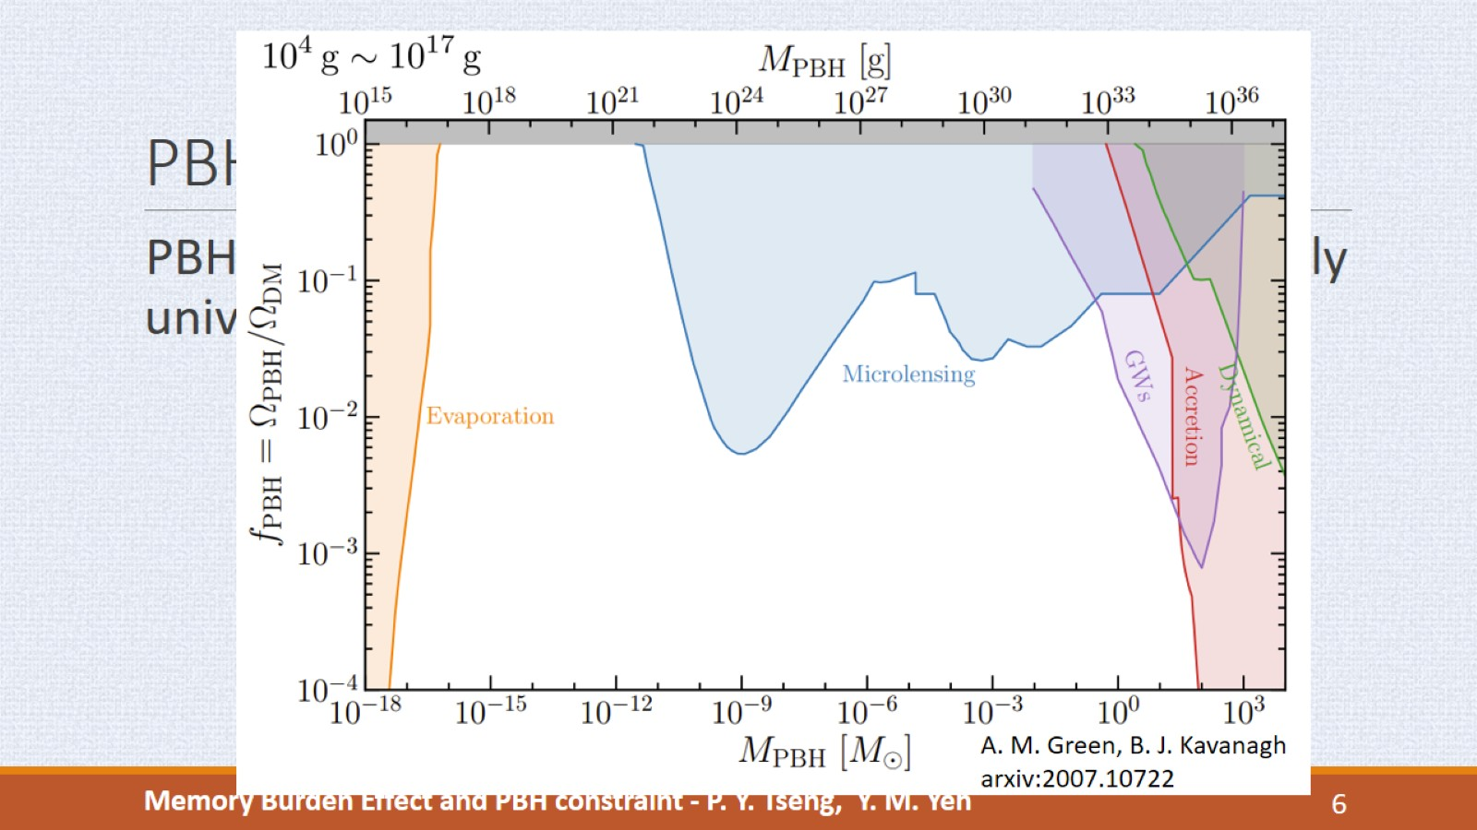
PBH Introduction
Notes:
In this work we focus on constraining the PBH abundance within the mass range 10^4~10^17g by the photon spectrum from hawking radiation. For the semi-classical radiation, the PBH lighter than 10^{15} grams completely evaporated before today. But a novel quantum effect called ``memory bunden’’ can prolong the lifetime of PBH.

Slide 7
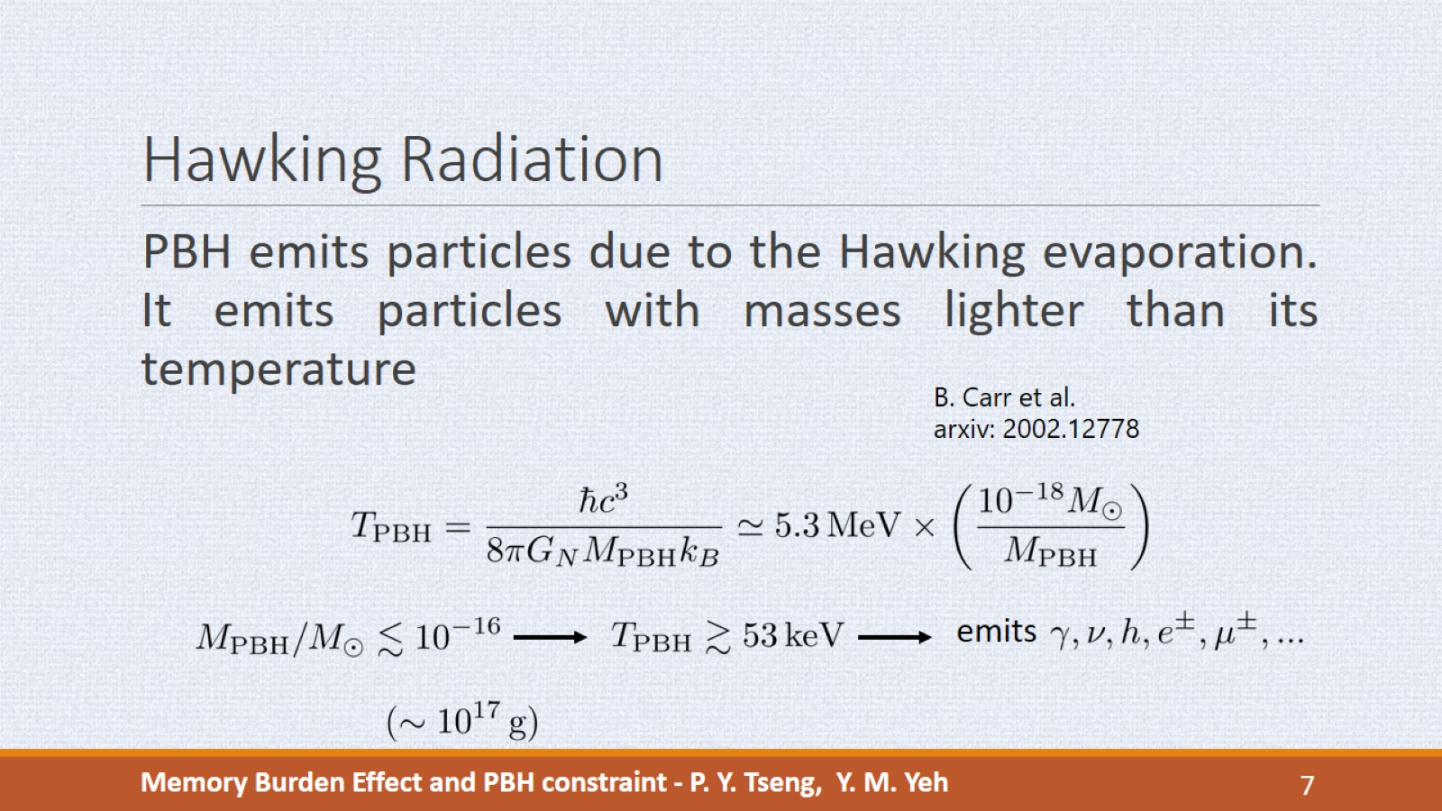
Hawking Radiation
Notes:
A PBH emits particles due to the Hawking evaporation, and it emits particles with masses lighter than its temperature. So for a heavy PBH, it emits mostly massless particles.
If the mass is less than 10^-16 times of solar mass, its temperature is 53 keV.
So the PBH with mass lighter than this has higher temperature to produce more massless particles and also massive leptons.

Slide 8

Notes:
Next we introduce Memory Burden effect.

Slide 9
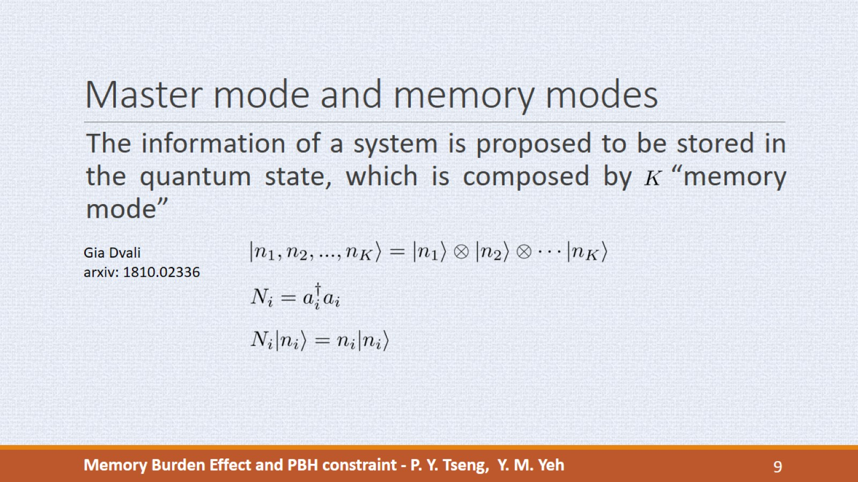
Master mode and memory modes
Notes:
This novel effect is proposed by Gia Dvali, he assumed that the information of a system is stored in a quantum state composed by K memory mode, and N_i is the number operator for each memory mode.
(The memory mode can be either boson state or fermion state, which depends on the commutation relations. )

Slide 10
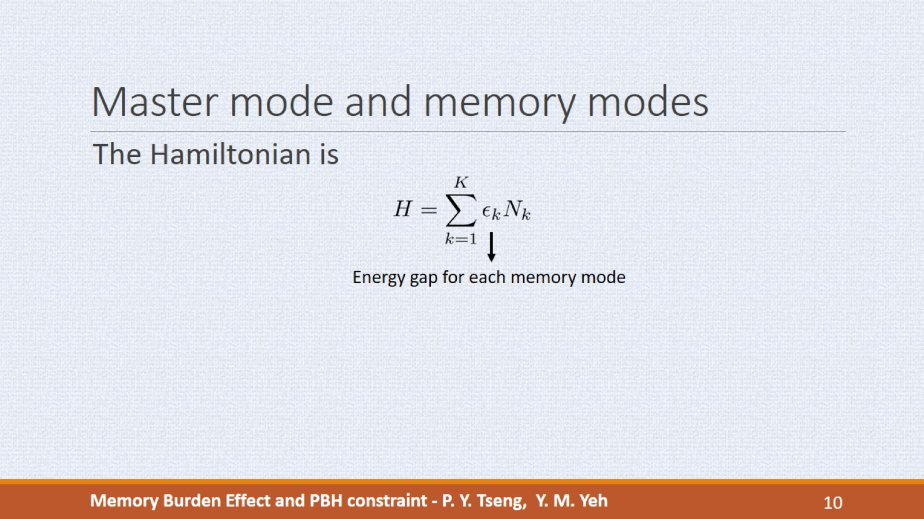
Master mode and memory modes
Notes:
The Hamiltonian of a state is the sum of energy gap for each memory mode times the number operator. So we can write down the energy difference of states with different occupation numbers. If epsilon_k is zero or negligible, we can have many degenerate states contribute the entropy.

Slide 11
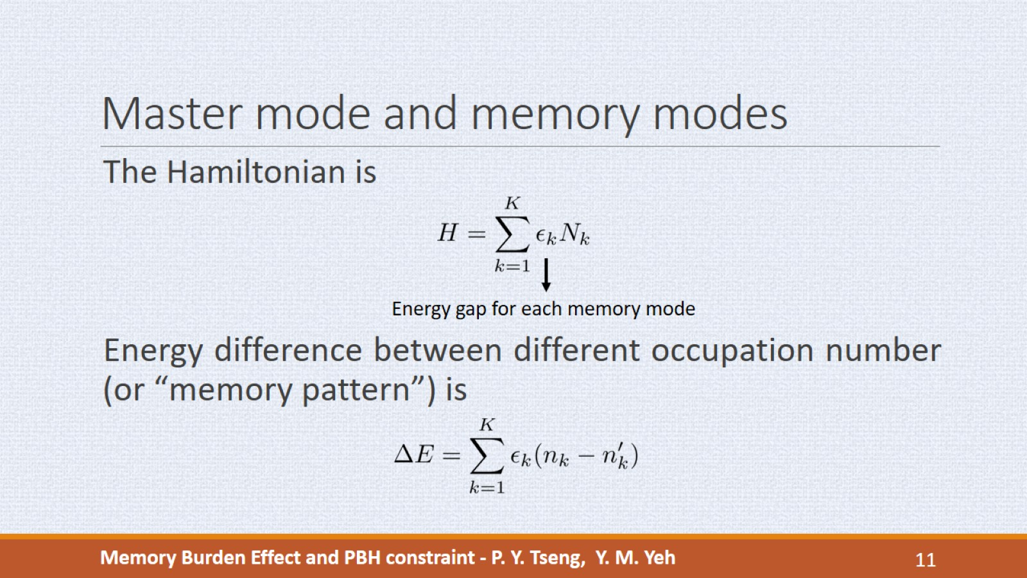
Master mode and memory modes
Notes:
The Hamiltonian of a state is the sum of energy gap for each memory mode times the number operator. So we can write down the energy difference of states with different occupation numbers. If epsilon_k is zero or negligible, we can have many degenerate states contribute the entropy.

Slide 12
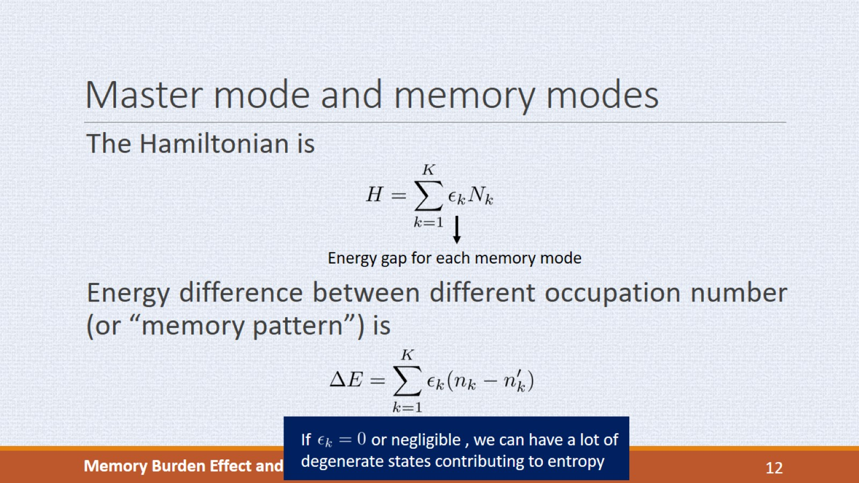
Master mode and memory modes
Notes:
The Hamiltonian of a state is the sum of energy gap for each memory mode times the number operator. So we can write down the energy difference of states with different occupation numbers. If epsilon_k is zero or negligible, we can have many degenerate states contribute the entropy.

Slide 13
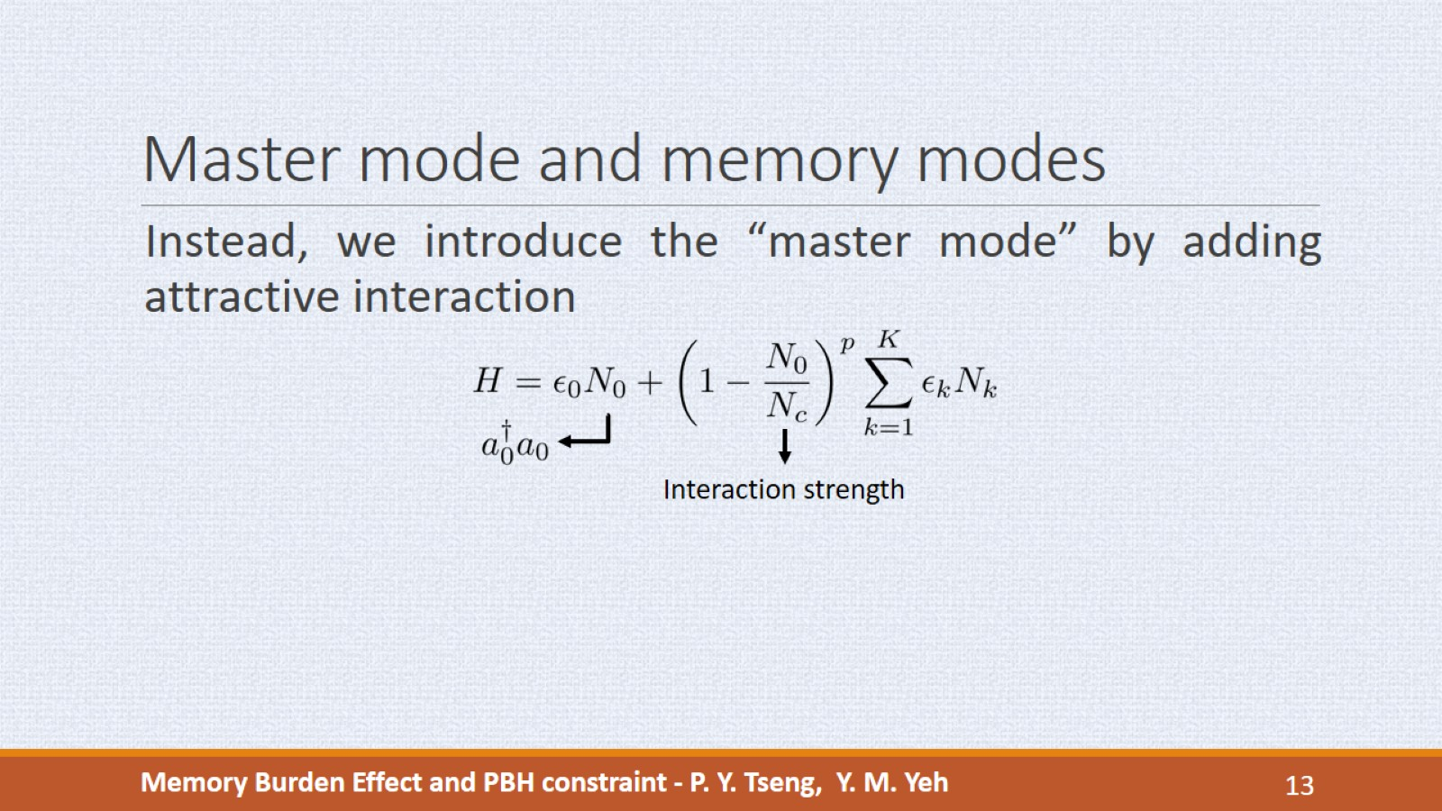
Master mode and memory modes
Notes:
Instead of setting epsilon_k zero, we add a new mode called master mode, and its occupation number is denoted by N_0. We assume that master mode has attractive interaction with all other modes. N_c is the interaction strength and it is much greater than 1, and p is a free parameter.
Once the master mode is occupied, the effective energy gap is decreased, and when n_0=N_c, the gap vanishes. So the n_0 equals N_c pattern is highly degenerate and the entropy is approximately the number of memory modes.

Slide 14
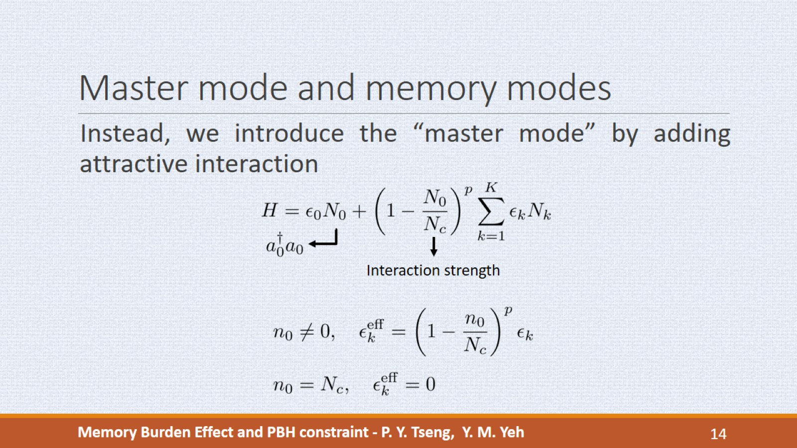
Master mode and memory modes
Notes:
Once the master mode is occupied, the effective energy gap is decreased, and when n_0=N_c, the gap vanishes. So the n_0 equals N_c pattern is highly degenerate and the entropy is approximately the number of memory modes.

Slide 15
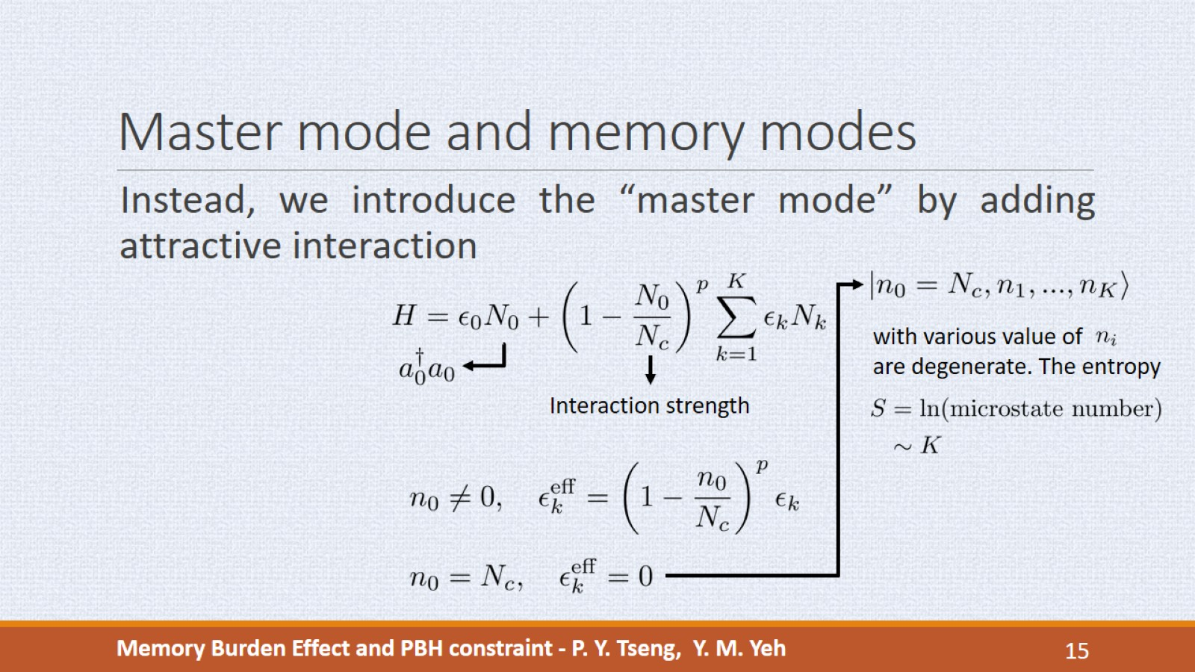
Master mode and memory modes
Notes:
Once the master mode is occupied, the effective energy gap is decreased, and when n_0=N_c, the gap vanishes. So the n_0 equals N_c pattern is highly degenerate and the entropy is approximately the number of memory modes.

Slide 16
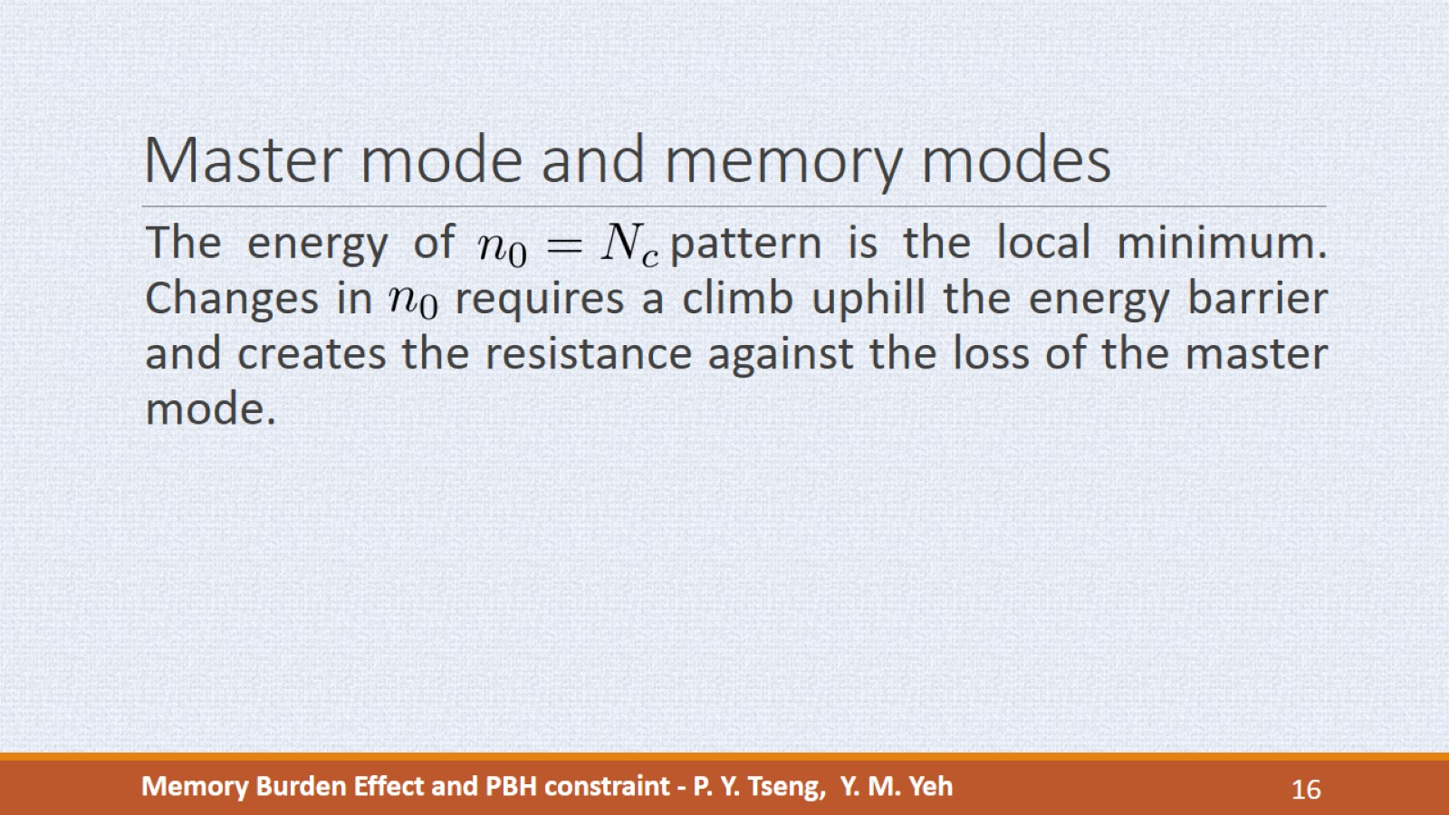
Master mode and memory modes
Notes:
The energy of n_0=N_c pattern is the local minimum. Any change in n_0 must overcome the energy barrier which creates the resistance against the loss of the master mode. This is the memory burden effect.
To apply memory burden to PBH, we note that the black hole entropy is related to the PBH mass. We assume PBH is initially at n_0=N_c pattern, and as PBH evaporates, the mass and entropy decrease (or the n_0 decreases), so the emission rate will be suppressed by the memory burden effect.

Slide 17
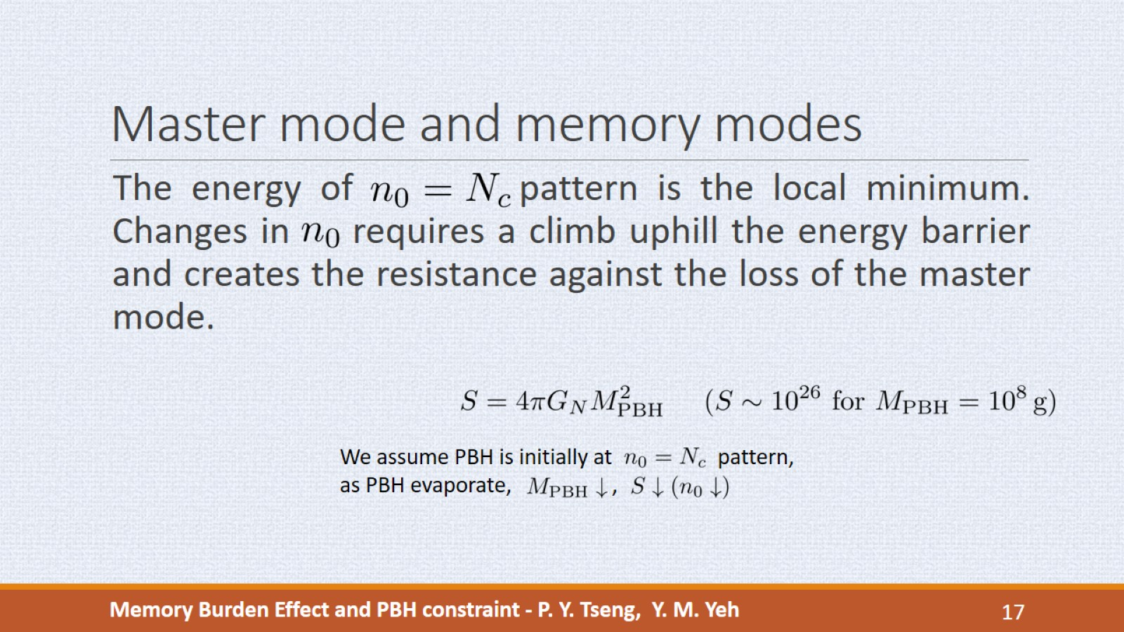
Master mode and memory modes
Notes:
The energy of n_0=N_c pattern is the local minimum. Any change in n_0 must overcome the energy barrier which creates the resistance against the loss of the master mode. This is the memory burden effect.
To apply memory burden to PBH, we note that the black hole entropy is related to the PBH mass. We assume PBH is initially at n_0=N_c pattern, and as PBH evaporates, the mass and entropy decrease (or the n_0 decreases), so the emission rate will be suppressed by the memory burden effect.

Slide 18

Memory burden of PBH
Notes:
It can be shown that when the free parameter p is large, the memory burden can be delayed at most until PBH loss half of its original mass.
The T_\phi denotes the formation temperature of PBH, and it is irrelevant to our calculation. It is just a notation of initial mass. The parameter q denote fraction of PBH mass when it enters the burden phase.
So, when the PBH mass is greater than half of initial mass, it evaporates by hawking radiation without suppression, which we called semi-classical phase. When the mass is lower that half of initial mass, it enters the burden phase, and the emission rate is suppressed.

Slide 19
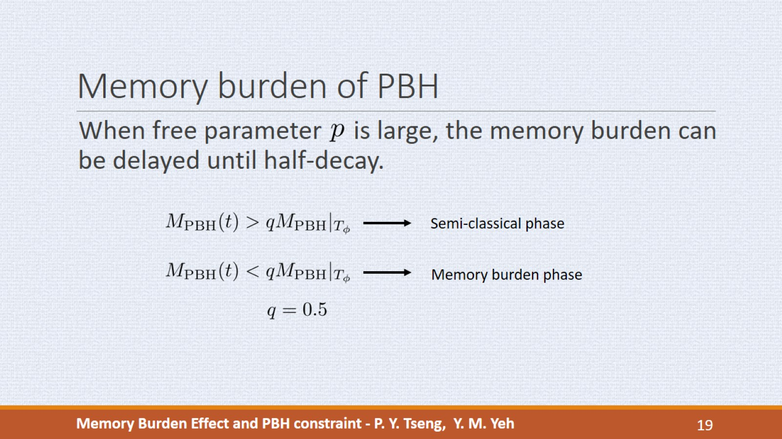
Memory burden of PBH
Notes:
It can be shown that when the free parameter p is large, the memory burden can be delayed at most until PBH loss half of its original mass.
The T_\phi denotes the formation temperature of PBH, and it is irrelevant to our calculation. It is just a notation of initial mass. The parameter q denote fraction of PBH mass when it enters the burden phase.
So, when the PBH mass is greater than half of initial mass, it evaporates by hawking radiation without suppression, which we called semi-classical phase. When the mass is lower that half of initial mass, it enters the burden phase, and the emission rate is suppressed.

Slide 20
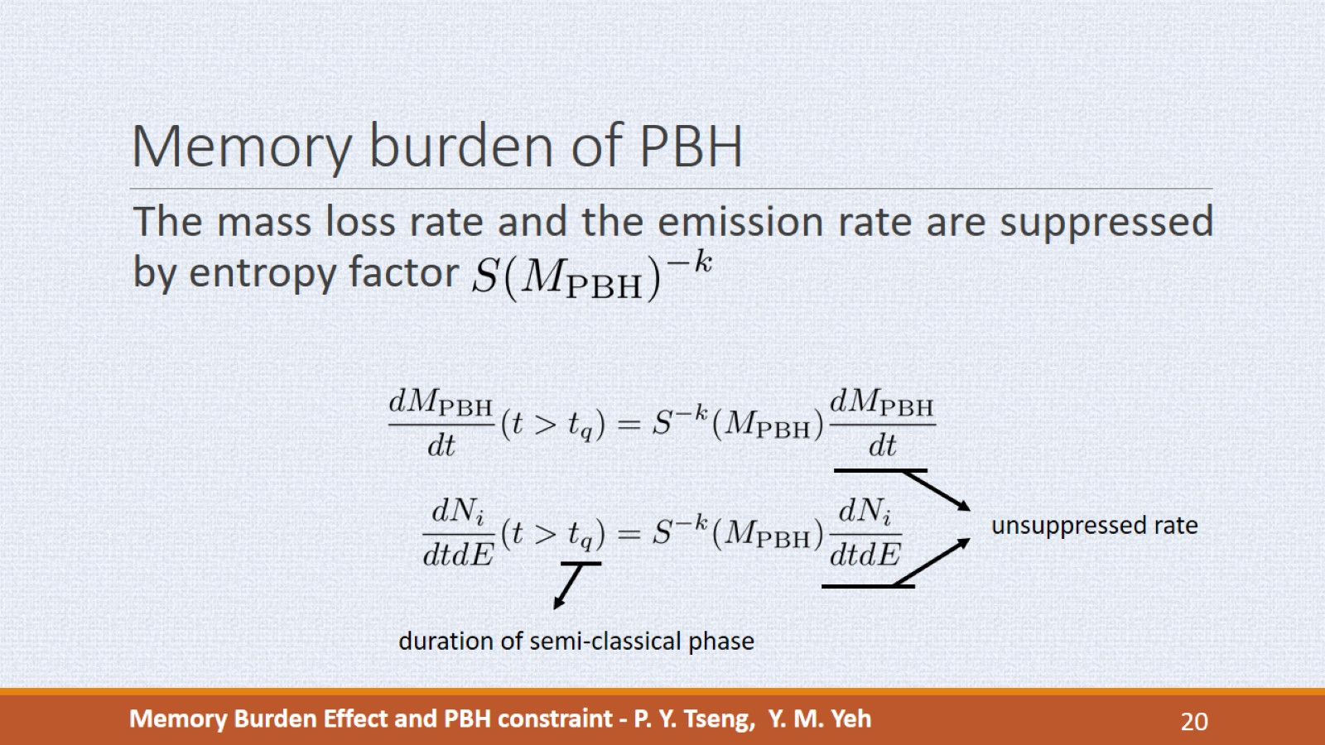
Memory burden of PBH
Notes:
In the burden phase, the mass loss rate and the emission rate are suppressed by the same entropy factor, where k is an adjustable parameter that control the strenghth of memory burden effect. t_q is the times it takes for PBH to evaporate half of the initial mass. If k=0 we get the unsuppressed semi-classical rate.
This the graviton spectra of initial PBH mass 10^8 grams from different value of k. For k=0 the spectrum only has on peak. As we increases k, the spectrum first drop because PBH enters burden phase, then raise again as it keep evaporating.
We see that all spectra with non-zero k exhibit double peak shape, and this is a feature due to the burden effect. We call the low energy peak as the first peak, and the high energy peak as second peak.

Slide 21
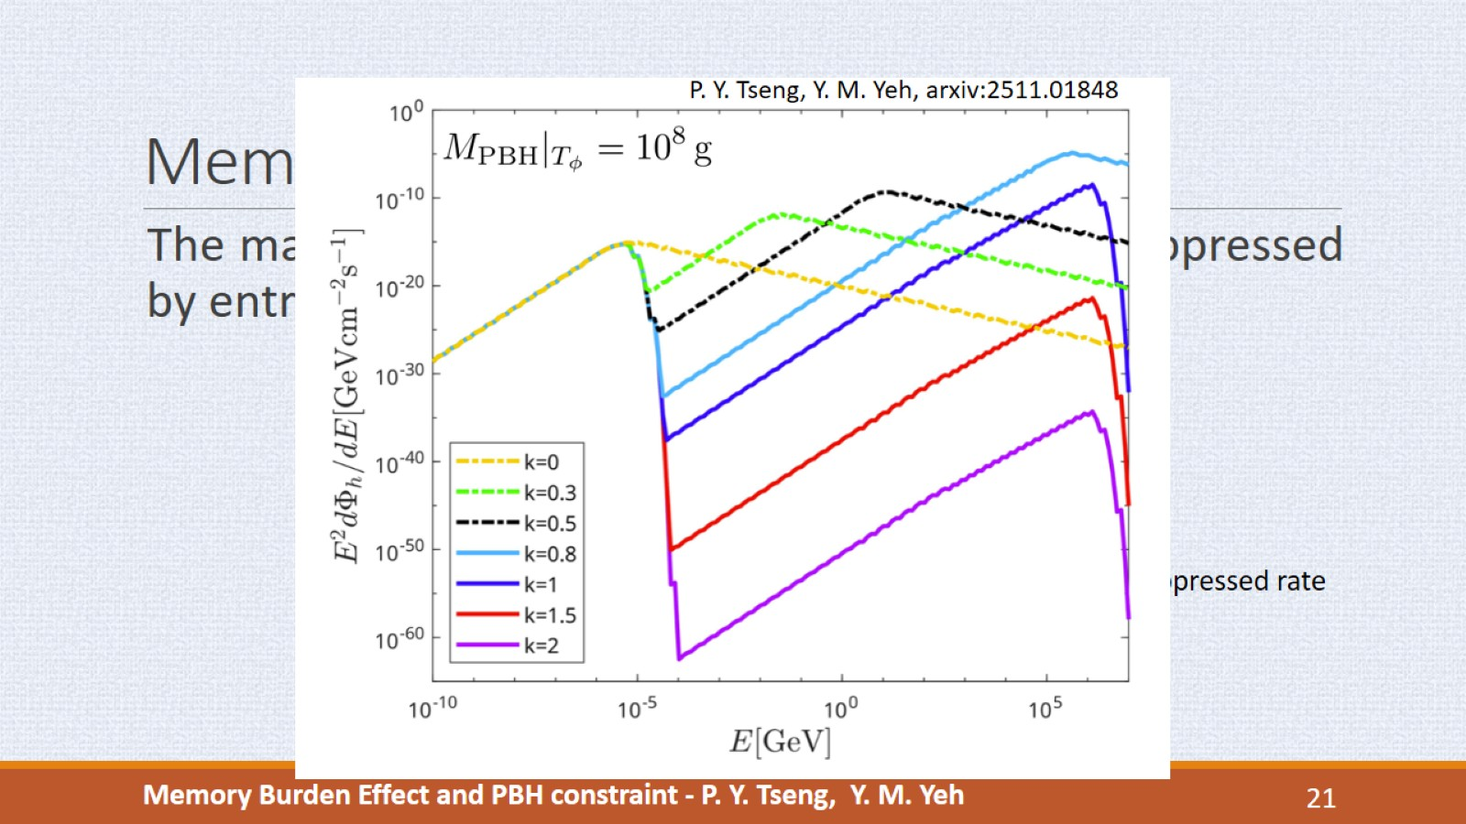
Memory burden of PBH
Notes:
This the graviton spectra of initial PBH mass 10^8 grams from different value of k. For k=0 the spectrum only has on peak. As we increases k, the spectrum first drop because PBH enters burden phase, then raise again as it keep evaporating.
We see that all spectra with non-zero k exhibit double peak shape, and this is a feature due to the burden effect. We call the low energy peak as the first peak, and the high energy peak as second peak.

Slide 22
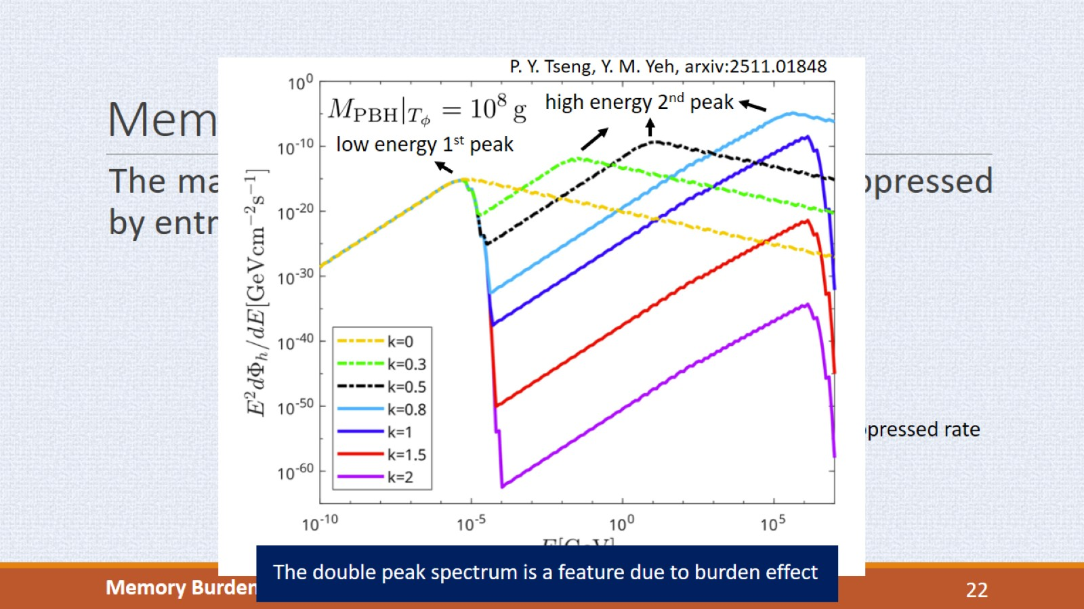
Memory burden of PBH
Notes:
This the graviton spectra of initial PBH mass 10^8 grams from different value of k. For k=0 the spectrum only has on peak. As we increases k, the spectrum first drop because PBH enters burden phase, then raise again as it keep evaporating.
We see that all spectra with non-zero k exhibit double peak shape, and this is a feature due to the burden effect. We call the low energy peak as the first peak, and the high energy peak as second peak.

Slide 23
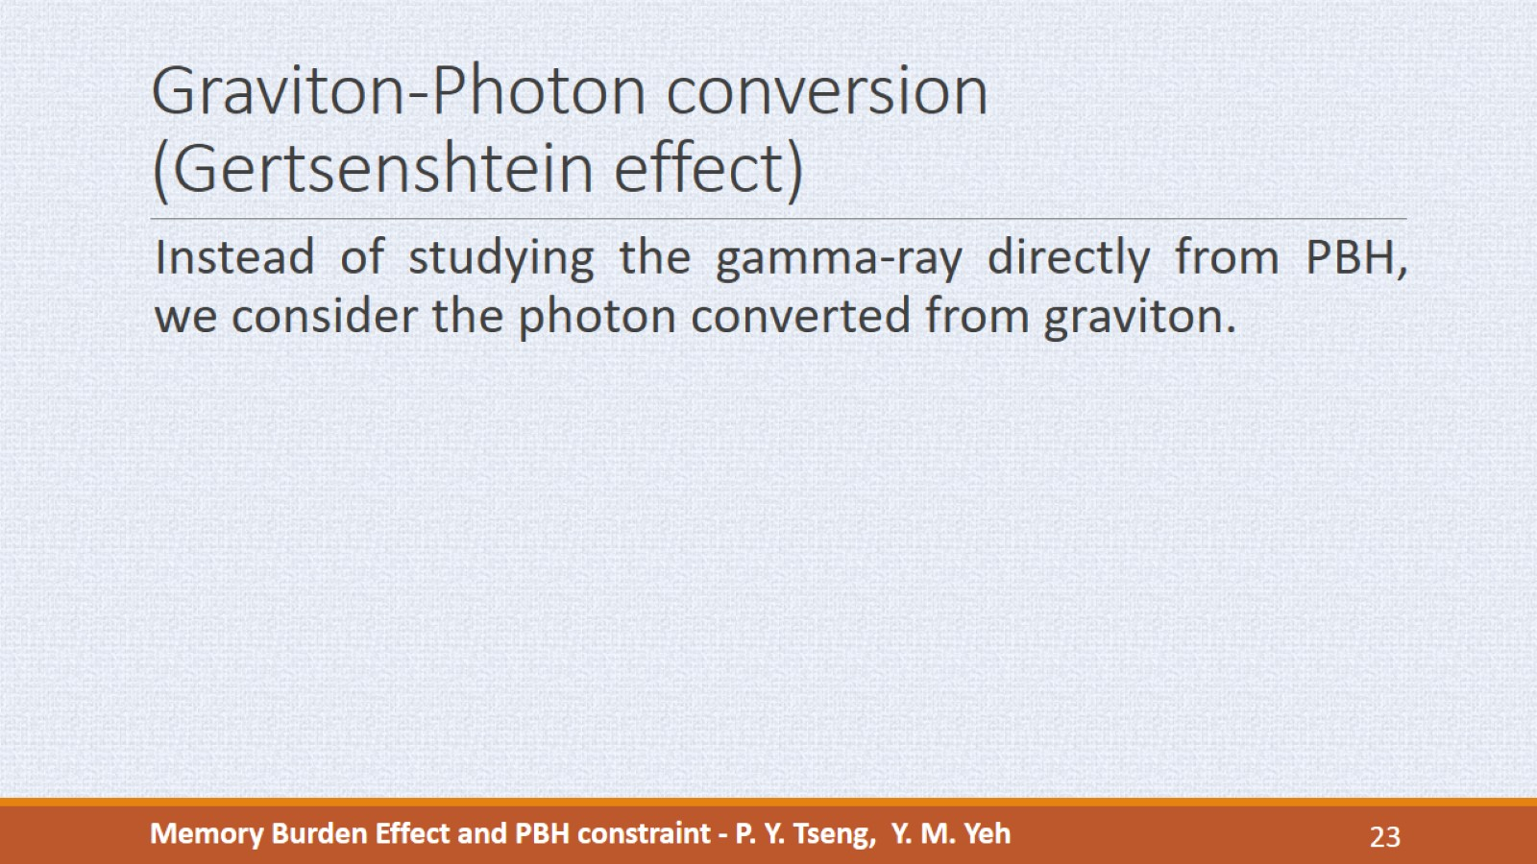
Graviton-Photon conversion
(Gertsenshtein effect)
Notes:
In this work we use the photon spectrum from PBH to set limit on abundance ratio. But Instead of studying the gamma-ray directly from PBH, we consider the photon spectrum converted from graviton.
(The reason is that the PBH with mass less than 10^{13} grams, their low energy first peaks are produced before CMB formation, and since photons are scattered intensively before CMB, we choose to consider graviton-photon conversion mechanism. The gravitons are free to propagate before and after CMB, so we can use converted photon flux after CMB to calculate the f_PBH limit. )
The graviton-photon conversion mechanism is called the Gertsenshtein Effect (Герценштейн, after Михаил Евгеньевич Герценштейн), which is named after a Soviet union physicist.
The effect describes the gravitational wave that propagates under the influence of EM field, then GW will be mixed by EM wave (analogous to neutrino oscillation). Therefore, we can calculate the probability for graviton to convert into photon.
In our work, we consider the gravitons emitted from a PBH propagate through the cosmic filament, which possess uniform magnetic field.

Slide 24
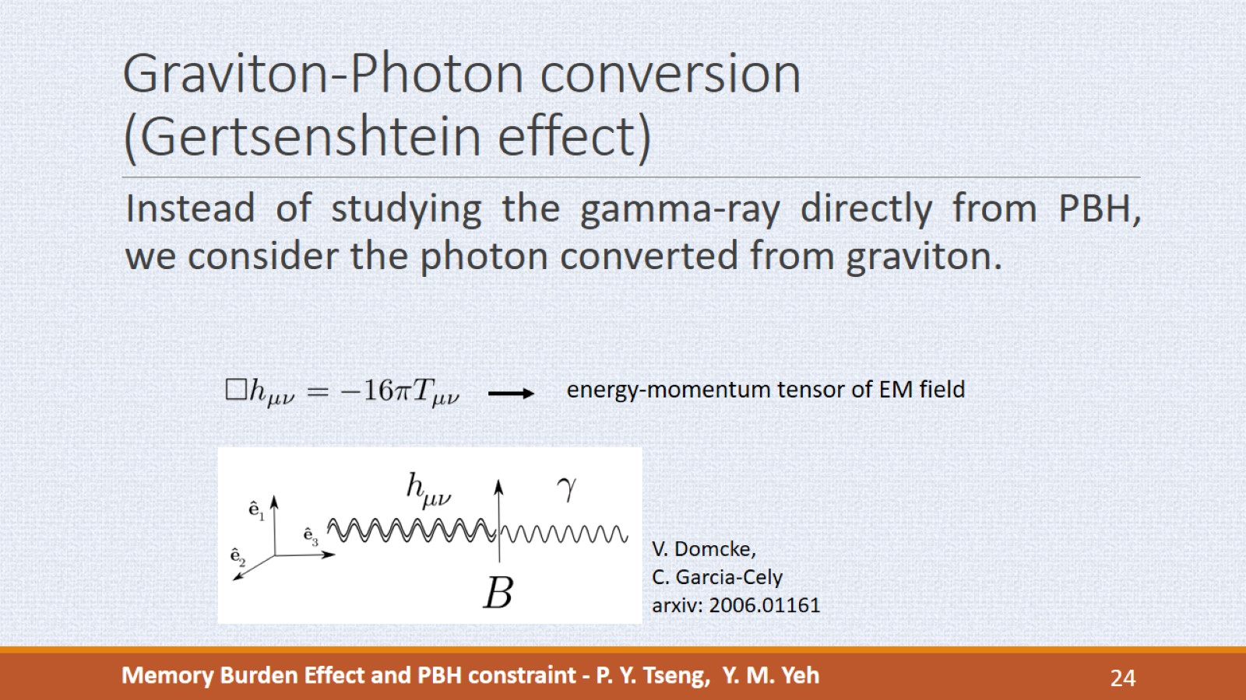
Graviton-Photon conversion
(Gertsenshtein effect)
Notes:
The graviton-photon conversion mechanism is called the Gertsenshtein (Герценштейн, after Михаил Евгеньевич Герценштейн) Effect, which is named after a Soviet union physicist.
The effect describes the gravitational wave that propagates under the influence of EM field, then GW will be mixed by EM wave (analogous to neutrino oscillation). Therefore, we can calculate the probability for graviton to convert into photon.
In our work, we consider the gravitons emitted from a PBH propagate through the cosmic filament, which possess uniform magnetic field.

Slide 25
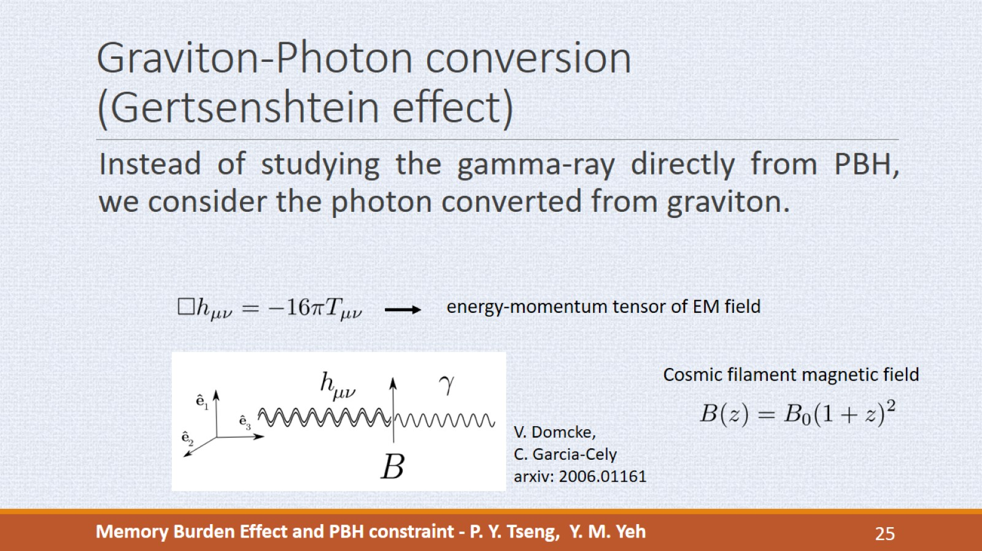
Graviton-Photon conversion
(Gertsenshtein effect)
Notes:
In our work, we consider the gravitons emitted from a PBH propagate through the cosmic filament, which possess uniform magnetic field.

Slide 26
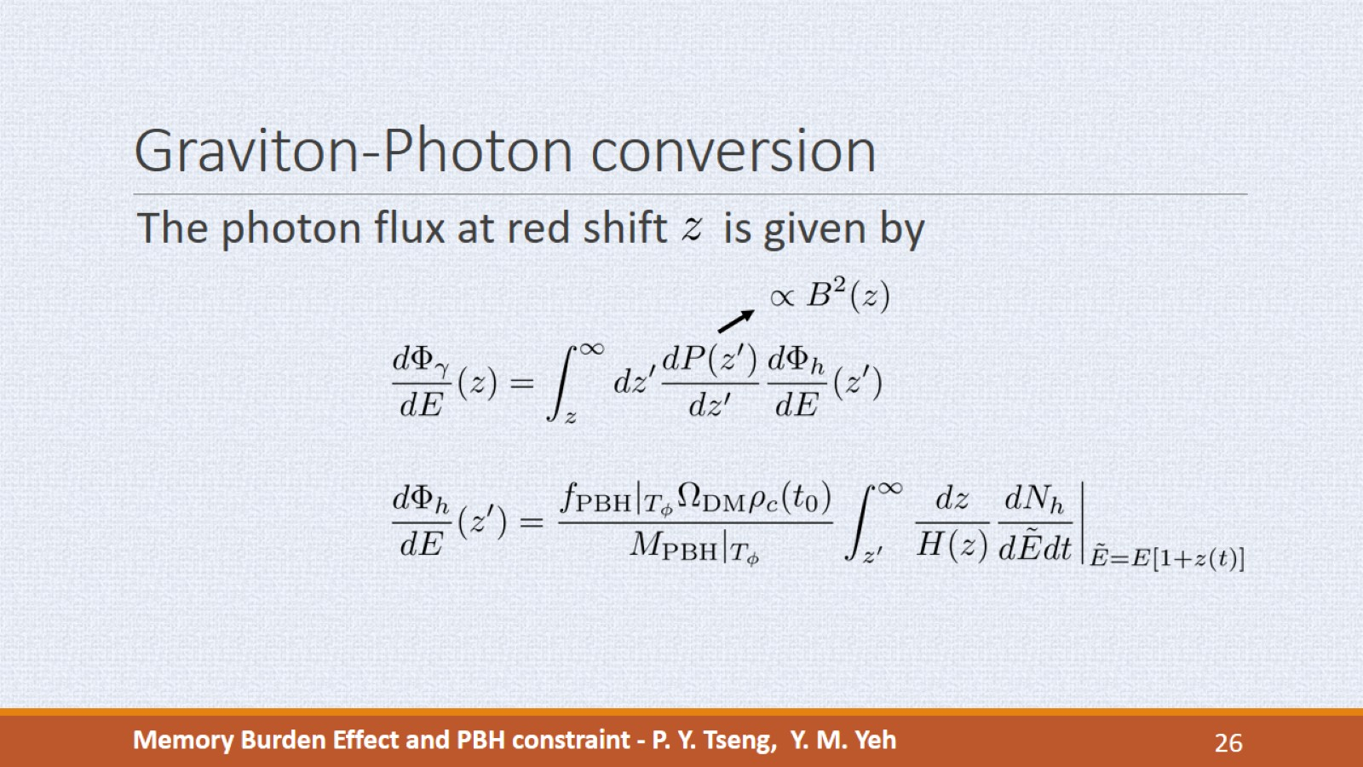
Graviton-Photon conversion
Notes:
We compute photon flux from the differential conversion probability, which is proportional to the square of magnetic field, and the graviton flux from PBH.
The graviton flux from PBH is proportional to the initial abundance ratio and initial mass, so by requiring the extragalactic photon flux remain below the experiment sensitivity, we obtain the constraint on f_PBH, where values above the curve are excluded by experiments. The band is the uncertainty from the magnetic field amplitude, and the central line if for B0=100 nG.
The k=1 curve can be divided into four regions. In region I, the PBH mass is too small so even though its life time is extended by burden effect, it still totally evaporated before today. The f_PBH decrease because when we increase the PBH mass, its lifetime get closer to the age of universe, and the flux gets enhanced due to the final evaporation.
In region II, the PBH is in burden phase at present universe, the high energy second peak of its spectrum decreases as mass becomes larger, because the suppression is proportional to entropy, and entropy is proportional to mass square, so the heavier PBH has lower second peak.
In region III, the low energy first peak amplitude overtakes the second peak, and the first peak amplitude increases with mass, so f_PBH falls again.
In region IV, the PBH is too heavy so it still haven’t loss half of its original mass, and it is still in semi-classical phase today. In this region k is irrelevant and the spectrum only has one peak, and the heavy PBH evaporates weakly because of its low temperature, so f_PBH rises again.
We have also computed the constraint for k=0.5 and k=2 for comparison. From k=0.5 to k=1, the valley between region I and II shift to lower mass because the burden effect gets stronger.
The colored shaded regions are the constraint on f_PBH using the flux directly from PBH emissions and they are much stronger than our results. But the photon signal before cosmic recombination are undetectable because photons are intensively scattered by electrons. So the photon spectrum from PBH that we observed today is produced after CMB formation and is suppressed by burden effect.
But in our case, the graviton can propagate freely through the cosmic recombination, so the subsequent converted photon flux are free to propagate to earth. So our constraints can provide a complementary limit on the abundance of PBH. (Complement from those signals before CMB)

Slide 27
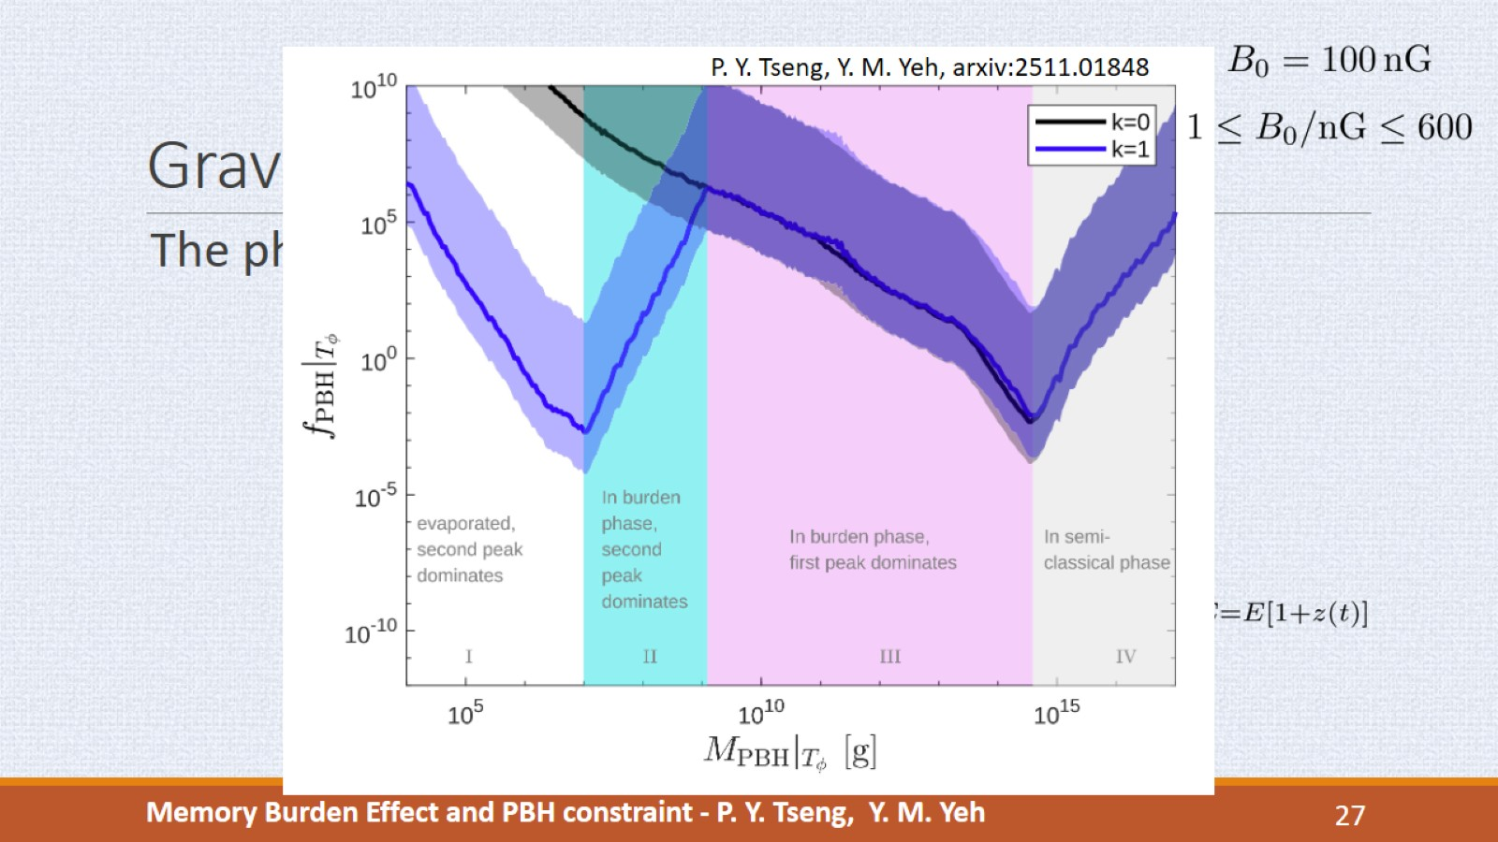
Graviton-Photon conversion
Notes:
The graviton flux from PBH is proportional to the initial abundance ratio and initial mass, so by requiring the extragalactic photon flux remain below the experiment sensitivity, we obtain the constraint on f_PBH, where values above the curve are excluded by experiments. The band is the uncertainty from the magnetic field amplitude, and the central line if for B0=100 nG.
The k=1 curve can be divided into four regions. In region I, the PBH mass is too small so even though its life time is extended by burden effect, it still totally evaporated before today. The f_PBH decrease because when we increase the PBH mass, its lifetime get closer to the age of universe, and the flux gets enhanced due to the final evaporation.
In region II, the PBH is in burden phase at present universe, the high energy second peak of its spectrum decreases as mass becomes larger, because the suppression is proportional to entropy, and entropy is proportional to mass square, so the heavier PBH has lower second peak.
In region III, the low energy first peak amplitude overtakes the second peak, and the first peak amplitude increases with mass, so f_PBH falls again.
In region IV, the PBH is too heavy so it still haven’t loss half of its original mass, and it is still in semi-classical phase today. In this region k is irrelevant and the spectrum only has one peak, and the heavy PBH evaporates weakly because of its low temperature, so f_PBH rises again.
We have also computed the constraint for k=0.5 and k=2 for comparison. From k=0.5 to k=1, the valley between region I and II shift to lower mass because the burden effect gets stronger.
The colored shaded regions are the constraint on f_PBH using the flux directly from PBH emissions and they are much stronger than our results. But the photon signal before cosmic recombination are undetectable because photons are intensively scattered by electrons. So the photon spectrum from PBH that we observed today is produced after CMB formation and is suppressed by burden effect.
But in our case, the graviton can propagate freely through the cosmic recombination, so the subsequent converted photon flux are free to propagate to earth. So our constraints can provide a complementary limit on the abundance of PBH. (Complement from those signals before CMB)

Slide 28
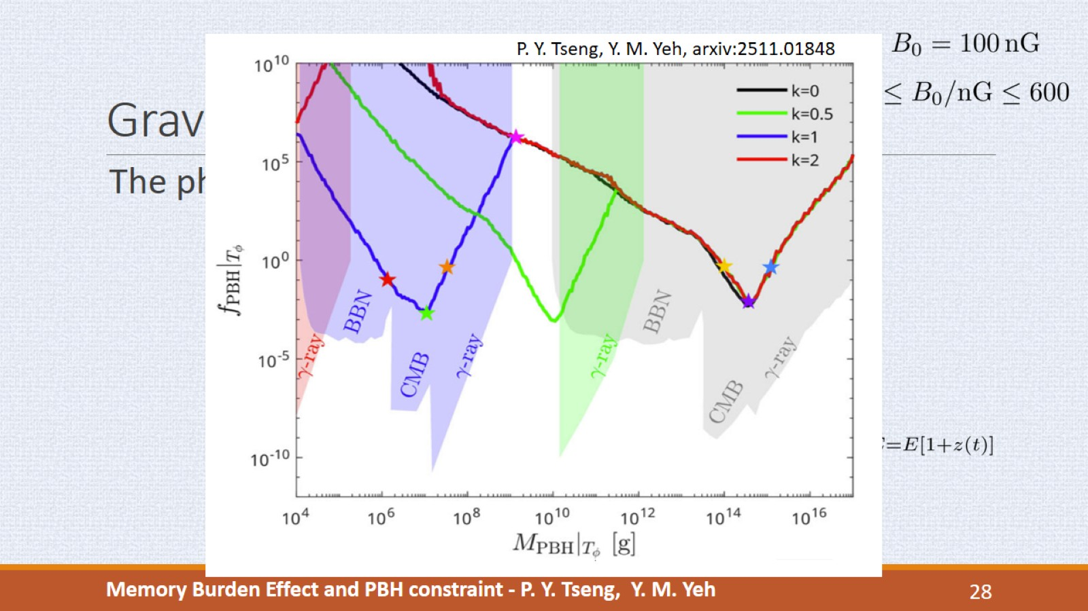
Graviton-Photon conversion
Notes:
We have also computed the constraint for k=0.5 and k=2 for comparison. From k=0.5 to k=1, the valley between region I and II shift to lower mass because the burden effect gets stronger.
The colored shaded regions are the constraint on f_PBH using the flux directly from PBH emissions and they are much stronger than our results. But the photon signal before cosmic recombination are undetectable because photons are intensively scattered by electrons. So the photon spectrum from PBH that we observed today is produced after CMB formation and is suppressed by burden effect.
But in our case, the graviton can propagate freely through the cosmic recombination, so the subsequent converted photon flux are free to propagate to earth. So our constraints can provide a complementary limit on the abundance of PBH. (Complement from those signals before CMB)

Slide 29
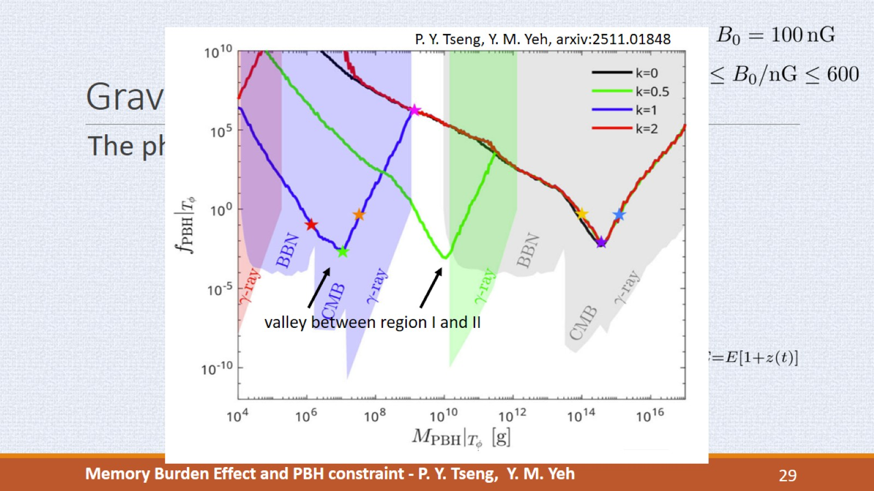
Graviton-Photon conversion
Notes:
We have also computed the constraint for k=0.5 and k=2 for comparison. From k=0.5 to k=1, the valley between region I and II shift to lower mass because the burden effect gets stronger.
The colored shaded regions are the constraint on f_PBH using the photon flux directly from PBH emissions and they are much stronger than our results. But the photon signal before cosmic recombination are undetectable because photons are intensively scattered by electrons. So the photon spectrum from PBH that we observed today is produced after CMB formation and is suppressed by burden effect.
But in our case, the graviton can propagate free through the cosmic recombination, so the subsequent converted photon flux contain both the low energy first peak and high energy second peak. So our constraints can provide a complementary limit on the abundance of PBH. (Complement from those signals before CMB)

Slide 30
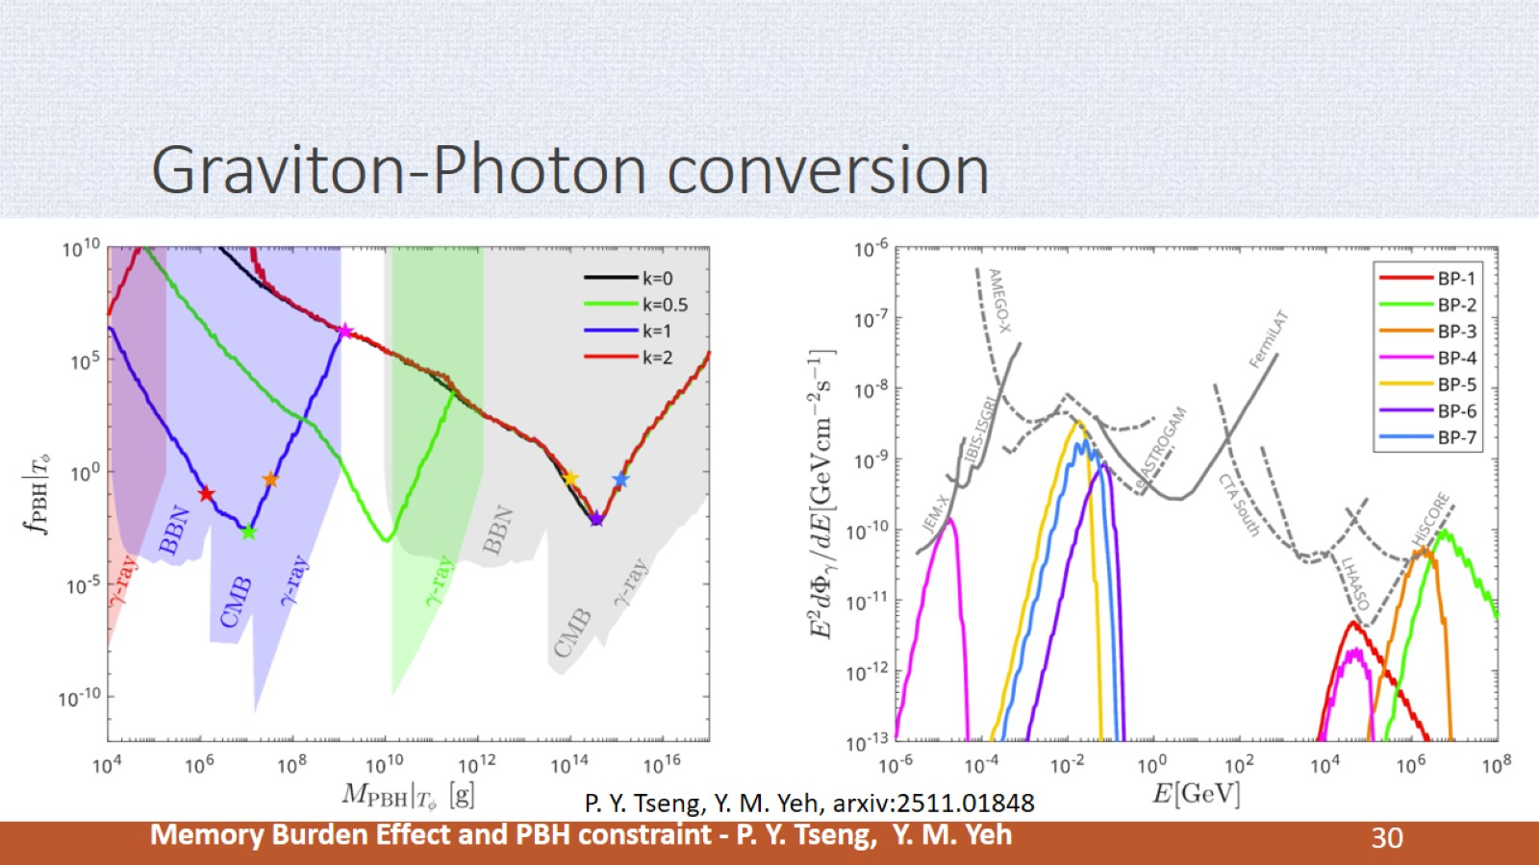
Graviton-Photon conversion
Notes:
The stars on the k=1 curve are the BPs we chose, and the plot on the right are their photon spectra. For BP1 to 3, they locate at region I and II, so their spectra are dominated by the high energy second peak, so these are the second peak of BP1, 2, and 3.
For BP4, it locates between region II and III, so the amplitude of first and second peak are comparable, and its spectrum shows explicitly two-peak feature.
For BP5, 6, their spectra are dominated by the low energy first peak, and for BP7, it is still in semi-classical phase, so it has only one peak.

Slide 31
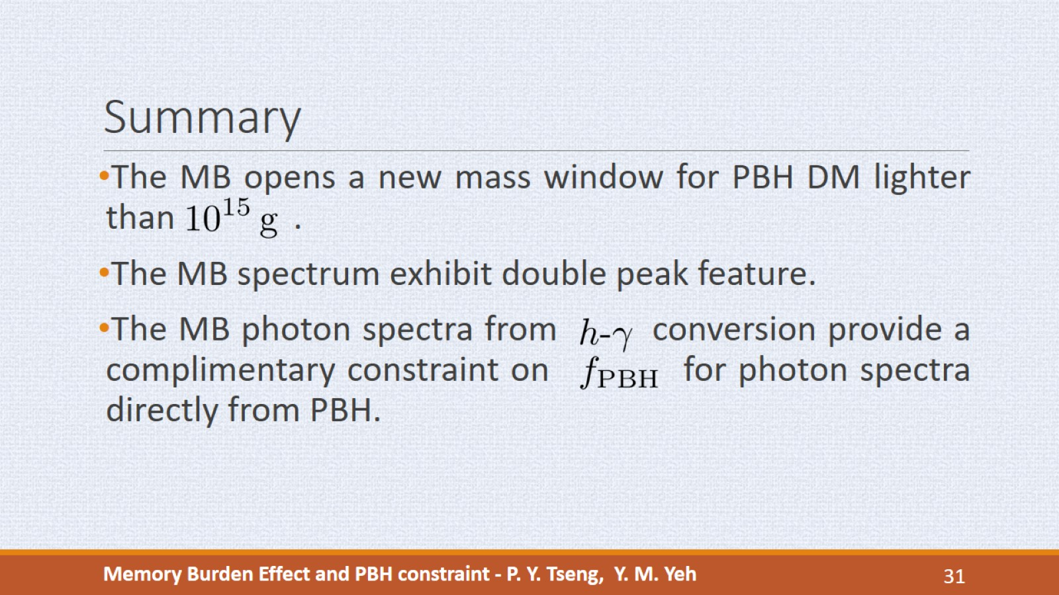
Summary
Notes:
To summarize,
We focus on the memory burden effect and its application to PBH. The burden effect extend the lifetime of low mass PBH, and making them the viable dark matter candidate. We compute the memory burden spectra and find them exhibit the double energy peak feature. Then we consider the photon spectrum from graviton conversion, and calculated the limits on f_PBH, where the limits can be consider as the complimentary constraint for those using the photon spectrum directly from PBH.
we focus on the novel quantum effect on the memory storage, and we find the memory burden spectra exhibit the double energy peak feature. We consider the photon spectrum from graviton conversion, and calculated the limits on f_PBH, where the limits can be consider as the complimentary constraint for those using the photon spectrum directly from PBH.

Slide 32


Slide 33
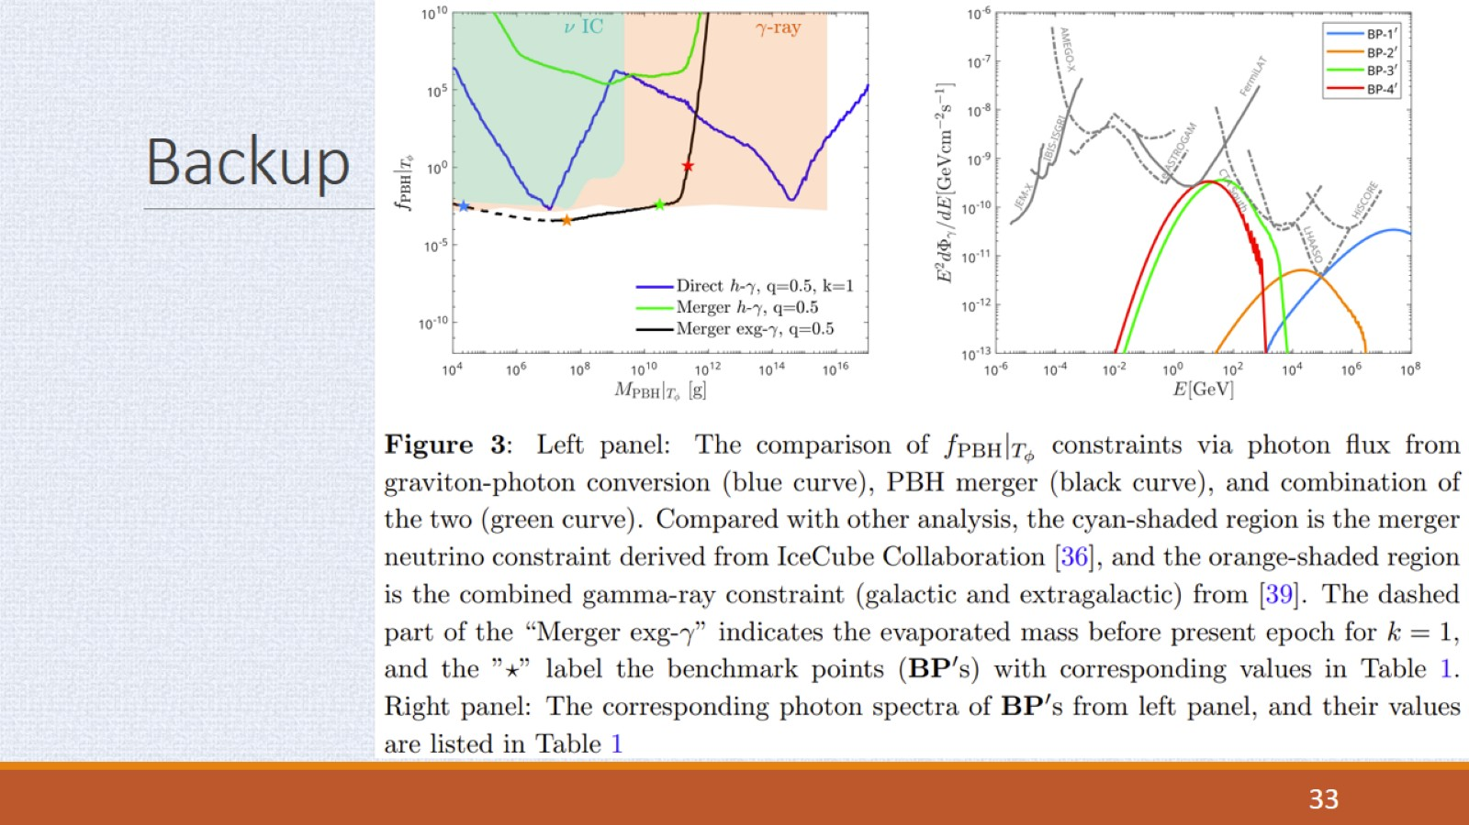
Backup

Slide 34
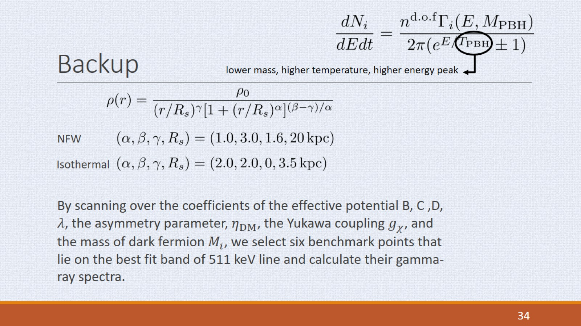
Backup

Slide 35
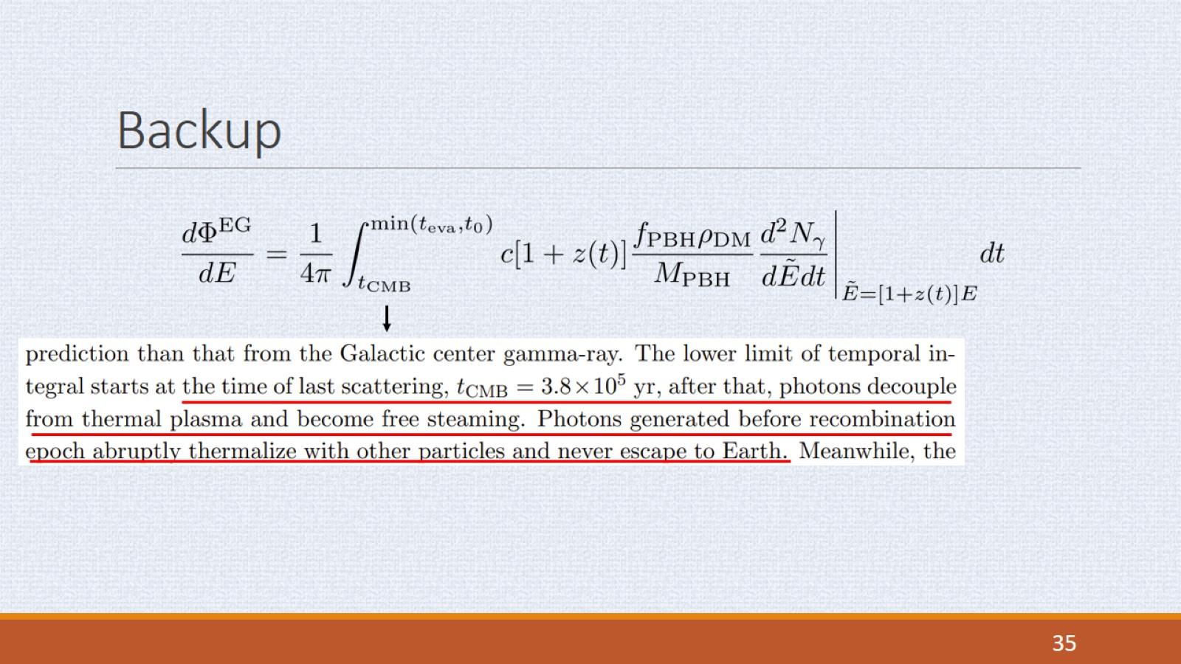
Backup

Slide 36
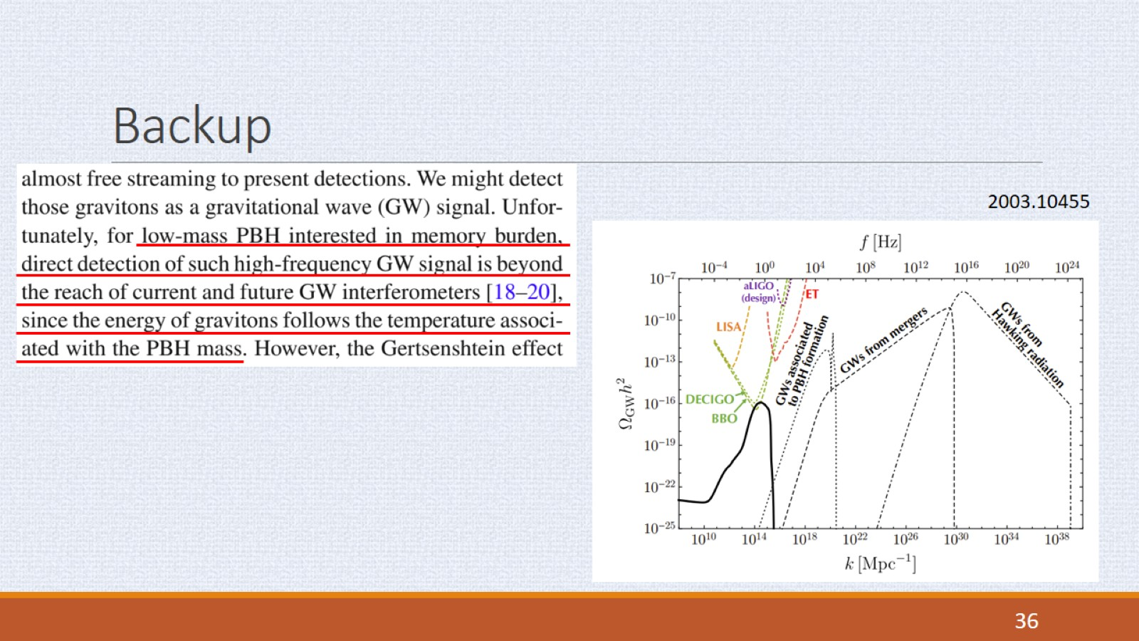
Backup

Slide 37
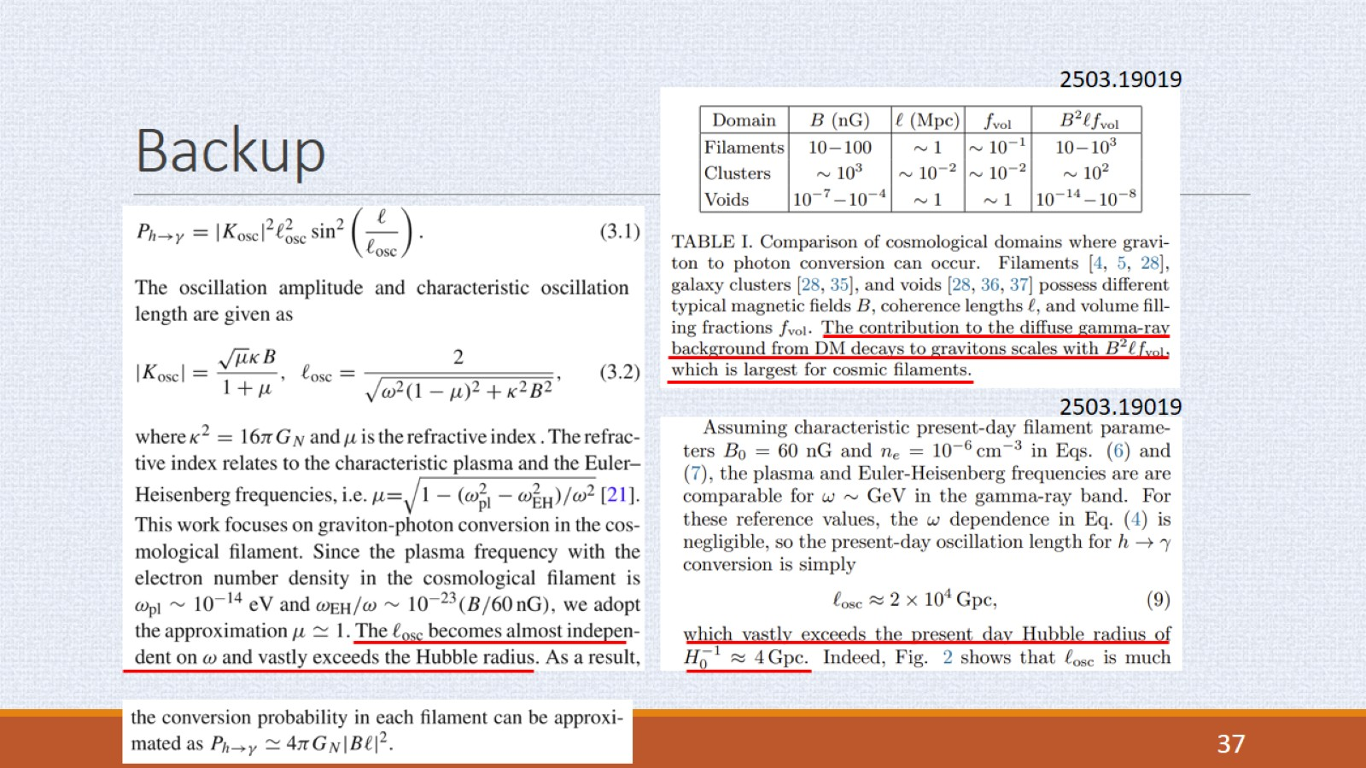
Backup

Slide 38
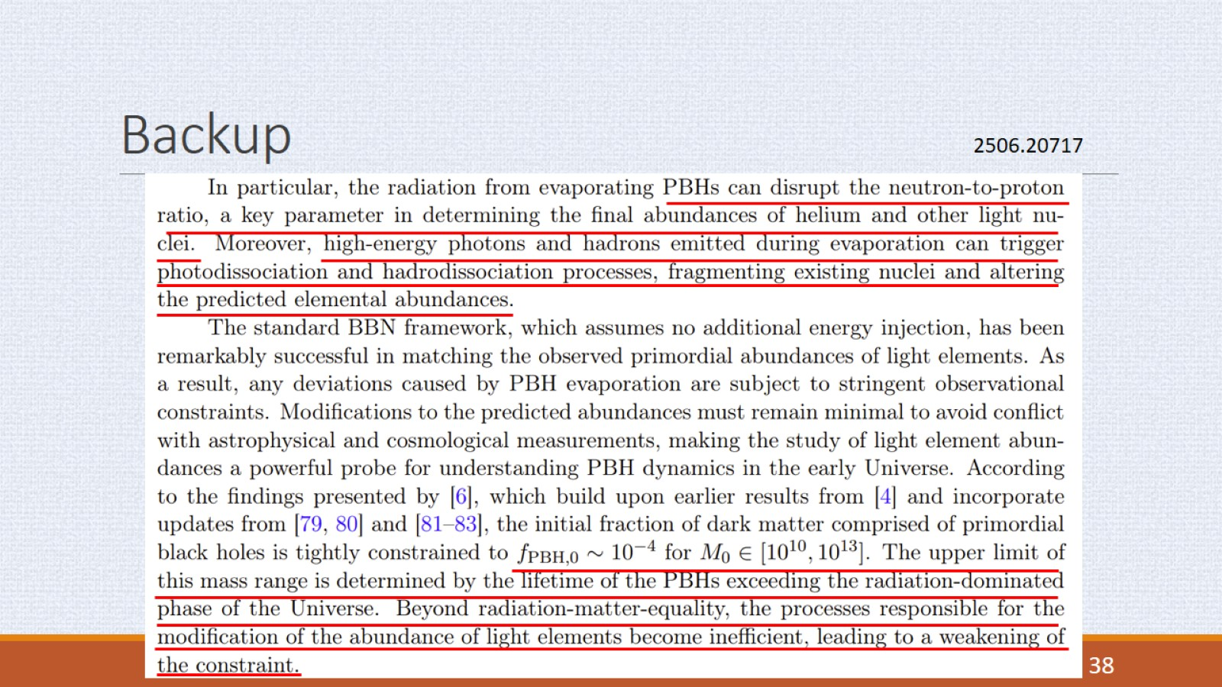
Backup

Slide 39
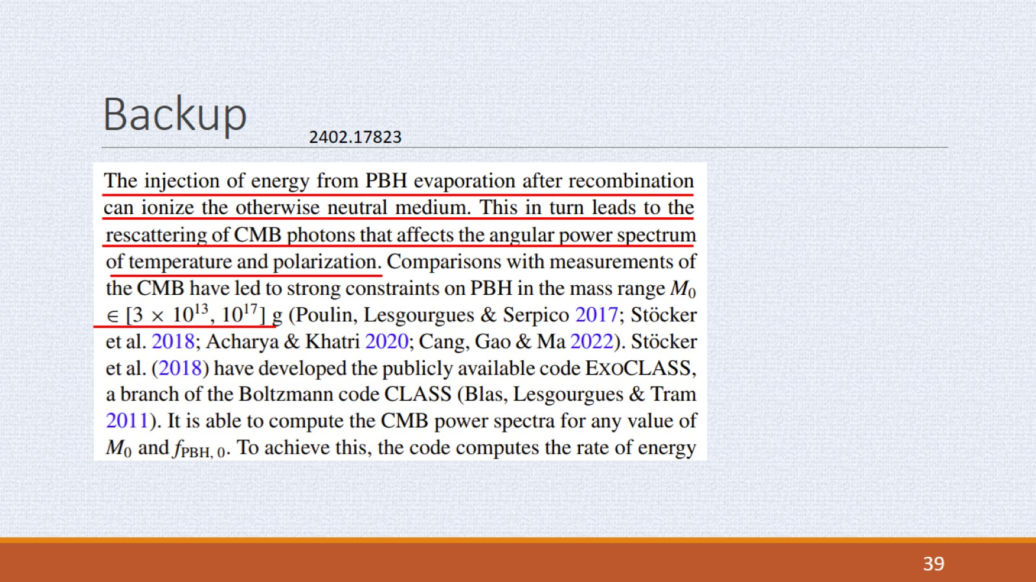
Backup

