Slide 1
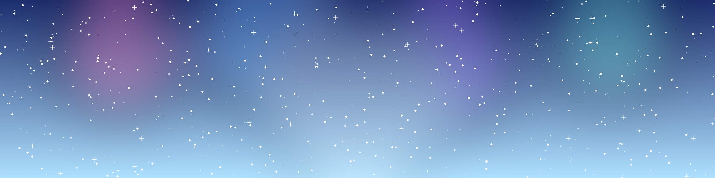



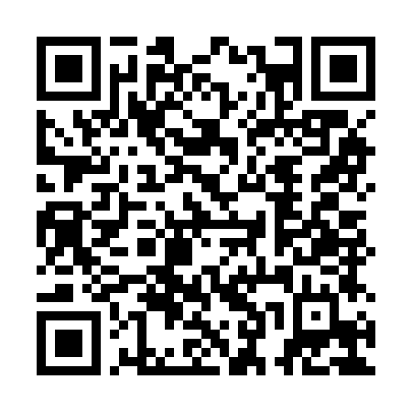
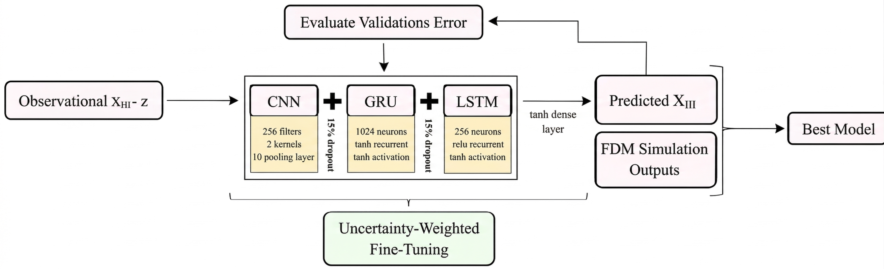
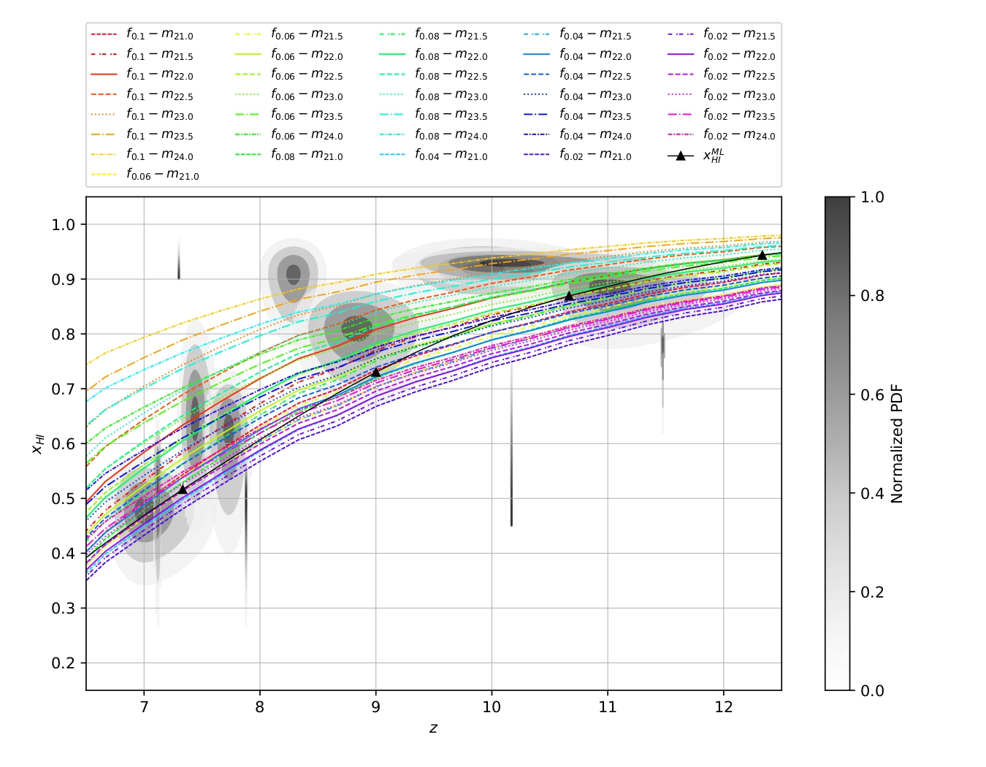
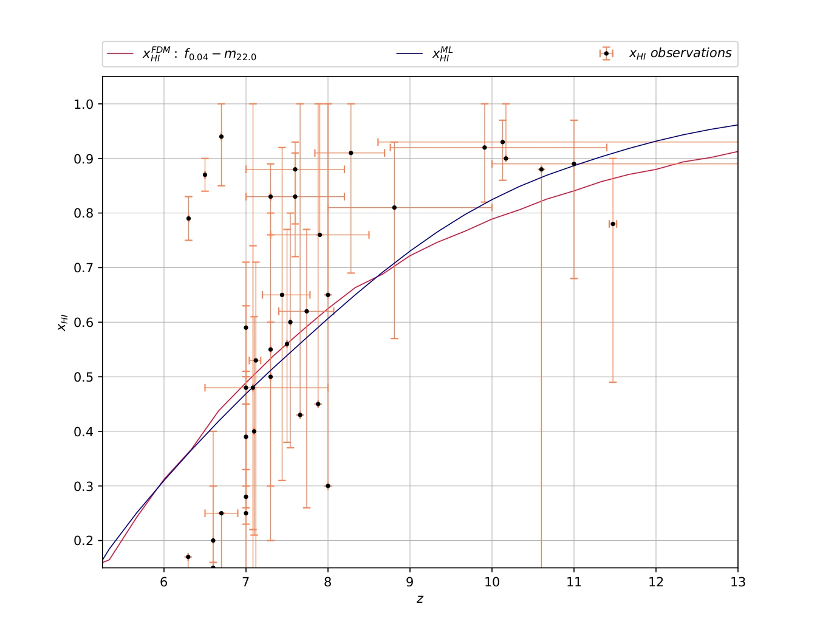
Uncertainty-aware Neural Networks for Fuzzy Dark Matter
Model Selection from x_{HI} Measurements
Bahareh Soleimanpour Salmasi^{1,2}, S. Mobina Hosseini³
1- Institute of Astronomy, National Tsing Hua University, Hsinchu, Taiwan
2- School of Mathematical and Physical Sciences, Macquarie University, NSW 2109, Australia
3- Department of Physics, Shahid Beheshti University, Tehran, Iran
Introduction
Many standard ΛCDM-consistent reionization models predict a relatively rapid reionization history, but recent James Webb Space Telescope (JWST) observations indicate a higher neutral hydrogen fraction (x_{HI}) at z > 8. This tension motivates testing whether a modified dark-matter scenario can better reproduce the high-redshift reionization history implied by JWST.
Fuzzy dark matter (FDM) consists of ultralight axions whose quantum pressure suppresses sub-kiloparsec density fluctuations [1]. This naturally delays early low-mass halo collapse and postpones star formation, extending the reionization timeline.
Scan for the published paper
DOI: 10.3847/1538-4357/ae1cca
JWST yields non-Gaussian posteriors, making point estimates inadequate. Since reionization is both spatial and temporal, we adopt a hybrid architecture to model both efficiently.
Method
Hybrid architecture used in the paper
Four-step pipeline
1
We generated 21 cm histories using 21cmFirstCLASS [2] across a grid of
m_{FDM} ∈ [10⁻²⁴, 10⁻²¹] eV and f_{FDM} ∈ [0.02, 0.10]
2
We used Bayesian No-U-Turn Sampler (NUTS) inference to build JWST-based probability distributions for x_{HI} and redshift.
3
We trained a CNN to extract spatial dependencies from the uncertainty maps, while GRU and LSTM layers captured the temporal redshift evolution.
4
We selected the FDM scenario that best matches the machine-learned observational trend.
Key design choice: observational uncertainty is carried through the model-selection pipeline instead of being collapsed to a single best-fit value.
Results
Fig. 1: The network tracks the JWST-informed posterior envelope.
Fig. 2: Best-match model is near m_{FDM} ~ 10⁻²² eV and f_{FDM} ~ 0.04.
x_{HI}
Normalized PDF
x_{HI}
z
z
Gray contours show credible regions from JWST-inferred x_{HI} posteriors. Colored dashed curves are 21cmFirstCLASS FDM histories, while the black curve is the hybrid posterior mean after uncertainty-aware fine-tuning. The overlap indicates that the learned trend remains consistent with the observational posterior envelope.​
The pink simulation curve shows the minimum discrepancy relative to the hybrid model. The blue curve is the machine-learned trend; observational points. This preferred configuration tracks the central trend while remaining consistent with upper bounds.​
Takeaway: JWST-informed posteriors prefer a slower decline in x_{HI} at high redshift.
This configuration gives the smallest discrepancy and tracks the JWST-informed trend with R² ~ 0.968.
Physical implications & Consistency
Fig. 3: Reionization becomes later and more gradual than in ΛCDM.
Fig.4:The preferred parameter choice remains outside major excluded regions in literature [3].
The preferred FDM case delays and smooths reionization instead of producing a rapid transition.
Excluded Regions
Consistency check: favored parameters avoid over-suppressed structure growth and over-delayed reionization.
Future work and takeaway
Future possible work
Final takeaway
Combine JWST with 21 cm power spectrum, CMB optical depth, and UV luminosity functions.
Build a unified uncertainty-aware likelihood to reduce astrophysical dark matter degeneracies.
Apply simulation-based inference for stronger parameter constraints.
Forecast performance for next-generation facilities such as SKA and HERA.
Identify the observables most sensitive to dark matter microphysics.
Using JWST-informed uncertainty distributions, the study finds that an FDM model near m_{FDM} ~ 10⁻²² eV and f_{FDM} ~ 0.04 best matches current reionization data. The result is both statistically favored and physically consistent with external constraints. This framework is not just a better fit; it turns the reionization era into a robust, testable laboratory for dark matter microphysics.
Key references
[1] Hu, Barkana & Gruzinov 2000, Phys. Rev. Lett., 85, 1158. [2] Flitter & Kovetz 2024, Phys. Rev. D, 109, 043513. [3] Lazare, Flitter & Kovetz 2024, Phys. Rev. D, 110, 123532.

