Slide 1



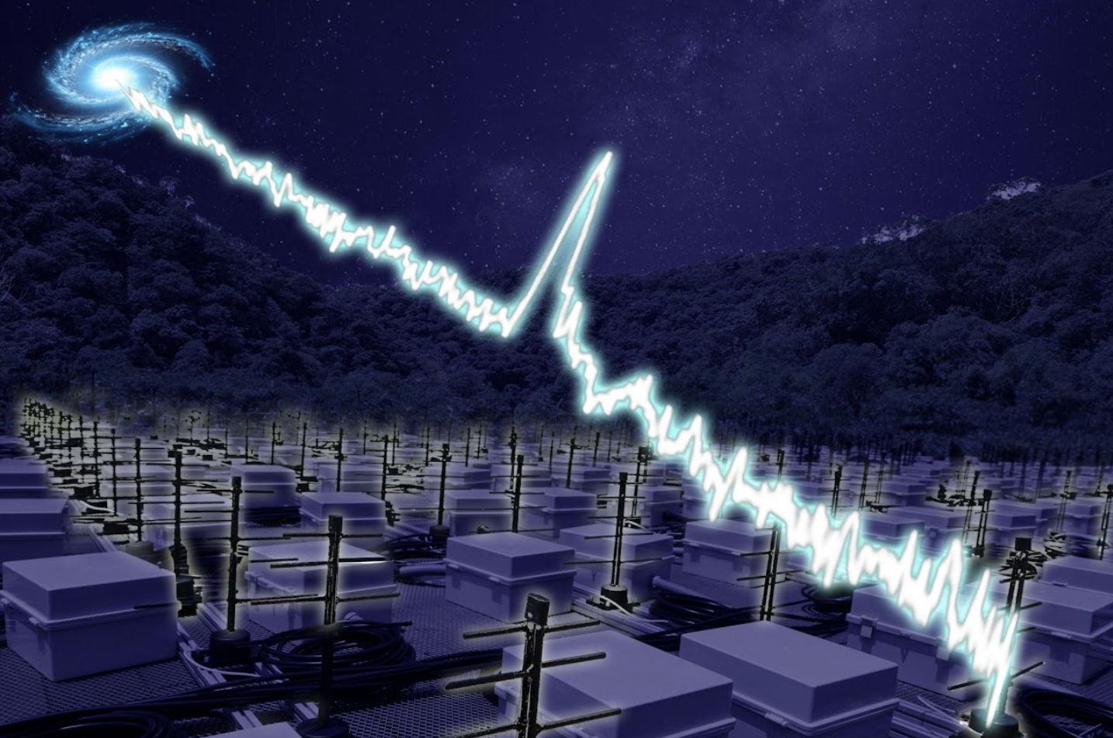
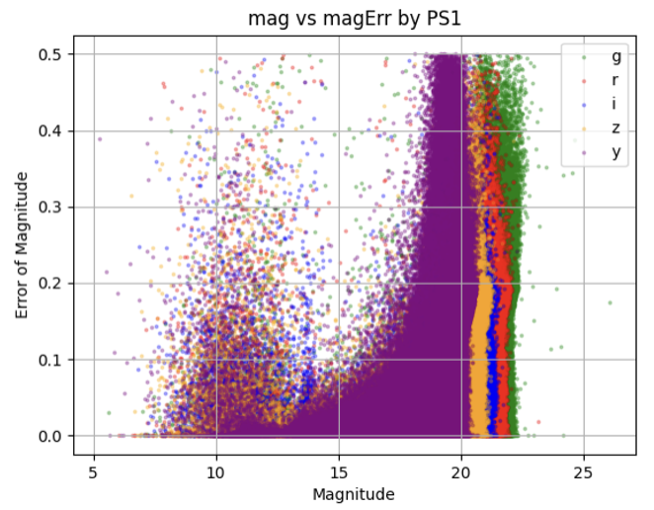
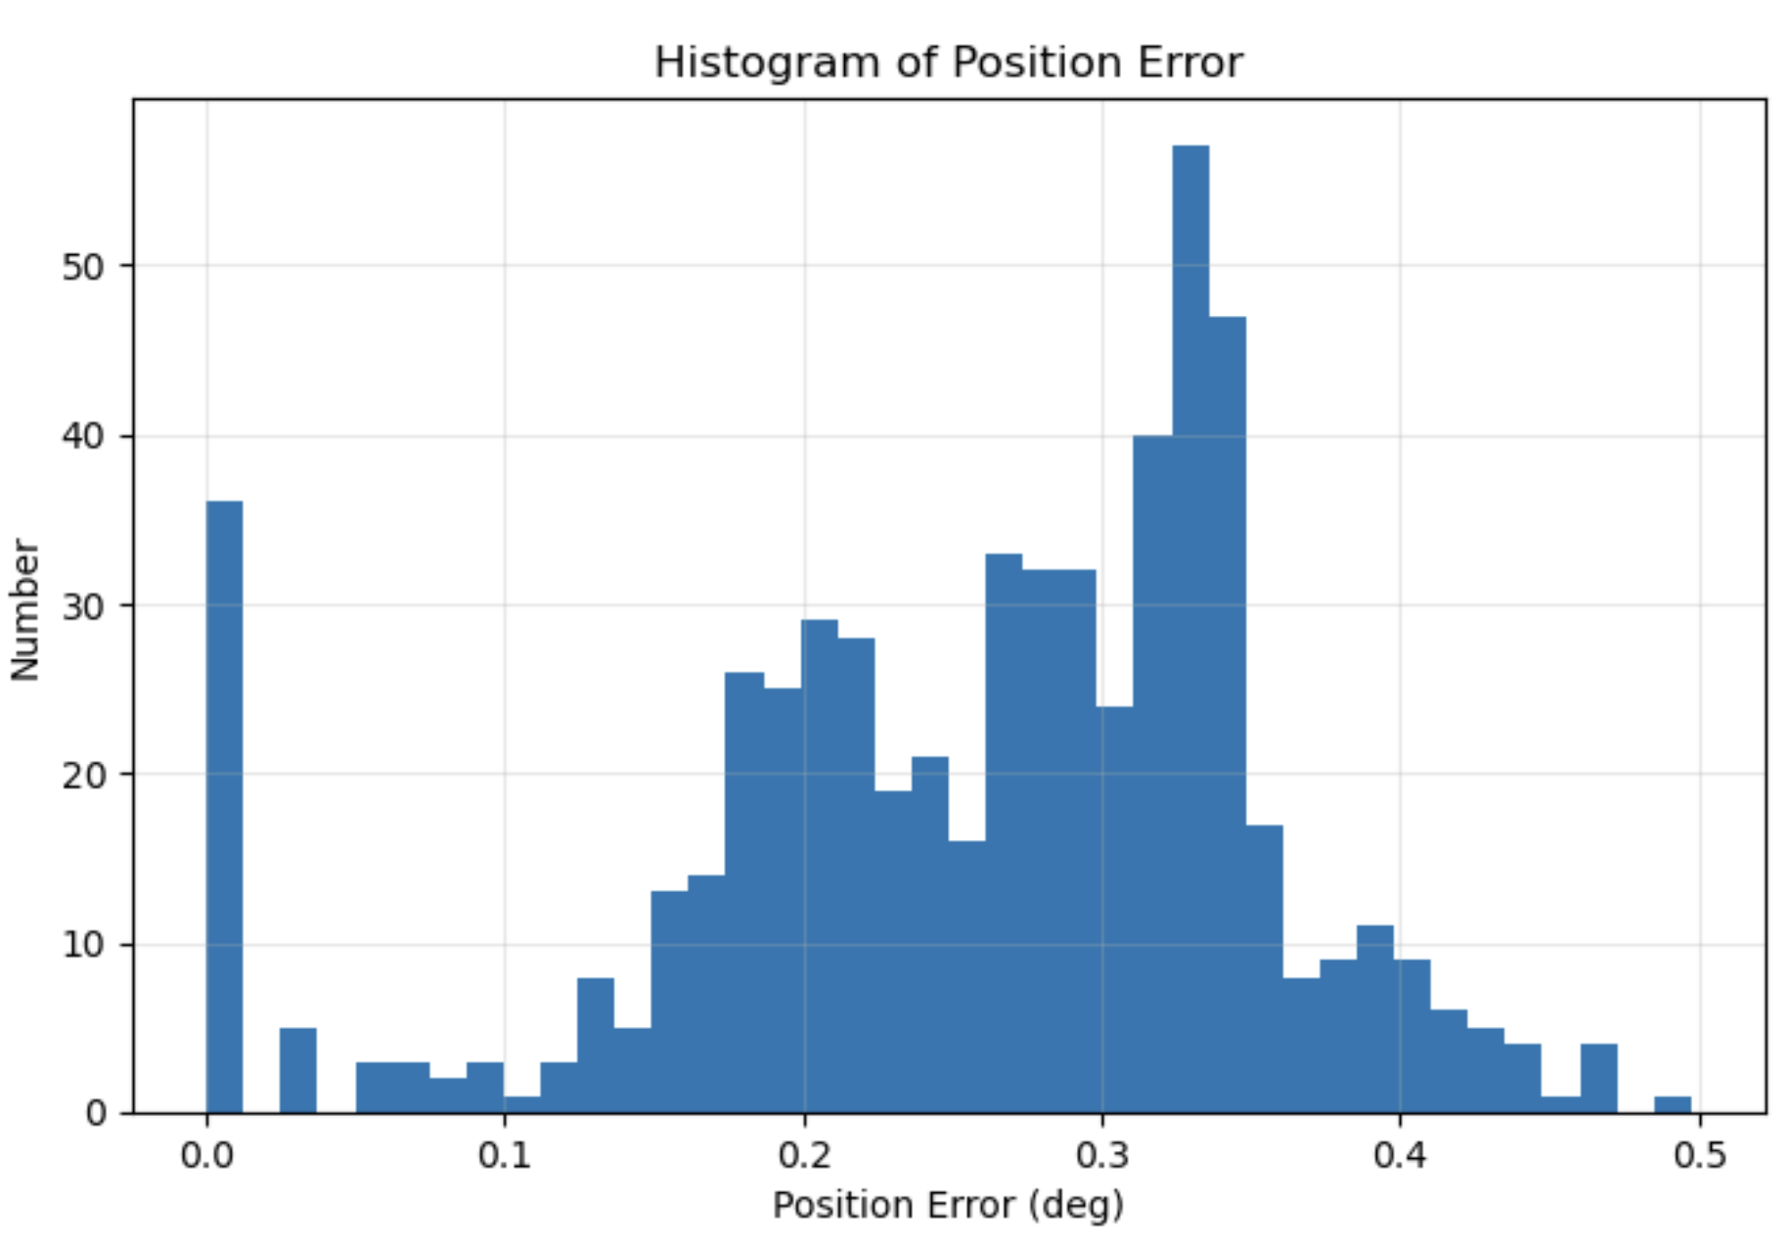
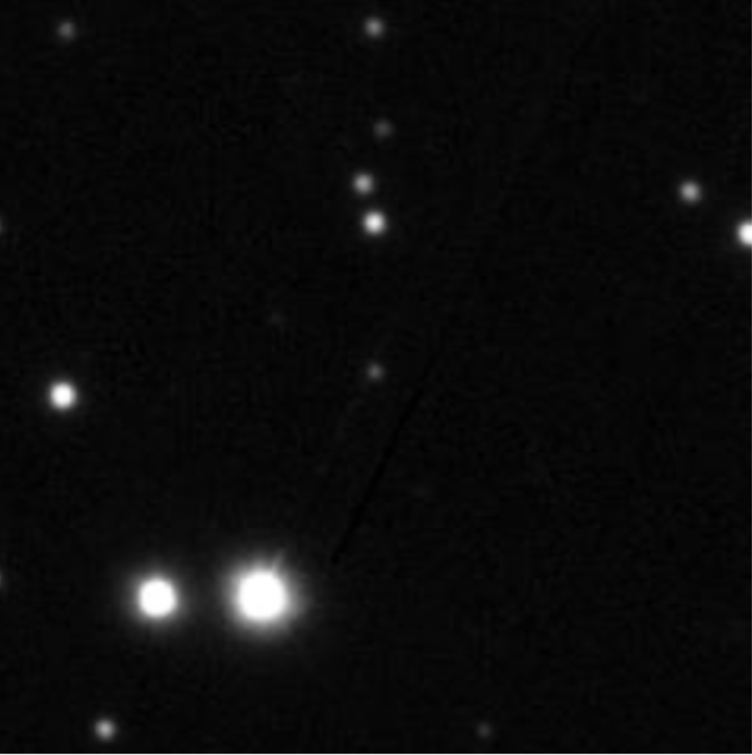
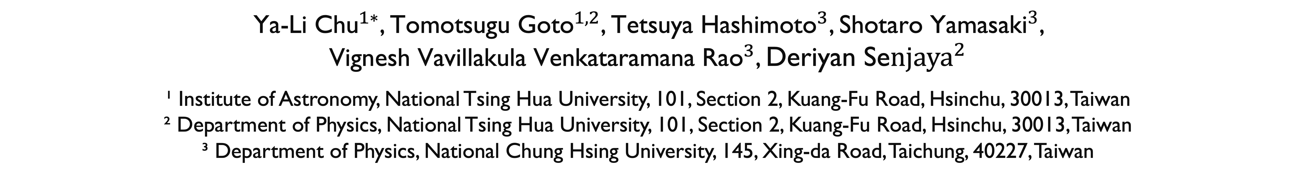

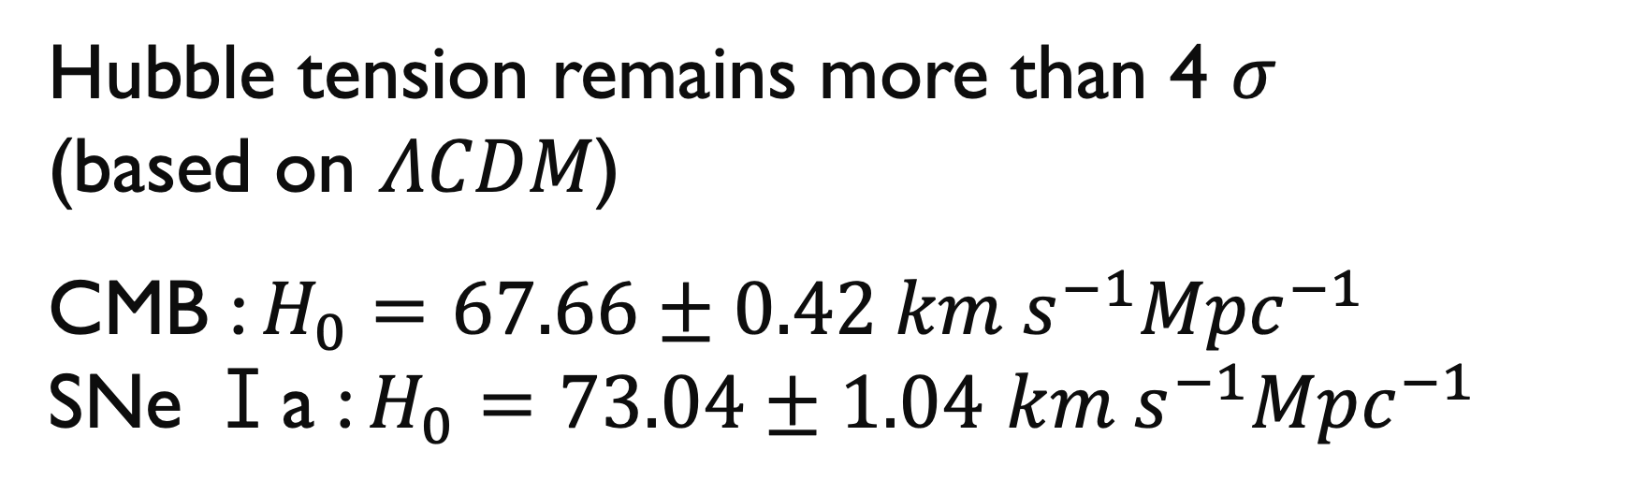


Estimating the Hubble Constant from Localized and Nonlocalized Fast Radio Bursts Using CHIME Data
${\text{Ya}\text{-}\text{Li} \text{Chu}}^{1∗}$, ${\text{Tomotsugu} \text{Goto}}^{1,2}$, ${\text{Tetsuya} \text{Hashimoto}}^{3}$, ${\text{Shotaro} \text{Yamasaki}}^{3}$,
${\text{Vignesh} \text{Vavillakula} \text{Venkataramana} \text{Rao}}^{3}$, ${\text{Deriyan} \text{S}\text{e}njaya}^{2}$
¹ Institute of Astronomy, National Tsing Hua University, 101, Section 2, Kuang-Fu Road, Hsinchu, 30013, Taiwan
² Department of Physics, National Tsing Hua University, 101, Section 2, Kuang-Fu Road, Hsinchu, 30013, Taiwan
³ Department of Physics, National Chung Hsing University, 145, Xing-da Road, Taichung, 40227, Taiwan
Hubble tension remains more than 4 $σ$
(based on $ΛCDM$)
CMB : $H_{0}=67.66±0.42 km{ s}^{−1}{Mpc}^{−1}$
SNe Ⅰa : $H_{0}=73.04±1.04$ $km s^{−1}{Mpc}^{−1}$
Develop an
independent way
Fast Radio Bursts (FRB)
short-lived & bright
Extragalactic signals
Localized & nonlocalized
(total: 536)
FRBs galaxies
CHIME + Pan-STARRS 1
Probabilistic Association of Transients to their Host (PATH)
FRB can provide dispersion measure (DM): DM traces the integrated free-electron density which depends on cosmic distance and the expansion rate.
For FRB with known redshifts, the Macquart relation (DM-z relation) is proportional to $H_{0}$, allowing an independent constraint on the $H_{0}$.
The host galaxies‘ probabilities
Mikulski Archive Space Telescope (MAST)
My unique way: $z_{FRB}=P_{1}z_{1}+P_{2}z_{2}+P_{3}z_{3}+…$
&
$${DM}_{IGM}$$
MCMC
How to get redshift ?
It is hard to get spectroscopic redshift (spec-z).
→ need a full spectrum of light.
We use photometric redshift (photo-z).
→ measure brightness in a few broad color filters.
$$H_{0}$$
Methods
Macquart relation: It shows the contribution of the intergalactic medium (IGM) to the dispersion measure of FRBs as a function of redshift.
Approximately 81 FRBs have precise localizations. For nonlocalized FRBs, redshift uncertainties derived from the DM-z relation are incorporated into the MCMC analysis.
This relation also provides a consistency check to assess whether the host galaxy and its redshift are reasonable.
Data chosen: We first choose PS1 data under 15 < rmag < 23.
And test FRB data within small position error to run PATH code
Fig 1. Mag vs magErr of PS1
Fig 2. Histogram of position error
PATH algorithm: It is used to compute the association probability for each candidate host galaxy within the search radius. Based on the probabilities of candidates, then we can identify the redshift of the chosen FRB.
P ~ 6.09e-27
Ra= 82.99791421
Dec= 33.15088172
Future Work
P ~ 1
Ra= 82.99797489
Dec= 33.14760143
FRB20181119D
Ra=82.994575 (err: 4e-7)
Dec=33.147941 (err: 4e-6)
DM=595.2
Combine nonlocalized FRBs by marginalizing over their redshift distributions, as inferred from the cosmic FRB population.
Use the joint likelihood of localized and nonlocalized FRBs to estimate the Hubble constant.
Incorporate the upcoming data.
References
Fig 1. FRB and PS1 candidates
Measuring Hubble constant using localized and nonlocalized fast radio burst (arXiv: 2410.03994)

