Slide 1
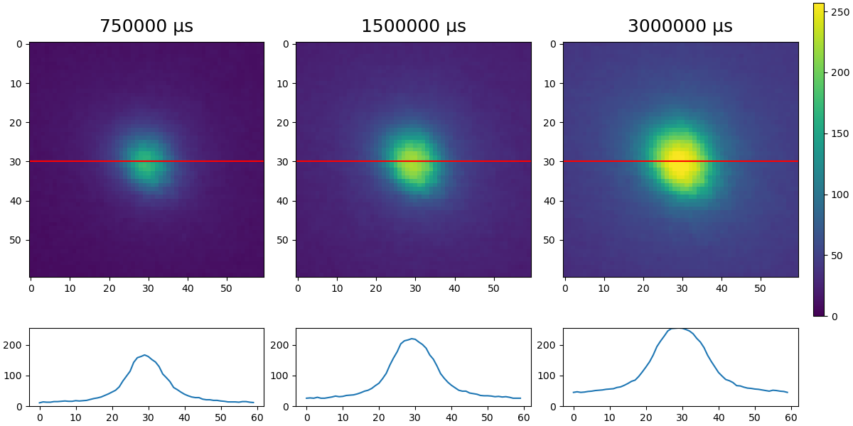
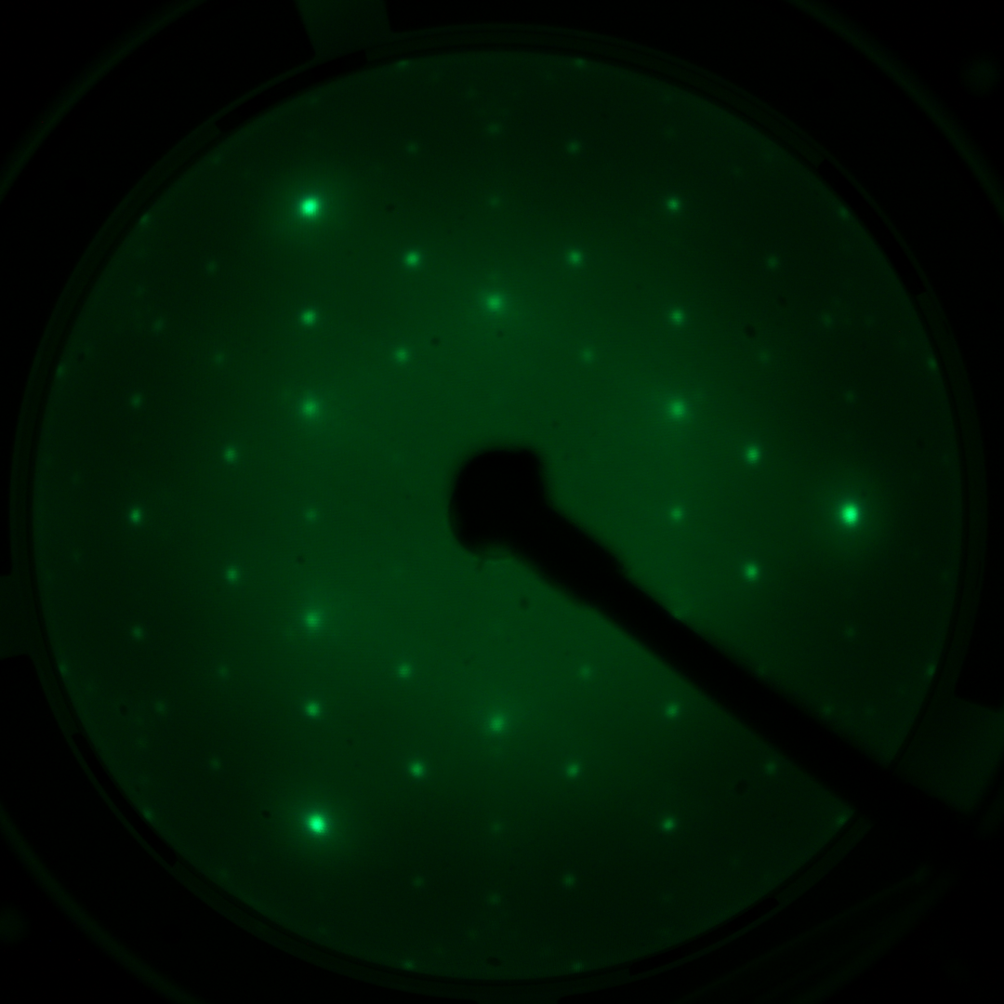
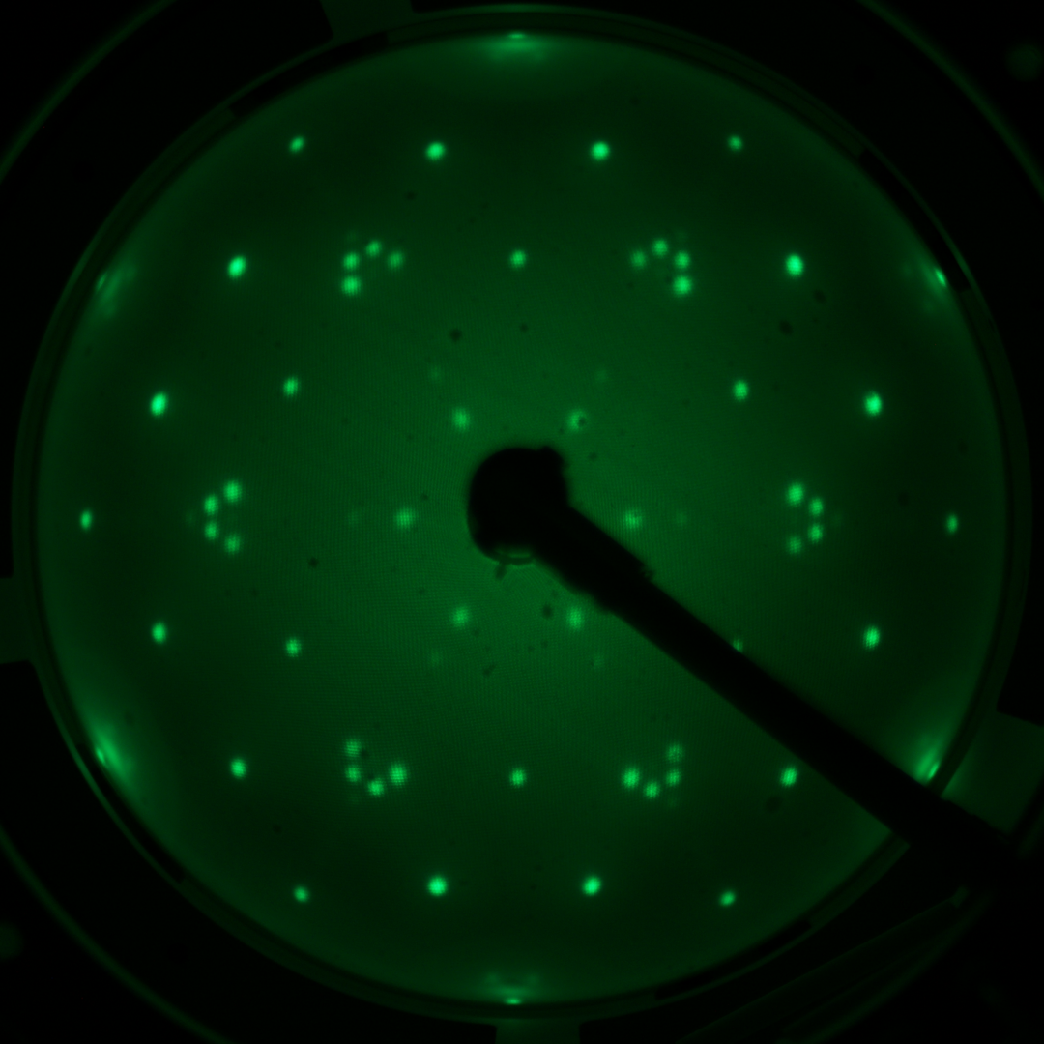
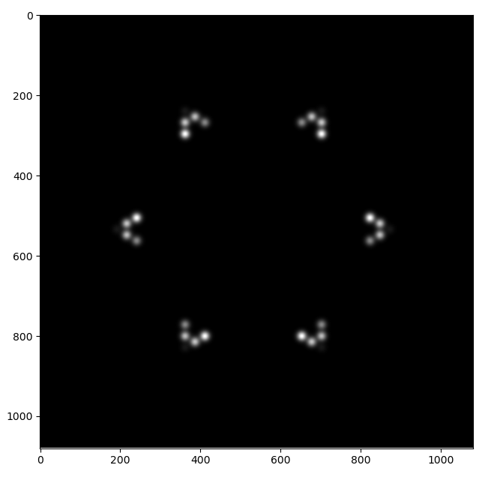
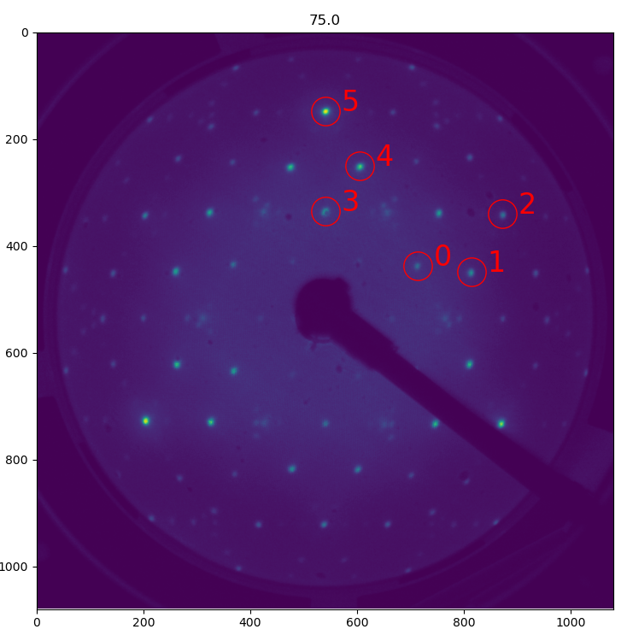
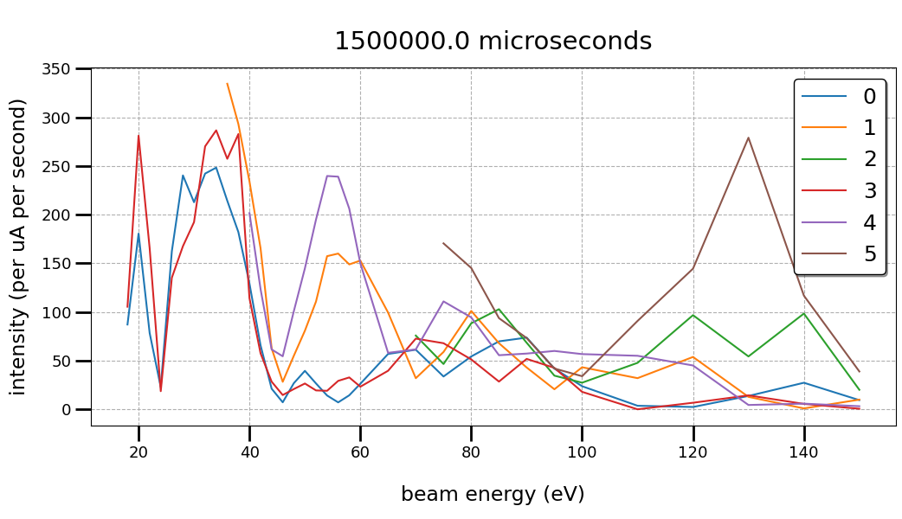


Using Python and Raspberry Pi to efficiently capture (high-quality) LEED images and accurately extract lattice constants Ka-Weng Lei¹, David Mikolas¹, and Shu-Jung Tang^{1,2,3}
¹ Department of Physics, National Tsing Hua University, Hsinchu 30013, Taiwan
² National Synchrotron Radiation Research Center (NSRRC), Hsinchu 30076, Taiwan
³ Institute of Physics, Academia Sinica, Taipei 11529, Taiwan
Abstract : Accurate determination of surface atomic positions relies on high-quality LEED I(V) data. This study show how to use Python to control a Raspberry Pi camera for capture LEED data. Furthermore, it shows how to fit the data to accurately extract the positions of LEED spots. In addition to obtaining high-precision lattice constants, this method also obtain I(V) curves of the diffraction spots, effectively integrating with theoretical simulation tools such as SATLEED and ViPErLEED, optimizing the preprocessing workflow for surface structure analysis.
Reciprocal space projection into pixel coordinates :
We use Raspberry Pi and its official high-quality camera module to capture low-energy electron diffraction (LEED) data. The system has the following features:
Low Development Barrier : The Raspberry Pi is developed using Python, which has an intuitive syntax. Therefore, lab members do not need a strong programming background to write or modify custom scripts, enabling highly automated control processes for different experimental needs.
High Image SNR : A sufficiently large aperture(f/1.4) and resolution(4056 x 3040) enable the system to capture high-SNR diffraction spots in a short time, improving data quality.
Precise Quantitative Analysis Capabilities : Multiple exposure times can be captured in rapid succession, and the camera supports microsecond-level exposure time control. which facilitates subsequent LEED I(V) spectral intensity analysis.
High flexibility : Currently, Raspberry Pi serves as a control hub for everything except LEED power supply. Through its GPIO pins and USB ports, we will interface it directly with the LEED controller to enable data exchange, achieve more high-level automation.
Reciprocal space projection into pixel coordinates ： In actual measurements, various factors (such as sample misalignment or sample angle not perpendicular to the screen) can cause errors. To accurately project the reciprocal space vector G to image pixel coordinates, we must consider and correct for the following error factors: a. Translation correction : Since the sample axis and the screen axis may not be completely aligned, the coordinates of the pixel coordinates center need to be corrected using parameters such as $x_{0}$ and $y_{0}$. b. Scaling correction : If the actual distance D between the sample and the screen deviates from the ideal position, it will cause the entire diffraction pattern to be scaled. We use a scaling factor to correct this error. c. Tilt Correction : When the sample surface normal vector is not parallel to the screen normal vector, the projection of the reciprocal vector to the screen will be offset. In this case, the incident wave vector has a parallel component $k_{∥}$. This can be obtained using the angle $φ$ between the sample normal vector and the incident beam. The single scattering condition then becomes ${\left|k_{in}+k_{∥}\right|}^{2}>{\left|G\right|}^{2}$ d. Distortion Correction : In LEED experiments, the positions of diffraction spots deviate from theoretical predictions. Possible reasons include defects in the metal Grids, leading to non-uniform electric fields and thus distorting the diffraction spot positions. Camera lens distortion also cause diffraction spots that should be on a straight line to appear as curved line. This distortion is fixed, so we can use a sample with a known lattice type and lattice constant to create a spatial mapping function by comparing the measured positions of the diffraction points with the theoretically predicted positions, in order to accurately correct the nonlinear distortion.
Fitting function : We chose a two-dimensional Gaussian function as the basic model for LEED fitting. The Gaussian function is sufficient to accurately locate the spot center to extract the lattice constant, but the fitted model deviates slightly from the actual physical shape. Therefore, the extracted intensity information will also have errors. Since these fitting errors occur at all diffraction points, the relative intensity trends between the spots are still preserved. Furthermore, by introducing a background function into the fitting, the intensity information can be extracted more accurately. The background function can be a constant background or a linear background, the specific choice depends on the experimental data.
Choosing the right exposure time is very important since it is key to obtaining high-quality LEED data.
Underexposure : The weaker diffraction spots approach the noise level, due to insufficient signal strength, the diffraction spots are easily covered by random background noise, reducing accuracy of the fitted spot parameters.
Overexposure : Diffraction spots become distorted due to pixel saturation (as shown in the bellow figure). This makes it impossible for proper fitting, and thus finding the center position and severely affects the accuracy of intensity analysis (I-V curve).
To solve this problem caused by a single exposure time, we use exposure bracketing. By integrating different exposure time data, ensure that we can capture all diffraction spots from strong to weak without over-or under-exposure.
Figure 1. The three image on the left both have same beam energy but different exposure time, The curves below each image represent the intensity profiles at the corresponding red line locations. The image on the right is the original LEED image with highest exposure time, the red box representing the selected cropping position.
Fitting function :
To extract accurate lattice constants and intensity information for each diffraction spot from the experimental data, we need to fit the spot profile. The fitting process mainly consists of the following core equations :
Reciprocal space diffraction spot equation ： a. Transformation of Reciprocal lattice: Define the real space basis vectors of the sample as $a_{1}$, $a_{2}$，their corresponding reciprocal lattice basis vectors as $b_{i}$ $b_{i}=2π\frac{ (a_{j}×\hat{n})}{a_{i}∙(a_{j}×\hat{n})}$ where $\hat{n}$ is the surface normal vector. The reciprocal lattice vector 𝑮 represent as $G=hb_{1}+hb_{2}$ If the substrate or adlayer needs to be rotated relative to the normal axis of the screen, then a rotation matrix is ​​applied. $G_{rotated} =R_{z}G=\left[\begin{matrix}cosθ_{z} & −sinθ_{z} & 0 \\ sinθ_{z} & cosθ_{z} & 0 \\ 0 & 0 & 1\end{matrix}\right]\left\lfloor \begin{matrix}G_{x} \\ G_{y} \\ G_{z}\end{matrix}\right\rfloor$ b. Diffraction conditions ： The wave vector of an incident electron beam is determined by the incident energy. According to the de Broglie equation : $k_{in}=\frac{2π}{λ}=\frac{2π}{h}\sqrt{2m_{e}e∗V}$ Where $m_{e}$ is the electron mass, e is the electron charge, V is the accelerating voltage. Under the condition of elastic scattering, the condition for single scattering is ${\left|k_{in}\right|}^{2}>{\left|G\right|}^{2}$. Therefore, by using the known electron energy and the reciprocal lattice vector 𝑮, we can obtain the positions of the diffraction points that are allowed to appear on the screen at a specific energy.
Reciprocal space diffraction spot equation :
Figure 2. The left image shows the LEED data for Bi deposited on Ag(111) at room temperature, and the right image shows the initial stage of fitting the left image data. in this example, we only fit these six clusters of four points for simplicity, and because they are particularly sensitive to the lattice constant.
In order to obtain precise atomic position information in the future, we used two-dimensional Gaussian fitting to extract diffraction spots intensity.
Figure 3. 75 eV LEED diffraction spots (left) and corresponding I-V curves (right) of the spots. The red circles and their labels represent the fitted spot. To prevent overexposure and obtain accurate intensity, exposure time was 1500000 $µs$.
Future work :
Future work :
1. Develop communication between the Raspberry Pi and the LEED controller to automate the experimental process.
2. Integrate a new, simple analysis program (using the Laplacian of Gaussian) into the image capture program to obtain LEED spots locations for preliminary estimation of the lattice constant.

