Slide 1
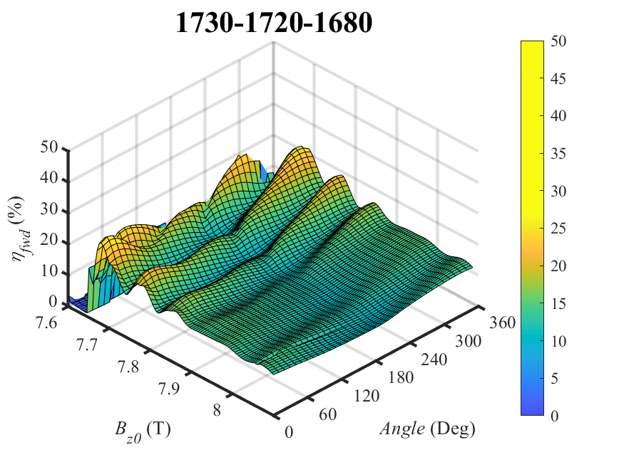
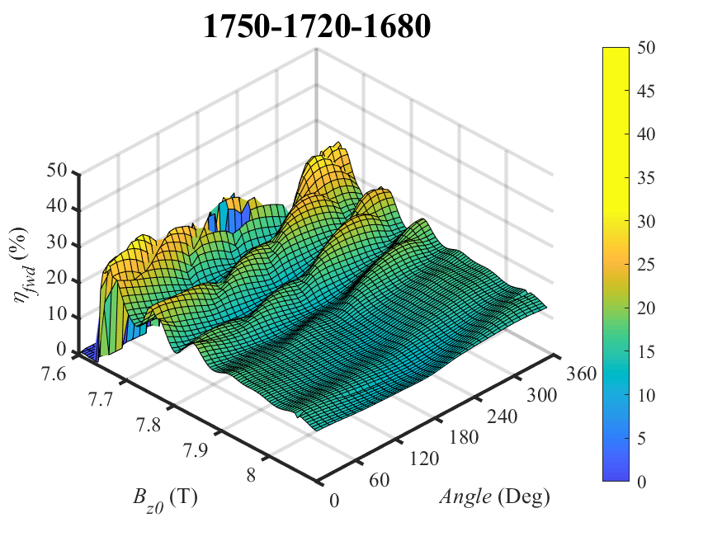
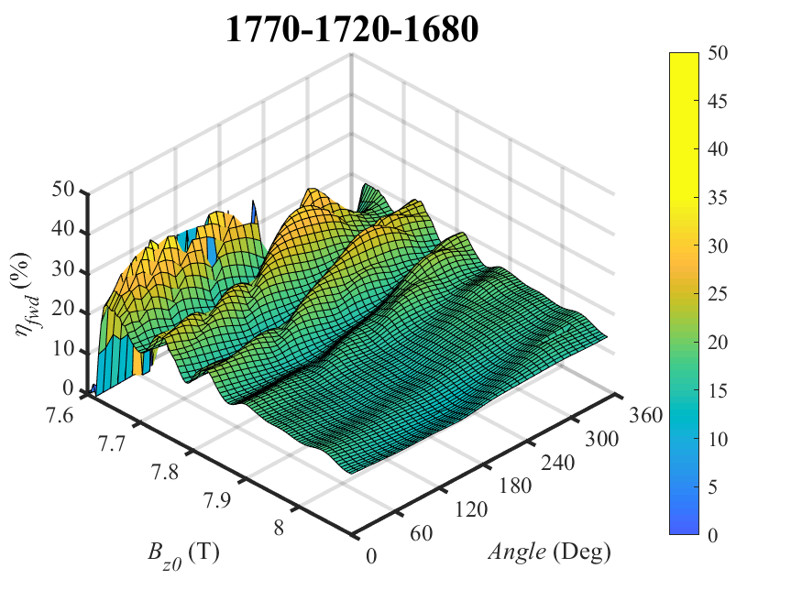
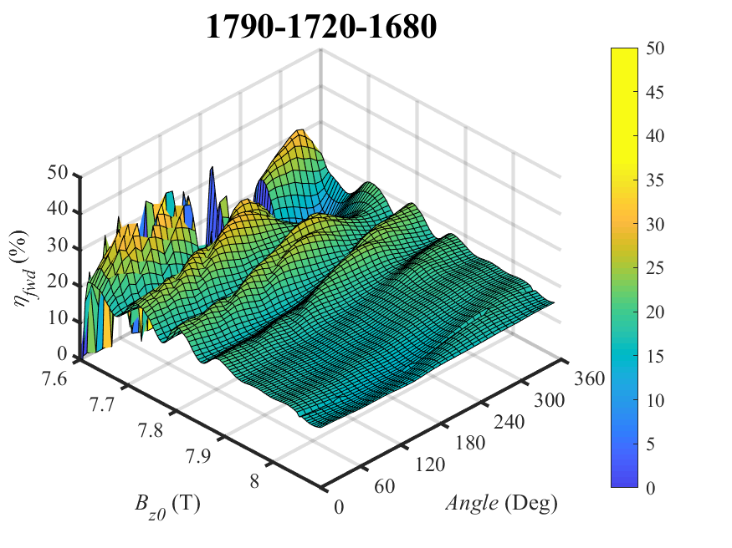
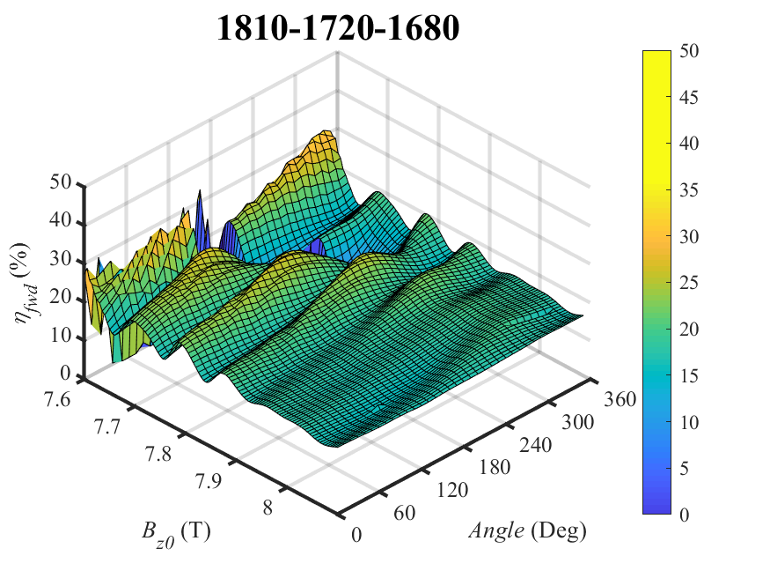
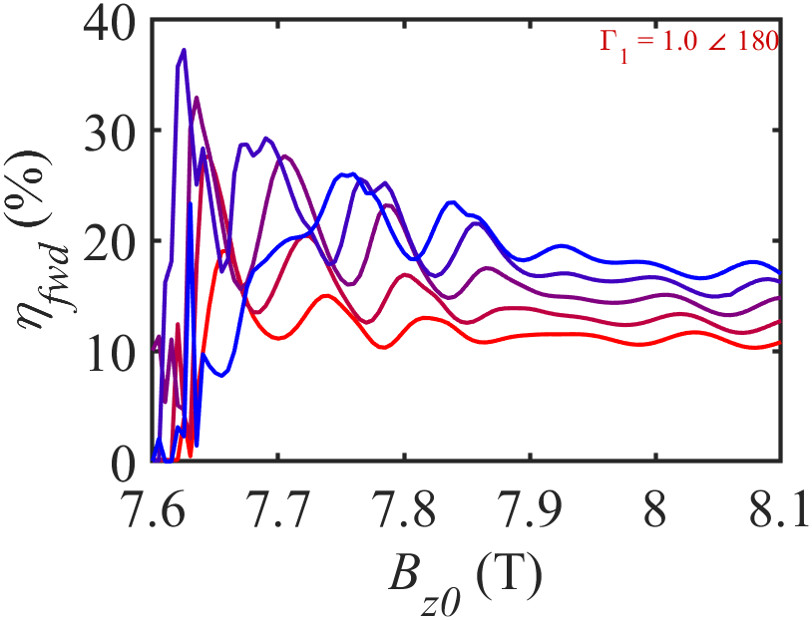
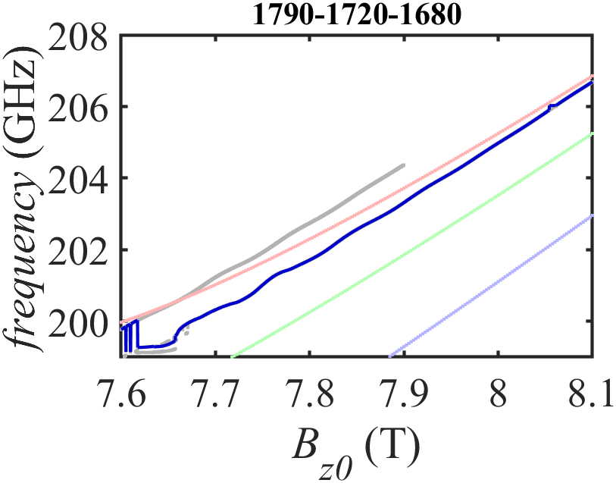
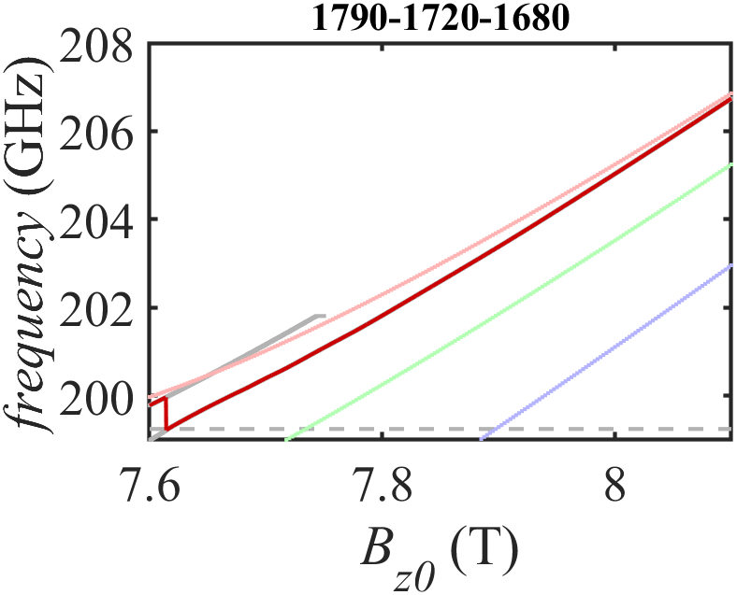
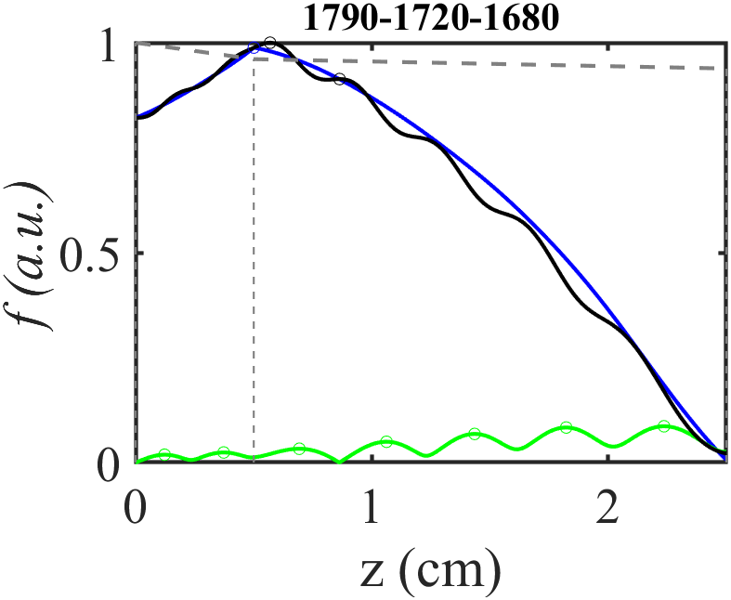
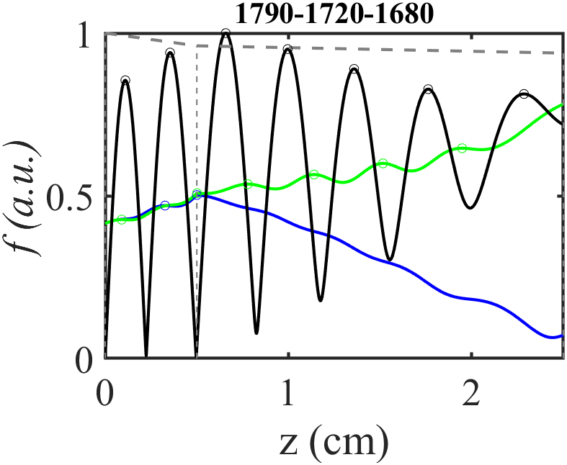
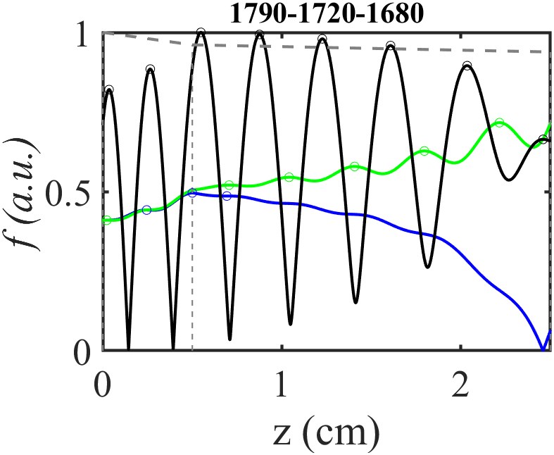
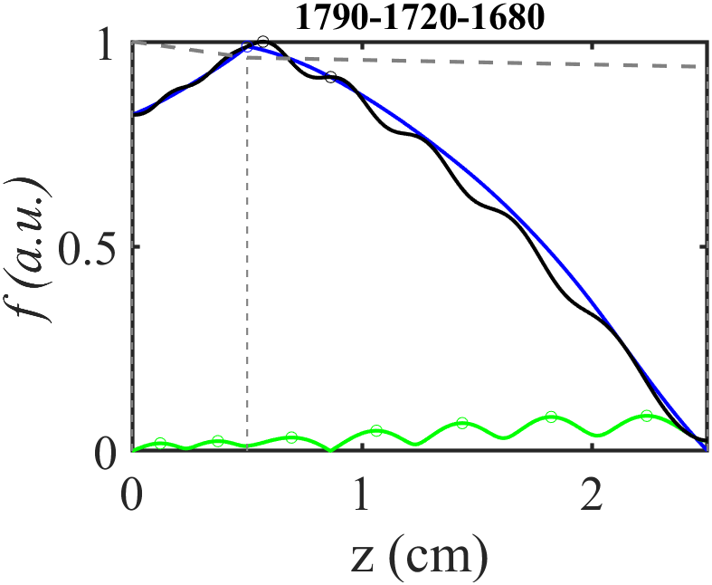
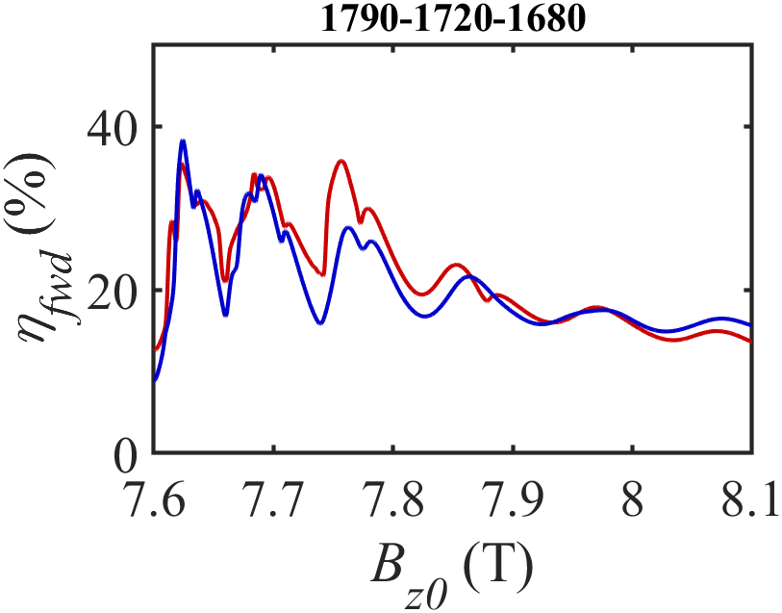
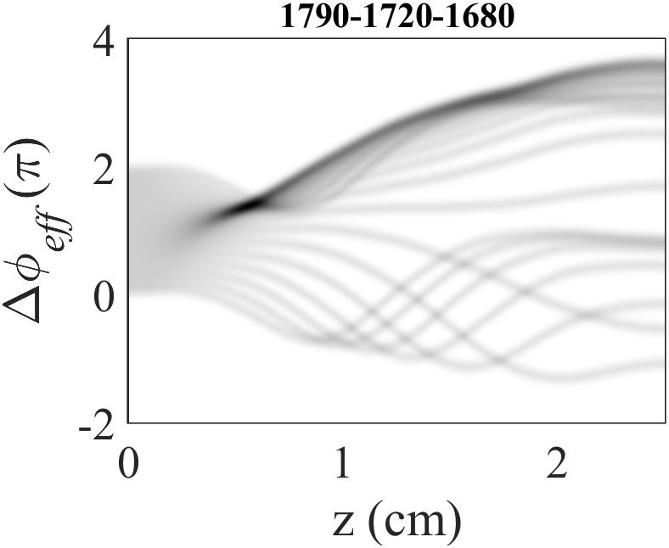
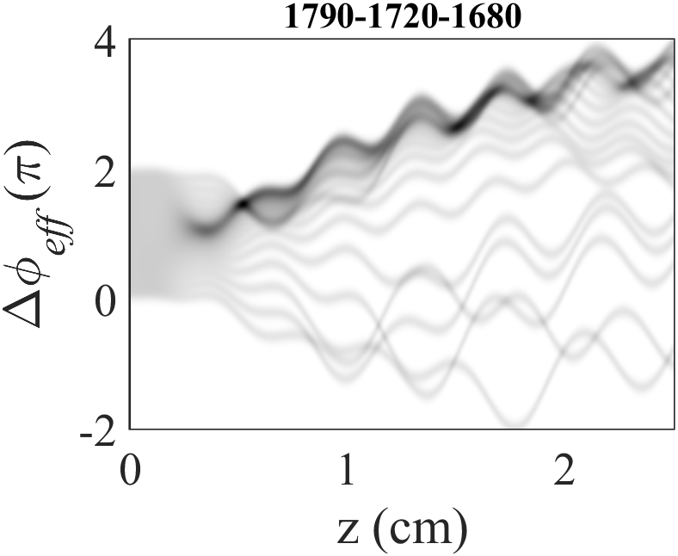
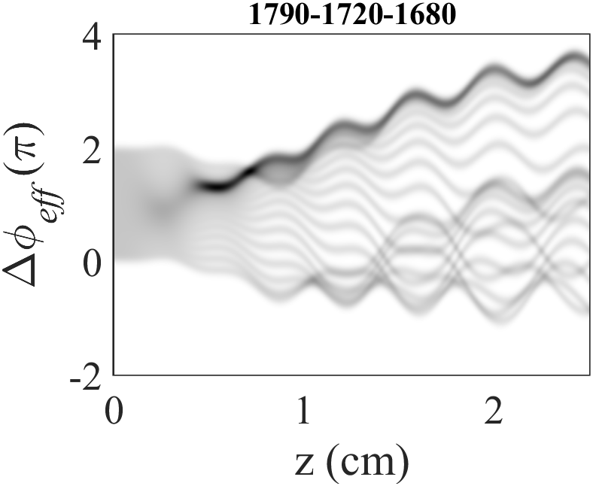
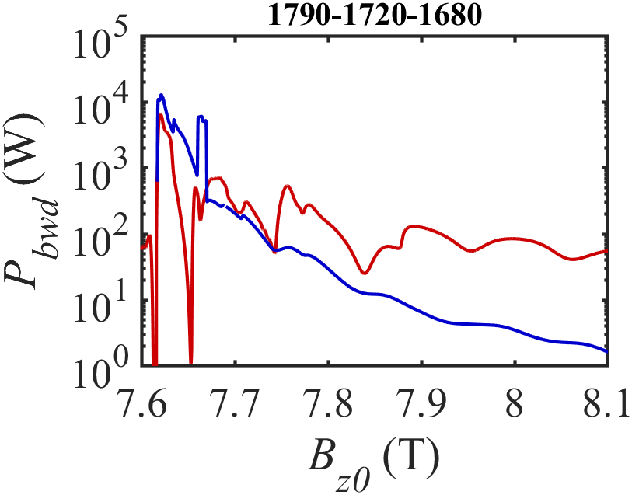
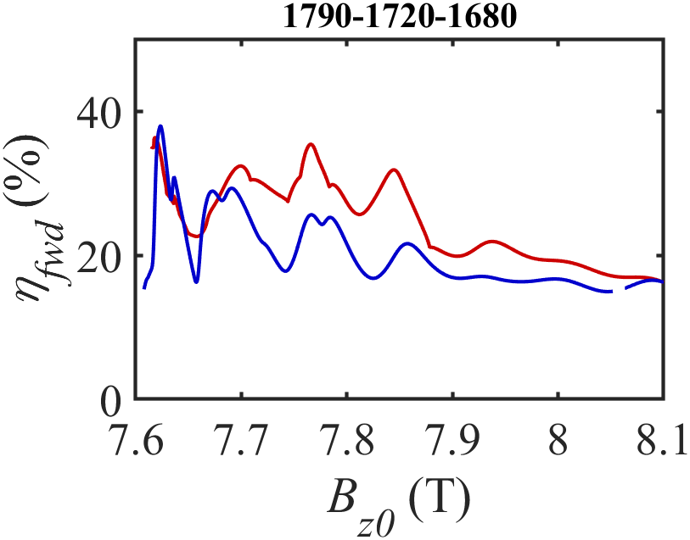
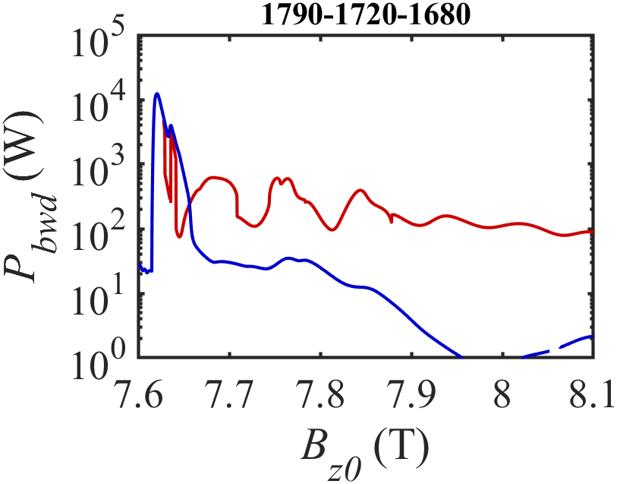
Structure Effect on Reflective Gyrotron Backward-Wave Oscillator
Chia-Chuan Chang(張家銓)¹ ,Tien-Fu Yang(楊添福) ¹, Hsin-Yu Yao(姚欣佑) ², Tsun-Hsu Chang(張存續) ¹ ¹Department of Physics, National Tsing Hua University, Hsinchu, Taiwan
²Department of Physics, National Chung Cheng University, Chiayi, Taiwan
Email: cc1141596063@hotmail.com
Abstract –gyrotron devices, based on the principles of the electron cyclotron maser (ECM) instabilities, are powerful high-frequency microwave sources. In this study, we focus on specific type of reflective type gyro-BWO , which consist of several tapered section and can achieve a phenomenal output efficiency and bandwidth. This study investigates the effect of structural nonuniformities on the beam-wave interactions in the gyrotron backward-wave oscillator (gyro-BWO). Employing the effective-boundary method both upstream and downstream of the primary cavity, we examine the modulation effect resulting from end reflections. The gyrotron's beam-wave dynamics during backward wave and forward wave interactions are analyzed separately. The study reveals a significant modulation effect during the electron bunching stage of backward-wave interaction, influencing tunability positively or negatively. This modulation effect is contingent upon the acquired phase from upstream reflections. The influence of both upstream and downstream structural nonuniformities is elucidated. These findings not only provide valuable insights but also offer a clear physical understanding for optimizing current gyrotron devices.
I. Introduction and motivation
(B)Structure Effect Of First Taper
Gyrotron backward-wave oscillator (gyro-BWO), featuring continuous and smooth frequency tuning in a non-resonant structure (internal feedback), is capable of stable operation in the nonlinear region with fine frequency tunability and high power. However, the absence of a terahertz mode converter for extracting wave energy at the beam entrance has led to interest in converter-free, reflective-type gyro-BWOs (R-gyro-BWOs). These R-gyro-BWOs, resembling the gyromonotron in delivering wave power forward, have sparked interest. Nevertheless, the characteristic of the R-gyro-BWO seems not well understood to date and it tends to be ambiguous with that of the low power gyrotron. They do have analogous configurations in interaction structure, but the working mechanisms as well as design principles are studied from the distinct perspectives: beam-wave resonance and structure resonance. To better comprehend the linear and nonlinear properties of a frequency-tunable gyrotron, a general principle applied for both the R-gyro-BWO and the low power gyrotron is pressingly desired.
(a)
(b)
(c)
(d)
(e)
(f)
1810-1720-1680
1790-1720-1680
1770-1720-1680
1750-1720-1680
1730-1720-1680
II. Model and Simulation Parameters
(A) Interaction Structure and Beam Parameters
Interaction structure
Output taper
Table. 1. Dimension of interaction structure.
Fig. 4. (a) ~ (e) Simulated output efficiency( ) of Fig.1(b) interaction structure as a function of magnetic field and initial assigned reflection phase ( ), the title of each figure is the radius(r1-r2-r3) in μm. (f) Output efficiency vs magnetic field in different structure, the original structure(1790-1720-1680) is indeed the optimum structure when choosing typical reflection phase (π).
(a)
First taper
Tapered cavity
l₄
Position(cm) | position | Length(cm) |  | Radius(cm) | Radius | Angle(Deg)
z₁ | 0 | l₁ | 0.5 | r₁ | 0.179
z₂ | 0.5 | l₂ | 2.0 | r₂ | 0.172
z₃ | 2.5 | l₃ | 0.7 | r₃ | 0.168 | 0.3
z₄ | 3.2 | l₄ | 0.2 | r₄ | 0.1718 | 3.0
z₅ | 3.4 | l₅ | -- | r₅ | 0.182
r
l₁
l₂
l₃
l₅
e⁻
r₁
r₂
r₃
r₄
r₅
Why Sensitive in reflection phase?
z₁
z₂
B_{z0}
z₃
z₄
z₅
z
IV. Physical interpretation
(b)
Table. 2. Electron and wave parameters
(A) Initial mismatch (∆) (Detuning)
r
Parameter | Symbol | Value | Unit
Mode |  | TE₀₂⁽¹⁾
Beam Voltage | V_{b} | 25 | kV
Beam Current | I_{b} | 0.5 | A
Velocity Ratio | α | 1.5
Guiding Center | r_{c} | 0.0442 | cm
Velocity Spread | ∆υ_{z}/υ_{z} | 0.0 | %
Magnetic Field | B_{z0} | 7.6-8.1 | T
(a)
(b)
(c)
r =0.168
z₁
z₂
z₃
z₄
z₅
z
Good
Bad
Good
Bad
r =0.172
r =0.179
Fig. 1. Radius (r) vs position (z). A total reflection B.C. at left boundary for R-gyro-BWO;
An outgoing-wave B.C. at left boundary for gyro-BWO. (a)Normal model: Out-going wave B.C. at right boundary. (b) Effective model: Truncate the structure at z₃ and apply effective B.C. for structure reflection. The output power in Section III(A) was sampled at z = z₃ on both models.
Fig. 5. Dispersion relation for different waveguide radius and beam wave interaction line for different magnetic field. (a) Normal case of dispersion and interaction in uniform waveguide, initial mismatch is slightly larger than zero for positive emission (azimuthal bunching). (b) Larger radius at upstream, higher detuning accelerate the effect phase( ) in order to meet the contracted field at a earlier stage of gyro-BWO and compensate the weak interaction at higher magnetic field. (c) Oscillation frequency as a function of magnetic field for two tapered interaction structure, dark blue is reflective gyro-BWO with effective boundary in both side; dark red line is gyro-BWO with Outgoing-wave boundary in both side. Light colored line is the intersection frequency of r =0.179, r =0.172 and r =0.168 respectively.
(B) Initial Assignment and End Discriminant of Wave Equation
The Wave Equation
Decompose when f is weak dependence of z
(B) Reflective Type Gyro-BWO Field Profile
Beam-wave interaction
Fig. 2. Calculated reflection amplitude and phase at of output end by single mode frequency domain simulation.
(a)
(b)
(c)
z_{i}
Integral to right
z_{f}
End Discriminant
Initial Assignment
Effective Reflection B.C.
Effective Reflection
B.C.
Outgoing-Wave B.C.
Outgoing-Wave B.C.
III. Simulated Results
(A)Structure Effect Of Output Taper
An intuitive difference between normal and effective model is that they might have different feedback power due to additional beam-wave interaction. This part investigates the relation between feedback power (sampled at z = z₃) and overall efficiency.
(a)
(b)
Fig. 6. Field Profile and effect phase as a function of z with B_{z0}=7.69 T. (a) Effective Gyro-BWO with zero reflection at left end. (b) Effective R-gyro-BWO with total reflection phase angel 180 degrees (efficiency=31.54%). (c) Reflection phase angle 300 degrees (efficiency=10.75%).
Feedback enhancement
The downstream taper effect is an extension that improves the efficiency and bandwidth of the main interaction in the low frequency region.
For R-gyro-BWO, due to standing wave-like field profile , the position where the electron beam bunch is a very important factor affecting the interaction efficiency. This can be seen from the phase and quantity of the electron bunch and the effective interaction length after the bunch is formed.
Fig. 3. Simulated result of two model, red line and blue line represent normal model and effective model respectively. (a) Forward wave efficiency vs magnetic field. (b)Feedback power at z =z₃ of output end two stage output taper end.
V. References
N.-C. Chen, T.-H. Chang, C.-P. Yuan, T. Idehara, and I. Ogawa, "Theoretical investigation of a high efficiency and broadband subterahertz gyrotron," Appl. Phys. Lett., vol. 96, no. 16, pp. 161503, Apr. 2010.

